Slide 1
EO-SIM CODEBASE DESCRIPTION
Vinay Ravindra
Updated: 22 March 2022

Slide 2
File-tree structure
├───eosim
│ │ config.py
│ │ __init__.py
│ │
│ ├───gui
│ │ │ executeframe.py
│ │ │ helpwindow.py
│ │ │ mainapplication.py
│ │ │ mapprojections.py
│ │ │ welcomeframe.py
│ │ │ __init__.py
│ │ │
│ │ ├───configure
│ │ │ │ cfconstellation.py
│ │ │ │ cfcoverage.py
│ │ │ │ cfframe.py
│ │ │ │ cfgroundstation.py
│ │ │ │ cfintersatellitecomm.py
│ │ │ │ cfmission.py
│ │ │ │ cfpropagate.py
│ │ │ │ cfsatellite.py
│ │ │ │ cfsensor.py
│ │ │ │ __init__.py
│ │ │ │
│ │ │
│ │ ├───help
│ │ │
│ │ ├───operations
│ │ │ │ operationsframe.py
│ │ │ │ __init__.py
│ │ │
│ │ ├───visualizeframe
│ │ │ │ clock_template.json
│ │ │ │ contacts_template.json
│ │ │ │ covgrid_pkt_template.json
│ │ │ │ ground_station_template.json
│ │ │ │ insightsframe.py
│ │ │ │ observed_gp_template.json
│ │ │ │ satellite_template.json
│ │ │ │ vis2dframe.py
│ │ │ │ visglobeframe.py
│ │ │ │ vismapframe.py
│ │ │ │ visualizeframe.py
│ │ │ │ __init__.py
│ │ │ │
│ .gitignore
│ debug.log
│ LICENSE
│ Makefile
│ README.md
│ setup.py
│
├───bin
│ eosimapp.py
│
├───cesium_app
│ │ .gitignore
│ │ index.css
│ │ index.html
│ │ LICENSE.md
│ │ package-lock.json
│ │ package.json
│ │ README.md
│ │ server.js
│ │ workshop_index.html
│ │
│ └───Source
│ │ App.js
│ │ AppSkeleton.js
│ │ eosimApp.js
│ │
│ └───SampleData
│ │
│ └───Models
│ CesiumDrone.gltf
│
├───docs
│ codebase_description.pptx
│

Slide 3
eosimapp.py
This is the script which when invoked starts the EO-Sim application.
It can be called with an argument specifying the level of logging required (CRITICAL or ERROR or WARNING or INFO or DEBUG).
It instantiates the MainApplication object, which accepts as argument the root.

Slide 4
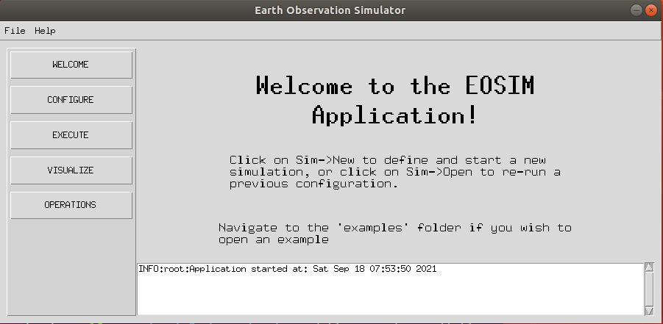
mainapplication.py
container
Stack of frames. In figure the WelcomeFrame is on the top.
This is the main python file inside which the widgets inside the root window are configured. It configures the overall GUI window and the frames inside it.
The parent_frame encompasses all frames inside the main-window. Inside the parent_frame we have the following items defined:
menubar (Menubar)
lsidebar (left-sidebar) (Frame)
messagearea (Frame)
container (Frame)
The below frames are stacked on top of each other inside the container frame.
WelcomeFrame
ConfigureFrame
ExecuteFrame
VisualizeFrame
OperationsFrame
menubar
messagearea
Displays messages from the application to the user.
lsidebar
“Control-panel” Clicking a button will bring the respective Frame to the top in the container Frame.

Slide 5
helpwindow.py
This module contains set of functions which are used to display the help-window (contextual help).
The help-window must first be opened by clicking on: Menubar->Help-> Help Window
When the mouse-pointer hovers over an widget-of-interest, if there is any associated help-item, it is displayed in the help window.
When no longer desired, the help-window should be closed.
The help-database is mainly the json file (help_database.json) inside the folder ./eosim/gui/help/ The folder also has images which are to be displayed inside the help window.
To provide contextual help to a widget following steps must be undertaken:
Enter the help-info inside the help_database json file. The database entry must be associated with a widget-id.
Bind the <Enter> event to an widget with the update_help_window (event, widget_id)function.
Example:
"basicsensor":{
"heading": "Basic Sensor",
"description": ["Model parameters of a basic-sensor."],
"images": false,
"morehelp": false
}
other_specs_frame.bind('<Enter>',lambda event, widget_id="basicsensor": helpwindow.update_help_window(event, widget_id))

Slide 6
welcomeframe.py
This is the topmost frame (when the application is first started) in the stack of frames defined inside the container.
It is also displayed by clicking on the “WELCOME” button on the left-sidebar.
This frame simply contains textual information on how to use the EOSim app.

Slide 7
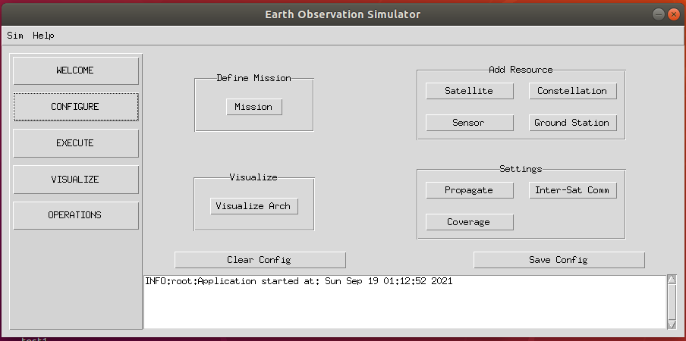
configure/cfframe.py
The configure folder contains the modules relating to the mission configuration.
cfframe module (ConfigureFrame class) lays out all the widgets required for configuring various aspects of the mission.
The widgets along with their associated modules is presented in the figure.
cfconstellation
cfmission
cfsatellite
cfsensor
cfpropagate
cfgroundstation
cfcoverage
cfintersatellitecomm

Slide 8
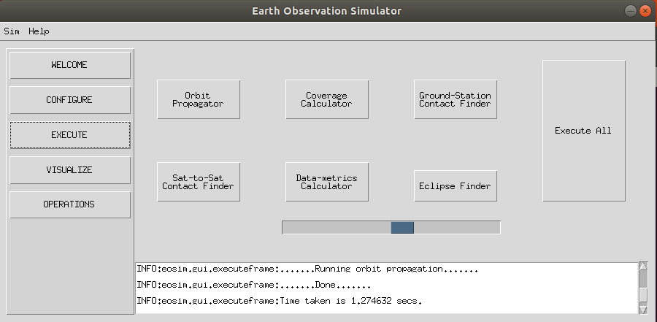
executeframe.py
The executeframe module contains the widgets to initiate execution of the various functionalities.
Orbit propagation
Coverage calc
Ground-stn contact finder
Inter-sat contact finder
Eclipse finder
Data-metrics calc
Each function is run in a separate thread to not freeze the GUI while the execution is taking place. The “progress” bar indicates the status of the process.
The output-info (meta-data about the output files such as location of the files) is written onto the MissionSpecs.json file (when saved).
It is important that the orbit-propagation be run prior to any of the other functions. The coverage calculation must be run prior to the data-metrics calculation.

Slide 9
visualize/visualizeframe.py
This module creates tabs for the following visualization modules:
Vis2DFrame (X-Y plots)
VisMapFrame (Plots on a map with configurable projections)
VisGlobeFrame (CesiumJS powered animated view)
InsightsFrame (textual information, under construction)

Slide 10
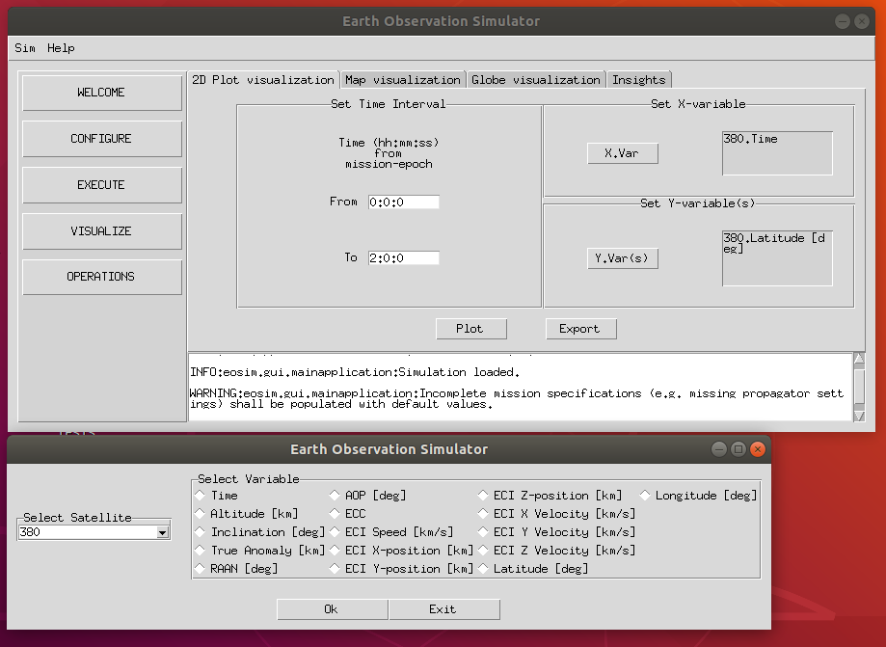
visualize/vis2dframe.py
X-variable is time (of a satellite),
Y-variable is the altitude of the same satellite.
Time-interval of the data to be plotted
Module to handle visualization with X-Y plots.
The module contains the class Vis2DFrame to build the frame in which the user enters the plotting parameters. A time-interval of interest is to be specified, and the X, Y data corresponding to this time-interval shall be plotted. A single x-variable (belonging to a satellite) is selected (see the class ``Plot2DVisVars`` for list of possible variables). Multiple y-variables may be selected to be plotted on the same figure.
The module currently only allows plotting of satellite orbit-propagation parameters (and hence association of only the satellite (no need of sensor) with the variable is sufficient).
Data can also be exported to a csv-formatted file.
X-variable selection window: Choosing the Satellite and parameter to be plotted.

Slide 11
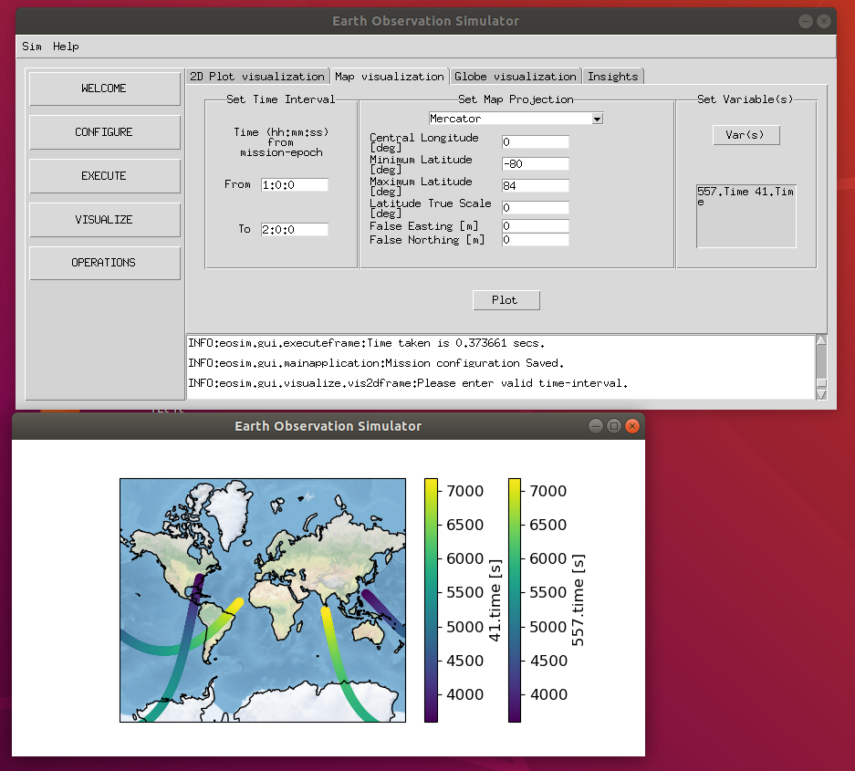
visualize/vismapframe.py
Select the variables. Here two satellites with the ‘time’ variable is selected.
Set the time-interval
Choose the map projection
Module to handle visualization with plots on a map background.
CartoPy is used to create the background maps. Different projections can be specified.
A time-interval of interest is to be specified and one or many variables (corresponding to the different satellites in the mission) can be plotted on the map.
The codebase is similar to the visualize/vis2dframe.py module.
Map Plot. This is essentially the ground-track of the two satellites, color-coded to reflect the time, i.e., the time at which the satellites are the respective ground-locations.

Slide 12
Cesium App
The Cesium JavaScript app is based on the showcased example of Cesium features in the cesium-workshop repository. It is contained in the .\cesium_app\ folder.
The original index.html file has been modified, while the original cesium-workshop index.html file has been retained under the name
workshop_index.html.
A new javascript source file by the name eosimApp.js has been added (based on the available App.js source file). This source file is the one being executed. (Refer to <script src="Source/eosimApp.js"></script> in the index.html file.)
The interface with this app is through CZML files. A new CZML file is produced based on the mission processed in EOSim. This file is saved in the
location /cesium_app/Source/SampleData/.
The simple.czml file in cesium_app/Source/SampleData/ is a new addition which was not there in the cesium-workshop repo.
Note: The cesium-app needs to be updated each time a new version is released by updating the <script src=> and the <link href=> tags in the cesium_app/index.html file.

Slide 13
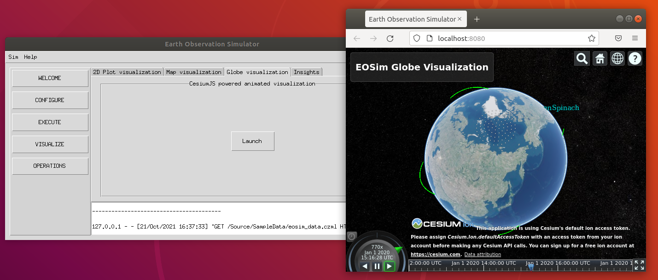
Cesium App
TODO
Add enter widget for user to enter their token key. Current setup uses the default key.
Cesium plot

Slide 14
Cesium App
Following resources are useful in working with the CesiumJS platform.
https://github.com/CesiumGS
https://github.com/CesiumGS/cesium/wiki
https://github.com/CesiumGS/cesium-workshop
https://sandcastle.cesium.com/
https://sandcastle.cesium.com/?src=CZML.html
https://github.com/AnalyticalGraphicsInc/czml-writer/wiki/CZML-Structure
https://github.com/AnalyticalGraphicsInc/czml-writer/wiki/Packet
https://github.com/CesiumGS/cesium/tree/main/Apps/SampleData
https://help.agi.com/AGIComponents/html/Cesium.htm
https://github.com/AnalyticalGraphicsInc/czml-writer
https://stackoverflow.com/questions/59035298/realtime-interaction-with-cesiumjs

Slide 15
Cesium App, visglobeframe.py
Code structure
The interaction to the app is through CZML files. CZML files corresponding to the simulated mission is prepared by the visglobeframe module.
CZML packet templates corresponding to different plotting functions are available in the directory eosim/gui/visualize/czml_templates/
A copy of the template is made and filled with the actual plot-values. For example, to configure the mission clock, the clock_template.json is copied to a python-dict and the currentTime, interval key-values are replaced with the mission specific values.
The VisGlobeFrame.build_czmlpkts_for_mission_background function builds the CZML packets corresponding to the mission epoch, duration, satellite-orbits, ground-station and coverage-grid information.
The VisGlobeFrame.build_czmlpkts_for_ground_stn_contact_opportunities and the VisGlobeFrame.build_czmlpkts_for_intersat_contact_opportunities functions build the CZML packets corresponding to ground-station contact opportunities and intersatellite contact opportunities.

Slide 16
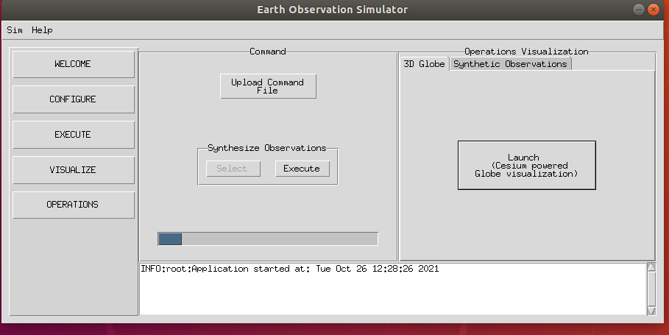
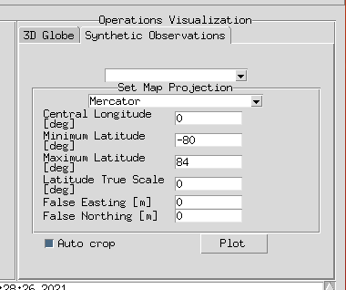
operations/operations.py
The module is named as 'operationsframe' since it is used to initiate computation and visualization of 'operations' of a satellite during the mission. Is consists of mainly two parts:
Initiating synthesization of satellite imagery, corresponding to times during the mission at which the observations are made.
Illustrating the operations on the CesiumJS globe. Operations visualized on the CesiumJS globe are:
TakeImage: Lights up the ground-location (a point) with a user-supplied color.
TransmitData: Draws line b/w the communicating entities (sat/ground-station or sat/sat) during the time of communication.
The module differentiates between ‘commands’ and ‘operations’, in that commands are supplied by user, while operations are the ones actually executed by the spacecraft after seeing the validity of the commands. Currently though there are no validity checks performed and hence commands = operations. A operations.json file is automatically saved when the command-file is uploaded in the user-directory.
Visualize the synthetic observations on a chosen projection by selecting the image-id and projection-parameters.
Command Panel:
Upload list of s/c commands to be executed during mission.
Synthesize observations for TAKEIMAGE operations.
View animation of the mission operations.

Slide 17
operations/operations.py
See the doc ‘Commands File Schema.docx’ for detailed description of the schema.
Brief description of the JSON packets::
1. TakeImage command
2. TransmitData command
{
"@id": “ANI-10000231”,
"@type": "TakeImage",
"spacecraftId": "557",
"startTime": “2018-07-17T15:08:36Z”,
"endTime": "2018-07-17T15:08:40Z",
"observedPosition": {"@type": "cartographicDegrees",
"cartographicDegrees": [[30, 30, 0],
[-30, -30, 0]]
},
"color": {"rgba": [255,0,0,255]}
}
{
"@id": "ANI-10000271",
"@type": "TransmitData",
"txEntityId": "557",
"txxEntityType": "Spacecraft",
"rxEntityId": "41",
"rxEntityType": "GroundStation",
"startTime": “2018-07-17T15:08:36Z”,
"endTime": "2018-07-17T15:08:40Z"
}
Give unique ids to the packets (‘@id’) in the format ‘ANI-xxxxxxxx’, where ‘x’ is a digit (0-9).
The startTime, endTime are in UTC.
The cartographicDegrees field is a list of ground-points in the format [longitude[deg], latitude[deg], height[m]]. (Note that first the longitude is defined.)
In TransmitData command, the tx, rx entity types can be either Spacecraft or GroundStation.
An example command-file is present in the examples/mission2/ folder.

Slide 18
operations/operations.py
Code structure:
Synthetize observations:
CesiumJS globe visualization:
The CesiumJS globe visualization relies upon the VisGlobeFrame.build_czmlpkts_for_mission_background static-functions available in the visualize/visglobeframe.py module. This function builds the mission-background and sets the stage for adding in the operations for visualization.
The CesiumGlobeOperationsVisualizationFrame.build_czmlpkts_for_operational_contacts function builds the czml packets corresponding to the operations. The way in which the packets are built is similar to the technique used for building the czml packets for the mission-background (i.e. copying and modifying templates).
The CZML file to be input to the CesiumJS engine is saved in the /cesium_app/Source/SampleData/ location.
The contact czml packets are built differently form the ones in the visglobeframe module. In the visglobeframe module intervals of no-contacts and intervals of contacts is specified. In the operations module first the entire mission-interval is declared to be of no-contact. Then the intervals of contact are appended.

Slide 19
config.py
This module contains the GuiStyle class, which contains the configuration of the GUI widgets.
It can be referenced in other modules and a uniform custom style (e.g., fonts of labels, color of buttons, etc.) can be maintained easily. (Not done currently, mostly the default widget style is used.)
The module also stores variables which are used as global variables over the other modules of eosim.
workspace_dir: This variable stores the workspace directory. It is written onto when the user selects the workspace directory (new or old) in the menubar.
mission_specs: This variable stores the mission specifications as and when they are updated in the Configure frame.
This method of using global variables is not safe. Unless the variables are manipulated (write, read) in the correct order, the application can fail.

Slide 20
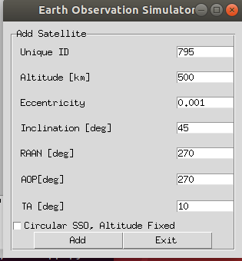
General notes on coding style
sat_win_frame
‘frame’ widgets are used to define the different sections of the window. A “master” frame encompasses all the frames in the window is also usually defined.
E.g. in the alongside window (see cfsatellite.py module), there are three frames defined: (1) sat_win_frame (the master frame) (2) sat_kep_specs_frame (3) okcancel_frame.
Default values can be provided as illustrated in the following snippet:
alt_entry.insert(0,500)
alt_entry.bind("<FocusIn>", lambda args: alt_entry.delete('0', 'end’))
‘500’ is the default value in the altitude entry widget. It gets cleared when one clicks inside the entry widget.
sat_kep_specs_frame
okcancel_frame

Slide 21
General notes on coding style
Typically, the grid function is used to lay out widgets within a frame. The rows and columns are configured with weights and widgets are laid out in the cells.
Example: In the cfsatellite module, the below snippet corresponds to the rows and cols illustrated in the figure (on the right). The labels and entry widgets are placed within each cell.
sat_kep_specs_frame.columnconfigure(0,weight=1)
sat_kep_specs_frame.columnconfigure(1,weight=1)
sat_kep_specs_frame.rowconfigure(0,weight=1)
sat_kep_specs_frame.rowconfigure(1,weight=1)
sat_kep_specs_frame.rowconfigure(2,weight=1)
sat_kep_specs_frame.rowconfigure(3,weight=1)
sat_kep_specs_frame.rowconfigure(4,weight=1)
sat_kep_specs_frame.rowconfigure(5,weight=1)
sat_kep_specs_frame.rowconfigure(6,weight=1)
sat_kep_specs_frame.rowconfigure(7,weight=1)

Slide 22
General notes on coding style
In many cases stacks of frames (on top of each other, of the same size) are used. The frame at the top of the stack is visible to the user.
Example in the alongside snippet from the mainapplication module, the WelcomeFrame, ConfigureFrame, ExecuteFrame, VisualizeFrame and OperationsFrame are stacked on top of each other. The show_frame(.) function is used to push a required frame to the top of the stack.
self.frames = {}
# put all of the pages in the same location;
# the one on the top of the stacking order
# will be the one that is visible.
for F in (WelcomeFrame, ConfigureFrame, ExecuteFrame, VisualizeFrame, OperationsFrame):
page_name = F.__name__
frame = F(parent=container, controller=self)
self.frames[page_name] = frame
# put all of the pages in the same location;
# the one on the top of the stacking order
# will be the one that is visible.
frame.grid(row=0, column=0, sticky="nsew")
self.show_frame("WelcomeFrame")
def show_frame(self, page_name):
'''Show a frame for the given page name'''
frame = self.frames[page_name]
frame.tkraise()

Slide 23
General notes on coding style
Frames may be defined as classes. They materialize at the point in the program when an object of that class is instantiated.
Example: WelcomeFrame, ConfigureFrame, etc

