Slide 1
SUMMARY CLASSIFICATION FOR THE SOUTH COASTAL REGION OF ALASKA

Slide 2
Regional definition
MASK: This classification covers the extent of the Northern Pacific LCC + the Kodiak Island.
ECOREGIONS: Within this extent, the various ecoregions considered are based on Nowacki ecoregion map:
The Alexander Archipelado
The boudary Ranges
The Chugach-St Ellias Mountains
The Gulf of Alaska Coast
The Kodiak Island

Slide 3
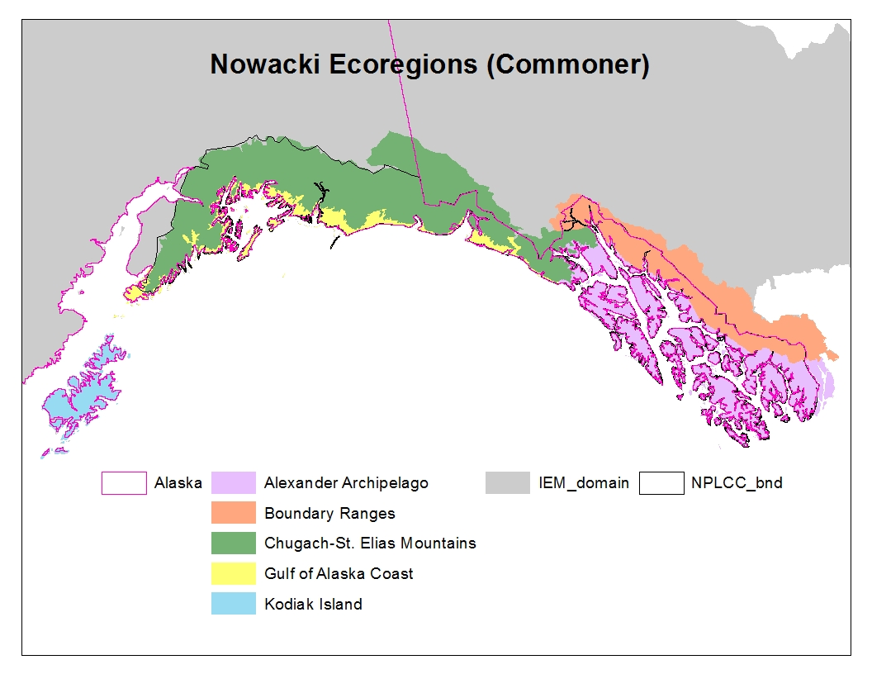

Slide 4
Classification by ecoregions
Four sets of rules have been developed for the following regions:
Classification name | Ecoregions
Kodiak | The Kodiak Island
Maritime | The Alexander Archipelado, The Gulf of Alaska Coast The Alaskan part of the Boundary Range
Mountains | Chugach-St Ellias Mountains
Canadian Boundary | The Canadian part of the Boundary Range

Slide 5
Set of rules for Kodiak classification
NLCD Class | NLCD description | Comparison with Fleming’s EVT | TEM Class
11 | Open Water | 99% Water | No Veg
12 | Perennial Snow/Ice | 95% Snow-Ice | No Veg
22 | Developed, Low | 93% Sand-Gravel-Mud | No Veg
23 | Developed, Med | 99% Sand-Gravel-Mud | No Veg
31 | Barren (Rock/Sand/Clay) | 70%Rock-Talus-Gravel, 20% Sand-Gravel-Mud | No Veg
41 | Deciduous Forest | 58% Balsam Poplar (Black Cottonwood) Forest, 23% Paper Birch Forest, 12% Paper Birch-Balsam Poplar Forest | Deciduous Forest
42 | Evergreen Forest | 96% Sitka Spruce Forest | Maritime Upland Forest
51 | Dwarf Scrub | 85% Crowberry Dwarf Shrub Tundra, 6% Mtn Heath-Cassiope Dwarf Shrub Tundra | Shrub tundra
52 | Shrub/Scrub | 75% Alder Shrub, 11% Willow Shrub | Alder shrubland
71 | Grassland/Herbaceous | 87% Mesic Forb Herbaceous, 6% Salmonberry-Elderberry | Graminoid Tundra
72 | Sedge/Herbaceous | 78% Wet Sedge Bog Meadow, 8% Crowberry Dwarf Shrub Tundra, 7% Mesic Forb Herbaceous | Wetsedge Tundra
90 | Woody Wetland | 34% Sweetgale-Graminoid Bog, 31% Willow Shrub, 21% Birch-Willow Shrub, 5% Mesic Forb Herbaceous | Shrub Tundra
95 | Emergent Herbaceous Wetland | 41% Sedge-Willow-Dryas Tundra, 37% Aquatic Herbaceous, 6% Mesic Forb Herbaceous | Wetsedge Tundra

Slide 6
Set of Rules for Maritime classification
NLCD landcover class | NLCD tree canopy cover (%) | TEM Class
0, 11, 12, 21, 22, 23, 24, 31 |  | No Veg
42 | >20 | Maritime upland forest
 | <= 20 | Maritime Fen
41, 43, 51, 52, 71, 72, 90, 95 | > 20 | Maritime wetland forest
 | <= 20 | Maritime Fen
81,82 |  | Alder shrubland
The effect of logging on the vegetation composition still needs to be added to this classification. For details, please refer to SEAK_CoverType_GISProcessingSteps_1.3.docx.
81,82 was before classified as “Other veg” but we needed to relate this class to an existing parameterization in TEM and decided to call is Alder Shrubland after Frances looked at the Tongass National Forest (TNF) cover type GIS map. Dixit: ”Basically, the Other Veg class includes: alder brush, brush, recurrent slide, willow, or mass wasting.”

Slide 7
Set of rules for the Mountains classification
NLCD landcover class | TEM Class
0, 11, 12, 21, 22, 23, 24, 31 | No Veg
41 | Alder shrubland
42 | Boreal white spruce forest
43 | Boreal deciduous forest
51,52 | Shrub tundra
71,72 | Heath tundra
90 | Shrub tundra
95 | Wetsedge tundra

Slide 8
Canadian Boundary classification
Since the Canadian part of the Boundary ecoregion is not entirely covered by NLCD data, we’ll use NALCMS for this region with the related crosswalk detailed in the metadata of the TEM landcover classification in TEM.
The temperate or sub-polar needleleaf or deciduous forests present in this region will though be classified as maritime upland forest, since it is a mountainous area, part of the Canadian side of the North Pacific LCC.

