Slide 1


EARTH STRIKE
GENERAL STRIKE TO SAVE THE PLANET

Slide 2

WHO WE ARE
We are a horizontal, grassroots movement demanding immediate climate action from governments and corporations worldwide
Earth Strike began in November 2018, from a rallying cry on a post in r/chomsky to disrupt the system and fight for our future. It grew into an international movement within the span of a few days, united by a common cause
We now have members in over 60 countries, with national and local chapters organizing autonomously across the globe
How do we intend to disrupt the system? A global general strike!

Slide 3
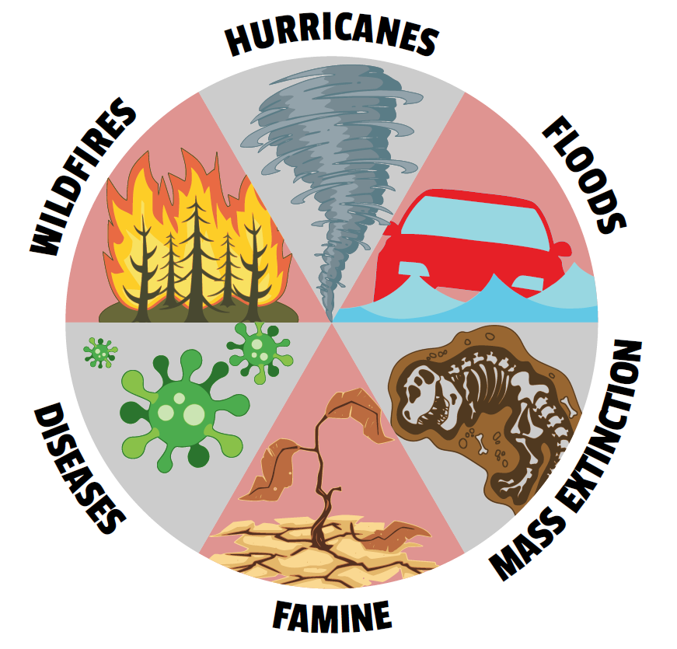
THE PROBLEM
In October 2018, the UN Intergovernmental Panel on Climate Change released a report stating that if the global temperature increases exceed 1.5 °C by 2030, there will be a global climate catastrophe.
The graphic on the right gives us an idea on what is in store for us if we do not act immediately on climate change.

Slide 4
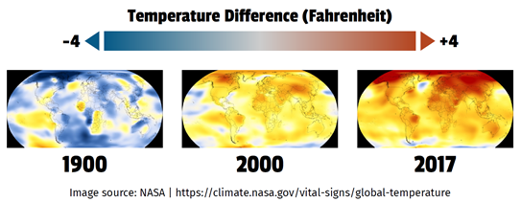
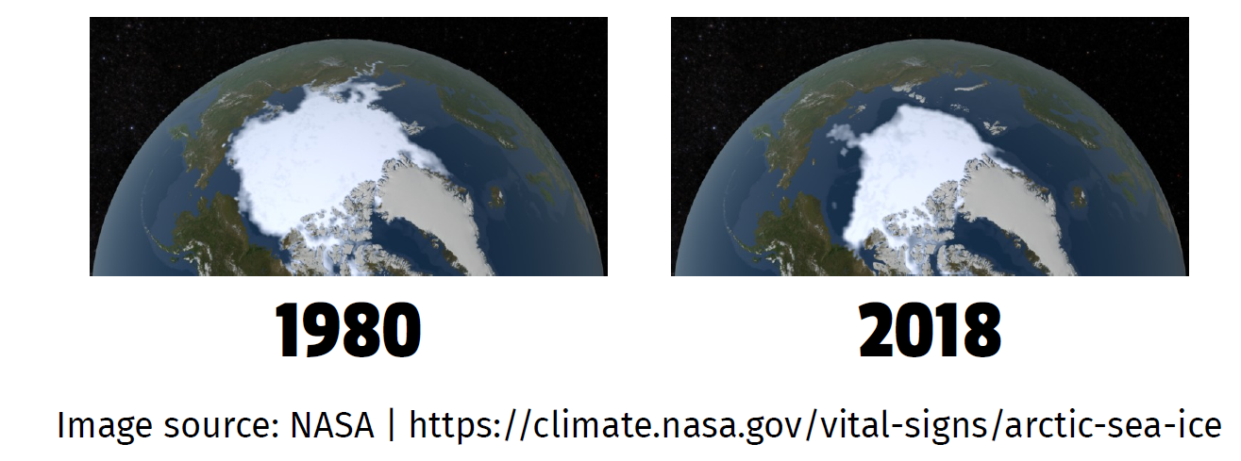
THE FACTS
The worldwide climatological community has shown beyond a doubt that the planet's climate changing, and human industry is responsible. Notice the temperature differences between 1900-2000 and 2000-2017
In 1980, our north pole had about 8 million km² of sea ice. In 2018, it was down to only 4.6 million km².

Slide 5
THE EFFECTS
Severe weather events such as hurricanes and flooding
-Loss of life and property, contaminated water
-Rising sea levels causing millions to leave their homes and become climate refugees
Droughts & famines caused from increased temperatures
-Without efforts to reduce emissions, yields of vegetables would be cut by about 35 percent in the second half of this century
-Higher food prices, less stable food supply, and general food insecurity

Slide 6
THE EFFECTS
Dangerous heatwaves
-Dehydration and heat smoke are common heat-related fatalities
Devastating wildfires
-Caused by dry conditions
-Extremely destructive of land, human life, and wildlife
Spread of illness vectors
-Disease-carrying ticks and mosquitos thrive in the hot and humid climates
-Malaria, Zika virus, Lyme and West Nile Virus

Slide 7
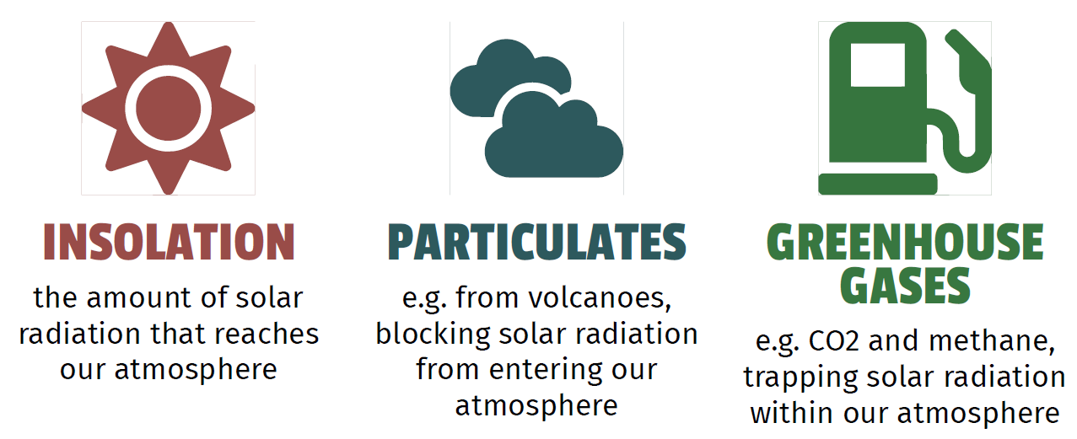
THE CAUSE

Slide 8
THE CAUSE
Insolation is pretty predictable. The amount of solar radiation merely depends on our orbit and axial tilt, which is also predictable. So it is not responsible for our current warming trend.
The amount of particulates is much less predictable, but they don’t factor into our calculations
So what’s to blame for climate change?

Slide 9
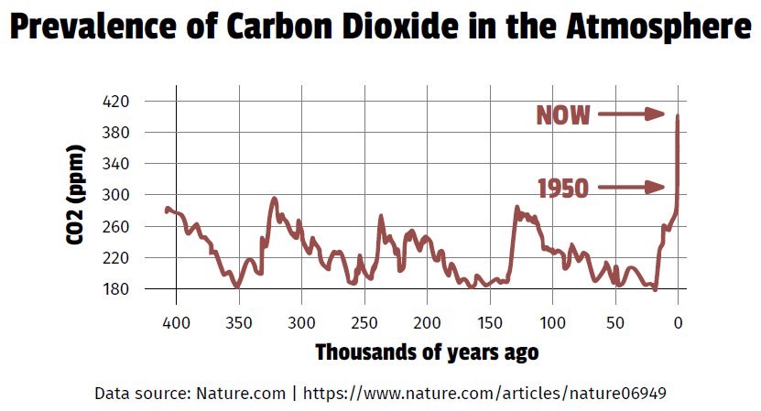
THE CAUSE
It’s man-made greenhouse gases.

Slide 10
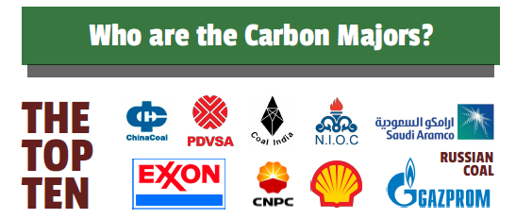
THE CULPRITS
Scientists from Cambridge University have discovered from their data that, in 2010, 67.3% of global greenhouse gas emissions come from the burning of fossil fuels.
According to the CDP’s 2017 Carbon Majors Report, 100 polluters are responsible for 71% of global industrial greenhouse gas emissions.

Slide 11
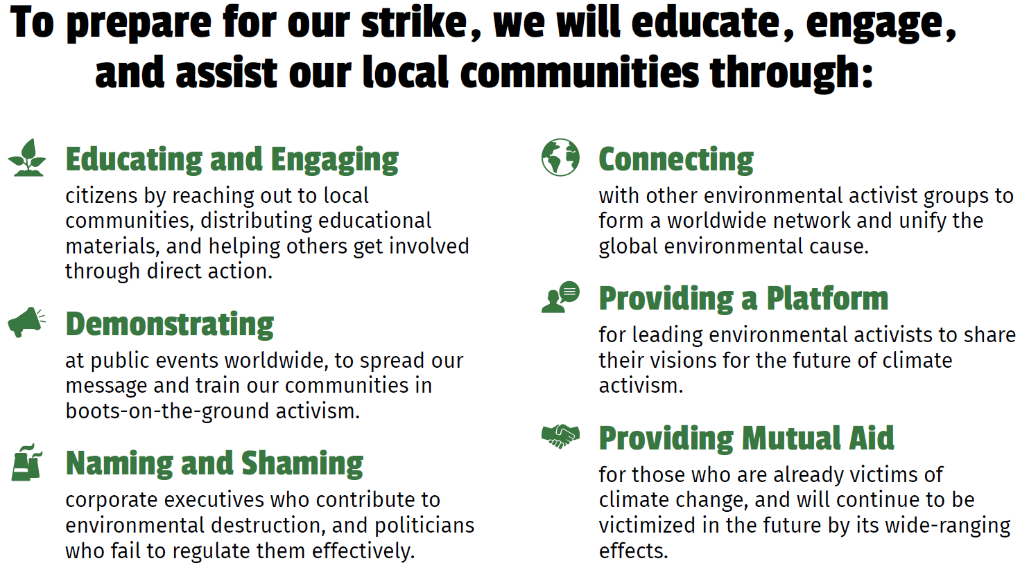
OUR PLAN

Slide 12
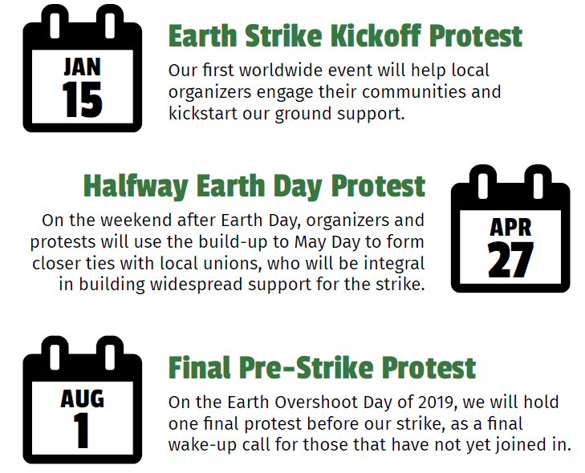
INTERNATIONAL SCHEDULE

Slide 13
OUR PRINCIPLES
Solidarity: Only by standing together, unified around a common goal, will we stand a chance against climate change
Horizontalism: This is a people’s movement. As long as these principles are followed, anyone is free to organize a local chapter and run it autonomously how they see it.
Clarity of Purpose: Our global, general strike is the focal point of our movement, and is what differentiates us from other environmental movements. The worldwide protests are important, but they are simply a means for us to spread our message. By withholding our labor, we are putting economic pressure on those in charge and displaying our power.

Slide 14
OUR PRINCIPLES
Clarity of Message: We do not wish to embark on frivolous campaigns against tiny issues of consumption, and recognize that our real target is the institutions of production.
Respect for Tactics and Organizers: Our solidarity will be based on respect for a diversity of tactics. Any debates or criticisms will stay internal to the movement. That said, we oppose any state repression of dissent, including surveillance, infiltration, disruption and violence, and agree not to assist law enforcement actions against activists and others.
Inclusivity: Earth Strike has absolutely zero tolerance for hateful, bigoted, or reactionary politics (e.g. transphobia, ethnonationalism, imperialism, genocide apologia/denial, etc.)

Slide 15
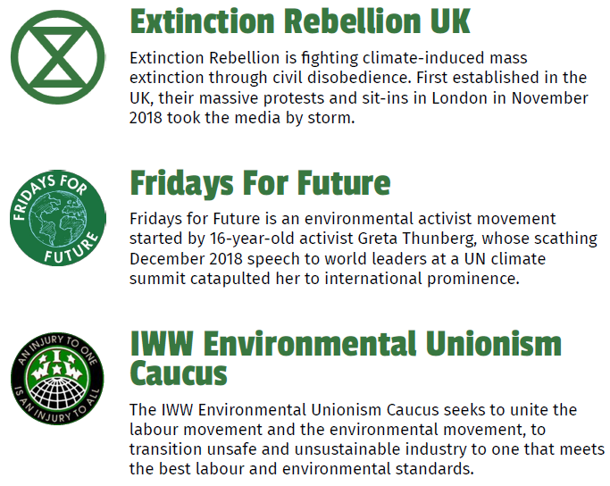
OUR PARTENERS AND SUPPORTERS
For a full list of endorsements
from international and local
organizations, visit:
earth-strike.com/supporters

Slide 16
SOURCES
Burke, K. D., et al. “Pliocene and Eocene Provide Best Analogs for near-Future Climates.” PNAS, Oct. 2018, p. 201809600. https://www.pnas.org/content/115/52/13288.
“Global Greenhouse Gas Emissions Data.” EPA, Environmental Protection Agency, 13 Apr. 2017, www.epa.gov/ghgemissions/global-greenhouse-gasemissions-data.
“Global Surface Temperature | NASA Global Climate Change.” NASA's Goddard Institute for Space Studies, 3 May 2018, https://climate.nasa.gov/vital-signs/global-temperature/.
Griffin, Paul, “CDP Carbon Majors Report 2017.” The Carbon Majors Database (2017). Accessed November 2018.
IPCC, 2014: Climate Change 2014: Synthesis Report. Contribution of Working Groups I, II and III to the Fifth Assessment Report of the Intergovernmental Panelon Climate Change [Core Writing Team, R.K. Pachauri and L.A. Meyer (eds.)].IPCC, Geneva, Switzerland, 151 pp.
“National Snow and Ice Data Center.” Animals and Frozen Ground | National Snow and Ice Data Center, NASA, 6 Nov. 2018, http://nsidc.org/arcticseaicenews/2018/11/unusual-warmth-continues/.
Steffen, Will, et al. "Trajectories of the Earth System in the Anthropocene," PNAS, 115.33 (2018) https://www.pnas.org/content/115/33/8252.
Vose, James M., et al. “Effects of Climatic Variability and Change on Forest Ecosystems: A Comprehensive Science Synthesis for the U.S.” United States Department of Agriculture Forest Service, Dec. 2012.

Slide 17
GET IN TOUCH!
Email: info@earth-strike.com
Twitter: @EarthStrikeInt
Facebook: @EarthStrikeInt
Instagram: EarthStrike2019
Youtube: Earth Strike
Mastodon: @EarthStrikeInt

