Slide 1
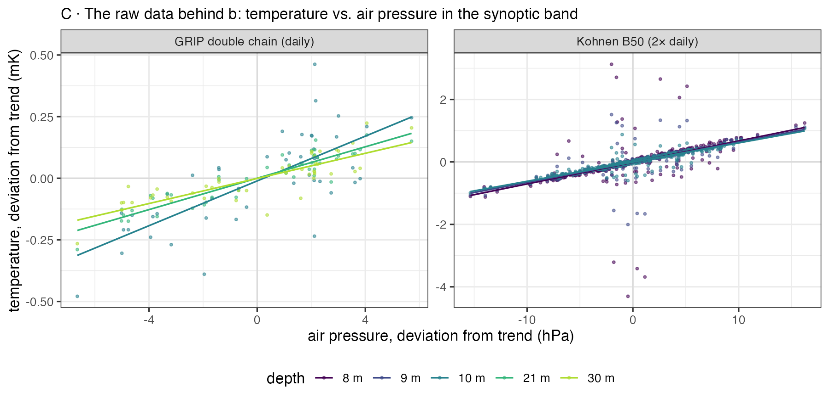
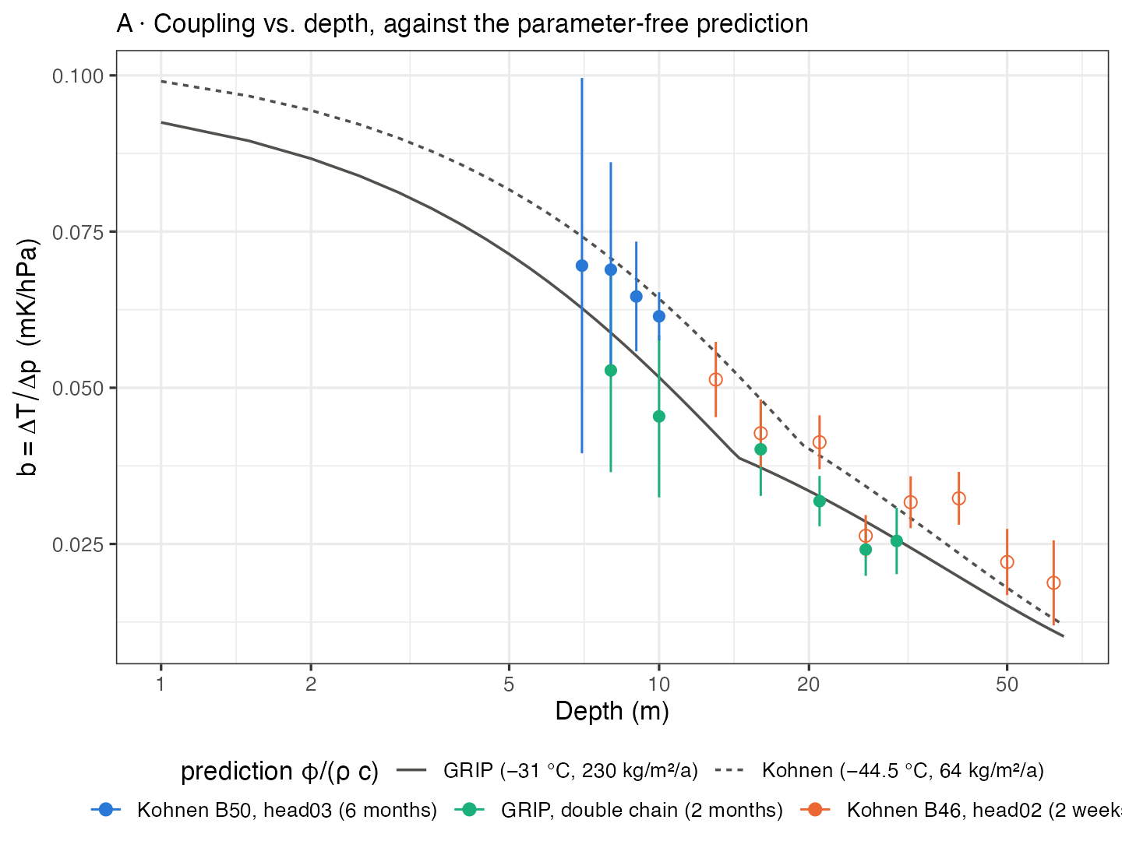
Firn temperature follows barometric pressure
Raw data (left): firn temperature vs. air pressure, synoptic band. Two sites, one line per depth — the coupling is in the data, not in the statistics.
Depth dependence (right): measured against the parameter-free prediction b = φ/(ρ c), with no free parameter. Factor 0.95 ± 0.02 over 10 nodes, 7–30 m.
Kohnen B50 (6 months, 41 hPa) · GRIP double chain (2 months, 21 hPa) · Kohnen B46 (2 weeks, open symbols: shape only)

Slide 2
A route to in-situ open porosity and close-off
Principle
A pressure rise pushes air into the connected pore space; the compression heat is absorbed by the ice matrix:
b = ΔT/Δp = φ_open / (ρ · c_ice)
Only pore space connected to the atmosphere responds — the functional quantity firn-air models need, not the geometric one from a core.
Two read-outs
Backfilled hole: in-phase response → φ_open(z). With core density (φ_total = 1 − ρ/ρ_ice) the difference is the closed porosity.
Open borehole: response to dp/dt drops 4.5× between 75 and 92 m at B40 — the wall turns impermeable. The hole marks its own close-off.
Expected magnitudes (Kohnen)
0.09 mK/hPa at 1 m → 0.03 at 30 m → 0.006 at close-off (84 m); below: thermoelastic floor of ice, 0.002 mK/hPa
Precision
0.1 mK per sample, σ_p = 5 hPa, 2 samples/day → φ_open to 0.6 % at 10 m, 5 % at close-off after 3 years
Lab pycnometry on cores: 2 % at low density, up to 20 % near close-off, plus cut-bubble and relaxation corrections
What it needs
Thermistor chain in a backfilled hole through the lock-in zone · reference barometer within ~100 km, time-matched · ≥2 samples/day · 1–3 years
Limits
Vertical resolution = node spacing (metres) — complementary to μCT, not a replacement. Absolute accuracy set by c_ice (~1 %).

