Slide 1


The Global Statistical Geospatial Framework
Presented by the Co-Chairs of the UN Expert Group on the Integration of Statistical and Geospatial Information:
Ms Gemma Van Halderen, Australian Bureau of Statistics, Australia
Mr Rolando Ocampo, INEGI, Mexico

Slide 2
Agenda:
Introduction and Major Outcomes of EG-ISGI Third Meeting
Overview of the Global Consultation on the Proposal for a Global Statistical Geospatial Framework
EG-ISGI Work Programme
Discussion and Conclusions
Notes:
Outline of agenda

Slide 3
Outcomes of the 3rd EG-ISGI meeting
Focused on the Global Statistical Geospatial Framework
Discussed feedback from global consultation amongst EG members
Agreed on a way forward on the issues raised by EG members
Agreed on the importance of committing to the originally agreed timeframe of seeking endorsement of the Framework at the 6th meeting of UN-GGIM in August 2016
Undertook to meet an ambitious timeframe of
May - finalise the draft Framework
June – Global consultation
July – UN-GGIM Member State consideration
August – 6th meeting of UN-GGIM

Slide 4
Six key issues identified by EG members
Is it a standard or a framework?
The EG agreed the GSGF is a principles-based framework, not a statistical or technical standard.
The GSGF should be as inclusive as possible with regard to georeferencing.
Address and property-level georeferencing are preferable but are not the only method of locating statistical units
What is the scope?
The scope of the GSGF covers all statistical information including demographic, social, economic and environmental data.
Consistent Terminology
The first principle of the GSGF changed to ‘Fundamental’ geospatial data instead of ‘Authoritative’
What about ‘new data sources?”
“New data” sources identified as an area that could benefit from application of GSGF principles e.g. mobile phone datasets.
Inclusion of open data policies and principles.
The Expert Group agreed to include references to international principles and/or agreed national policies on open data.
Notes:
The Expert Group discussed in detail the proposal for a GSGF and reviewed key issues raised.
In the lead-up to the 3rd meeting consultation on the GSGF was carried out amongst members of the Expert Group.
Six key issues were raised at the 3rd EG meeting. Resolutions on each of these issues were incorporated in the final GSGF paper for global consultation.

Slide 5
Outcomes of the 3rd EG-ISGI meeting
In addition it was agreed that the Expert Group would:
Collect national level examples of practices, policies, guidelines, standards and use cases to be published through the Expert group’s webpage;
Establish a small editorial board (led by Eurostat) to advance work on common terminology, and thanked Eurostat, Finland and Australia work already undertaken;
Progress national and international collaboration on data and metadata standards; and
Retain it’s existing co-chairs, each to serve for another period of three years.
Notes:
Further aspects of the future expert group work program were agreed to.
- Collect national level examples of practices, policies, guidelines, standards and use cases to be published through the Expert group’s webpage;
- Establish a small editorial board (led by Eurostat) to advance work on common terminology, and thanked Eurostat, Finland and Australia work already undertaken;
- Progress national and international collaboration on data and metadata standards; and
- Retain it’s existing co-chairs, each to serve for another period of three years.

Slide 6
Outcomes of the 3rd EG-ISGI meeting
The meeting also included presentations on Sustainable Development Goals and the UN Global Working Group on Big Data.
The Expert Group has been invited to join the IAEG-SDGs Working Group on Geospatial Information.
Notes:
The Expert Group is seeking to have a member join the IAEG-SDGs Working Group on Geospatial Information.
It was agreed to proceed with a global consultation with the geospatial and statistical communities
And submit the proposal to UN-GGIM and UNSC.

Slide 7
The Expert Group made two recommendations following the meeting:
Adopt the Framework
That the Global Statistical Geospatial Framework be adopted by the Committee of Experts at its session in August 2016 and endorsed by the UN Statistical Commission in March 2017.
EG-IGSI should continue
That the Committee of Experts and the Statistical Commission support the continuation of the Expert Group with a focus on:
Consolidation and implementation of the Global Statistical Geospatial Framework;
Capability building;
Knowledge management; and
Interaction with existing and emerging bodies, global or regional, in the development and implementation of Global Statistical Geospatial Framework.
Notes:
The Expert Group is seeking to have a member join the IAEG-SDGs Working Group on Geospatial Information.
It was agreed to proceed with a global consultation with the geospatial and statistical communities
And submit the proposal to UN-GGIM and UNSC.

Slide 8
Overview of the Global Consultation on the Proposal for a Global Statistical Geospatial Framework

Slide 9
International Mandate
UN Economic and Social Council (ECOSOC)
UN Statistical Commission (UNSC)
Global Statistical-Geospatial program review – proposed a global framework
UN Committee of Experts on Global Geospatial Information Management (UN-GGIM)
List of nine issues included 'linking of spatial to statistics'
UN Expert Group – Integration of Statistical Geospatial Information
Notes:
International context.
The Expert Group has a mandate from the UN Statistical Commission (UNSC) and the UN Committee of Experts on Global Geospatial Information Management (UN-GGIM) to develop the GSGF.

Slide 10
Introduction
A recognised need to better integrate statistical and geospatial information:
“there is an urgent need for a mechanism, such as a global statistical-spatial framework, to facilitate consistent production and integration approaches for geo-statistical information.” Global Forum on the Integration of Statistical and Geospatial Information, 2014 New York
Integration is crucial to getting the most out of data:
Decision making for smaller geographic areas
Sustainable Development Goals and 2020 Population Censuses
Data sharing and new insights
Investment in modernisation
Notes:
The Global Forum on the Integration of Statistical and Geospatial Information, (2014 New York) have given the Expert Group a mandate to deliver this ‘mechanism’.
While the GSGF is a relatively simple framework, it is what it’s principles will enable that is the greatest value.

Slide 11
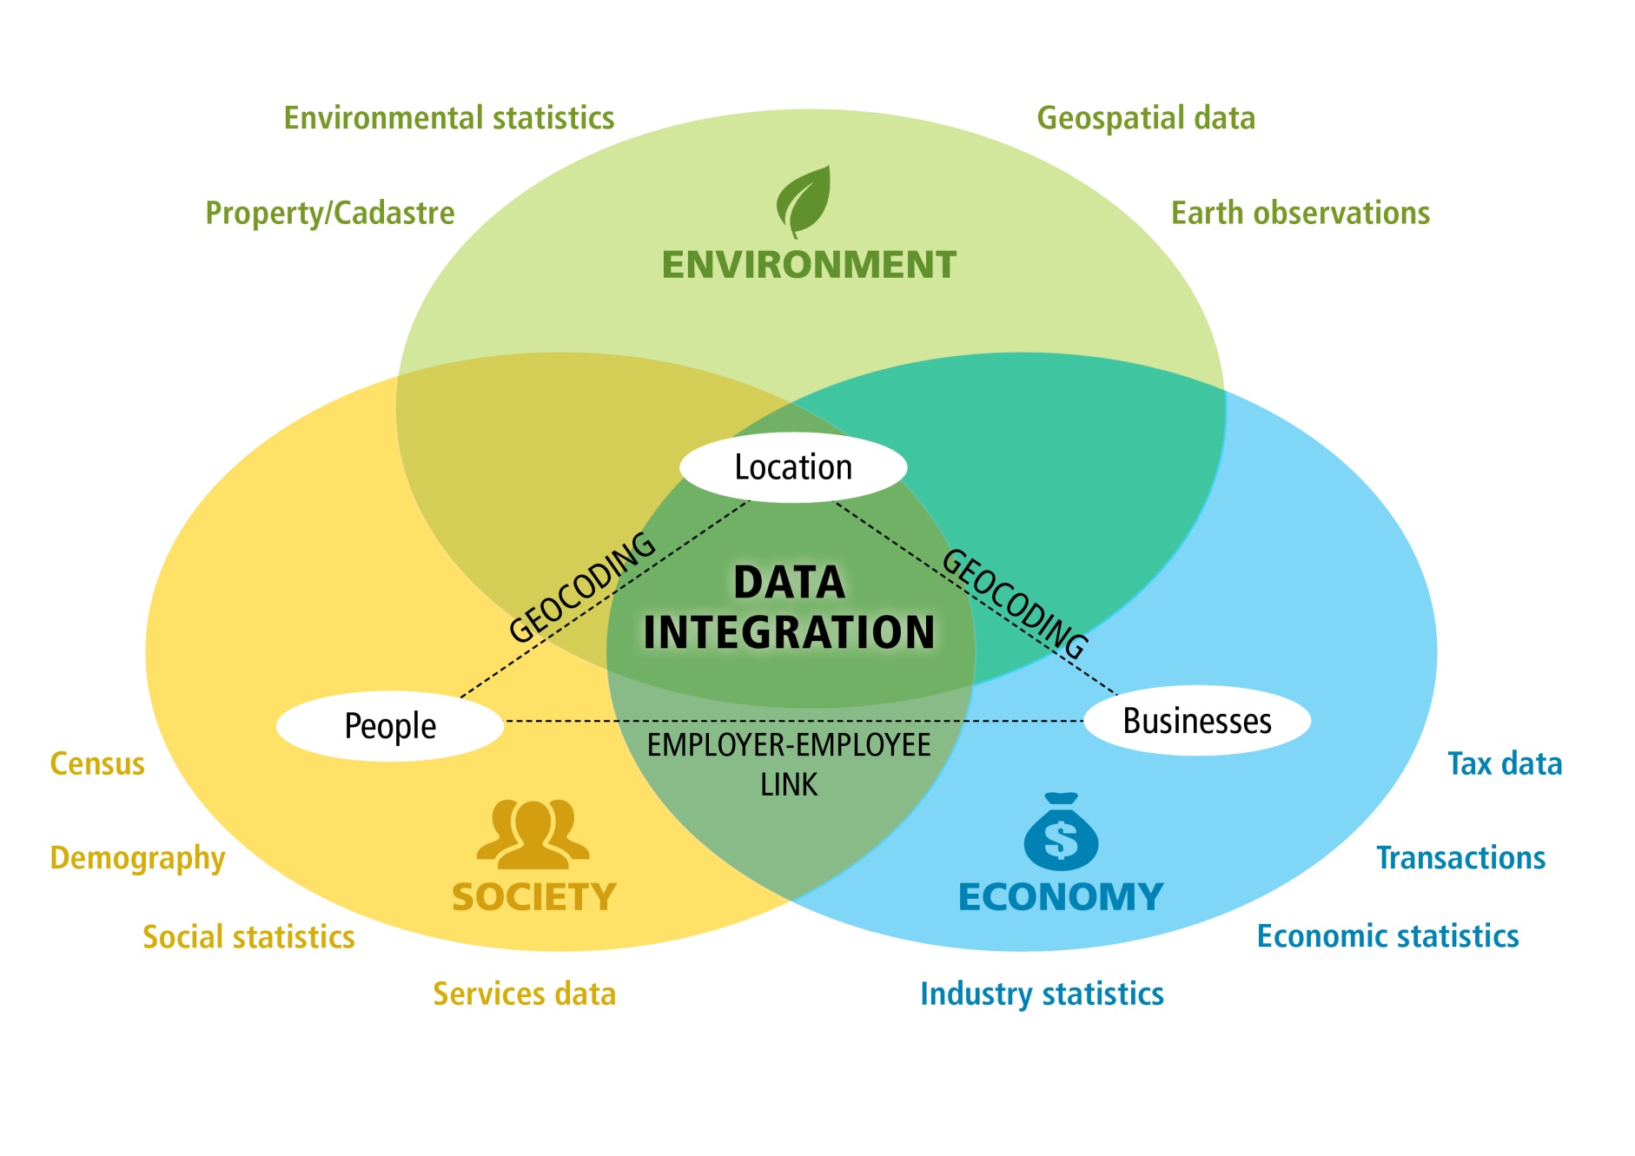
Location – bridging 3 domains
Notes:
This diagram provides an explanation of what the Framework offers the statistical community. It presents a way for the statistical community to understand how environmental data can connect into statistics via the framework.
The Global Statistical Geospatial Framework enables the linkages between all three spheres of the diagram, recognising that the green components have always had a strong spatial grounding.
The diagram highlights the Expert Group’s thinking in this space, Location is a 3rd dimension that has been playing a secondary role until recently in many NSOs.
Geocoding (or georefernces) provide that bridge to link traditional statistical data with the environment domain (strongly geospatial) and open up new possibilities (Data integration and Geo-Statistics)
The diagram might provide a higher level view of the framework for use in National statistical agencies where the concept of Geospatial is less common.

Slide 12
Overview of Global Consultation
Following the 3rd UN EG-ISGI meeting, global consultation was undertaken
May - EG Members
June – Member States
193 Members States times two! (NMAs and NSOs)
58 Responses
Very pleasing to have such a strong positive response

Slide 13
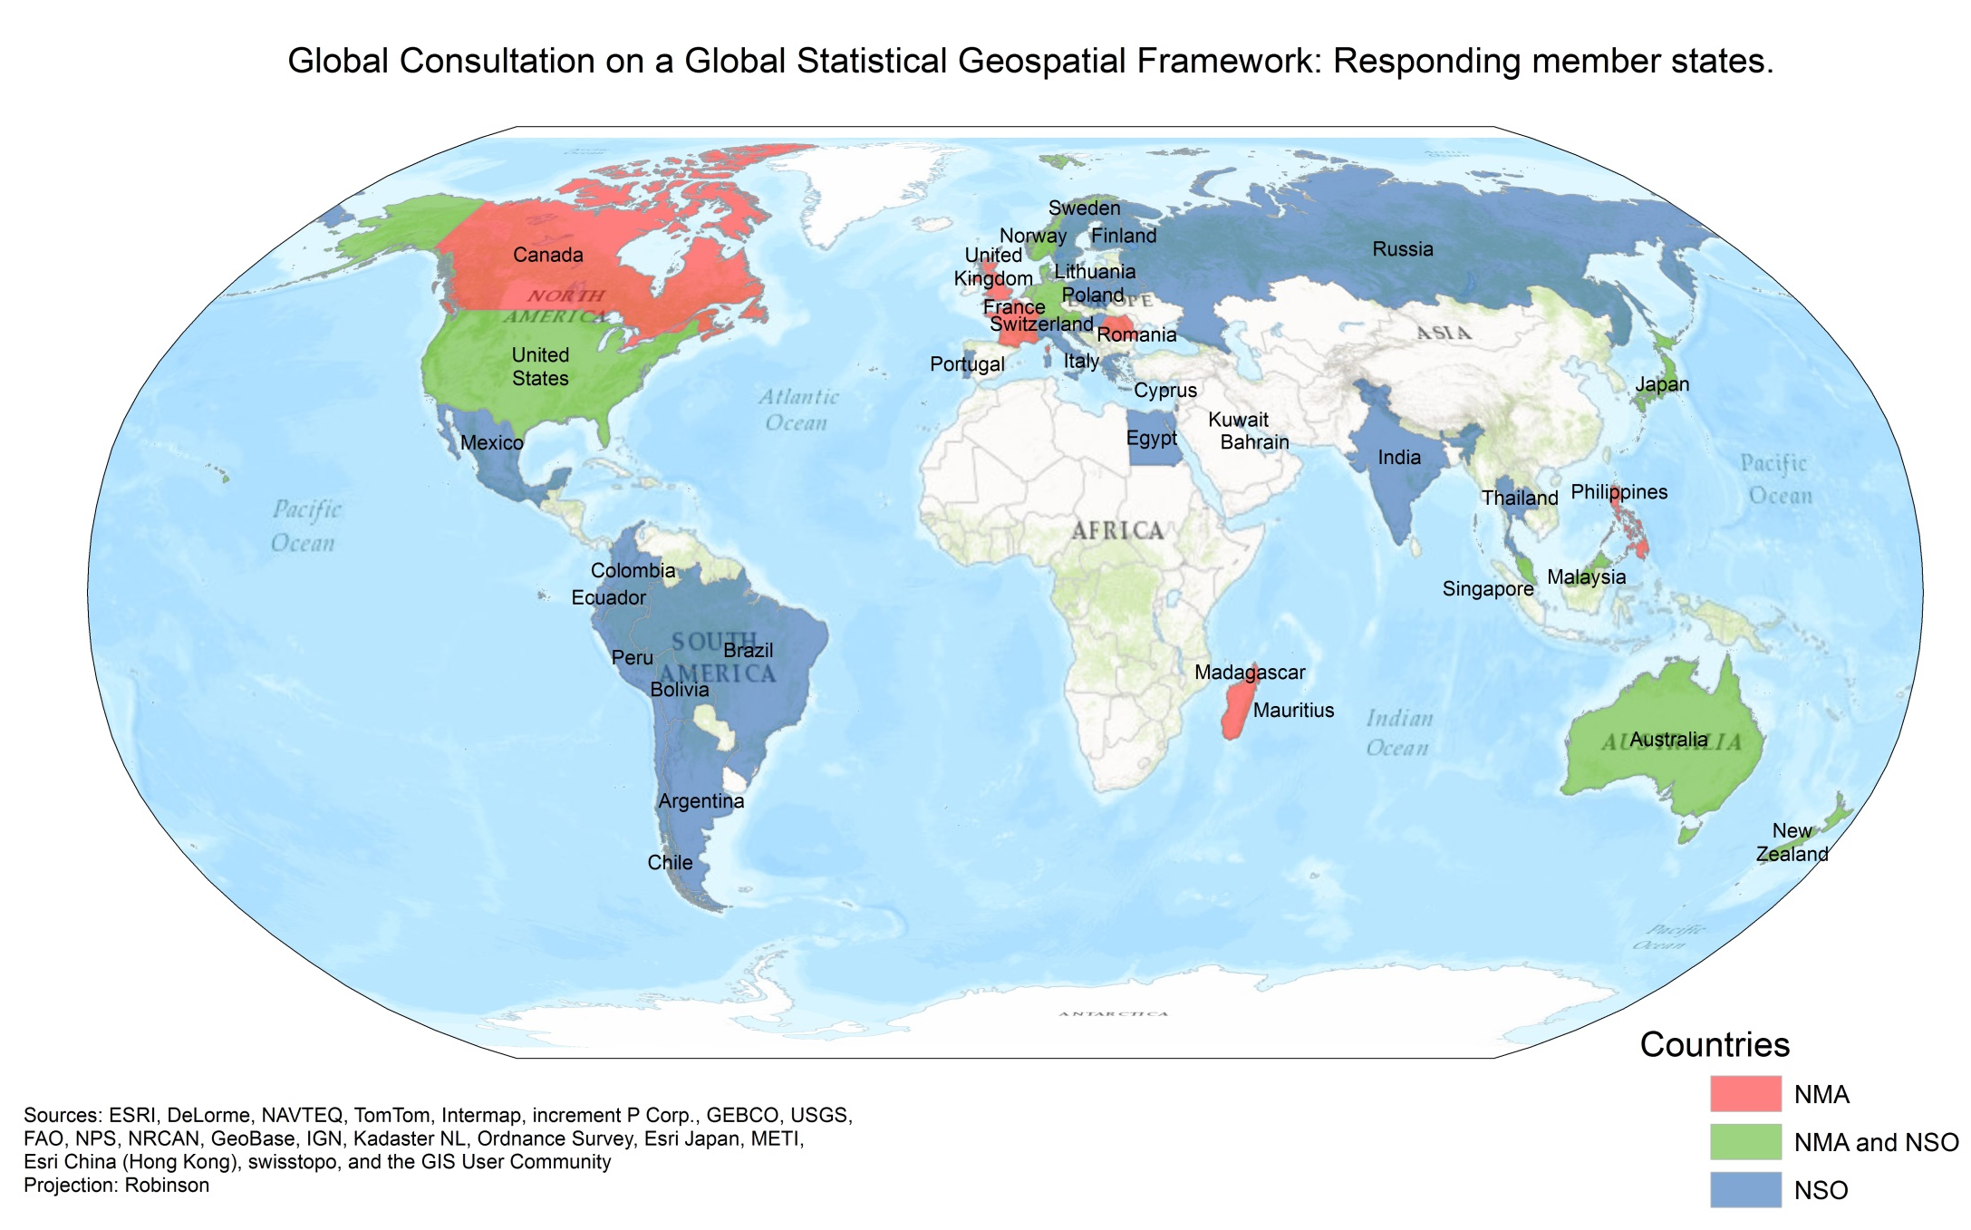
Overview of responses to the Global Consultation
Notes:
Includes both the countries responding to the international consultation plus those that provided input to the EG draft only (USA, India and Argentina extra).

Slide 14
Regional bodies are also responding
UN-GGIM Americas
UN-GGIM Europe
UN-GGIM Africa
UNECE
Statistics Division
Notes:
Includes both the countries responding to the international consultation plus those that provided input to the EG draft only (USA, India and Argentina extra).

Slide 15

Overview of Global Consultation
Overwhelming support for the five principles of the Global Statistical Geospatial Framework
The majority of feedback focused on details of the application of the Framework
In some instances, feedback was given on the level of completeness for these detailed aspects.

Slide 16
Overview of Global Consultation
Three main areas of detail were highlighted in the global consultation process:
Confidentiality and management of unit record information.
Response
Principle 5 of the Global Statistical Geospatial Standard was strengthened to take on board feedback
Specific guidance on protecting confidentiality added to the future work programme of the Expert Group

Slide 17
Overview of Global Consultation
Time series analysis in relation to geospatial information (managing changing boundaries in particular).
Response
Global Statistical Geospatial Framework content strengthened
The challenge of managing change over time is applicable to both statistical and geospatial information, and guidance from each community will be included in the Framework

Slide 18
Overview of Global Consultation
Assessment and application of grids, as well as administrative geographies, particularly with the emergence of the Discrete Global Grid System (DGGS).
Response
The Global Statistical Geospatial Framework was updated to highlight the DGGS, in particular Principle 3: Common geographies for dissemination of statistics
The Expert Group have considered this issue previously and work has commenced on guidance material.

Slide 19

Overview of Global Consultation
Based on results of the Global Consultation, the Expert Group are seeking adoption of the five principles of the Global Statistical Geospatial Framework.

Slide 20
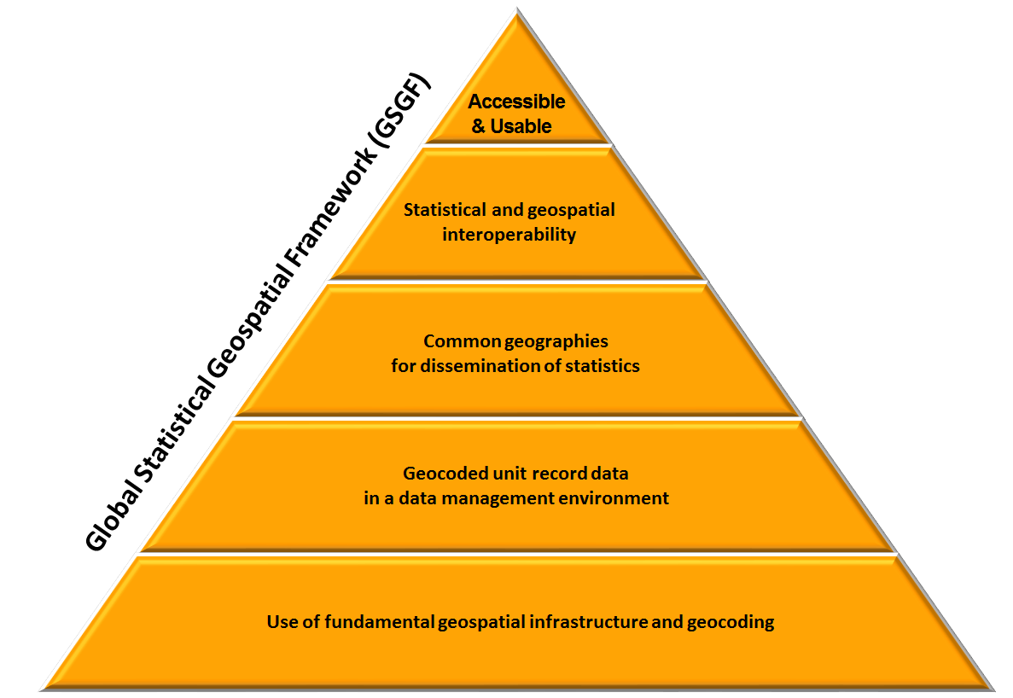
Global Statistical Geospatial Framework 5 principles
Notes:
Five principles of the proposed Global Statistical Spatial Framework from bottom to top:
1. Use of fundamental geospatial infrastructure and geocoding.
“Fundamental geospatial infrastructure” will differ between countries. In this context it refers to those geospatial datasets that underpin the core business of NSOs.
In developed nations it is likely to include:
National Address Lists, land parcel databases, road networks, business registers, building footprints.
In developing nations it is likely to include:
national and regional boundaries, town and locality locations.
What is fundamental is always evolving! Fundamental datasets in the Geospatial/environmental realm such as land use and land cover (often based on Earth Observations) are of growing interest to NSOs. The push for monitoring of Sustainable Development Goals is a good example of this.
2. Geocoded unit record data in a data management environment.
Key to geospatial enablement and flexibility, the finer the better. Statistical data management ensures confidentiality.
3. Common geographies for dissemination of statistics.
Provide the tools for aggregation and release of data. Also allow for integration of aggregate data on common geography.
4. Statistical and geospatial interoperability – Data, Standards and Processes.
Allows data to be accessed and used efficiently. New services and machine to machine applications will support the modernisation agenda of many NSOs and NMAs.
5. Accessible and useable geospatially enabled statistics.
This is the end game. Informing decision making in a more flexible, agile approach using new and existing data. Needs to reassure custodians of safe release but enable users discovery and access.

Slide 21

Principle 1: Use of fundamental geospatial infrastructure and geocoding
A common and consistent approach to establishing a location and temporal description of each unit in a dataset, using national fundamental datasets.
Objectives:
Accurate and consistent address, property, building and location information
Accurate and consistent geocoding results, and consistent management of geocoding issues.
Consultation highlighted:
Infrastructure capacity in developing countries – trial GPS capture
GSGF a road map for development
Notes:
Use national fundamental geospatial infrastructure to ensure a common and consistent approach to geocoding.
By geocoding we mean:
establishing the location and providing a geocode for each unit in a dataset,
Unit = person, household, business, building or parcel/unit of land.
Geocode = x & y coordinate, and a small area code (Meshblock)
recording the time or date for each instance of location information.
# Fix the unit in space and time #
To do this need to use:
National fundamental geospatial infrastructure –integration with geospatial data.
Particularly national address systems, and property, building registers
# UN-GGIM has a strong role in this. #
Consistent geocoding infrastructure and methods – ensure integration of disparate datasets
Developing countries
Current geospatial infrastructure may not support fine geocoding
trial GPS capture in the field
use region, suburb and village names geocode to larger geography
# GSGF provides a road map for development of infrastructure #

Slide 22
Principle 2: Geocoded unit record data in a data management environment
Storage of the unit record statistical data linked to a geocode within a data management environment will ensure flexibility over time and protect privacy and confidentiality.
Objectives:
Effective data management and custodianship
Consistent and interpretable geocode information
Simplified data aggregation
Consultation highlighted:
Managing confidentiality and privacy
Persistent geocodes and linked data
Notes:
Linking geocodes to each statistical unit record in a dataset needs to occur within a data management environment.
Data management environment allows:
apply persistent linking mechanisms for address/location to geocode (consultation issue)
enable statistical data linking processes – varying data types and sources
implement mechanisms to protect privacy and confidentiality.
Geocoding statistical units enables;
Flexibility in applying different geographic contexts to the data
aggregating data into a variety of larger geographies
adaptability to changes in geographies over time and to new geog.
compatible with grid based approaches – e.g. DGGS
Objectives for this principle are to achieve:
Consistency in geocodes
Simplified aggregation of data
Effective data management – incl. privacy & confidentiality

Slide 23
Principle 3: Common geographies for dissemination of statistics
A common set of geographies for the display, reporting and analysis of statistics to enable comparisons across datasets – statistical and geospatial.
Objective:
Data from disparate sources can be integrated
Metadata supports data integration and use
Visualisation and analysis is simplified
Conversion of data between geographies is supported
Consultation highlighted:
Consistent geography model, Poland
Discrete Global Grid System
Notes:
Use of common geographies enables comparisons across datasets from different sources, also more efficient access and use of these data. Traditional statistical and administrative geographies
Poland model of consistency with geospatial objects – some further thought. ?? Possibly show slide ?? – next slide
EG examining application of grid formats
Eurostats – population grid
Discrete Global Grid System (DGGS) – further examination required – flexible and consistent, and useful for converting data between geographies – more info to be provided by Stuart / GA at UN-GGIM.
The following objectives to be met:
Data from disparate sources can be integrated using common geography.
Visualisation and analysis is simplified.
Metadata supports data integration and use.
Conversion of data between geographies is supported, e.g. correspondences.

Slide 24
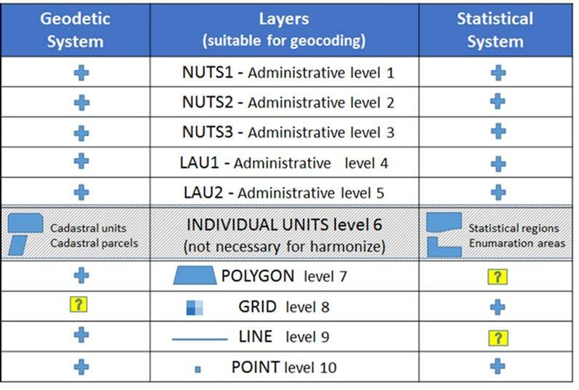
The 10 Levels Model
unique identifiers system
Personal proposition of Janusz Dygaszewicz CSO Poland

Slide 25
Principle 4: Statistical and geospatial interoperability
A common set of geographies for the display, reporting and analysis of statistics to enable comparisons across datasets – statistical and geospatial.
Greater interoperability to enhance the efficiency of creation, discovery, access and use of data.
Objectives;
Greater efficiency and simplification in the creation and use of data.
A wider range of data available for analysis and increasing potential applications of data and technologies.
Consultation highlighted:
W3C/OGC - Spatial Data on the Web Working Group (SDWWG)
GEOSTAT - Common Statistical Production Architecture
Notes:
This principle emphasises the need to work to overcome barriers between data and metadata across the two communities.
Barriers create inefficiency in accessing, integrating, interrogating and analysing data for statistical and geospatial purposes.
The general data models and metadata capabilities and standards of both communities, are often not universally applied within both communities.
Need to:
Overcome structural and syntactic barriers across the two communities
Ensure standards from both communities can be applied in each others contexts, not one subsume the other – they must be truly interoperable.
EG encouraging a number of initiatives that have started internationally - for example, W3C - Spatial Data on the Web working group (SDWWG) [OGC involved in this] - GEOSTAT project – looking at GSBPM and Common Stats Infrastructure - emphasis on harmonisation across various streams of this work.
Objectives;
Greater efficiency and simplification in the creation and use of data.
Data available for analysis, and increased application of new technologies.

Slide 26
Principle 5: Accessible and Useable Geospatially enabled statistics
Identification and development of policies, standards and guidelines to support the release and use of geospatially enabled information.
Objectives:
Data released and accessible, with privacy and confidentiality protected.
Web services enabling machine-to-machine access and dynamic linking.
Promote best practices.
Consultation highlighted:
Need for more guidance and support material for this section.
Notes:
This principle specifies the need to identify or, where required, develop policies, standards and guidelines that support the release, access, analysis and visualisation of geospatially enabled data (i.e. best practice)
Two important aspects of this principle are to:
ensure data can be accessed using safe mechanisms that protect confidentiality - but also enable access to data in order to undertake analysis.
encourage the use of open data principles, - including the release of data in machine readable formats.
This principle will help:
Custodians to release data in appropriate forms
Users to discover, access, integrate, analyse and visualise statistical data.
Global consultation highlighted the need for more guidance and support material.
EG will be bringing together material to help with this.

Slide 27
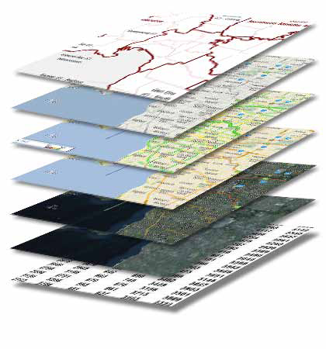

Global Statistical Geospatial Framework - bridging integration gaps
Statistical Community
Spatial Community
Socio-Economic Datasets
Fundamental Geospatial Datasets
Core Statistical
Census, Demographics, Agriculture, Building, Labour Force, etc.
Tax
Income and Business Tax
Admin. & statistical boundaries
Immigration
Addressing, Place Names
Health
Medicare, Pharmaceuticals, Workforce
GSGF bridge
Transport, Water
Land and Property
Land Valuation and Use
Elevation and Depth
Social Welfare
Unemployment, Disability, Family Support
Imagery
Others …
Positioning

Slide 28
Consultation has been extensive
Large number of Country examples collected or volunteered
Regional sessions e.g. Beijing
Input from UNSC and UN-GGIM and their regional bodies
Professional Interest e.g. EFGS, IAOS
Global Consultation with members of EG-ISGI
Membership growing e.g UN-GGIM-Africa
Global Consultation with NMAs and NSOs

Slide 29
The Roadmap towards a Global Statistical Geospatial Framework
44th UNSC
March 2013
46th UNSC
Mar 2014
46th UNSC
Mar 2015
47th UNSC
Mar 2016
48th UNSC
Mar 2017
3rd UN-GGIM
Aug 2013
4th UN-GGIM
Aug 2014
5th UN-GGIM
Aug 2015
6th UN-GGIM
Aug 2016
EG-IGSI established
March 2013
1st EG-IGSI
Nov 2013
2nd EG-IGSI
May 2015
3rd EG-IGSI
April 2016
4th EG-IGSI
Jan 2017 (tentative)
Global Forum
Aug 2014
EG-IGSI Informal Side Event
Aug 2015
EG-IGSI
Formal Side Event
Aug 2016
EG-IGSI
Side Event
Mar 2016

Slide 30


Now is an important time for Member States to have guidance on how to integrate statistical and geospatial information
2030 Agenda for Sustainable Development
2020 Round of Population Censuses

Slide 31
Conclusion
The UN-GGIM/UNSC Expert Group on the Integration of Statistical and Geospatial Information was established with a mandate to develop an international statistical geospatial framework
By evaluating the Australian Statistical Spatial Framework and determining if, and how, it could be internationalised.
The Expert Group has concluded that the Australian Statistical Spatial Framework is a practical, principle based framework that is flexible enough to be customised to suit national contexts.

Slide 32
Recommendation
That the UN-GGIM
Adopt the five guiding principles as foundation of the Global Statistical Geospatial Framework
Agree to retain the current co-Chairs for another three year term to help steer the discussion and consultation on the Global Statistical Geospatial Framework towards its endorsement by the Statistical Commission.

Slide 33
EG-ISGI Work Programme

Slide 34
Existing EG-ISGI work program
Adoption and endorsement will allow the Expert Group to focus on already identified areas of further work:
Application of the principles of the Framework to the development of statistical and geospatial information to support the global indicator framework for Sustainable Development Goals (SDGs).
Build capability through the application of the Global Statistical Geospatial Framework and geospatial technologies to the 2020 Round of Population Censuses;
Work to operationalise the principles of the Framework to ensure they are implemented and consolidated;

Slide 35
Existing EG-ISGI work program
Enhance collaboration and build partnership between statistical and geospatial organisations;
Work towards consistent terminology internationally and across communities;
Protect confidentiality within statistics released for small geographic areas and across different geographies;
Ensure data is interoperable between statistical and geospatial domains through connecting, extending and enhancing information (data and metadata) standards and information architectures and the development and application of linked data methods;

Slide 36
Existing EG-ISGI work program
Investigate the application of statistical, administrative and grid geographies to data release and any issues associated with managing confidentiality and data comparability;
Develop and share methods for ensuring effective and authoritative geocoding; and
Contribute to the broader discussion on the use of Big Data in official statistics and geospatial information; for example, The United Nations Statistics Division Global Working Group on Big Data for Official Statistics .

Slide 37
Topics from consultation
A number of topics were identified from the consultation process that the Expert Group will consider at its next meeting.
Some examples include:
The potential role of linked data in geocoding, and geospatial and statistical data and metadata interoperability.
Work to harmonise the geographic and geospatial objects used by the statistical and geospatial communities as their geographic reference framework.
Identify where there are synergies between the Global Framework and the Discrete Global Grid System (DGGS) to ensure efficient use of grid technology in the integration of data.
Consult users of geospatially enabled statistics on their requirements in order to better assess the usefulness and effectiveness of the Global Framework.

Slide 38
Discussion and Conclusions

