Slide 1

HACKING

Slide 2
Cyber Professionals
are Hackers
BUT
Hackers are not necessarily Cyber Professionals

Slide 3
Hackers love to…
Break things, understand why it broke and put them back together in a better way
Study low level stuff (C/C++, Assembly, Hardware devices, Network Analysis, etc…)
Satisfy their curiosity by constantly learning and improving their skills
Solve problems by thinking outside of the box

Slide 4
Types Of Hackers
Script Kiddies | White Hats | Gray Hats | Black Hats
Usually very young | Cyber professionals or serious hobbyists | Reformed black hats or cyber pros with a grudge | Motivated by personal gain ($$)
Trying things just for the **lulz** | Motivated by curiosity and knowledge | Motivated by power to some extent | No interest in getting credit for their work
Noisy, no real skills | Reformed black hats | No tolerance for human stupidity | Know how to cover their tracks, live in the shadows
Can do serious damage | Happy to share their knowledge | Hactivists | Can be hired to work along side of the government

Slide 5
Types of Cyber Professionals
Malware Analysts | Network Pentesters | Social Engineers
Forensic Experts | Incident Response and Management | IoT Devices Researchers
Exploit Developers | Researchers | Web Application Pentesters

Slide 6
Hacking Methodology
Passive / Active Reconnaissance
Enumeration
Exploitation
Clean Up / Backdoor Assessment

Slide 7
What does it mean in the WWW
Cross-Site Scripting YES…
SQLI YES…
but let’s talk about CSRF

Slide 8
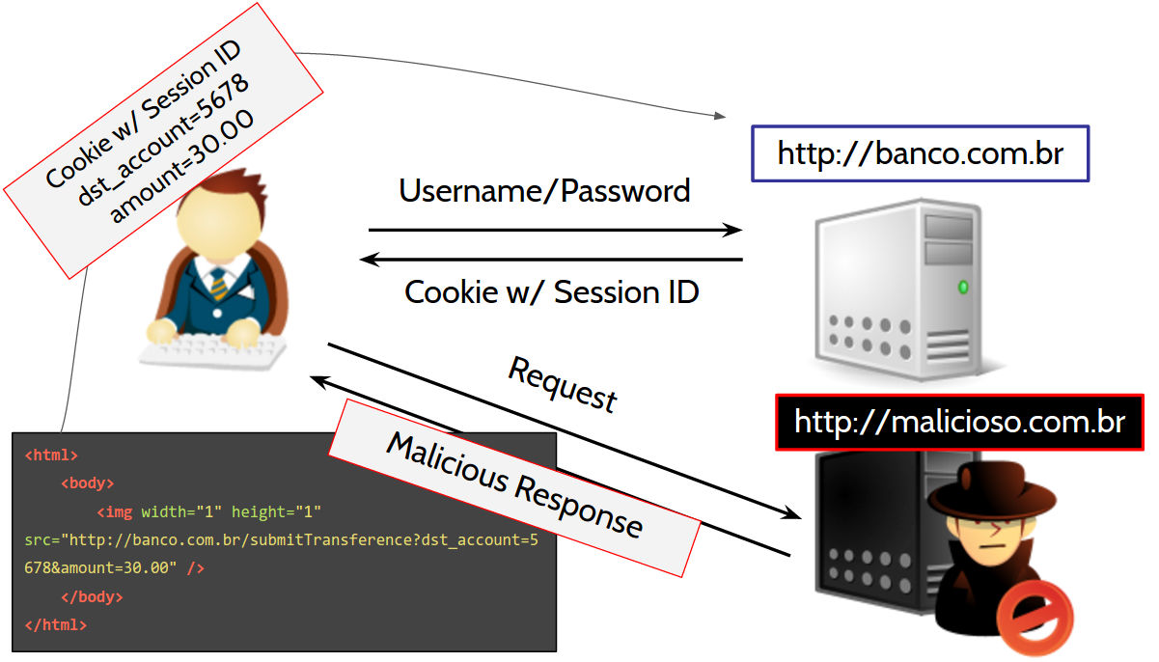

Slide 9
CSRF Characteristics
It involves sites that rely on a user’s identity
It exploits the site’s trust in that identity
It tricks the user’s browser into sending HTTP requests to a target site
It involves HTTP requests that have side effects

Slide 10
CSRF Demo

Slide 11
What Can We Do?

Slide 12
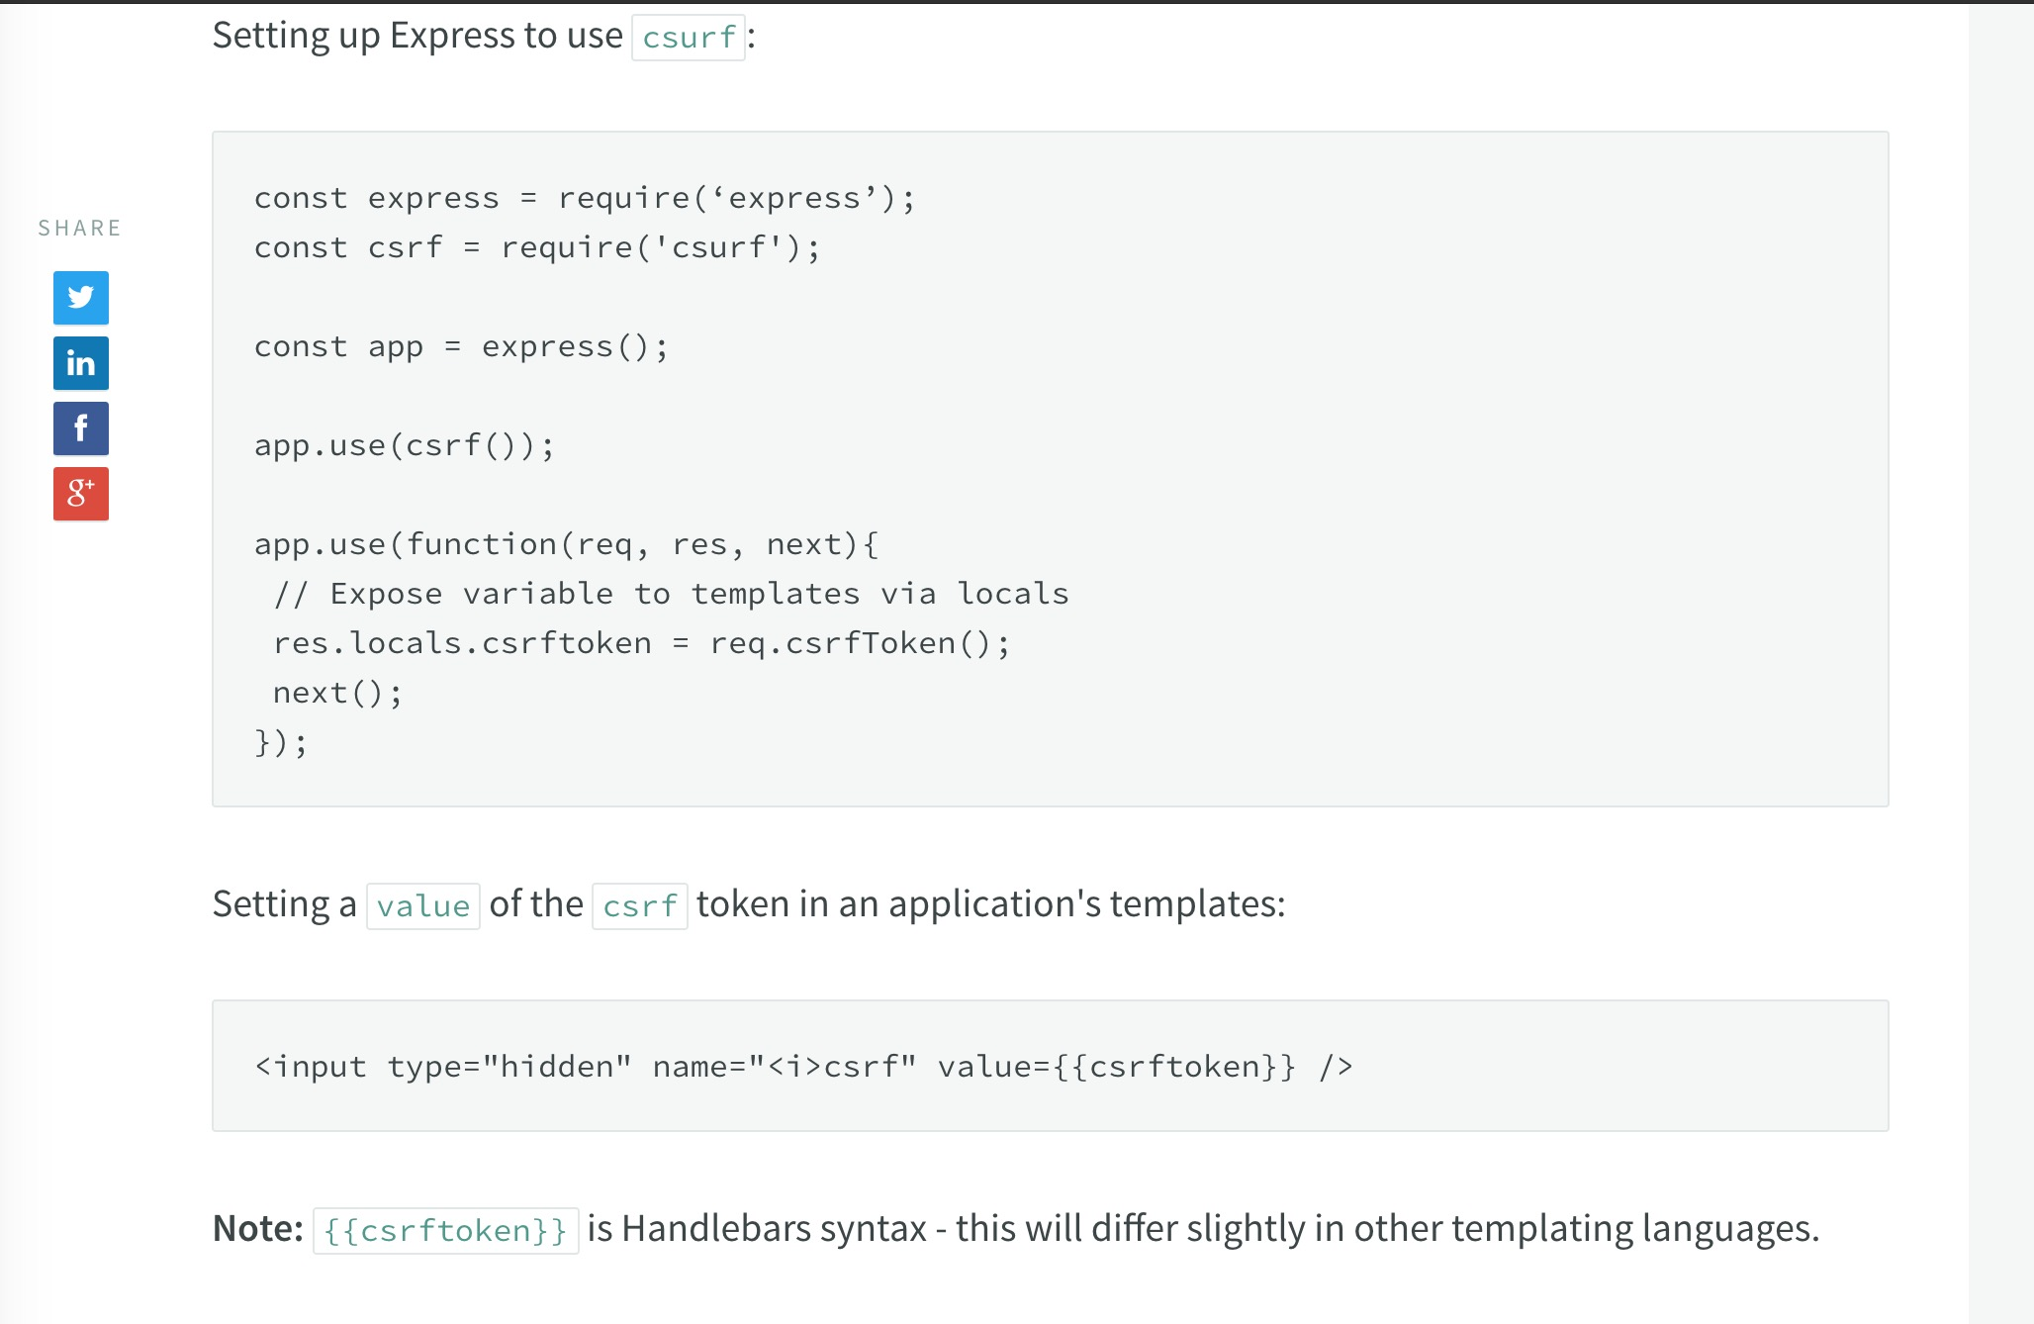

Slide 13
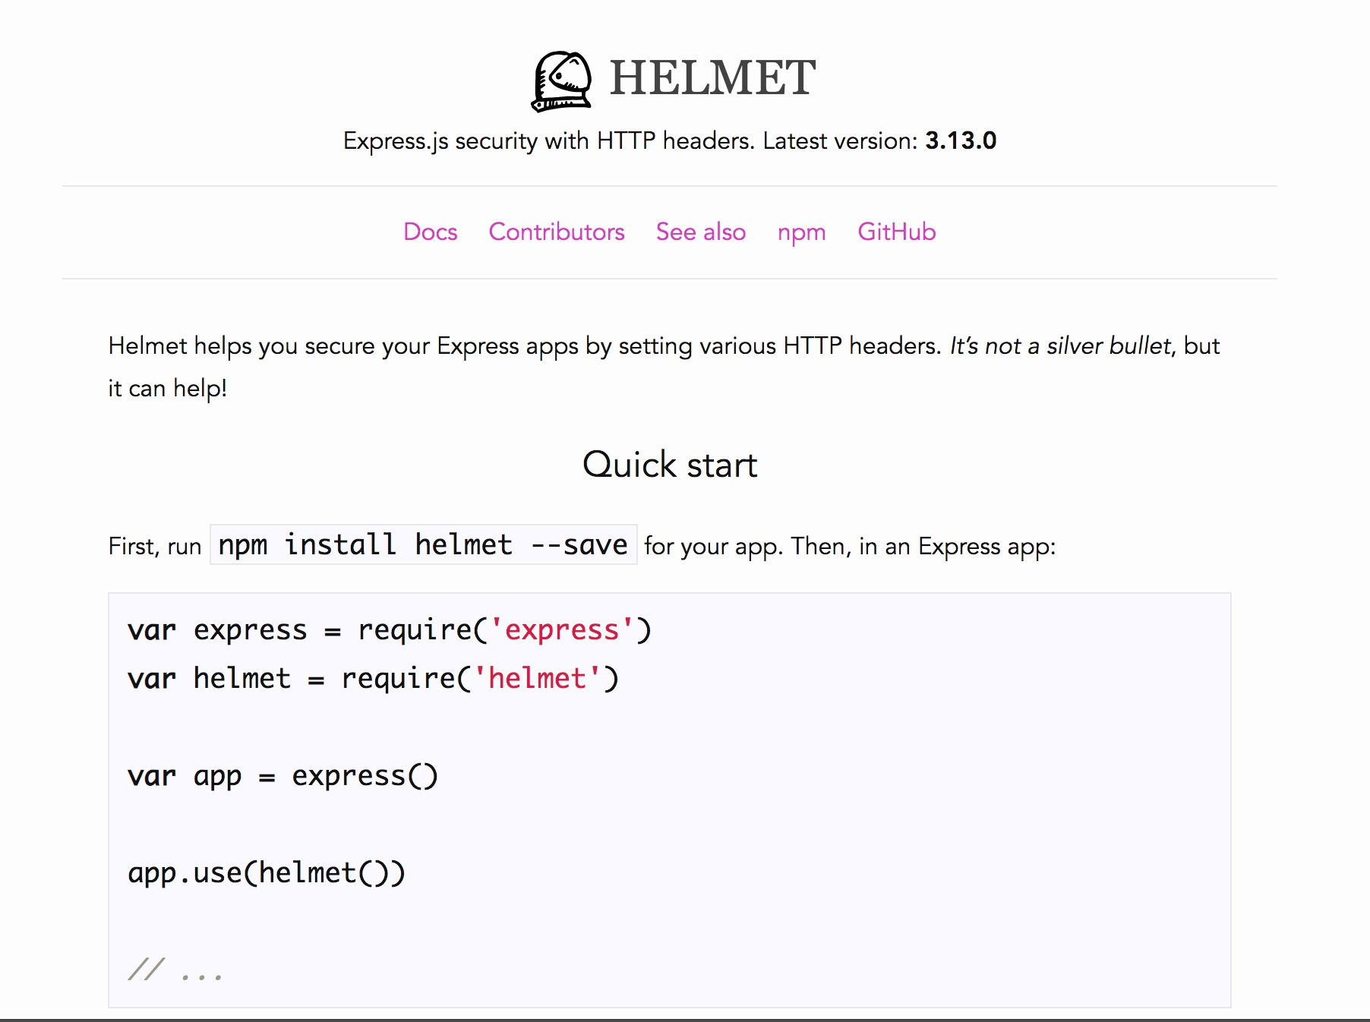

Slide 14
HTTP Parameter Pollution

Slide 15
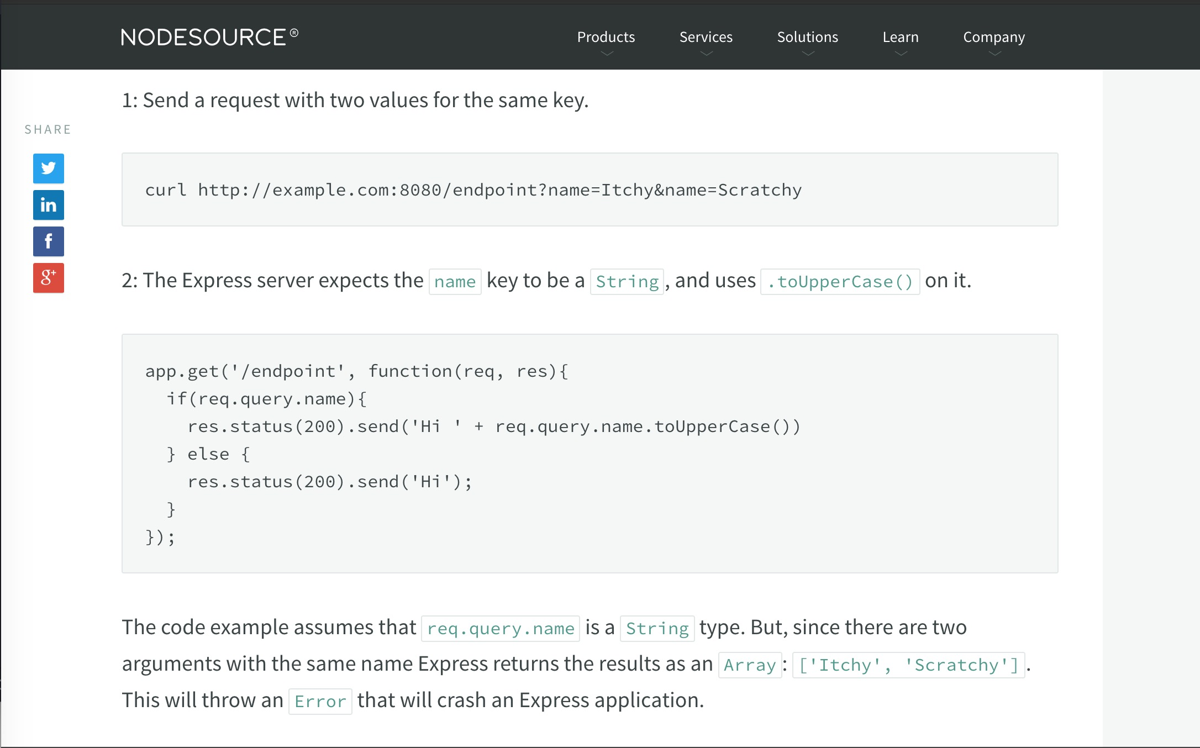

Slide 16
Regular Expression Denial of Service (ReDos)

Slide 17
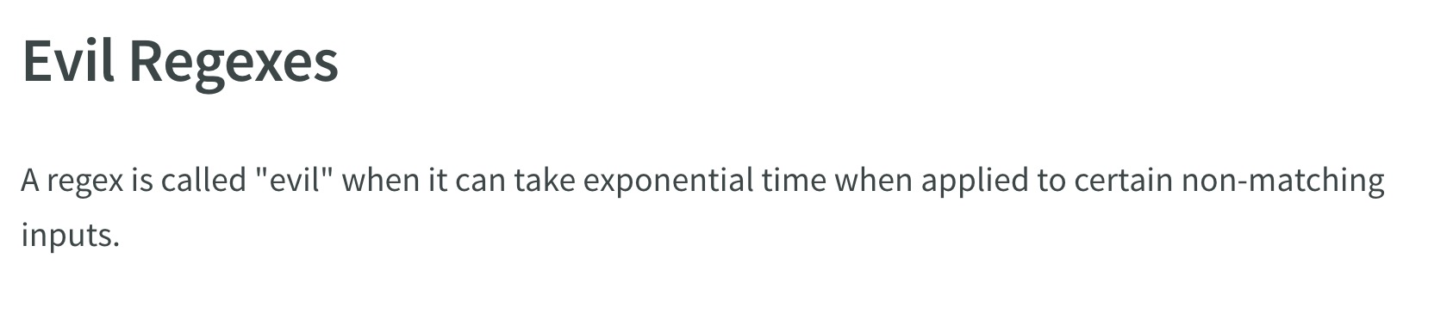
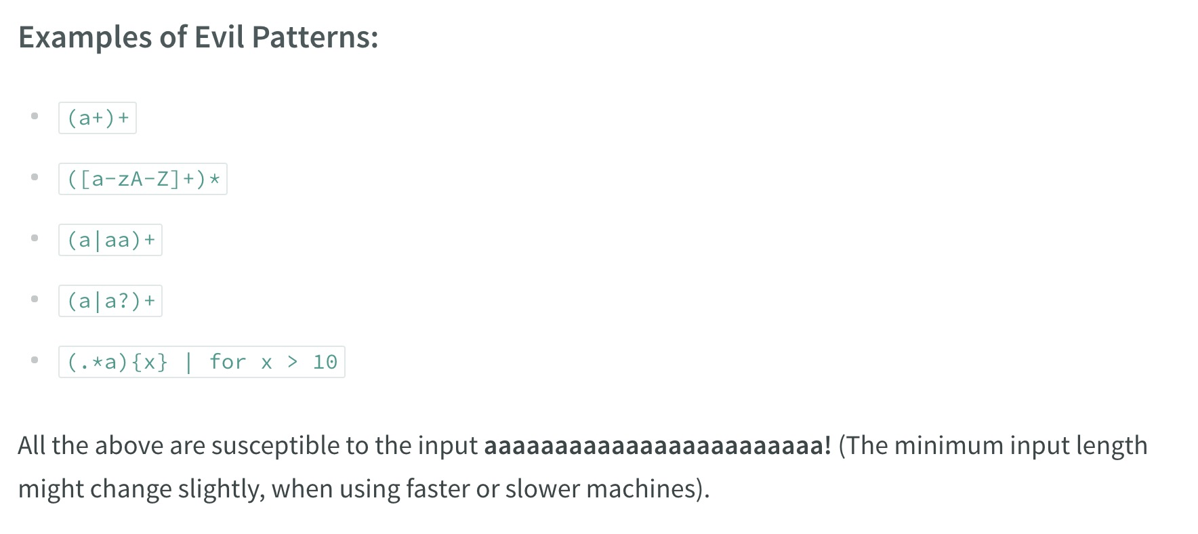

Slide 18
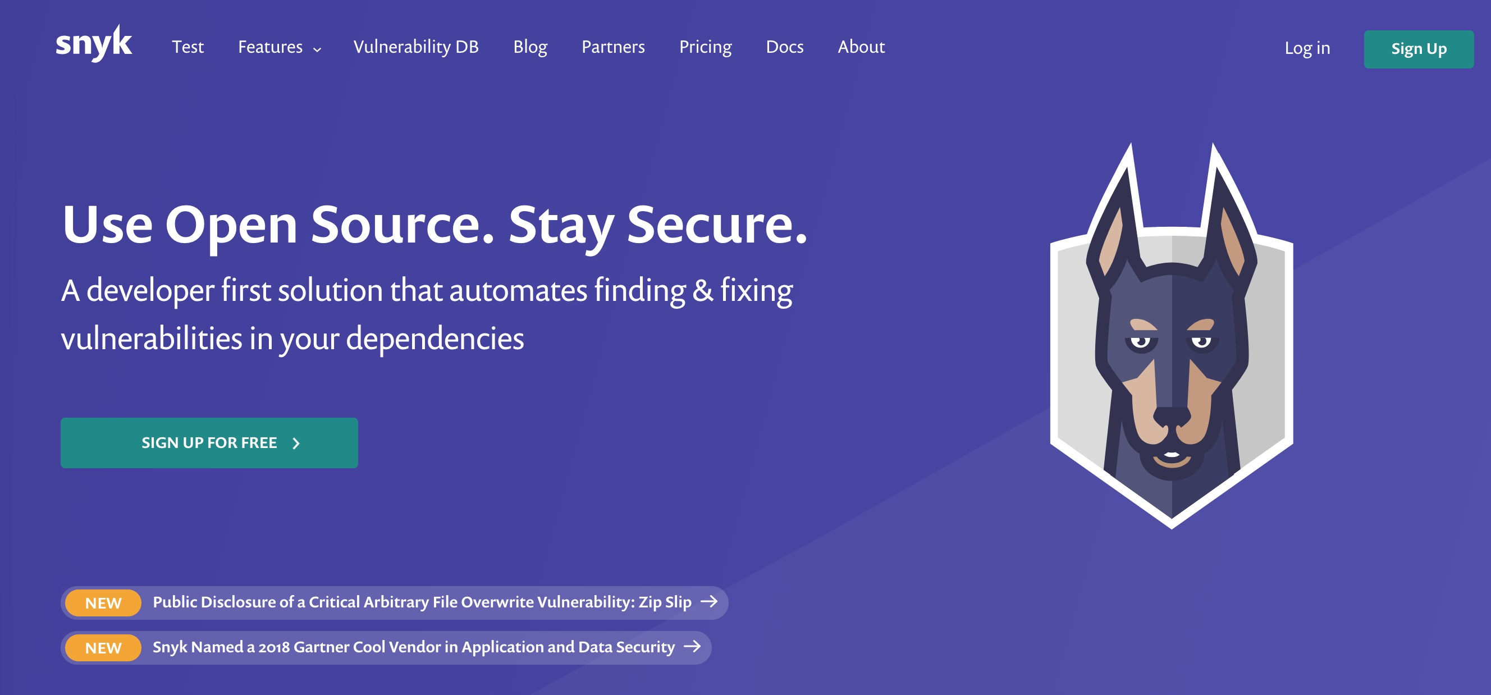
https://snyk.io/

Slide 19
RED
BLUE

Slide 20



Bug Bounty Platforms

Slide 21
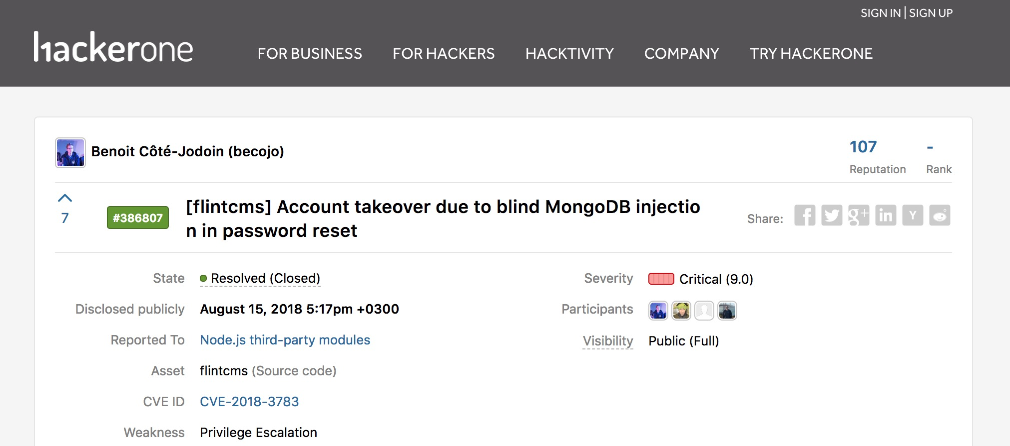

Slide 22
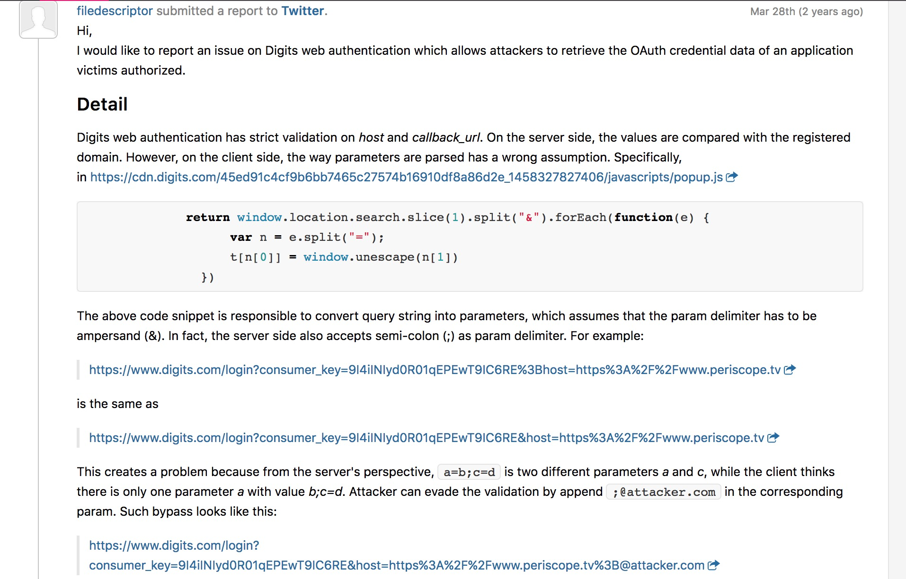

Slide 23
Shellshock
Not all vulnerabilities come from the applications themselves

Slide 24
Shellshock is a Remote Command Execution vulnerability in bash
It relies in the fact that bash incorrectly executes trailing commands when it imports a function definition stored into an environment variable

Slide 25
Shellshock Demo

Slide 26
Finding/Publishing Exploits
Exploit-DB

Slide 27
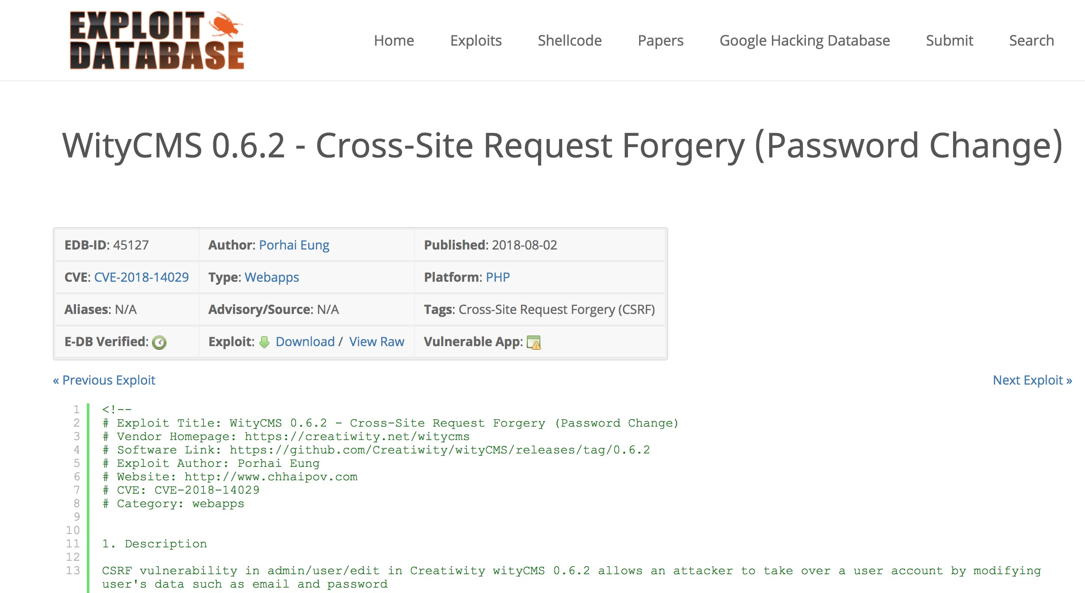

Slide 28
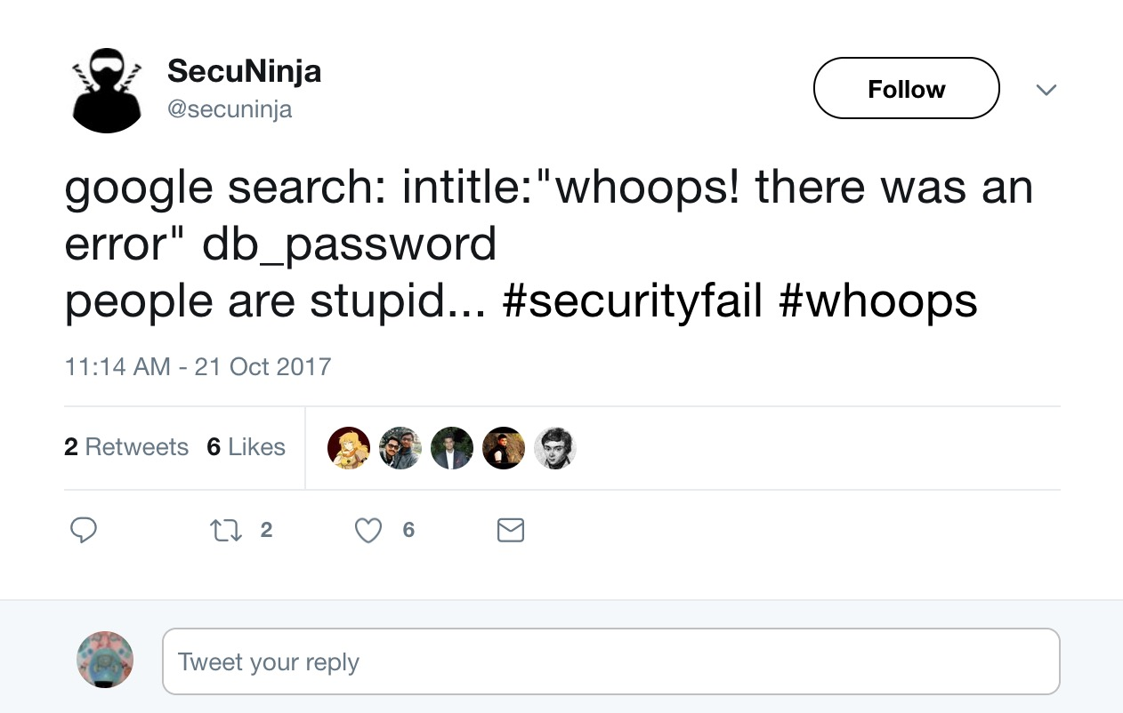
The Magic of Google Dorks

Slide 29
Reverse Engineering

Slide 30
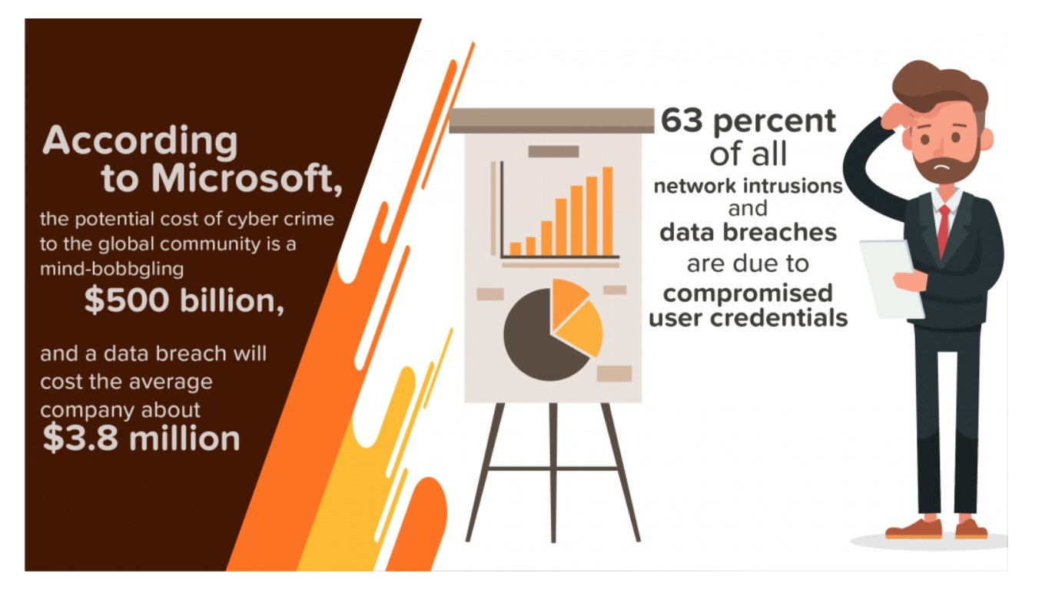
Why should you care?

Slide 31
77%: Proportion of respondents
in a survey of 2,800 IT professionals
who said their organizations
do not have a formal cybersecurity
incident response plan

Slide 32
“According to the Sonatype 2017 State of Software Supply Chain Report, 80 – 90% of an application is built from 3rd party components that often contain critical vulnerabilities as well. Often dev teams use out-dated versions with known security defects. But even if they are up-to-date, 84% of OpenSource projects (probably mostly smaller ones) do not fix known security defects at all.”
https://blog.secodis.com/2018/01/23/statistics-web-application-security-breaches/

Slide 33
Ressources
Tools | BurpSuite | Wireshark | Kali Linux
Websites | root-me.org hackthis.co.uk | vulnhub.com | Youtube: Defcon Conferences
Readings / Courses | The Web Application Hacker’s Handbook v.2 | OWASP Testing Guide v.4 | Metasploit Unleashed (OFSEC)

Slide 34

What we didn’t have time to cover…
Privacy / Anonymity
Cybercrime Laws
Cybercrime Impact on National Security and Infrastructures

Slide 35
Thank You
&&
Happy Hacking

