Slide 1
CS222/CS122C: Principles of Data Management Lecture #01 Fall 2019
Instructor: Prof. Chen Li
Department of Computer Science
UC Irvine

Slide 2
Overview
Homepage
https://grape.ics.uci.edu/wiki/public/wiki/cs222-2019-fall
Canvas page: https://canvas.eee.uci.edu/courses/20422
Piazza page
https://piazza.com/uci/fall2019/cs222cs122c
Sign up ASAP

Slide 3
Related courses at ICS
CS122A: Introduction to Data Management
CS122B: Projects in databases and web applications
CS122C/222: Principles in data management
CS223: Transaction Processing & Distributed Systems
CS224: Advanced topics
CS221: Information Retrieval

Slide 4
Pre-requisites
CS122A or equivalent
Data structures, algorithms, OS
C++ programming skills
Willingness to write code to make it work!

Slide 5
Grading
Four-Part Programming Project: 50%
Final Exam: 50%
“2-week window” to do a rebuttal

Slide 6
Textbooks
Required: Database Management Systems, 3rd edition, by R. Ramakrishnan and J. Gehrke, McGraw Hill, 2003.
Recommended: Readings in Database Systems, 4th edition, by J. Hellerstein and M. Stonebraker, MIT Press, 2005.

Slide 7
Team Projects
1: file and record management
2: relation manager
3: index manager
4: query engine
C++
48-hour grace period with a 10% penalty

Slide 8
Managing submissions on github
All code and submissions will be handled on github.
We will use the copy and timestamp of the “master” as your submission and whether you are using the grace period.
For a team of 2 students, each member is expected to do the best effort to make equal contributions. We reserve the rights to deduct points for both students if we see unbalanced contributions.

Slide 9
Next: Overview of DBMS

Slide 10
Structure of a DBMS
These layers must consider concurrency
control and recovery
A typical DBMS has a layered architecture.
The figure does not show the concurrency control and recovery components (CS 223).
This is one of several possible architectures; each system has its own variations.
Query Optimization
and Execution
Relational Operators
Files and Access Methods
Buffer Management
Disk Space Management
DB

Slide 11
DBMS Structure In More Detail
SQL
Query Parser
Query Optimizer
Query plans
Plan Executor
Relational Operators (+ Utilities)
(CS223)
API calls
Files of Records
Access
Methods
(Indices)
Transaction
Manager
Buffer Manager
Lock
Manager
Log
Manager
Disk Space and I/O Manager
Data
Files
Index
Files
Catalog
Files
WAL

Slide 12
Components’ Roles
Query Parser
Parse and analyze SQL query
Produce data structure capturing SQL statement and the “objects” that it refers to in the system catalogs
Query optimizer (often w/2 steps)
Rewrite query logically
Perform cost-based optimization
Goal is a “good” query plan considering
Physical table structures
Available access paths (indexes)
Data statistics (if known)
Cost model (for relational operations)
(Cost differences
can be orders
of magnitude!)

Slide 13
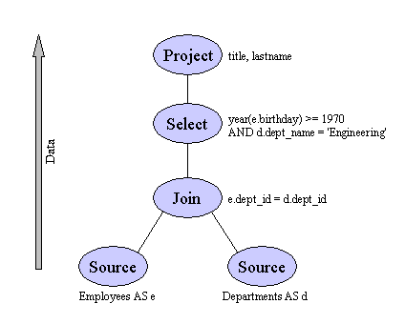
Components’ Roles (continued)
Plan Executor + Relational Operators
Runtime side of query processing
Usually based on “tree of iterators” model, e.g.:
Nodes are relational operators (actually they are physical implementations of the various operators)

Slide 14
Components’ Roles (continued)
Files of Records
OSs usually have byte-stream based APIs
DBMSs instead provide record-based APIs
Record = set of fields
Fields are typed
Records reside on pages of files
Access Methods
Index structures for access based on field values
We’ll look at tree-based, hash-based, and spatial structures (including the time-tested B+ tree)
Peer layer to record-based files (to map from field values to lists of RIDs or lists of primary keys)

Slide 15
Components’ Roles (continued)
Buffer Manager
DBMS answer to main memory management
Cache of pages from files and indices
“DB-oriented” page replacement scheme(s)
All disk page accesses go via the buffer pool
Also interacts with logging/recovery management (to support undo/redo and thus data consistency)
Disk Space and I/O Managers
Manage space on disk (pages), including extents
Also manage I/O (sync, async, prefetch, …)
Notes:
22

Slide 16
Components’ Roles (continued)
System Catalog
Info about physical data (volumes, table spaces, …)
Info about tables (name, columns, types, … ; also constraints, keys, etc., etc.)
Data statistics (e.g., value distributions, counts, …)
Info about indexes (types, target tables, …)
And so on!
Views, triggers, security, …
Transaction Management (CS 223)
ACID: Atomicity, Consistency, Isolation, Durability
Lock Manager for C+I
Log Manager for A+D

Slide 17
A Brief History of Databases
Pre-relational era: 1960’s, early 1970’s
Codd’s seminal paper: 1970
Basic RDBMS R&D: 1970-80 (System R, Ingres)
RDBMS improvements: 1980-85
Relational goes mainstream: 1985-90
Distributed DBMS research: 1980-90
Parallel DBMS research: 1985-95
Extensible DBMS research: 1985-95
OLAP and warehouse research: 1990-2000
Stream DB and XML DB research: 2000-2010
Big data R&D: 2005-present

Slide 18
So What’s the Plan?
We’ll start working our way up the architectural stack next time
You should also start on the 4-part course project right away
Immediate to-do’s for you are:
Read the materials indicated on the wiki
Get yourself signed up on Piazza
Review SQL and chapters 1-8 if need be
Start on part 1 of the project (solo) today!

Slide 19
Next
Disks and files
Project 1 Overview
Paged File Manager
Record-Based File Manager
Notes:
22

Slide 20
Disks and Files
DBMS stores information on (“hard”) disks.
This has major implications for DBMS design!
READ: transfer data from disk to main memory (RAM).
WRITE: transfer data from RAM to disk.
Both are high-cost operations, relative to in-memory operations, so must be planned carefully!

Slide 21
Why Not Store Everything in Main Memory?
Costs too much. Dell wants (in early 2014) $65 for 500GB of disk, $600 for 256GB of SSD, and $57 for 4GB of RAM ($0.13, $2.34, $14.25 per GB)
Main memory is volatile. We want data to be saved between runs. (Obviously!)
Your typical (basic) storage hierarchy:
Main memory (RAM) for currently used data
Disk for the main database (secondary storage)
Tapes for archiving older versions of the data (tertiary storage)
And we also have L1 & L2 caches, SSD, …

Slide 22
Storage Hierarchy & Latency (Jim Gray): How Far Away is the Data?
Andromeda
10
9
Tape /Optical
2,000 years
Robot
10
6
Disk
Pluto
2 years
Irvine (UCI)
1.5 hr
100
Memory
10
On Board Cache
This Building
10 min
2
On Chip Cache
This Room
1
Registers
My Head
1 min

Slide 23
Disks
Secondary storage device of choice.
Main advantage over tapes: random access vs. sequential.
Data is stored and retrieved in units called disk blocks or pages.
Unlike RAM, time to retrieve a disk page varies depending upon location on disk.
Therefore, relative placement of pages on disk has a major impact on DBMS performance!
(SSDs simplify things a bit in this respect)

Slide 24
Components of a Disk
Spindle
Tracks
The platters spin (5400 rpm)
Disk head
The arm assembly is moved in or out to position a head on a desired track Tracks under heads form a cylinder (imaginary!)
Sector
Arm movement
Platters
Only one head reads/writes at any one time.
Arm assembly
Block size is a multiple of sector size (which is fixed)

Slide 25
Accessing a Disk Page
Time to access (read/write) a disk block:
seek time (moving arms to position disk head on track)
rotational delay (waiting for block to rotate under head)
transfer time (actually moving data to/from disk surface)
Seek time and rotational delay dominate.
Seek time varies from about 1 to 20 msec
Rotational delay varies from 0 to 10 msec
Transfer rate is about 1 msec per 4KB page (old)
Key to lower I/O cost: Reduce seek/rotation delays! Hardware vs. software solutions?

Slide 26
Arranging Pages on Disk
`Next` block concept:
blocks on same track, followed by
blocks on same cylinder, followed by
blocks on adjacent cylinder
Blocks in a file should be arranged sequentially on disk (by `next’) in order to minimize seek and rotational delay
For a sequential scan, prefetching several pages at a time is a big win!

Slide 27
RAID (Redundant Array of Inexpensive Disks)
Disk Array: Arrangement of several disks that gives abstraction of a single, large disk.
Goals: Increase performance and reliability.
Two main techniques:
Data striping: Data is partitioned; size of a partition is called the striping unit. Partitions are distributed over several disks.
Redundancy: More disks => more failures. Redundant information allows reconstruction of data if a disk fails.

Slide 28
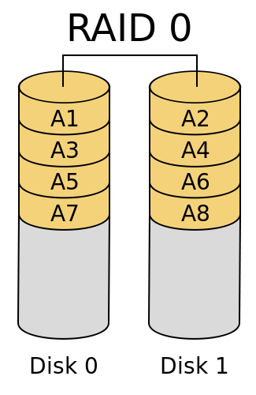
RAID 0: No redundancy (just striping)

Slide 29
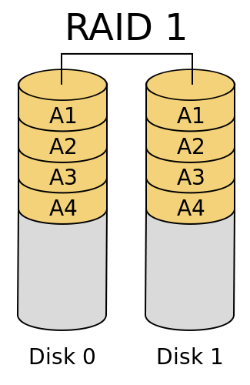
RAID 1: Mirrored (two identical copies)

Slide 30
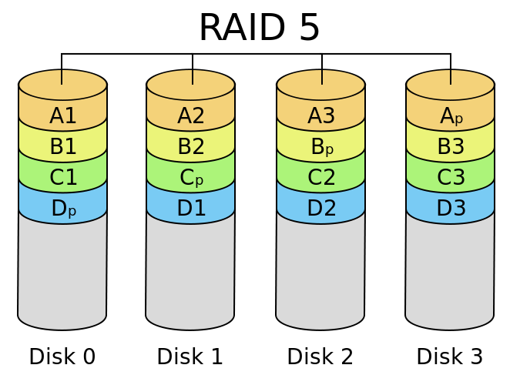

Slide 31
Disk Space Management
Lowest layer of DBMS software manages the space on disk.
Higher levels call upon this layer to:
allocate/deallocate a page
read/write a page
A request for a sequence of pages must be satisfied by allocating the pages sequentially on disk! Higher levels don’t need to know how this is done or how free space is managed.

Slide 32
Project 1 Overview

