Slide 1
CS222/CS122C: Principles of Data Management UCI, Fall 2019 Lecture #02 Storing Data: Record/Page Formats
Instructor: Chen Li

Slide 2
Files of Records
Page or block is OK when doing I/O, but higher levels of DBMS operate on records, and thus want files of records.
FILE: A collection of pages, each containing a collection of records. Must support:
Insert (append)/delete/modify record
Read a particular record (specified using record id)
Scan all records (possibly with some conditions on the records to be retrieved)

Slide 3
Example
CREATE TABLE Emp(id INT,
gender CHAR(1),
name VARCHAR(30),
Salary float
);

Slide 4
Record Formats: Fixed Length
F1
F2
F3
F4
L1
L2
L3
L4
Base address (B) of record
Address of F3 = B+L1+L2
Information about field types is the same for all records in file; it is stored in the system catalogs. (Note: Record field info in Project 1 passed in “from above”…!)
Finding the i’th field of a record does not require scanning the record.

Slide 5
Record Formats: Variable Length
Several alternative formats (# fields is fixed):
F1 F2 F3 F4
v1
$
v2
$
v3
$
v4
$
Fields Delimited by Special Symbols
F1 F2 F3 F4
L1
v1
v2
v3
v4
L2
L3
L4
Fields Preceded by Field Lengths
Some thought questions for you:
(1) What’s true of the second format but not the first?
(2) What annoying disadvantage do both formats share?
(3) And, how do we know the field count in each case?

Slide 6
Record Formats: Variable Length (continued)
Variable-length fields with a directory:
F1 F2 F3 F4
4
v1
v2
v3
v4
Array of field offsets (a.k.a. directory)
This format:
(1) Offers direct access to the i'th field.
(2) Helps support efficient storage of null values. (Q: How?)
(3) Just requires a small directory overhead.
(4) Can even help with ALTER TABLE ADD COLUMN! (Q: How?)

Slide 7
Record Formats: Variable Length
More variations on a theme...
Addition of null flags:
F1 F2 F3 F4
4
0000
v1
v2
v3
v4
Inlining of fixed-size fields:
(F1) F2 (F3) F4
4
0000
l1
v2
l3
v4
v1
v3

Slide 8
Next: Page formats

Slide 9
Page Formats: Fixed Length Records
Slot 1
Slot 1
Slot 2
Slot 2
. . .
Free
Space
. . .
Slot N
Slot N
Slot M
N
1
. . .
0
1
1
M
number
of records
M ... 3 2 1
number
of slots
PACKED
UNPACKED, BITMAP
Record id = <page id, slot #>. In the first (packed) alternative, records will move around for free space management: Rids change 🡪 may be unacceptable!

Slide 10
Page Formats: Variable Length Records
Rid = (i,N)
Page i
Rid = (i,2)
Rid = (i,1)
Free space...
(in middle!)
. . .
F
20
16
24
N
SLOT DIRECTORY (offset, length)
Can move records within page w/o changing RIDs; not so unattractive for fixed-length records as a result.
Record movement? (1) Tombstones, or (2) PKeys (vs. RIDs)

Slide 11
... Variable Length Records (cont.)
Page i
i,1
i,2
i,20
. . .
RECORDS ...
... SLOT DIRECTORY (etc.)
Two variable-sized areas growing towards to each other (living within a one-page space budget!)
Other variations on these formats are possible as well
Could track free space holes with an offset-based list structure
Could use a different record format (e.g., PAX, which clusters values by field in page rather than by record and then field)
....

Slide 12
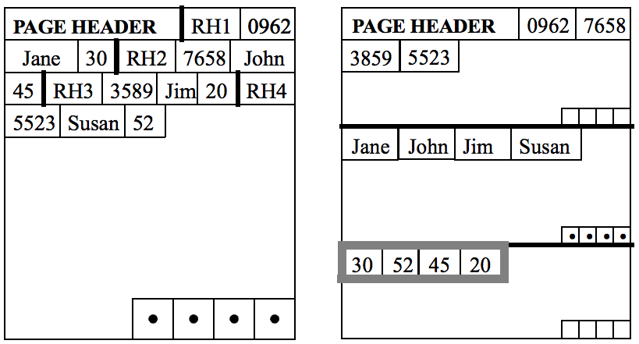
PAX format
Traditional
Format
PAX
Format
PAX partitions each page into minipages based on fields
Good caching behaviors for “select fields from …”;
Compression
www.pdl.cmu.edu/PDL-FTP/Database/pax.pdf
Column store (e.g., Vertica)

Slide 13
Project 1: RecordBasedFileManager
insertRecord
readRecord
printRecord

