Slide 1
CS222/CS122C: Principles of Data Management
UCI, CS, Fall 2019
Notes #03
Row/Column Stores, Heap Files, Buffer Manager, Catalogs
Instructor: Chen Li

Slide 2
Column Stores vs Row Stores
Row stores: store data row by row
  Traditional DBs, e.g., MySQL
  Example: select * from sales WHERE sid = 9414;
Column stores: store data column by column
  Benefits: easy compression, good for queries accessing few columns
  Example: select AVG(price) from sales;
  Examples: MonetDB, Vertica
Nowadays many commercial DBs support both, e.g., SQL Server
Notes:
13

Slide 3
OLTP vs OLAP queries
OLTP: Online Transaction Processing
  Many concurrent requests by many users
  Tend to be simple
  High requirements on latency (in ms) and throughput
  Indexes are very critical
  Row stores are often good
Notes:
13

Slide 4
OLTP vs OLAP queries
OLAP: Online Analytical Processing
  Need to access large amounts of data
  Often aggregation operations (e.g., AVG, SUM, MIN) for reporting purposes
  Few, complicated queries. Take long time to run
  Indexes can be less helpful. Often needs scan
  Columns are often helpful
Notes:
13

Slide 5
Files of Records
Page or block is OK when doing I/O, but higher levels of DBMS operate on records, and thus want files of records.
FILE: A collection of pages, each containing a collection of records. Must support:
  Insert (append)/delete/modify record
  Read a particular record (specified using record id)
  Scan all records (possibly with some conditions on the records to be retrieved)
Notes:
13

Slide 6
Unordered (“Heap”) Files
Simplest file structure that contains records in no particular (logical) order.
As file grows and shrinks, disk pages are allocated and de-allocated.
To support record level operations, we must:
  keep track of the pages in a file
  keep track of free space within and across pages
  keep track of the records on a page
  keep track of fields within records
There are many alternatives for each.
Notes:
14

Slide 7
Heap File Implemented as a List
Data
Page
Data
Page
Data
Page
Full Pages
Header
Page
Data
Page
Data
Page
Data
Page
Pages with
Free Space
The header page id and Heap file name must be stored someplace. (Project 1 note: The OS filesystem can help…! ☺)
Each page contains two extra “pointers” in this case.
Refinement: Use several lists for different degrees of free space (to mention just one of many possibilities).
Notes:
15

Slide 8
Heap File Using a Page Directory
Data
Page 1
Header
Page
Data
Page 2
Data
Page N
DIRECTORY
Page entries can include the number of free bytes on each page
Directory is a collection of pages; linked list just one possible implementation. (Note: Can also do extents!)
Notes:
16

Slide 9
Next topic: Buffer Management
Page Requests from Higher Levels
BUFFER POOL
Note: Project 1’s PagedFileManager class would do the buffering inside if we were doing it…!
disk page
free frame
MAIN MEMORY
DISK
choice of frame dictated
by replacement policy
DB
Data must be in RAM for DBMS to operate on it!
Table of <frame#, pageid> pairs is maintained.
Notes:
4

Slide 10
When a Page is Requested ...
If requested page is not in pool:
  Choose a frame for replacement
  If that frame is dirty, write it to disk
  Read requested page into chosen frame
Pin the page and return its address
* If requests can be predicted (e.g., sequential scans)
pages can be prefetched several pages at a time!
Notes:
5

Slide 11
More on Buffer Management
Requestor of page must unpin it, and indicate whether page has been modified, when done:
  dirty bit used for the latter purpose
Page in pool may be requested many times
  a pin count is used, and a page is a candidate for replacement iff pin count = 0.
CC & recovery may entail additional I/O when a frame is chosen for replacement. (Write-Ahead Log protocol; more in CS 223.)
Notes:
6

Slide 12
Buffer Replacement Policy
Frame is chosen for replacement using a replacement policy:
  Least-recently-used (LRU), Clock, MRU, etc.
Policy can have big impact on # of I/O’s; depends on the access pattern.
Sequential flooding: Nasty situation caused by LRU + (repeated) sequential scans.
  # buffer frames < # pages in file means each page request causes an I/O. MRU much better in this situation (but not in all situations, of course).
Notes:
7

Slide 13
Buffer management: DBMS vs. OS File System
OS does disk space & buffer management – so why not let the OS manage these tasks…?
Buffer management in DBMS requires ability to:
  pin a page in buffer pool, force a page to disk (important for implementing CC & recovery), and
  adjust replacement policy, and prefetch pages based on access patterns in typical DB operations.
DBMS buffer manager can do a better job using knowledge about disk behaviors
Notes:
8

Slide 14
Example
Consider a join of R and S using nested loop
R has 50 pages, and S has 100 pages
The buffer pool has 101 pages:
  1 used for reading an R page,
  1 used for the output
  99 used for reading S
What’s the behavior of the LRU policy?
What’s the behavior of the MRU policy?
Notes:
8

Slide 15
Topic: System Catalogs
For each relation:
  name, file name, file structure (e.g., Heap)
  name, type, and length (if fixed) for each attribute
  index name, target, and kind for each index
  also integrity constraints, defaults, nullability, etc.
For each index:
  structure (e.g., B+ tree) and search key fields
For each view:
  view name and definition (including query)
Plus statistics, authorization, buffer pool size, etc.
* Catalogs themselves stored as record-based files too!
Notes:
18

Slide 16
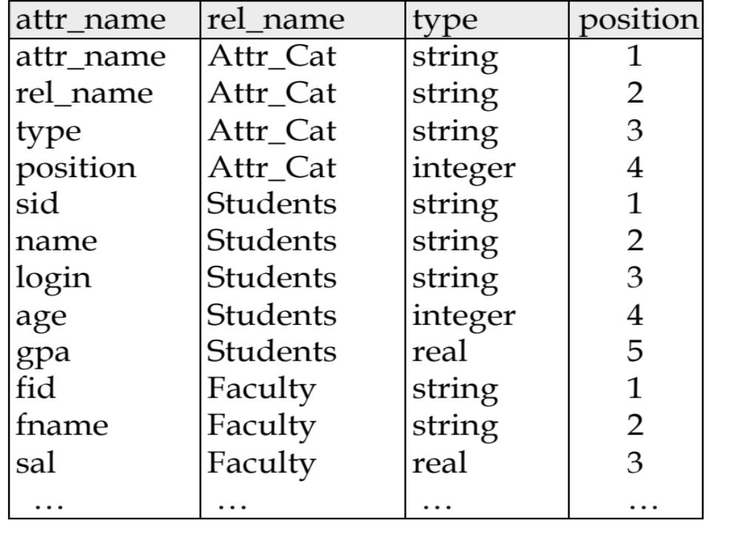
Attr_Cat(attr_name, rel_name, type, position)
Notes:
19

