Slide 1
CS222/CS122C: Principles of Data Management
UCI, Fall 2019
Notes #04
Schema versioning and
File organizations
Instructor: Chen Li

Slide 2
Schema Versioning
How to handle existing records when the schema is changed?
Scheme versioning technique adds the version of the schema to each record
  All versions of the schema are kept in the catalog
  When the schema changes, create a new schema version
  Records are interpreted based on it’s schema version and current schema during a query
Version | Schema
1 | A, B, C
2 | A, B, C, D
3 | A, B, D
Record | Version
a1, b1, c1 | 1
a2, b2, c2 | 1
a3, b3, c3, d3 | 2
a4, b4, d4 | 3
Table
Catalog
Notes:
18

Slide 3
Example
Create table R(A, B, C)
Insert 1 million records
  All records are with schema version 1
Add attribute D
  Create new schema version 2
Insert 10 records
  10 records are with schema version 2
Select * from R
  records with version 1 are padded with null for field D
Drop attribute D
  Create new schema version 3
Select * from R
  field D are truncated from records with version 2

Slide 4
Next topic: File Organizations
Many alternatives exist. Each one is ideal for some situations, but not so good in others:
  Heap (random ordered) files: Suitable when typical access is a file scan retrieving all record or access comes through a variety of secondary indexes.
  Sorted Files: Best if records must be retrieved in some order, or only a `range’ of records is needed.
  Indexes: Data structures to organize records via trees or hashing.
    Like sorted files, they speed up searches for a subset of records, based on values in certain (“search key”) fields.
    Updates are much faster than in sorted files.
Notes:
2

Slide 5
Cost Model
We will ignore CPU costs, for simplicity, so:
  B: The number of data pages
  R: Number of records per page
  D: (Average) time to read or write disk page
  Counting the number of page I/Os ignores gains of prefetching a sequence of pages; thus, even the real I/O cost is only roughly approximated for now.
  Average-case analysis; based on several simplistic assumptions.
  * Good enough to convey the overall trends!
Notes:
3

Slide 6
Comparison of File Organizations
Heap files (random order; insert at eof)
Sorted files, sorted on <age, sal>

Slide 7
Operations to Compare
Scan: Fetch all records from disk
Equality search
Range selection
Insert a record
Delete a record

Slide 8
Assumptions for Our Analysis
Heap Files:
  Equality selection on key; exactly one match.
Sorted Files:
  File compacted after a deletion (vs. a deleted bit).
Notes:
4

Slide 9
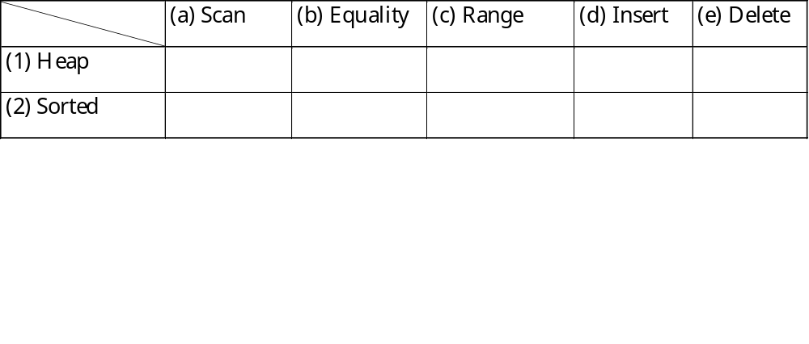
Cost of Operations
* Several assumptions underlie these (rough) estimates!
Notes:
5

Slide 10
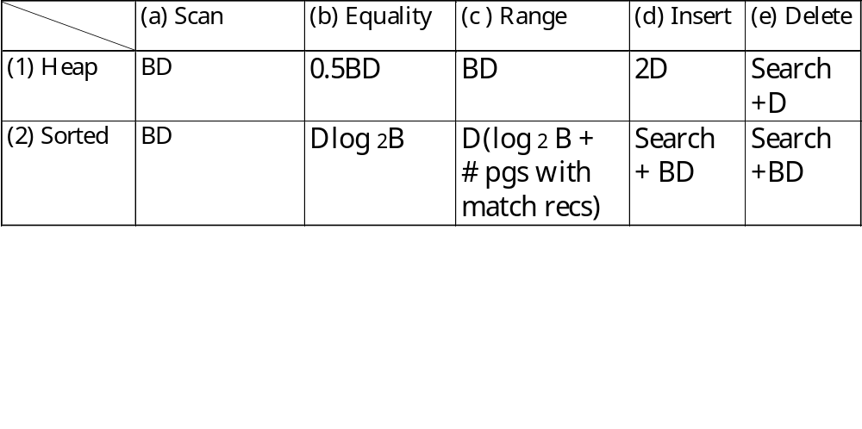
Cost of Operations (disk IOs)
* Several assumptions underlie these (rough) estimates!
Notes:
5

