Slide 1
CS222/CS122C: Principles of Data Management
UCI, Fall 2019
Notes #09
External Sorting
Instructor: Chen Li

Slide 2
Why Sort?
A classic problem in computer science! (☺)
Data sometimes requested in sorted order.
  E.g., find students in decreasing gpa order.
Sorting is first step in bulk loading B+ tree index.
Sorting useful for eliminating duplicate copies (i.e., SELECT DISTINCT) in a collection of records. (Why?)
Sort-merge join algorithm involves sorting.
Problem: sort 1 TB of data with 1 GB of RAM.
  Q: Why not just use virtual memory?
Notes:
4

Slide 3
2-Way Sort: Requires 3 Buffers
Pass 1: Read a page, sort it, write it out
  only one buffer page is used
Pass 2, 3, …, etc.: Read and merge pairs of runs
  three buffer pages are used:
INPUT 1
OUTPUT
...
...
INPUT 2
Main memory buffers
Disk
Disk
Notes:
5

Slide 4
Sorting N=2^{k} Pages of Data
Pass 0:
  Read, sort, write → 2^{k} 1-page runs (subfiles)
Pass 1:
  Read+merge 1-page pairs, write → 2^{k-1} 2-page runs
Pass 2:
  Read+merge 2-page pairs, write → 2^{k-2} 4-page runs
  •••
Pass k-1:
  Read+merge 2^{k-2} -page pairs, write → 2 2^{k-1} -page runs
Pass k:
  Read+merge 2^{k-1}-page pairs, write → 1 2^{k} –page result
Notes:
4

Slide 5
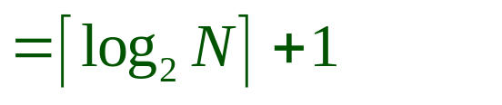
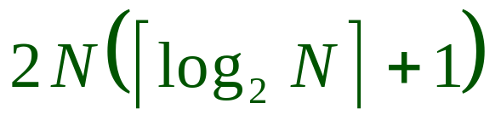
Two-Way External Merge Sort
Each pass we read + write each page in file.
N pages in the file => the number of passes
So total I/O cost is:
Idea: Divide and conquer: sort subfiles and merge
Q: See any room to do better, w/just 3 pages?
3,4
6,2
9,4
8,7
5,6
3,1
2
Input file
PASS 0
3,4
2,6
4,9
7,8
5,6
1,3
2
1-page runs
PASS 1
2,3
4,7
1,3
2-page runs
4,6
8,9
5,6
2
PASS 2
2,3
4,4
1,2
4-page runs
6,7
3,5
8,9
6
PASS 3
(k=3)
1,2
2,3
3,4
8-page runs
4,5
6,6
7,8
9
Notes:
6

Slide 6
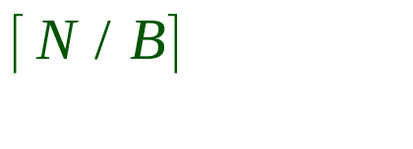
General External Merge Sort
More than 3 buffer pages. How can we utilize them?
To sort a file with N pages using B buffer pages:
  Pass 0: use B buffer pages. Produce sorted runs of B pages each. (Actually B-1 instead of B w/variable-length records.)
  Pass 2, …, etc.: merge B-1 runs.
INPUT 1
. . .
INPUT 2
. . .
. . .
OUTPUT
INPUT B-1
Disk
Disk
B Main memory buffers
Notes:
7

Slide 7
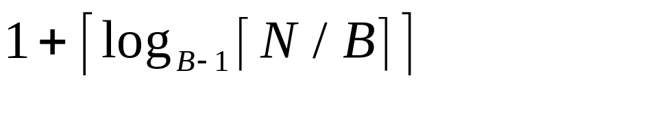
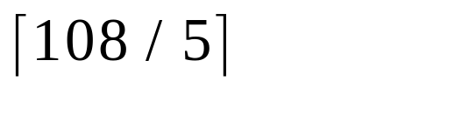
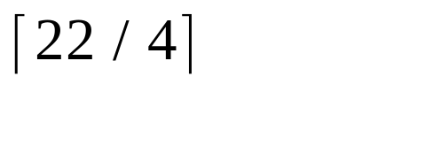
Cost of External Merge Sort
Number of passes:
Cost = 2N * (# of passes)
E.g., with 5 buffer pages, to sort 108 page file:
  Pass 0: = 22 sorted runs of 5 pages each (last run is only 3 pages)
  Pass 1: = 6 sorted runs of 20 pages each (last run is only 8 pages)
  Pass 2: 2 sorted runs, 80 pages and 28 pages
  Pass 3: Sorted file of 108 pages
Notes:
8

Slide 8
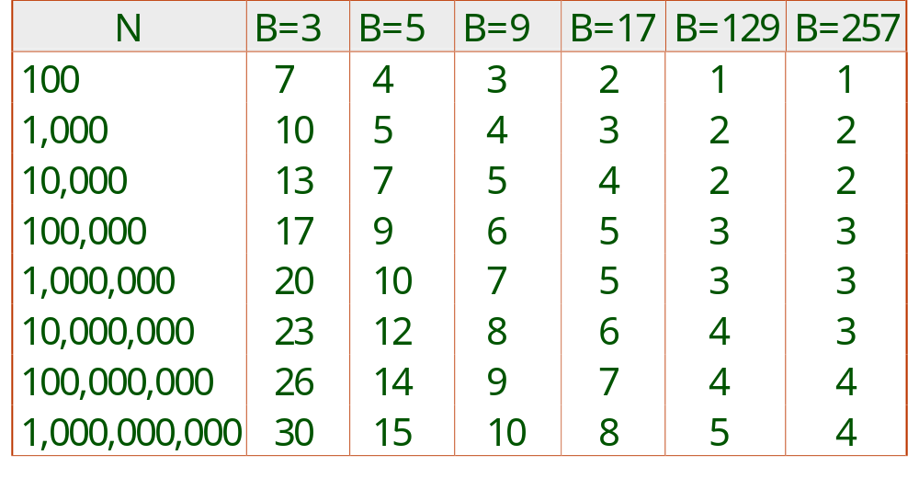
Number of Passes of External Sort
Notes:
9

Slide 9
Double Buffering
To reduce wait time for I/O request to complete, can prefetch into `shadow block’.
  Potentially, more passes; in practice, most files still sorted in 2-3 passes.
INPUT 1
INPUT 1'
INPUT 2
OUTPUT
INPUT 2'
OUTPUT'
b
Disk
INPUT k
block size
Disk
INPUT k'
B main memory buffers, k-way merge

Slide 10
Sorting Summary
External sorting is important; DBMS may dedicate part of buffer pool for sorting!
External merge sort minimizes disk I/O cost:
  Pass 0: Produce sorted runs of size B (# buffer pages), or of size B-1 if we are handling variable-length records. Passes > 0: Merge runs (until just one run is produced).
  # of runs merged at a time depends on B and block size.
  Larger block size means less I/O cost per page of data.
  Larger block size means fewer runs merged per step.
  In practice, # of passes needed rarely more than 2 or 3.
Notes:
19

