Slide 1

CS222/CS122C: Principles of Data Management
UCI, Fall 2019
Notes #11
Join!
Instructor: Chen Li

Slide 2
Schema for Examples
Sailors (sid: integer, sname: string, rating: integer, age: real)
Reserves (sid: integer, bid: integer, day: dates, rname: string)
Reserves:
  Each tuple is 40 bytes long, 100 tuples per page, 1000 pages.
  (Total cardinality is thus 100,000 reservations)
Sailors:
  Each tuple is 50 bytes long, 80 tuples per page, 500 pages.
  (Total cardinality is thus 40,000 sailing club members)
Notes:
4

Slide 3


Equality Joins With One Join Column
SELECT *
FROM Reserves R1, Sailors S1
WHERE R1.sid=S1.sid
In algebra: R S. Incredibly common! Must thus be carefully optimized. R S is large; so, doing R S followed by a selection would be highly inefficient.
Assume: M pages in R, p_{R} tuples per page, N pages in S, p_{S} tuples per page.
  In our examples, R is Reserves and S is Sailors.
We will consider more complex join conditions later.
Cost metric: # of I/Os. (We will ignore output costs.)
Notes:
5

Slide 4
Simple Nested Loops Join(s)
foreach tuple r in R do
foreach tuple s in S do
if r_{i} == s_{j} then add <r, s> to result
For each tuple in the outer relation R, we scan the entire inner relation S.
  Cost: M + (p_{R} * M) * N = 1000 + (100*1000)*500 I/Os
Page-oriented Nested Loops join: For each page of R, get each page of S, and write out matching pairs of tuples <r, s>, where r is in R-page and S is in S-page.
  Cost: M + M*N = 1000 + 1000*500
  If smaller relation (S) is outer, cost = 500 + 500*1000
  (Notice that we were essentially wasting an opportunity!)
Notes:
6

Slide 5
Block Nested Loops Join
Use one page as an input buffer for scanning the inner S, one page as the output buffer, and use all remaining pages to hold a “block” of outer R.
  For each matching tuple r in R-block, s in S-page, add <r, s> to result. Then read next R-block, scan S, etc.
R & S
Join Result
Hash table for block of R
(k <= B-2 pages)
. . .
. . .
. . .
Input buffer for S
Output buffer
Notes:
9

Slide 6
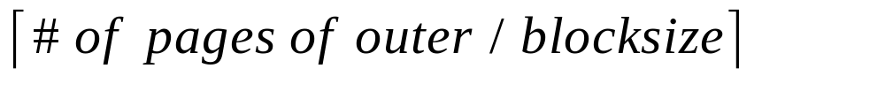
Examples of Block Nested Loops
Cost: Scan of outer + #outer blocks * scan of inner
  #outer blocks =
  M + M/B * N
With Reserves (R) as outer, and 100-page blocks of R:
  Cost of scanning R is 1000 I/Os; there’ll be 10 blocks total.
  Per R block, we scan Sailors (S); 10*500 (=5000) I/Os for S.
With (100-page blocks of) Sailors as outer:
  Cost of scanning S is 500 I/Os; a total of 5 blocks.
  Per block of S, we scan Reserves; 5*1000 I/Os for R.
(With sequential reads considered, analysis changes: may want to divide buffers evenly between R and S.)

Slide 7
Index Nested Loops Join
foreach tuple r in R do
foreach tuple s in S where r_{i} == s_{j} do
add <r, s> to result
If there is an index on the join column of one relation (say S), can make it the inner and exploit the index.
  Cost: M + ( (p_{R} * M) * cost of finding matching S tuples)
For each R tuple, cost of probing S’s index is about 1.2 for hash index, and say 2-4 for B+ tree. Cost of fetching actual S tuples (assuming Alt. (2) or (3) for index data entries) depends on clustering.
  Clustered (s_{j}) index: 1 I/O per R tuple (typical); unclustered: 1 I/O per matching S tuple per R tuple.

Slide 8
Examples of Index Nested Loops
Hash-index (Alt. 2) on sid of Sailors (as inner):
  Scan Reserves: 1000 page I/Os, 100*1000 (=100,000) tuples.
  For each Reserves tuple: 1.2 I/Os to get data entry in index, plus 1 I/O to get (the exactly one) matching Sailors tuple. Total: 220,000 I/Os. (Plus 1000 in Reserves “noise”.)
Formula: 1000 + 100 * 1000 * (1.2 + 1)
Notes:
8

Slide 9
Examples of Index Nested Loops
Hash-index (Alt. 2) on sid of Reserves (as inner):
  Scan Sailors: 500 page I/Os, 80*500 (=40,000) tuples.
  For each Sailors tuple: 1.2 I/Os to find index page with data entries, plus cost of retrieving matching Reserves tuples. Assuming uniform distribution, 2.5 reservations per sailor (100,000 / 40,000). Cost of retrieving them is 1 or 2.5 I/Os depending on the index’s clustering setup.
Formula: 500 + 500 * 80 * (1.2 + 100,000/40,000)
Notes:
8

Slide 10

Sort-Merge Join (R S)
i=j
Sort R and S on the join column, then scan them to do a “merge” (on join column), and output result tuples.
  Advance scan of R until current R-tuple >= current S tuple, then advance scan of S until current S-tuple >= current R tuple; do this until current R tuple = current S tuple.
  At this point, all R tuples with same value in Ri (current R group) and all S tuples with same value in Sj (current S group) match; output <r, s> for all pairs of such tuples.
  Then resume scanning R and S.
R scanned once; each S group scanned once per matching R tuple. (Multiple scans of an S group very likely to find all needed pages in buffer pool.)
Notes:
11

Slide 11
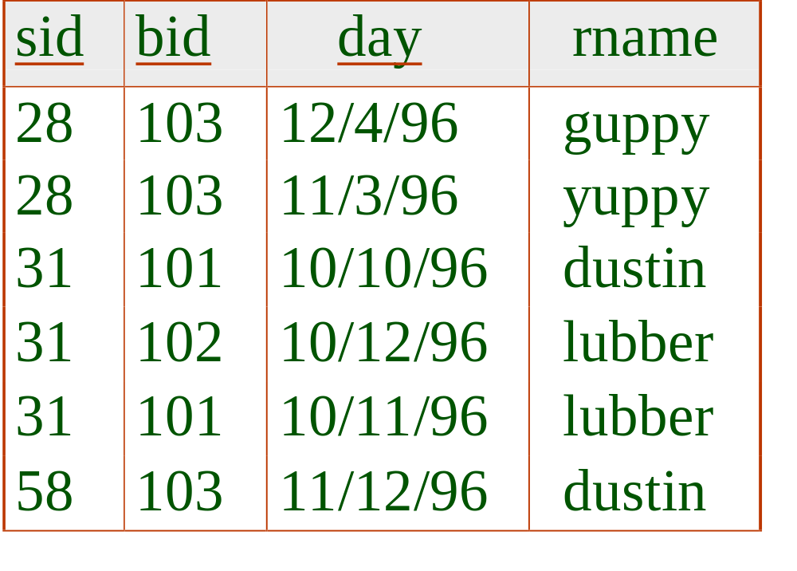
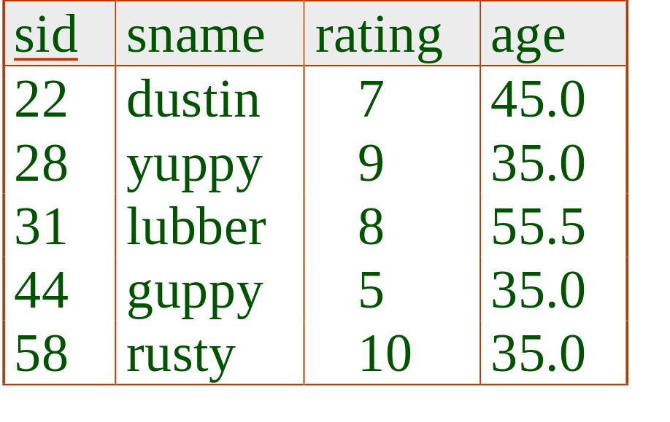
Example of Sort-Merge Join
Cost: Sort R (roughly M log M) + sort S (roughly N log N) + (M+N)
Notes:
12

Slide 12
Cost of Sort-Merge Join
The cost of scanning M+N could be M*N in the worst case
  When there are many records with the same join value
  Very unlikely
With 35 buffer pages, both Reserves and Sailors can be sorted in 2 passes; total join cost: 7500 = 5 * (1000 + 500).
Versus BNL cost: 2500 to 15000 I/O range
Notes:
12

Slide 13
Improving Sort-Merge Join
We can combine the merging phases in the sorting of R and S with the merging required for the join.
Allocate 1 page per run of each relation, and do a parallel `merge’ while checking the join condition. (Else wasteful!)
Cost: read+write each relation in Pass 0 + read each relation in (only) merging pass (+ writing of result tuples).
  Cost: goes down from 7500 to 4500 I/Os (3 * (1000 + 500)).
With large memory, the cost of sort-merge join, like the cost of external sorting, behaves like it’s linear.
Notes:
13

Slide 14
Improving sort-merge join
Join Result
R run (sorted)
R
R sorted
chunks
Sort B pages
in memory
to generate
runs
In-memory
merge join
S
Output buffer
S sorted
. . .
S run (sorted)
Memory requirement: M/B + N/B <= B – 1 So B >= sqrt (M + N)
Notes:
9

Slide 15
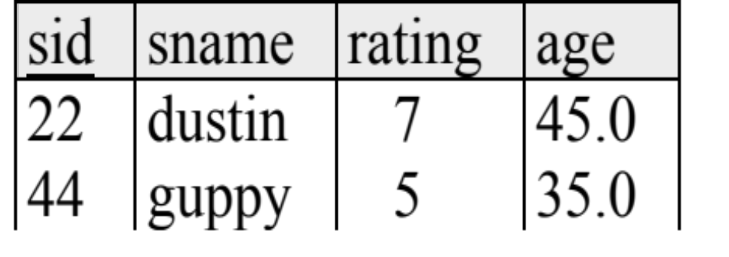
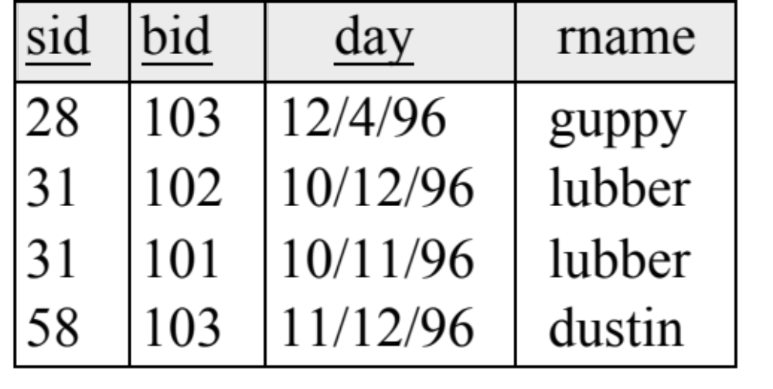
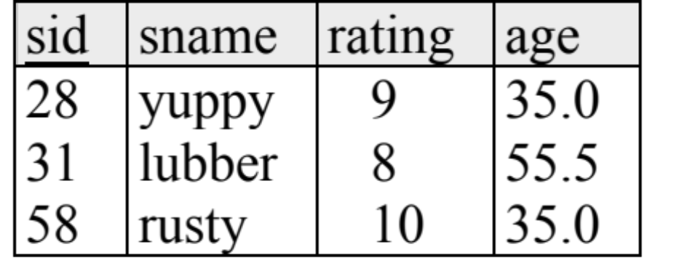
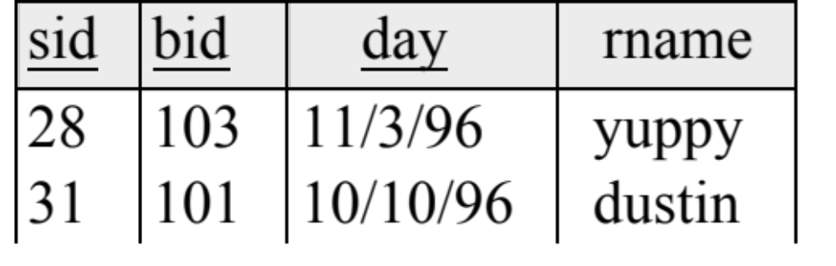
Improving sort-merge join
First create sorted runs for each table (S & R) .....
..... then merge S & R runs at the same time as joining them...!
Notes:
12

Slide 16
Grace Hash-Join
Original
Relation
(First do R,
then do S)
OUTPUT
Partitions
1
Partition both of the relations using a hash function h: R tuples in R’s partition i will only match S tuples in S’s partition i.
1
INPUT
2
hash
function
h
2
. . .
B-1
B-1
Disk
B main memory buffers
Disk
Partitions
of R & S
Join Result
Read in one partition of R, hashing it using function h2 (<> h). Scan the matching partition of S, search for its R matches.
Hash table for partition
Ri (k <= B-2 pages)
hash
fn
h2
h2
Input buffer
for Si
Output
buffer
Disk
B main memory buffers
Disk
Notes:
14

Slide 17
Observations on Grace Hash-Join
#partitions k ≤ B-1 (why?), and B-2 ≥ size of largest partition to be held in memory. Assuming uniformly sized partitions, and maximizing k, we get:
  k= B-1, and M/(B-1) ≤ B-2, i.e., B must be ≥ sqrt(M)
If we build an in-memory hash table to speed up the matching of tuples, a little more memory is needed.
If the hash function does not partition uniformly, one or more R partitions may not fit in memory. Can try hash-join technique recursively to do the join of such an R-partition with its corresponding S-partition.
Notes:
15

Slide 18
Cost of Grace Hash-Join
In partitioning phase, read+write both relns; 2(M+N). In matching phase, read both relns; M+N I/Os.
In our running example, this is a total of 4500 I/Os.
Sort-Merge Join vs. Hash Join:
  Given a minimum amount of memory, both have a cost of 3(M+N) I/Os. Hash Join superior on this count if relation sizes differ greatly (as it wins by needing less memory). Also, Hash Join is neatly parallelizable, as we will see later.
  Sort-Merge less sensitive to data skew; result is sorted.
Notes:
16

Slide 19
Simple Hash-Join (see Shapiro!)
Grace Hash-Join:
  Partitioning (“build”) does read+write of R and S [2(M+N)]
  Matching (“probe”) does read of R and S; M+N [3(M+N)]
  Q: What if the smaller relation (R) is just slightly too big?
Simple Hash-Join addresses this case:
  Scan R, using most of memory for a hash table; write overflow part of R to R’(R’s leftovers) on disk
  Scan S, probe R’s hash table with “most” of S; write overflow part of S to S’ (S’s leftovers) on disk
  Repeat (recursively!) to join R’ and S’
Notes:
16

Slide 20
Simple hash join
Memory
Step 1
Build
In-memory
Hash table
R
Passed
over
R tuples
Store
Output if match
Step 2
Probe
In-memory
Hash table
S
Passed
over
S tuples
Store
Repeat steps 1 and 2 for passed over tuples
Notes:
9

Slide 21
“Simple” Hash-Join (see Shapiro!)
  Cost when |R|≈ 2B? ➔ half of the pages go to the disk
  Cost: (M+N) + (.5M+.5N) * 2 = 2(M+N)
  Reason:
    M + N: each relation needs to be read into memory
    0.5M + 0.5N: half of the pages need to be written to disk and read from the disk again (round trip, thus “* 2”)
Notes:
16

Slide 22
Hybrid Hash-Join (see Shapiro!!)
Grace Hash-Join wins when both tables are very large compared to our memory allocation B. (Big Data? ☺)
Simple Hash-Join wins when R almost fits in memory. Q: What do you do when you have two winners, each with a region of superiority? → “Hybrid” Algorithm!
And thus Hybrid Hash-Join was born…
  Use a portion of B for an in-memory R hash table
  Use the rest of B for Grace-style partition buffering
  Result is that the leftovers are now partitioned!
    Like Grace HJ when B is small (if no room for a hash table)
    Like Simple HJ when B ≈|R|+ε (if only one partition is spilled)
Notes:
16

Slide 23
Hybrid hash join
Memory
Remaining R partitions
Step 1
R
h1(x) = 0
In-memory
Hash table
Output
page
Build
Output
buffers
h1(x) = i
i
Output if match
Remaining S partitions
Step 2
h1(x) = 0
In-memory
Hash table
Output
page
S
Output
buffers
Probe
h1(x) = i
i
Step 3: process remaining R/S partitions as in the Grace Join
Notes:
9

Slide 24
Join with multiple attributes
Equalities over several attributes (e.g., R.sid=S.sid AND R.rname=S.sname):
  For Index NL, build index on <sid, sname> (if S is inner); or use existing indexes on sid or sname.
  For Sort-Merge and Hash Join, sort or hash-partition on the combination of the two join columns.

Slide 25
More General (θ) Join Conditions?
Inequality conditions (e.g., R.rname < S.sname):
  For Index NL, need (clustered!) B+ tree index.
    Range scans on inner; # matches likely much higher vs. equijoins
  Hash Join, Sort Merge Join simply not applicable.
  Block NL quite likely to be the best join method here (ditto for other predicates w/non-hashable functions)

Slide 26
So Many Joins, So Little Time...!
Nested Loops Join:
  Simple NL-Join
  Index NL-Join
  Page NL-Join → Block NL-Join (also works for θ- joins!)
Sort-Merge Join
  SM-Join can avoid sorting R and/or S if ordered; can read and merge run sets from R and S together during the join
Hash-Join
  Grace Hash-Join
  Simple Hash-Join
  Hybrid Hash-Join
Notes:
16

