Slide 1
CS222/CS122C: Principles of Data Management
UCI, Fall 2019
Notes #12
Set operations, Aggregation, Cost Estimation
Instructor: Chen Li

Slide 2
Relational Set Operations
Intersection and cross-product special cases of join.
Union (distinct) and Except similar; we’ll do union.
Sorting-based approach to union:
  Sort both relations (on combination of all attributes).
  Scan sorted relations and merge them.
  Alternative: Merge runs from Pass 0⁺ for both relations (!).
Hash-based approach to union (from Grace):
  Partition both R and S using hash function h1.
  For each S-partition, build in-memory hash table (using h2), then scan corresponding R-partition, adding truly new S tuples to hash table while discarding duplicates.
Notes:
19

Slide 3
Sets versus Bags
UNION, INTERSECT, and DIFFERENCE (EXCEPT or MINUS) use the set semantics.
UNION ALL just combine two relations without considering any correlation.
Notes:
19

Slide 4
Sets versus Bags
Example:
R = {1, 1, 1, 2, 2, 2, 2, 3}
S = {1, 2, 2}
R UNION S = {1, 2, 3}
R UNION ALL S = {1, 1, 1, 1, 2, 2, 2, 2, 2, 2, 3}
R INTERSECT S = {1, 2}
R EXCEPT S = {3}
Notice that some DBs such as MySQL don't support some of these operations.
Notes:
19

Slide 5
Aggregate Operations (AVG, MIN, ...)
Without grouping:
  In general, requires scanning the full relation.
  Given an index whose search key includes all attributes in the SELECT or WHERE clauses, can do an index-only scan.
With grouping:
  Sort on the group-by attributes, then scan sorted result and compute the aggregate for each group. (Can improve on this by combining sorting and aggregate computations.)
  Or, similar approach via hashing on the group-by attributes.
  Given tree index whose search key includes all attributes in SELECT, WHERE and GROUP BY clauses, can do an index-only scan; if group-by attributes form prefix of search key, can retrieve data entries (tuples) in the group-by order.
Notes:
20

Slide 6
Aggregation State Handling
State: init( ), next(value), finalize( ) → agg. value
Consider the following query
SELECT E.dname, avg(E.sal)
FROM Emp E
GROUP BY E.dname
_{(dname count sum)}
Emp
Toy
2
35K
ename
sal
dname
h(dname) mod 4
Joe
10K
Toy
Shoe
2
33K
Sue
20K
Shoe
h
Mike
13K
Shoe
Chris
25K
Toy
Aggregate state (per unfinished group):
Count: # values
Min: min value
Max: max value
Sum: sum of values
Avg: count, sum of values
Zoe
50K
Book
…
…
…
Notes:
3

Slide 7

DBMS Structure (from Lecture 1)
SQL
We are here…
Query Parser
Query Optimizer
Plan Executor
Relational Operators (+ Utilities)
Files
of
Records
Access
Methods
(Indices)
Transaction
Manager
Buffer Manager
Lock
Manager
Log
Manager
Disk Space and I/O Manager
Data
Files
Index
Files
Catalog
Files
WAL
Notes:
22

Slide 8
Cost Estimation
For each plan considered, need to estimate its cost:
  Must estimate cost of each operation in plan tree.
    Depends on their input cardinalities.
    We’ve already discussed how to estimate the cost of one operation (sequential scan, index scan, join, etc.)
  Must also estimate size of result for each operation in the query plan tree!
    Use information about the input relations.
    For selections and joins, assume independence of query predicates.
Notes:
8

Slide 9
Estimating cost of a selection
In our earlier lectures, we already discussed how to estimate the cost of a selection predicate (scan, or using B+ tree)
We also analyzed the complexity of those operators (e.g., sort, different join methods)
Next we will mainly focus on size estimation of intermediate results
Notes:
8

Slide 10
Intermediate Result Size Estimation
Optimizers use statistics in catalog to estimate the cardinalities of operators’ inputs and outputs
  Simplifying assumptions: uniform distribution of attribute values, independence of attributes, etc.
For each relation R:
  Cardinality of R (|R|), avg R-tuple width, and # of pages in R (||R||) – pick any 2 to know all 3 (given the page size)
For each (indexed) attribute of R:
  Number of distinct values |π_{A}(R)|
  Range of values (i.e., low and high values)
  Number of index leaf pages
  Number of index levels (if B+ tree)
Notes:
16

Slide 11
Simple Selection Queries (σ_{p})
Equality predicate (p is “A = val”)
  |Q| ≈ |R| / |π_{A}(R)|
    Translation: R’s cardinality divided by the number of distinct A values
    Assumes all values equally likely in R.A (uniform distribution)
    Ex: SELECT * FROM Emp WHERE age = 23;
  RF (a.k.a. selectivity) is therefore 1 / |π_{A}(R)|
Range predicate (p is “val₁ ≤ A ≤ val₂”)
  |Q| ≈ |R| * ((val2 – val1) / ((high(R.A) – low(R.A))
    Translation: Selected range size divided by full range size
    Again assumes uniform value distribution for R.A
    (Simply replace val_{i} with high/low bound for a one-sided range predicate)
    Ex: SELECT* FROM Emp WHERE age ≤ 21;
  RF is ((val₂ – val₁) / ((high(R.A) – low(R.A))
Notes:
16

Slide 12
Boolean Selection Predicates
Conjunctive predicate (p is “p1 and p2”)
  RF_{p} ≈ RF_{p1} * RF_{p2}
    Ex 1: SELECT * FROM Emp WHERE age = 21 AND gender = ‘m’
    Assumes independence of the two predicates p1 and p2 (uncorrelated)
    Ex 2: SELECT * FROM Student WHERE major = ‘EE’ AND gender = ‘m’
Negative predicate (p is “not p₁”)
  RF_{p} ≈ 1 – RF_{p1}
    Translation: All tuples minus the fraction that satisfy p₁
    Ex: SELECT * FROM Emp WHERE age ≠ 21
Disjunctive predicate (p is “p1 or p2”)
  RF_{p} ≈ RF_{p1} + RF_{p2} – (RF_{p1} * RF_{p2} )
    Translation: All (unique) tuples satisfying either predicate
    Ex: SELECT * FROM Student WHERE major = ‘EE’ OR gender = ‘m’
← Q: Why?
Notes:
16

Slide 13
Two-way Equijoin Predicates
Query Q: R join S on R.A = S.B
Assume join value set containment (FK/PK case)
  π_{A}(R) is a subset of π_{B}(S) or vice versa
  Translation: “Smaller” relation’s join value set is subset of “larger” relation’s join value set (where “size” is based on # unique values)
    Ex: SELECT * FROM Student S, Dept D WHERE S.major = D.deptname
  |Q| ≈ (|R| * |S|) / max( |π_{A}(R)|, |π_{B}(S)| )
    Ex: 100 D.deptname values but 85 S.major values used by 10,000 students
    Estimated size of result is 1/100 of the cartesian product of Student and Dept
    Again making a uniformity assumption (i.e., about students’ majors)
  I.e., RF is 1 / max( |π_{A}(R)|, |π_{B}(S)| )
Repeat same principle to deal with N-way joins
← Q: Why? (Why not 1/85?)
Notes:
16

Slide 14
Improved Estimation: Histograms
We have been making simplistic assumptions
  Specifically: uniform distribution of values
  This is definitely violated (all the time ☺) in reality
  Violations can lead to huge estimation errors
  Huge estimation errors can lead to Very Bad Choices
By the way:
  In the absence of info, System R assumed 1/3 and 1/10 for range queries and exact match queries, respectively
  (Q: What might lead to the absence of info?)
How can we do better in the OTHER direction:
  Keep track of the most and/or least frequent values
  Use histograms to better approximate value distributions
Notes:
16

Slide 15
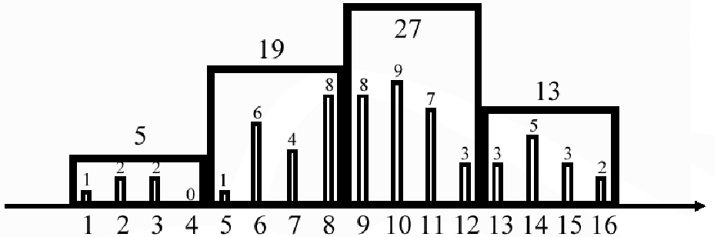
Equi-width Histograms
Divide the domain into B buckets of equal width
  E.g., partition Kid.age values into buckets
Store the bucket boundaries and the sum of frequencies of the values with each bucket

Slide 16
Histogram Construction
Initial Construction:
  Make one full one pass over R to construct an accurate equi-width histogram
    Keep a running count for each bucket
  If scanning is not acceptable, use sampling
    Construct a histogram on R_{sample}, and scale the frequencies by |R|/|R_{sample}|
Maintenance Options:
  Incremental: for each update or R, increment or decrement the corresponding bucket frequencies (Q: Cost?)
  Periodically recompute: distribution changes slowly!

Slide 17
Using Equi-width Histograms
Q: σ_{Α=5}(R)
  5 is in bucket [5,8] (with 19 tuples)
  Assume uniform distribution within the bucket
  Thus |Q| ≈ 19/4 ≈ 5.
  Actual value is 1
Q: σ_{Α>=7 & Α <= 16}(R)
  [7,16] covers [9,12] (27 tuples) and [13,16] (13 tuples)
  [7,16] partially covers [5,8] (19 tuples)
  Thus |Q| ≈ 19/2 + 27 + 13 ≈ 50
  Actual value = 52.

Slide 18
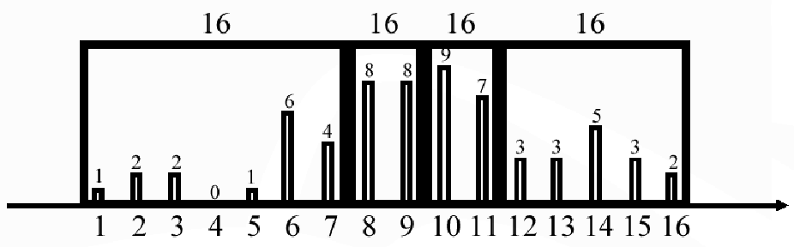
Equi-height Histogram
Divide the domain into B buckets with (roughly) the same number of tuples in each bucket
Store this number and the bucket boundaries
Intuition: high frequencies are more important than low frequencies

Slide 19
Histogram Construction
Construction:
  Sort all R.A values, and then take equally spaced slices
    Ex: 1 2 2 3 3 5 6 6 6 6 6 6 7 7 7 7 8 8 8 8 8 …
  Sampling also applicable here
Maintenance:
  Incremental maintenance
    Split/merge buckets (B+ tree like)
  Periodic recomputation

Slide 20
Using an equi-height histogram
Q: σ_{Α=5}(R)
  5 is in bucket [1,7] (with 16 tuples)
  Assume uniform distribution within the bucket
  Thus |Q| ≈ 16/7 ≈ 2. (actual value = 1)
Q: σ_{Α>=7 & Α <= 16}(R)
  [7,16] covers [8,9], [10,11],[12,16] (all with tuples)
  [7,16] partially covers [1,7] (16 tuples)
  Thus |Q| ≈ 16/7 + 16 + 16 + 16 ≈ 50
  Actually |Q| = 52.

Slide 21
Can Combine Approaches
If values are badly skewed
  Keep high/low frequency value information in addition to histograms
  Could even apply the idea recursively: keep this sort of information for each bucket
    “Divide” by converting values to some # ranges
    “Conquer” by keeping some statistics for each range
Some “statistical glitches” to be aware of
  Parameterized queries
  Runtime situations

