Slide 1
CS222/CS122C: Principles of Data Management
UCI, Fall 2019
Notes #13
Query Optimization (System-R)
Instructor: Chen Li

Slide 2
System R Optimizer
Impact:
  Most widely used currently; works well for < 10 joins.
Cost estimation: An approximate art at best (☺).
  Statistics, maintained in system catalogs, used to estimate cost of operations and result sizes.
  Considers combination of CPU and I/O costs.
Plan Space: Too large, must be pruned.
  Only the space of left-deep plans is considered.
    Left-deep plans allow output of each operator to be pipelined into the next operator without storing it in a temporary relation.
  Cartesian products avoided.
Notes:
2

Slide 3
Overview of Query Optimization
Plan: Tree of relational algebra ops annotated with the chosen algorithm for each op.
  Then at runtime, when an operator is `pulled’ for its next output tuple, it `pulls’ on its inputs and computes them.
Two main issues:
  For a given query, what plans are considered?
    Algorithm to search plan space for cheapest (estimated) plan.
  How is the cost of a plan estimated?
Ideally: Want to find very best available plan. (Reality: Avoid picking one of the worst plans!)
We will study the System R approach.
Notes:
2

Slide 4
Query Blocks: Units of Optimization
An SQL query is parsed into a collection of query blocks, and they are optimized one block at a time.
Nested blocks usually treated as calls to a subroutine, once per outer tuple. (Over-simplification, but will serve our purposes.)
SELECT S.sname
FROM Sailors S
WHERE S.age IN
(SELECT MAX (age)
FROM Sailors
WHERE rating = S.rating)
Outer
block
Nested
block
Query rewrite phase, before cost-based optimization phase, tries to “flatten” nested queries where it can (exposing joins).
Notes:
7

Slide 5
For each block
Fundamental decision in System R: only left-deep join trees are considered.
  As the number of joins increases, the number of alternative plans grows rapidly; we need to restrict the search space.
  Left-deep trees allow us to generate all fully pipelined plans.
    Intermediate results not written to temporary files.
    Not all left-deep trees are fully pipelined (e.g., SM join).
D
D
C
C
A
B
C
D
A
B
A
B
Notes:
15

Slide 6
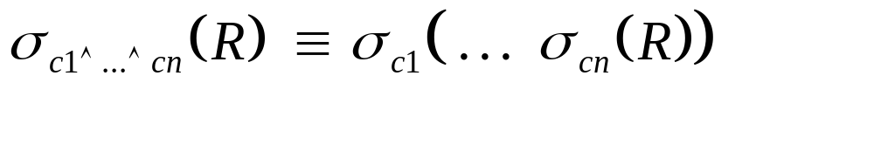
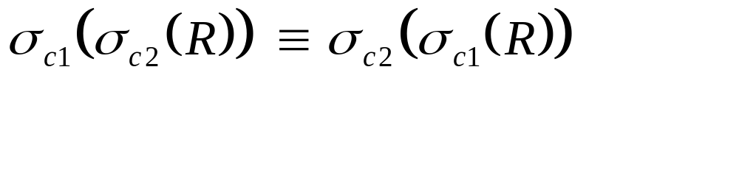
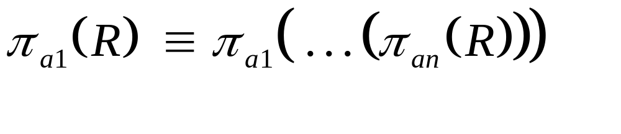




Relational Algebra Equivalences
Allow us to choose different join orders and to `push’ selections and projections ahead of joins.
Selections: (Cascade)
(Commute)
Projections:
(Cascade)
Joins:
R (S T) (R S) T
(Associative)
(R S) (S R)
(Commute)
Show that:
R (S T) (T R) S
Notes:
10

Slide 7

More Equivalences
A projection commutes with a selection that only uses attributes retained by the projection.
Selection between attributes of the two arguments of a cross-product converts the cross-product to a join.
A selection on just attributes of R commutes with R S. (i.e., (R S) (R) S ).
Similarly, if a projection follows a join R S, we can push it down (earlier) by retaining only attributes of R (and S) that are needed for the join or are kept by the projection.
Notes:
11

Slide 8
Enumeration of Alternative Plans
There are two main cases:
  Single-relation plans
  Multiple-relation plans
For queries over a single relation, queries consist of a combination of selects, projects, and aggregate ops:
  Each available access path (file scan / index) is considered, and the one with the least estimated cost is chosen.
  The different operations are essentially carried out together (e.g., if an index is used for a selection, projection is done for each retrieved tuple, and the resulting tuples are pipelined into the aggregate computation).
Notes:
12

Slide 9
Enumeration of Left-Deep Plans
Left-deep plans differ only in the order of relations, the access method for each relation, and the join method chosen for each join.
Enumerated using N passes (if N relations joined):
  Pass 1: Find best 1-relation plan for each relation.
  Pass 2: Find best way to join result of each 1-relation plan (as outer) to another relation. (All 2-relation plans.)
  Pass N: Find best way to join result of a (N-1)-relation plan (as outer) to the N’th relation. (All N-relation plans.)
For each subset of relations, retain only:
  Cheapest plan overall, plus
  Cheapest plan for each interesting order of the tuples.
…
Notes:
16

Slide 10
Interesting Orders
A given data order is deemed “interesting” if it has the potential to save work (i.e., lower cost) later on.
  Ordering on join attribute(s)
  Ordering on GROUP BY attribute(s)
  Ordering on DISTINCT attribute(s)
  Ordering on ORDER BY attribute(s)
Remaining plan
A
Intermediate relation
Attribute A
Subplan
Notes:
16

Slide 11
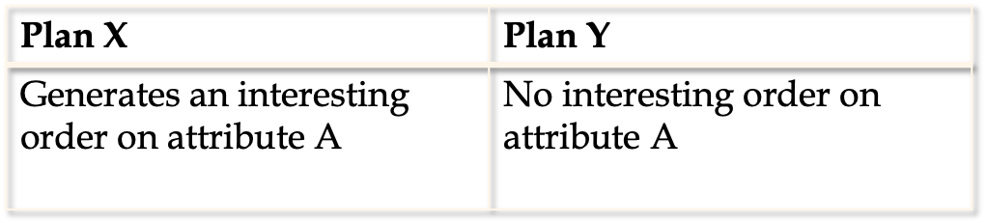
Plan pruning using interesting Orders
If cost(X) < cost(Y): Keep plan X; remove Y.
If cost(X) > cost(Y): keep both plans
Remaining plan
A
Intermediate relation
Attribute A
Subplan
Notes:
16

Slide 12
Enumeration of Plans (Contd.)
ORDER BY, GROUP BY, aggregates etc. handled as a final step, using either an “interestingly ordered” plan or via an additional sorting operator.
An N-1 way plan will not be combined with an additional relation unless there is a join condition between them, unless all WHERE predicates have been used up.
  i.e., avoid Cartesian products if possible!
In spite of pruning plan space, this approach is still exponential in the # of tables.
Notes:
16

Slide 13
Example
SELECT S.sid, count(*)
FROM Sailors S, Reserves R, Boats B
WHERE R.sid = R.sid AND R.bid = B.bid AND B.color = ‘red’
GROUP BY S.sid
Available indexes:
S.Sid: B+ tree
R.sid: B+ tree; R.bid: B+ tree (clustered)
B.color: B+ tree
Notes:
17

Slide 14
Example: Pass 1
SELECT S.sid, count(*)
FROM Sailors S, Reserves R, Boats B
WHERE R.sid = R.sid AND R.bid = B.bid AND B.color = ‘red’
GROUP BY S.sid
Access relation Sailors
  (1) Scan
  (2) B-tree (sid) scan: interesting order on sid
    Sid is used in a later join
  (3) B-tree search on an sid constant
  If Cost of (1) < cost of (2): keep (1)
  (2) is kept due to its interesting order on sid
  (3) is kept since it is needed for an index-based NLJ
Access relation Reserves
  (1) B-tree scan on sid (interesting order)
  (2) B-tree search on an sid constant
  (3) B-tree scan on bid (interesting order)
  (4) B-tree search on a bid constant
  (1) and (3) are kept: interesting order
  (2) and (4) are kept: needed for an index-based NLJ
Notes:
17

Slide 15
Example: Pass 1
SELECT S.sid, count(*)
FROM Sailors S, Reserves R, Boats B
WHERE R.sid = R.sid AND R.bid = B.bid AND B.color = ‘red’
GROUP BY S.sid
Access relation Boats
  (1) Scan
  (2) B-tree on “color” using “color = red “;
  If Cost of (2) < cost of (1): keep (2) only
Notes:
17

Slide 16
Example: Pass 2, join S and R
SELECT S.sid, count(*)
FROM Sailors S, Reserves R, Boats B
WHERE R.sid = R.sid AND R.bid = B.bid AND B.color = ‘red’
GROUP BY S.sid
For each access method of R, for each access method of S, consider all possible join methods:
sid=sid
sid=sid
B-tree scan (sid)
(Interesting Order)
B-tree scan (sid)
(Interesting Order)
B-tree scan (sid)
(interesting order)
Scan
Sailors
Reserves
Sailors
Reserves
Sort R, join S and R using sort-merge (benefits of interesting order of S)
Hash join
…
Sort-merge
Hash join
…
Notes:
17

Slide 17
Example: Pass 2, join R and S
SELECT S.sid, count(*)
FROM Sailors S, Reserves R, Boats B
WHERE R.sid = R.sid AND R.bid = B.bid AND B.color = ‘red’
GROUP BY S.sid
Do the same analysis for R join S
For all the plans, choose the cheapest ones with interesting orders
Notes:
17

Slide 18
Example: Pass 2, consider (R,B)
SELECT S.sid, count(*)
FROM Sailors S, Reserves R, Boats B
WHERE R.sid = R.sid AND R.bid = B.bid AND B.color = ‘red’
GROUP BY S.sid
Do the same analysis for R join B and B join R
Ignore (S, B) since it’s a cross product
Notes:
17

Slide 19
Example: Pass 3, consider (S,R,B)
SELECT S.sid, count(*)
FROM Sailors S, Reserves R, Boats B
WHERE R.sid = R.sid AND R.bid = B.bid AND B.color = ‘red’
GROUP BY S.sid
Consider ((S,R) join B), since we only consider left-deep trees
  For “(S,R)”, consider the best plans from pass 2 (with their interesting orders)
  Consider various ways to join B
Consider ((R,B) join S)
Choose the best plans with interesting orders
Notes:
17

Slide 20
Example: Pass 4, consider GROUP BY
SELECT S.sid, count(*)
FROM Sailors S, Reserves R, Boats B
WHERE R.sid = R.sid AND R.bid = B.bid AND B.color = ‘red’
GROUP BY S.sid
For each plan from (S, R, B), consider different GROUP BY plans
Pick the best one as the FINAL plan!
Notes:
17

Slide 21
System-R Optimizer summary
Left-deep trees only
Avoid Cartesian products
  All access paths considered, cheapest chosen.
Push selection down as much as possible
Deal with GROUP BY/Aggregation/Order by at the end
Keep “interesting order” for each plan
Use dynamic programming to do plan enumeration
Notes:
20

Slide 22
Summary
Query optimization is an extremely important task in a relational DBMS.
Must understand optimization to understand the performance impact of a given database design (relations, indexes) on a workload (set of queries).
Two parts to optimizing a query:
  Explore a set of alternative plans.
    Must prune search space; typically, left-deep plans only.
  Must estimate cost of each plan that is considered.
    Must estimate size of result and cost for each plan node.
    Key issues: Statistics, indexes, operator implementations.
Notes:
19

