Slide 1
CS222/CS122C: Principles of Data Management
UCI, Fall 2019
Notes #14
Volcano Optimizer, Other Indexes, Open Topics, and Wrap up
Instructor: Chen Li

Slide 2
Volcano Optimizer
Volcano optimizer
  Unified search engine based on rules.
  Cost-based optimization.
  Flexible and Extensible. Do not have multiple stages because everything is a transformation rule.
Impact:
  Another very popular optimizer besides System-R style.
  Also often called “Cascades” optimizer, an improvement to Volcano made by the same author Goetz Graefe.
  Widely used: Microsoft SQL Server, Google F1 Query, Greenplum Orca, Apache Calcite (used by Hive, Flink, ...)
Notes:
2
Volcano Optimizer Paper: The Volcano Optimizer Generator: Extensibility and Efficient Search https://cs.uwaterloo.ca/~david/cs848/volcano.pdf
Cascades Optimizer Paper: The Cascades Framework for Query Optimization https://www.cse.iitb.ac.in/infolab/Data/Courses/CS632/Papers/Cascades-graefe.pdf

Slide 3

Rule Example
Logical Equivalence Rules:
  Transform Logical Operators into another logically equivalent form.
  Join commutativity
  Join associativity
  Filter pushdown
  Project pushdown
  Merge Projects
  Merge Union
  ...
  Apache Calcite (open-source implementation of Volcano) currently has 100+ Logical Equivalence Rules!
Notes:
2

Slide 4
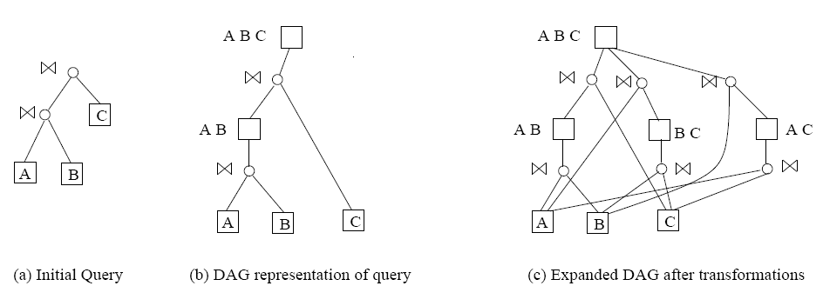
Memo (AND/OR tree)
Notes:
2

Slide 5
Volcano Optimizer summary
Use transformation rules to generate plan space and build logical and physical operators.
Use AND/OR tree to compactly represent all alternative plans in search space.
Use cost to evaluate a physical plan.
Use Dynamic Programming to find the best plan.
Notes:
20

Slide 6
Other indexing techniques
Spatial: R-tree
Text: inverted index
Notes:
2

Slide 7
R-Tree
Root
R1
R4
R11
R3
R5
R13
R9
R8
R14
R10
R12
R7
R18
R6
R17
R16
Q
R19
R15
R2

Slide 8
R-Tree
Root
R1
R2
R1
R2
R3
R4
R5
R6
R7
R3
R4
R5
R6
R7
R8
R9
R10
R11
R12
R13
R14
R15
R16
R17
R18
R19

Slide 9
Text indexing: Inverted index
Brutus
2
4
8
16
32
64
128
Calpurnia
1
2
3
5
8
13
21
34
Caesar
13
16

Slide 10
DBMS architecture revisited
SQL
Query Parser
Query Optimizer
Query plans
Plan Executor
Relational Operators (+ Utilities)
API calls
Files
of
Records
Access
Methods
(Indices)
Transaction
Manager
(CS
223)
Buffer Manager
Lock
Manager
Log
Manager
Disk Space and I/O Manager
Data
Files
Index
Files
Catalog
Files
WAL
Notes:
22

Slide 11
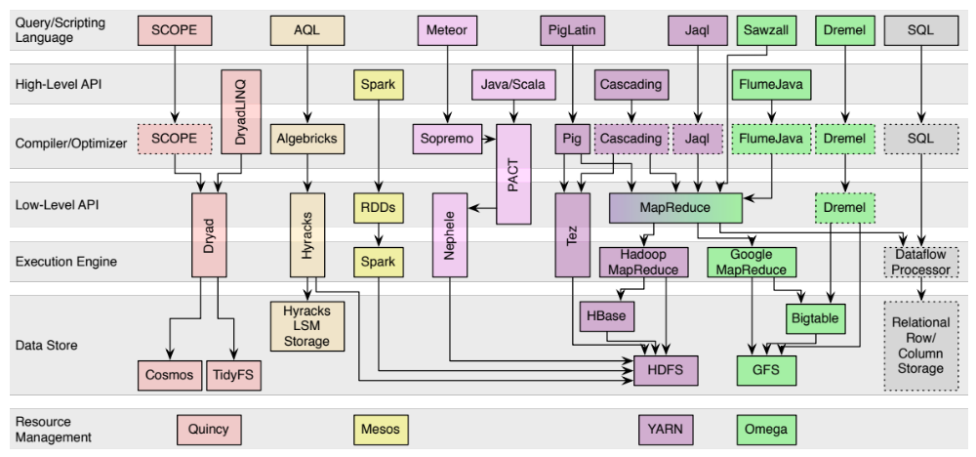
“NoSQL” / Big Data
Map each system to components in a DBMS!

Slide 12
So Where To From Here?
CS122D: Beyond SQL Database Management, https://grape.ics.uci.edu/wiki/asterix/wiki/cs190-2020-winter
CS 223: Transaction Processing and Distributed Data Management
Research projects
  Apache AsterixDB: parallel DBMS for semi-structured data
  Texera: Data analytics using GUI-based workflows
  Cloudberry: Big data visualizations

