Slide 1
Save the Veggie
Pests and Disease

Slide 2
Rules to remember
Your farm or garden in an ecosystem.
You must have pests to have beneficial insects, strike a balance.
Prevention is key.

Slide 3
Prevention
Maintain healthy plants
Clean up or turn in uninfected debris
Exclude
Fencing
Row cover
Rotate
Irrigation
Select varieties that are
Resistant
Resilient
Regionally appropriate

Slide 4
Prevention cont.
Trap cropping
Repellant
Companion planting
Scare tactics
Invite beneficial insects
Create habitat
Feed them
Diversify
Don’t grow it!

Slide 5
Scouting
“Your shadow is your most valuable tool”
-Paul Krautman
Monitor
Sticky tape
Early planting
Trap Cropping
Scout also for beneficials, and their habitat

Slide 6
Checks and Balances
Weigh the activity
Is the damage economically measureable?
What is your crops threshold?
Will predators balance the population if you wait?

Slide 7
Pests Categories
Virus
Fungus
Bacteria
4-legged types
Insects

Slide 8
Virus
Good Luck! No real organic controls besides prevention.
Choose resistant varieties
Use best practices for your situation
Sanitation
Mulches (organic or plastic)
Drip irrigation
Control insects that spread viruses
Rotation

Slide 9
Fungus
Fungus exists everywhere, try to foster a healthy complement.
Fungus is territorial
Inoculate soil and plants
Treatment
Copper Sulfate
Neem
Compost Tea

Slide 10
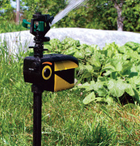
4-Legged
Exclusion
Fencing
Electrical fence
Hunting
Scare tactics
Dog
Cannons
“Scarecrow”

Slide 11
Insects
Foster or create predator habitat
Birds
Beneficial insects
Understand the ecology of the insects both good and bad, develop a strategy.
As a rule, insects are more vulnerable in their earlier stages of life.

Slide 12
Squash Bugs
True bug- Hemiptera
Adults lay golden eggs in a pattern on the underside of the leaf
Feed on tender leaf and fruit tissue
Every mobile life stage is damaging
Spread disease

Slide 13
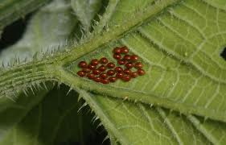
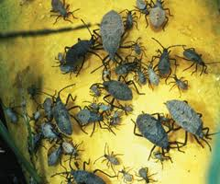
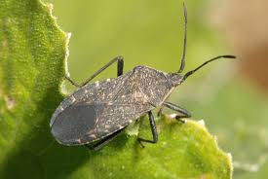
Squash Bug

Slide 14
Squash Bugs
Physical control/Prevention
Row cover
Squish, punch or incinerate eggs- most effective
Hand pick & kill larvae and adults
Fall tillage destroys larvae
Kaolin Clay
Plant tolerant and less preferred varieties
C. moschatas
Select C. pepo
Destroy crop residue or other overwintering opportunities

Slide 15
Squash Bugs
Chemical control
Neem and insecticidal soap on adults (“spreader sticker”)
Dormant Oil
Insecticidal Soap on eggs
Sabadilla
Biological Control
Tachinid Fly Larvae

Slide 16
Squash Vine Borer
Lepidoptera
Small moth
Lays an egg at the base of the stem and the larvae burrows into the stem
Larvae feed on the stem tissue of the Cucurbits
Can kill the crop without you knowing it was even there
Can fly ½ mile to find a host plant
As few as 10 moths can cause 100% infestation on 1 acre

Slide 17
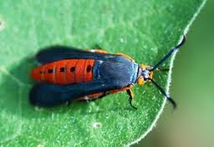
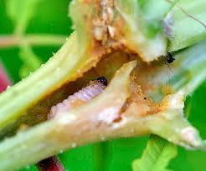
Squash Vine Borer

Slide 18
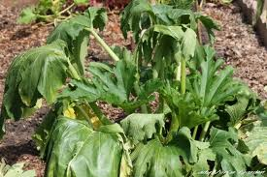
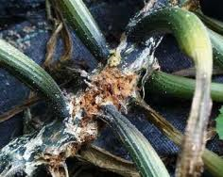
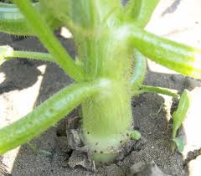
Squash Vine Borer

Slide 19
Squash Vine Borer
Physical Control/Prevention
Row cover
Cut out
Collars
Grow hard stem types
C. mixta
C. moschatas
Kaolin Clay
Diatomaceous Earth
Trap
Sticky Traps
Night light with a soapy/oily moat
Yellow Dixie plates coated in Vaseline
Biological Control
Bt injections

Slide 20
Caterpillars
Lepidoptera
Adults are butterflies or moths
Lay eggs on the underside of the leaf of a host plant
Larvae devour plant tissue

Slide 21
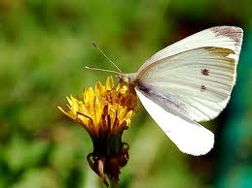
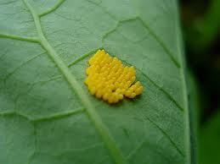
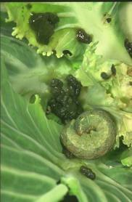
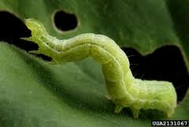
Cabbage Moth

Slide 22
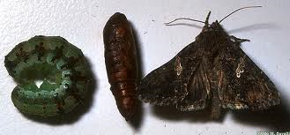
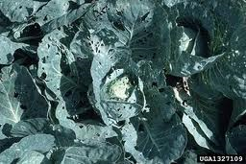
Cabbage Looper

Slide 23
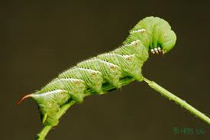
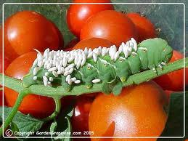
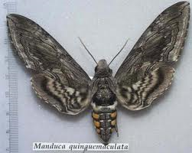
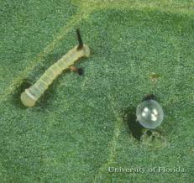
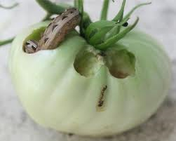
Tomato Hornworm

Slide 24
Caterpillars
Physical
Row cover
Pick off
Biological
Bt- Bacillus thuringiensis
Predatory Wasps
Encourage natural populations using small, flat flowing plants especially in the Umbelliferae family and sweet alyssum
Trap adults
Chemical
Insecticidal soap on eggs
Rotenone

Slide 25
Aphids
Hemiptera
Soft bodied, vulnerable insect
Unique reproductive strategy
Asexual & sexual reproduction
Gives birth to live young or eggs
Produces winged forms when it needs to disperse
Produces sexual aphids when eggs are needed
Suck soft plant tissue partial to new growth
Spread disease

Slide 26
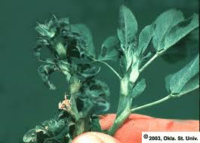
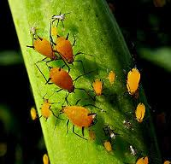
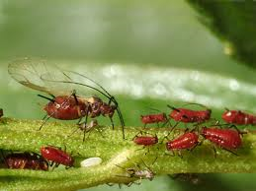
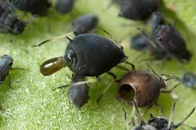
Aphids

Slide 27
Aphids
Physical
Row cover
Colored plastic mulch
Spray them off
Squish
Chemical
Neem
Soap
Biological
Preyed on by many other insects
Ladybird Larvea
Parasitic Fly
Lacewing Larea

Slide 28
Beetles
Coleoptera
Many beetles live at least part of their life cycle underground as a grub.
They vary in their mobility.
Their hard chitinous exoskeleton and cuticle is very hard to penetrate, thus they are hard to kill as adults. If you use chemicals they are not very effective and you must use a “spreader sticker”.
Spread disease (CMV, Powdery Mildew)

Slide 29
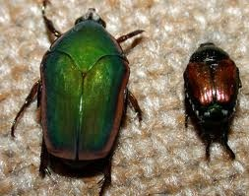
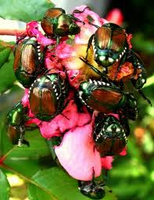
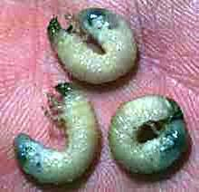
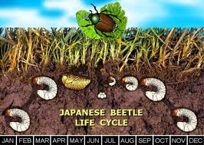
Japanese Beetles

Slide 30
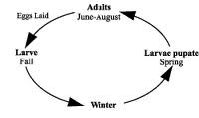
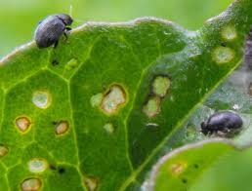
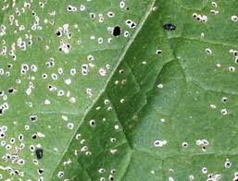
Flea Beetle

Slide 31
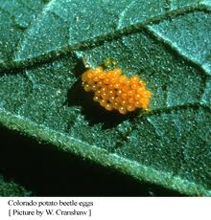
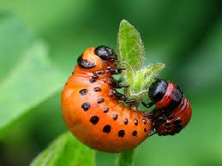
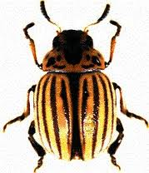
Colorado Potato Beetle

Slide 32
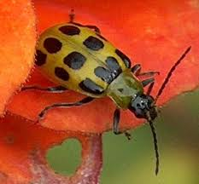
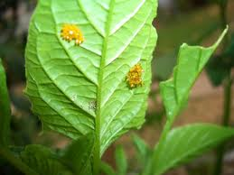
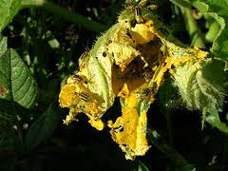
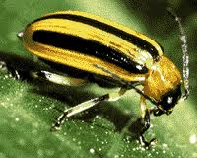
Cucumber Beetles

Slide 33
Beetles
Physical
Row Cover
Biological
Birds
Bt in some cases
Nematodes
Milky spore
Grind up and disperse on the field
Chemical
Soap on eggs
Neem and soap on adults, don’t expect a miracle
Rontenone

Slide 34
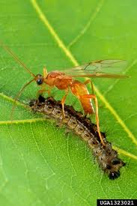
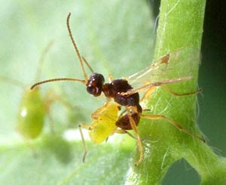
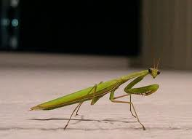
Beneficial Insects
Braconid Wasp
Lady Bird Beetle Larvae
Tachnid Fly
Lacewing
Praying mantis
Many more

Slide 35
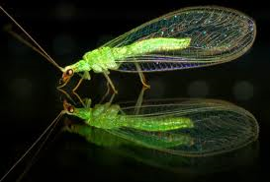
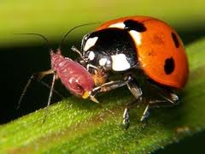
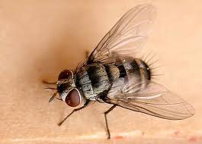
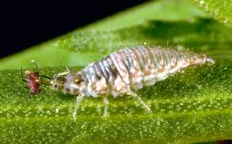
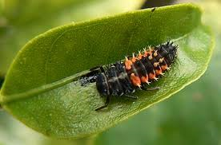
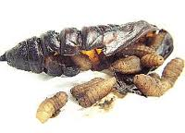
Beneficial Insects

Slide 36
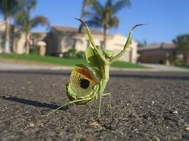
Resources
Garden Insects of North America: The Ultimate Guide to Backyard Bugs -Whitney Cranshaw
Rodale's Garden Insect, Disease & Weed Identification Guide
Identifying Diseases of Vegetables- Penn State
Handbook of Vegetable Pests -John Capinera
www.attra.org

