Slide 1

SMART INDIA HACKATHON 2026
Problem Statement ID – SIH26057
Problem Statement Title- AI-Powered Automated Underwater Marine Debris and Anomaly Detection System using Side-Scan Sonar Imagery
Theme- Disaster Management
PS Category- Software
Team ID-
Team Name (Registered on portal)

Slide 2
AQUA-SHIELD
Your Team Name
Problem:
Side-scan sonar surveys generate acoustic images in which most frames contain no actual target, creating false alarms.
Manual inspection is slow, fatiguing and inconsistent.
Sonar clutter such as rocks, sand ripples and acoustic shadows can resemble hazards.
Proposed Solution:
AI-based side-scan sonar analysis pipeline
Detects candidate underwater anomalies
Verifies candidates using physical sonar evidence
Calibrates confidence and removes duplicate detections
Innovation:
Detection + independent physical verification
Learned false-positive filter instead of only hand-written rules
Self-diagnostic verification exposes preprocessing/data issues

Slide 3
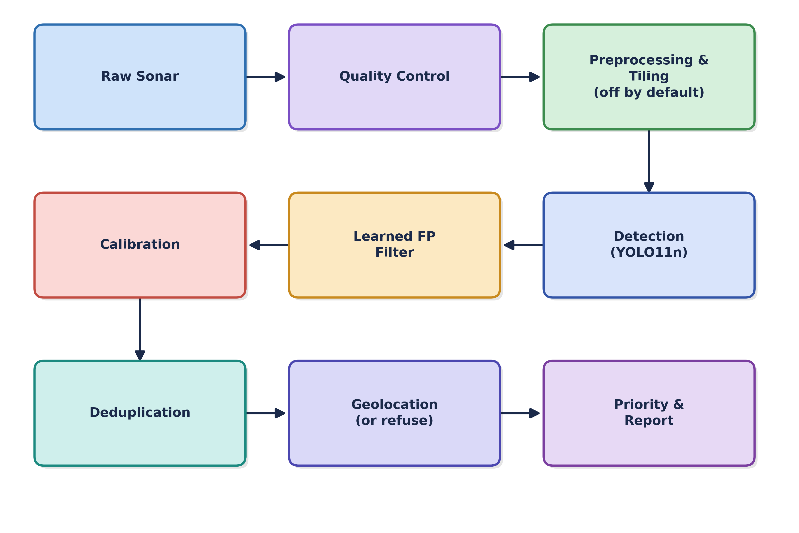
TECHNICAL APPROACH
Your Team Name
Tech Stack:
Python 3.12
PyTorch 2.13 OpenCV
pyproj
Streamlit
FastAPI
SQLite
ONNX
Pipeline:

Slide 4
FEASIBILITY AND VIABILITY
Your Team Name
Hardware Benchmarks:
CPU: Apple M5 (10-core)
GPU: Apple M5 GPU via MPS (no CUDA)
RAM: 24 GB unified memory
MPS tiled frame inference: 21.4ms
CPU fallback inference: 82.2ms (3.8 times slower)
Pipeline throughput: 37.4 frames/sec
Peak memory: 640 MB
ONNX model: 10.61 MB size
Execution time: 8.5ms
Ablation Test:
Method | True Positives | False Alarms
Detector Only | 21 | 37
Detector + Hand-Written Rules | 12 | 18
Detector + Learned FP Filter | 19 | 25
Potential Challenges & Risks:
High false-positive rate from seabed clutter
Ghost-gear result is one raw run, not yet ablated or verified
Geolocation cannot be validated without navigation metadata
Modest detector accuracy on cross-survey data
Strategies to Overcome:
Learned physical-feature filter to reduce false alarms
Safe refusal when navigation metadata is missing
Modular design for new datasets/models
Ghost-gear model trained (E14): mAP50 0.32, first result, pending full verification

Slide 5
IMPACT AND BENEFITS
Your Team Name
Potential Impact on Target Audience:
Faster underwater survey & inspection
Reduces manual sonar-image analysis
Helps operators identify and prioritize potential hazards
Supports marine cleanup and maritime safety
Benefits of the Solution:
Environmental: Faster detection of underwater debris/hazards
Economic: Reduces survey time and manual inspection effort
Operational: Fewer false alarms gives more focused human review
Safety: Helps identify potential underwater hazards before action
Technical: Offline deployment with no cloud/API dependency

Slide 6
RESEARCH AND REFERENCES
Your Team Name
Prior Art Matrix:
GhostVision (JMSE 14(10):951, 2025): MDPI Journal of Marine Science and Engineering
PINGMapper (Earth & Space Science, 2022): GitHub - CameronBodine/PINGVerter
sidescantools: GitHub - sonoware/sidescantools
AI4Shipwrecks (arXiv 2401.14546): arXiv:2401.14546
MILCO/NOMBO (Data in Brief 53:110132): ScienceDirect / Data in Brief
Methodologies:
Lee (1980) - Adaptive speckle filtering: IEEE Xplore / PubMed (DOI: 10.1109/TPAMI.1980.4766994)
Platt (1999) - Probabilistic calibration: Advances in Large Margin Classifiers (MIT Press)
Guo et al. (2017) - Neural-network calibration: arXiv:1706.04599

Slide 7
IMPORTANT INSTRUCTIONS
Please ensure below pointers are met while submitting the Idea PPT:
Kindly keep the maximum slides limit up to six (6). ( Including the title slide)
Try to avoid paragraphs and post your idea in points /diagrams / Infographics /pictures
Keep your explanation precise and easy to understand
Idea should be unique and novel.
You can only use provided template for making the PPT without changing the idea details pointers (mentioned in previous slides).
You need to save the file in PDF and upload the same on portal. No PPT, Word Doc or any other format will be supported.
Note - You can delete this slide (Important Pointers) when you upload the details of your idea on SIH portal.

