Slide 1
Analyzing Dependency Trends in the Maven Central Ecosystem
A study of growth patterns and dependency usage over time
- Eashan Joshi
Notes:
The focus is on understanding growth patterns and how libraries use dependencies over time.
This research sheds light on the evolution of the ecosystem and its implications for developers and researchers alike.

Slide 2
Research Objectives
RQ1: What are the patterns in the growth of the Maven Central graph across different time periods?
RQ2: Do libraries tend to use more dependencies than in the past?
Goal:
Analyze dependency trends in the Maven Central ecosystem (2005–2024) to understand growth and dependency usage patterns.
Notes:
What are the patterns in the growth of the Maven Central graph across different time periods?
Do libraries tend to use more dependencies than in the past?
These questions aim to uncover long-term trends in library dependency usage and management practices.
Our goal is to analyze data spanning from 2005 to 2024 to provide insights into how the Maven Central ecosystem has evolved.

Slide 3
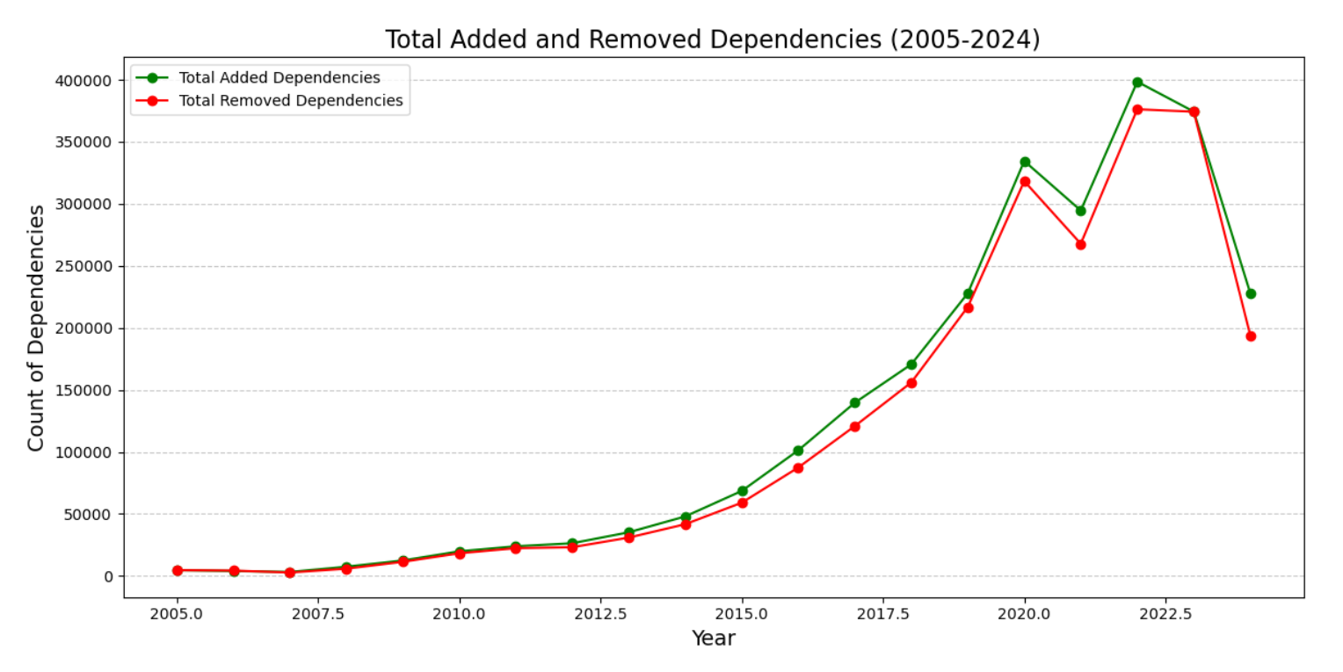
Findings for RQ1: Growth Patterns Over Time
Notes:
What are the patterns in the growth of the Maven Central graph over time?
From the data, we observed a steady increase in dependency additions, peaking in 2020.
Removed dependencies also grew, indicating active management of outdated or redundant dependencies.
A notable dip in 2022 followed by recovery in 2024 highlights periods of adjustment.
These trends align with three key phases:
Early expansion from 2005–2010,
Rapid growth from 2010–2020,
And an adjustment and recovery phase from 2021–2024.

Slide 4
Findings for RQ1: Growth Patterns Over Time
Key Observations:
Dependency additions increased consistently, peaking around 2020.
Removed dependencies grew in parallel, reflecting active dependency management.
2022 shows a temporary decline, followed by recovery in 2024.
Key Phases:
2005–2010: Early expansion.
2010–2020: Peak growth.
2021–2024: Adjustment and recovery.

Slide 5
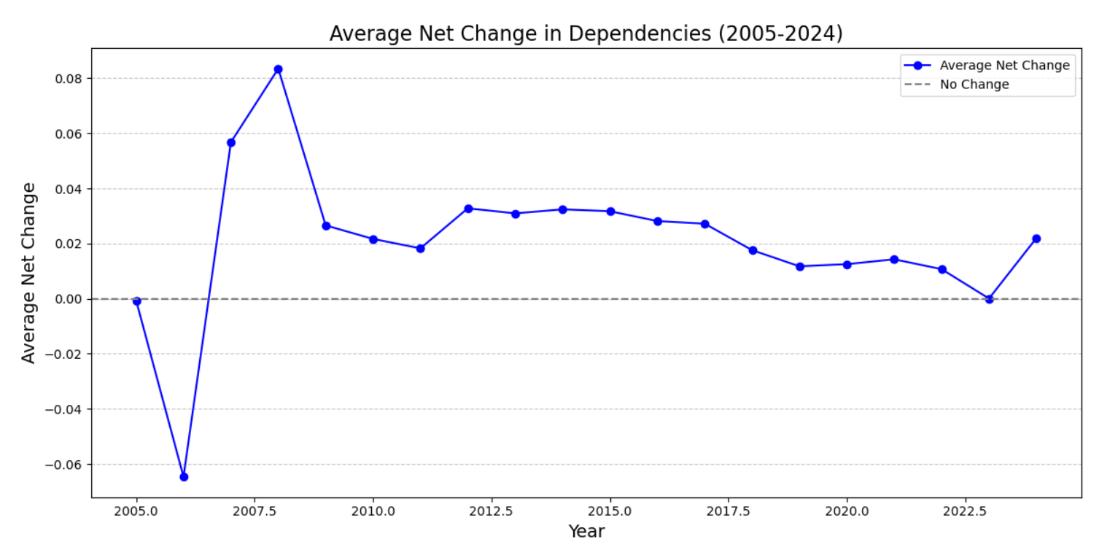
Findings for RQ2: Dependency Usage Trends
Notes:
Do libraries tend to use more dependencies over time?
Our findings reveal a consistent positive average net change in most years, confirming libraries’ increasing reliance on external dependencies.
The period from 2010–2020 saw stabilization, reflecting ecosystem maturity.
The dip in 2022 indicates efforts to clean up dependencies, possibly influenced by security concerns like the Log4j vulnerability.
Overall, the trend demonstrates the growing modularity and reliance on third-party tools in the ecosystem.

Slide 6
Findings for RQ2: Dependency Usage Trends
Key Observations:
Positive average net change in most years confirms libraries increasingly use more dependencies.
Stabilization from 2010–2020 reflects ecosystem maturity.
A dip in 2022 indicates a focus on dependency hygiene or response to vulnerabilities.

Slide 7
Conclusion
RQ1:
Growth patterns reveal steady expansion with phases of adjustment and recovery.
Dependency management practices have evolved over time.
RQ2:
Libraries tend to use more dependencies, aligning with trends in modular programming and ecosystem growth.
Notes:
For RQ1, we observed steady growth patterns in the Maven Central graph with distinct phases of expansion, adjustment, and recovery.
For RQ2, libraries tend to use more dependencies over time, reflecting trends in modular programming and ecosystem maturity.

Slide 8
Insights
Insights:
Ecosystem maturity requires balancing growth with dependency hygiene.
Tools for automated updates and security scans are crucial to manage growing dependency complexity.
Notes:
Key insights include the importance of balancing growth with dependency hygiene.
Developers need tools for automated updates and security scans to manage growing complexity.
This research provides valuable direction for future work in dependency management and ecosystem evolution.

