Slide 1






Architecture to CloudFormation
3
Agents for Amazon Bedrock
Similar
Documents
Amazon DynamoDB
(Cache)
query
=
step-by-step
explanation
Amazon Bedrock
Titan Embeddings
Knowledge Base
METADATA & GENERATED TEMPLATE
4
similar
templates
Streamlit
Web App
query
=
step-by-step
explanation
similar
templates
step-by-step
explanation
2
Generate()
Amazon Bedrock
Claude 3
streaming trace
1
architecture
image
step-by-step
explanation
/action
Agents for Amazon Bedrock
Claude 2.1
AWS Lambda
Bot Actions
ValidateTemplate()
Amazon Bedrock
Claude 3
AWS CloudFormation
API

Slide 2
Agents for Amazon
Bedrock
Similar
Documents
Amazon Bedrock
Claude 3
Amazon Bedrock
Titan Embeddings
Knowledge Base
/generateCloudFormation
query
=
step-by-step
explanation
/reiterateCloudFormation
similar
templates
Amazon Bedrock
Claude 3
/action
/validateCloudFormation
Agents for Amazon Bedrock
Claude 3
AWS Lambda
Bot Actions
AWS CloudFormation
API
/resolveError
/updateCloudFormation
Amazon Bedrock
Claude 3
Amazon Bedrock
Claude 3

Slide 3

Amazon Bedrock
Titan Embeddings
Pre-Processing
step-by-step explain
+
(S3 URI) template
+
(S3 URI) architecture
image
data
ingest
Generate
Embeddings
metadata
metadata
Amazon S3
(data source)
Vector
DB
Retrieve
Retrieve
similar
documents
User Response
=
(S3 URI) template
+
(S3 URI) architecture image
User query
=
step-by-step explain
Generate
Embeddings
metadata
Amazon Bedrock
Titan Embeddings

Slide 4
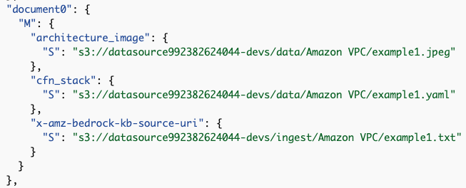
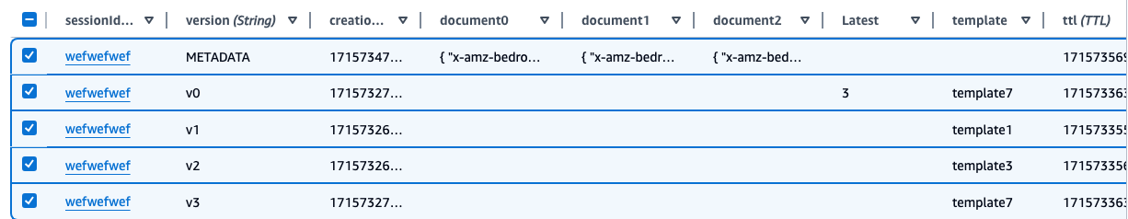
Amazon DynamoDB for Caching
Streamlit
Web App
AWS Lambda
Bot Actions
GET template
METADATA & GENERATED TEMPLATE
GET/ PUT template
GET/ PUT document
GET/ PUT document
Amazon DynamoDB
(Cache)

