Slide 1
Packaged Foods Data Analysis
By
Eashwar Sathyamurthy (DC21067)
Galina Reitz (Mentor)

Slide 2
Contents
Introduction
Goals
Data Analysis
Implications
Recommendation

Slide 3
Introduction
Datasets contains the ingredient details of all the packaged foods, serving size, brand owner information manufactured in US.
Datasets were released by US Department of Agriculture for the ultimate goal of enhancement of public health.

Slide 4
Project Objectives
Perform data analysis to obtain popular ingredients in each food category and for all over packaged food.
Finding the nutritious rich meal category.

Slide 5
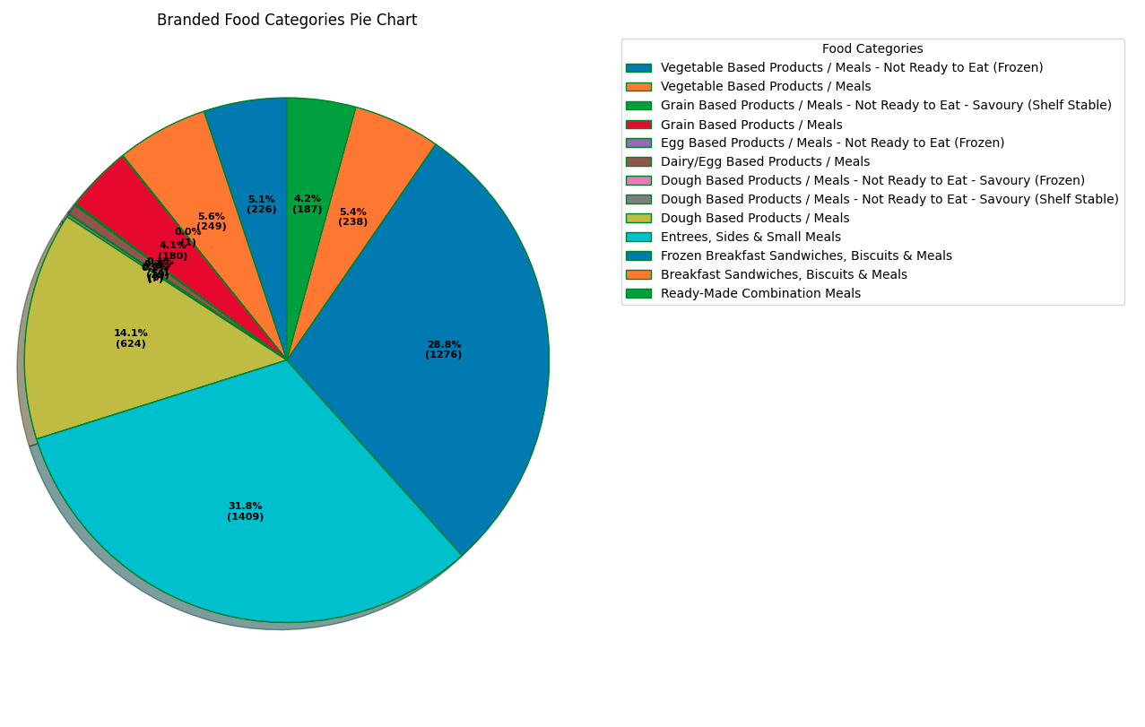
Preliminary Analysis
There are 13 branded food categories.
Packaged foods market in US has a total of 4437 varieties of food.
Entrees, Sides & Small Meals and Frozen Breakfast Sandwiches, Biscuits & Meals form 60.6% of the packaged foods.

Slide 6
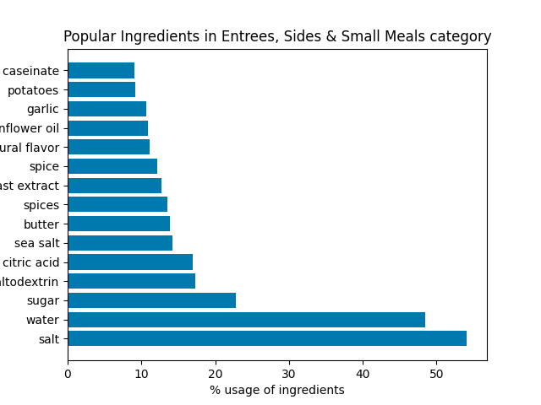
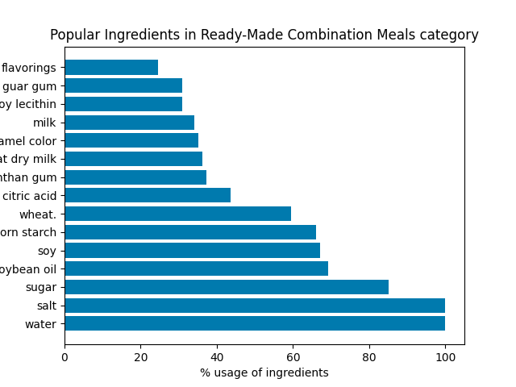
Analysis of Ingredients

Slide 7
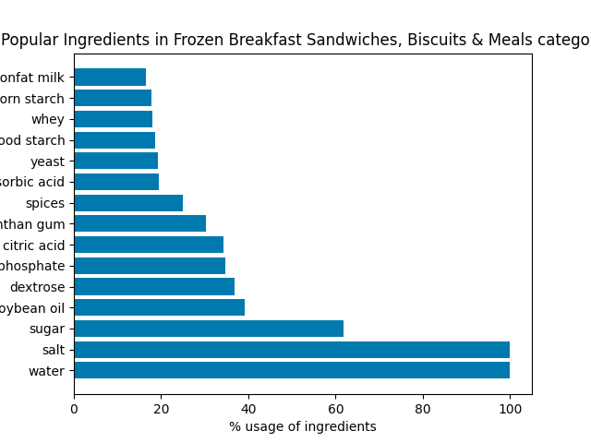
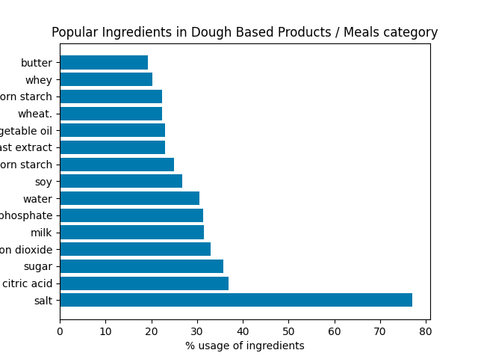
Analysis of Ingredients

Slide 8
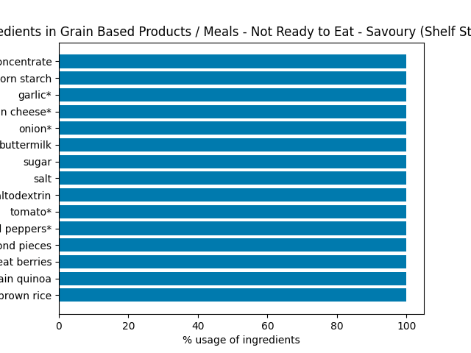
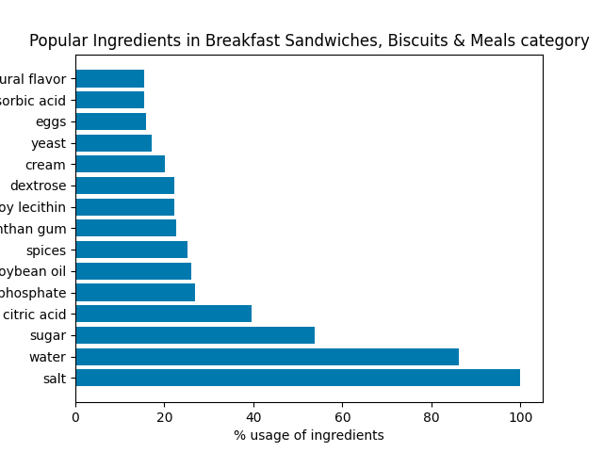
Analysis of Ingredients

Slide 9
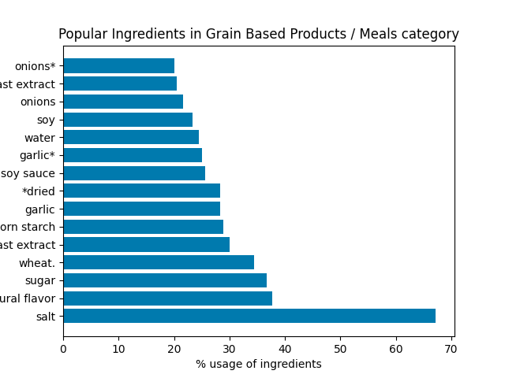
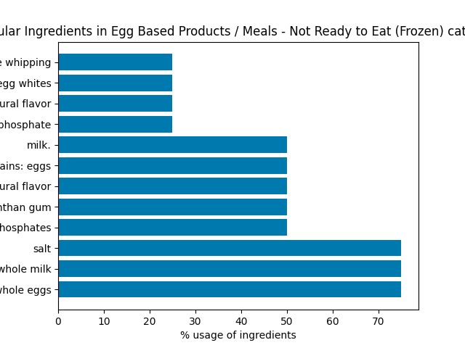
Analysis of Ingredients

Slide 10
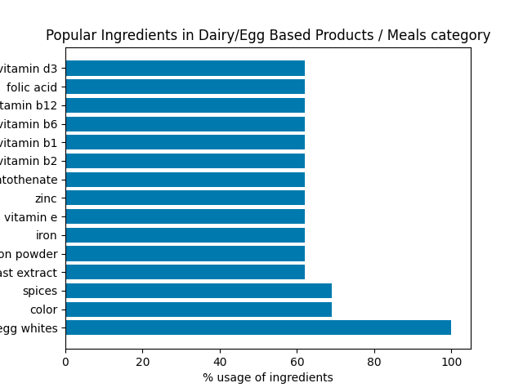
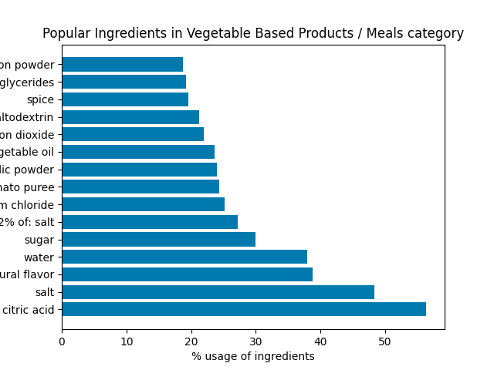
Analysis of Ingredients

Slide 11
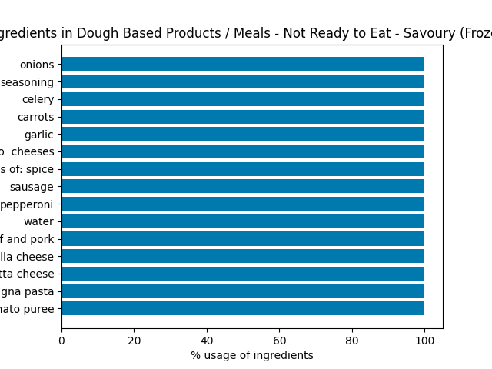
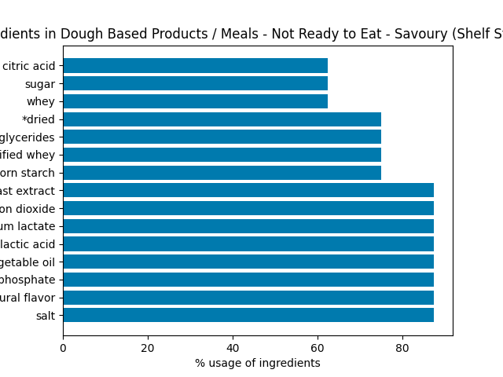
Analysis of Ingredients

Slide 12
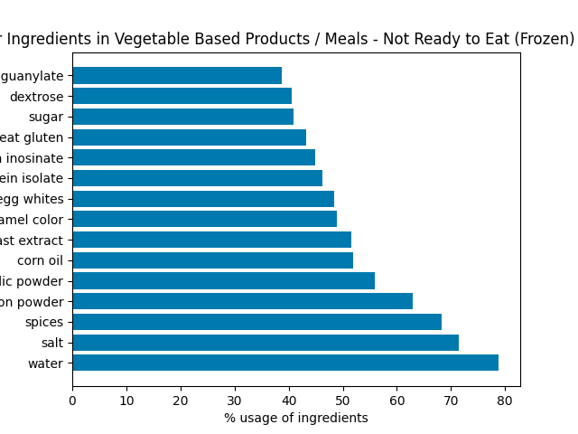
Analysis of Ingredients

Slide 13
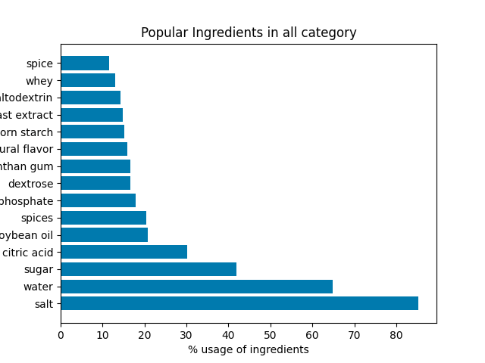
Overall analysis of Ingredients

Slide 14
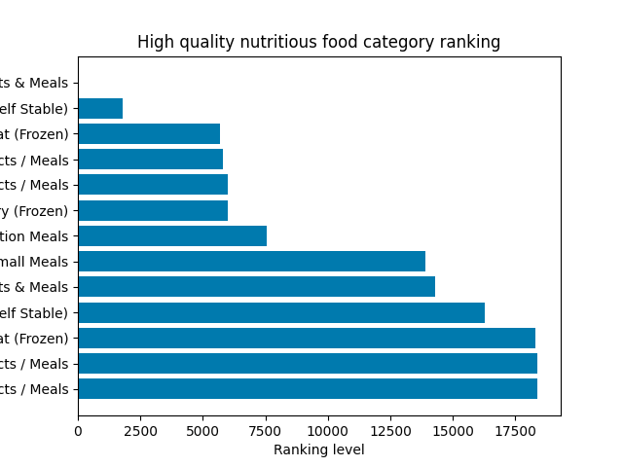
Nutrients Analysis
In terms of providing high quality nutrients,
Vegetable Based Products / Meals - 250
Dairy/Egg Based Products / Meals - 29
Egg Based Products / Meals - Not Ready to Eat (Frozen) - 4
categories ranks highest which forms only 6.3% of the total packages foods.

Slide 15
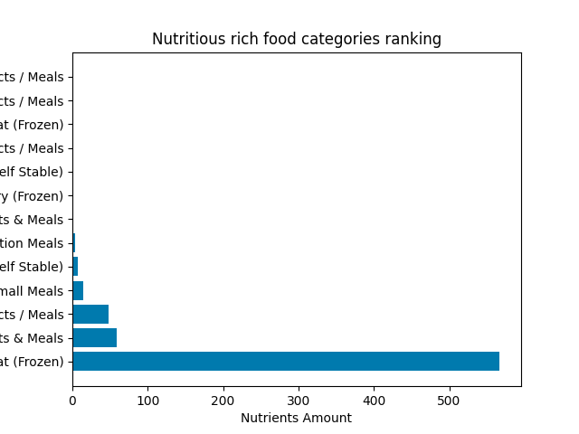
Nutrients Analysis
In terms of quantity of nutrients,
Vegetable Based Products / Meals - Not Ready to Eat (Frozen)
Frozen Breakfast Sandwiches, Biscuits & Meals
Grain Based Products / Meals
provides rich nutritious food.

Slide 16
Implications on Manufacturing side
Manufacturers can use to the popular ingredients information to manufacture new variant of popular packages foods.
Manufacture can add ingredients from nutritious rich and high quality nutrients food categories to low nutritious food categories.
Manufacturers can prioritize manufacturing process based on popular ingredients and nutrients.

Slide 17
Implications on Health Side
Although nutritious, Egg Based Products / Meals - Not Ready to Eat (Frozen), Frozen Breakfast Sandwiches, Biscuits & Meals and Dough based Products/ Meals contain more than 40% of sodium phosphate.
Elevated intake of sodium can raise blood pressure leading to stroke and heart attacks.
Packaged foods is the main source of sodium for american people.

Slide 18
Recommendations
Vegetable Based Products / Meals - Not Ready to Eat (Frozen) category is the best choice in terms of quality of nutrients.
Vegetable Based Products / Meals category is the best choice in terms of amount of ingredients.
Low sodium food is advisable.

Slide 19
Thank you

