Slide 1
Approach
Externally configurable yml file that can be used to inject classification
Hugging Face model collection to access the required models
Mistral 7B LLM with Few shot Prompting to predict the Email Type and Subtype with
Same model to extract important attributes such as borrower id, loan number etc

Slide 2
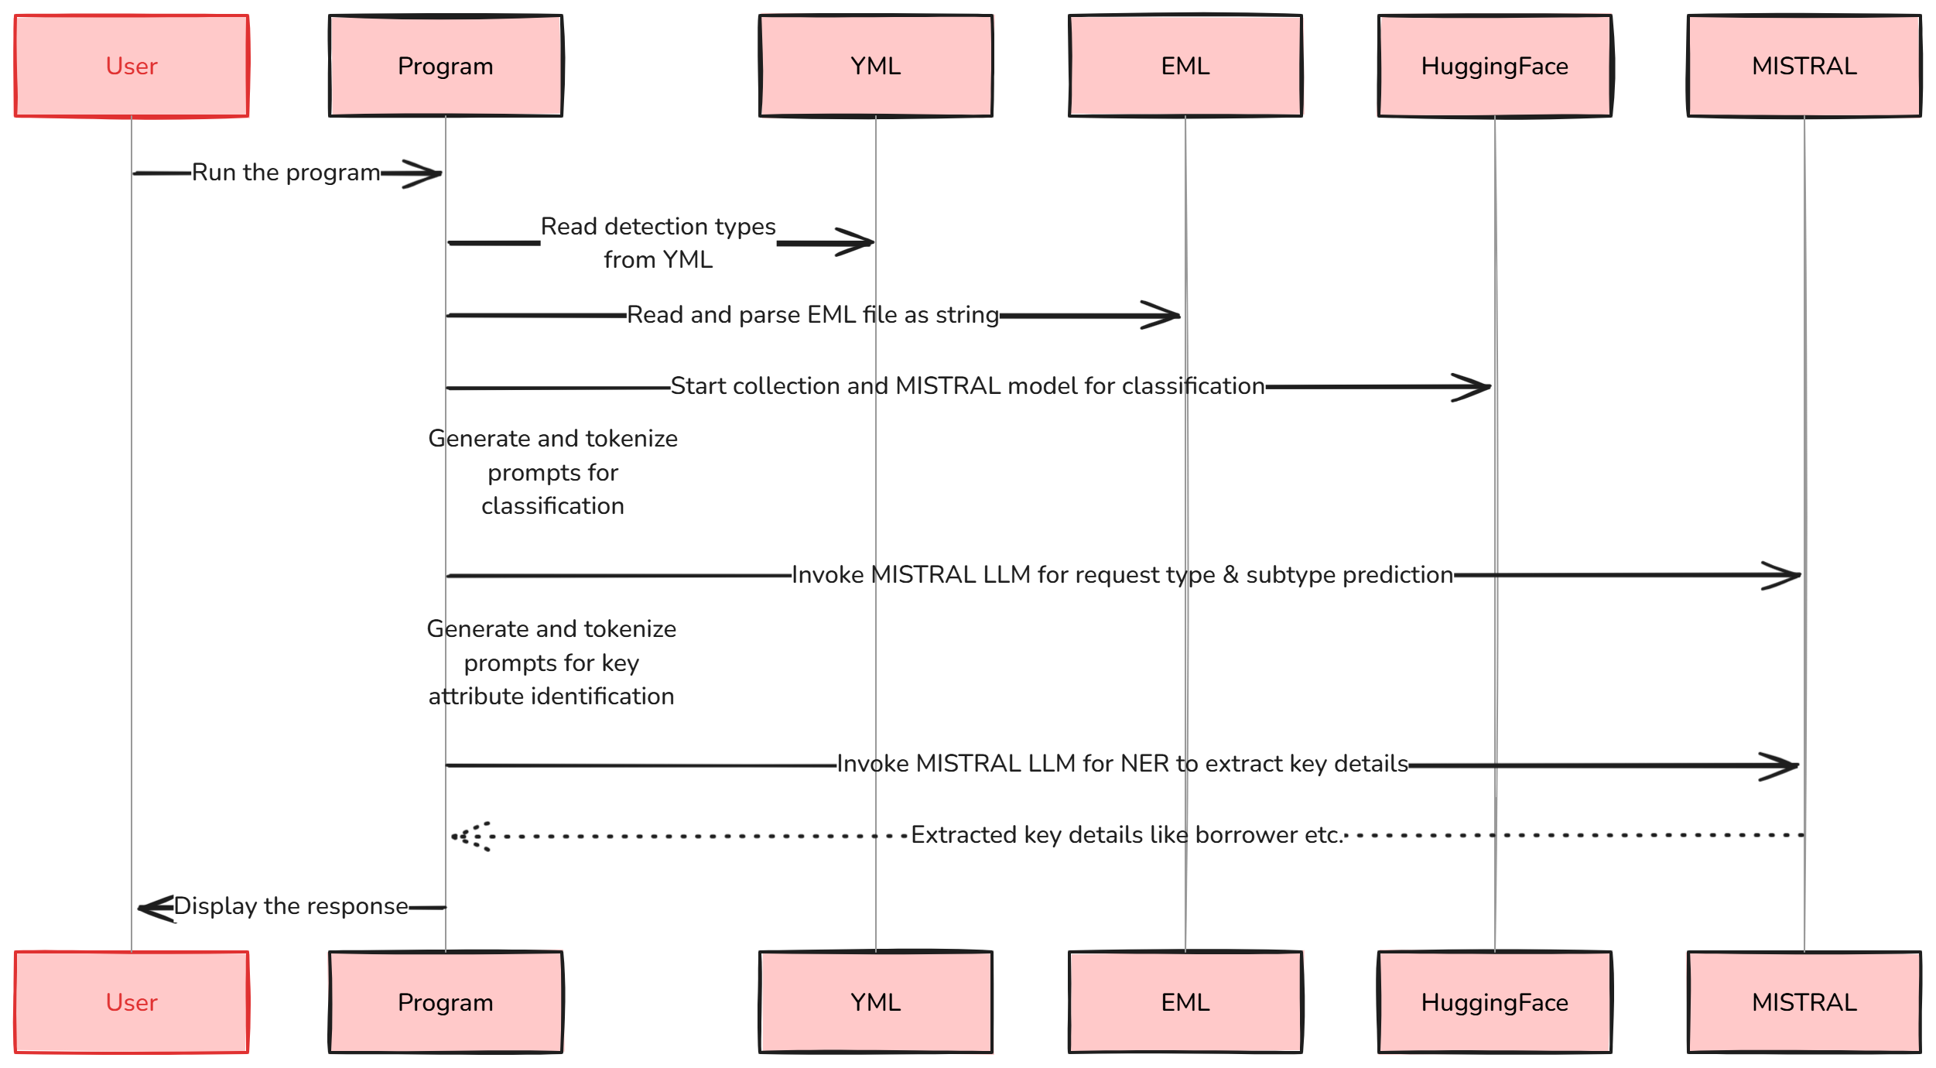

Slide 3
Models Used
Hugging Face collection
MISTRAL Model - mistralai/Mistral-7B-Instruct-v0.3
Few Shot Classification
Named Entity Recognition

Slide 4
Advantages
Highly configurable since the key pharases can be modified easily
Plug and play approach to the models
Open source models

Slide 5
Area of improvements
Explore better prompting to the models for accurate detection
Email attachments reading and prioritization

