Slide 1
Gen AI Orchestrator for Email and Document triage
By LPMC-AI team

Slide 2
Approach
Externally configurable yml file that can be used to inject email classification types
Hugging Face model collection to access the required models
Input Email and Config YML is converted to Prompts
Prompts are Tokenized and then passed as inputs to LLM Model
Mistral 7B LLM with Few shot Classification to predict the Email Type and Subtype
Mistral 7B LLM with Named Entity Recognition to extract important attributes such as borrower id, loan number etc
Store the Classification Types and Key Attributes in DB for Duplicate email detection

Slide 3
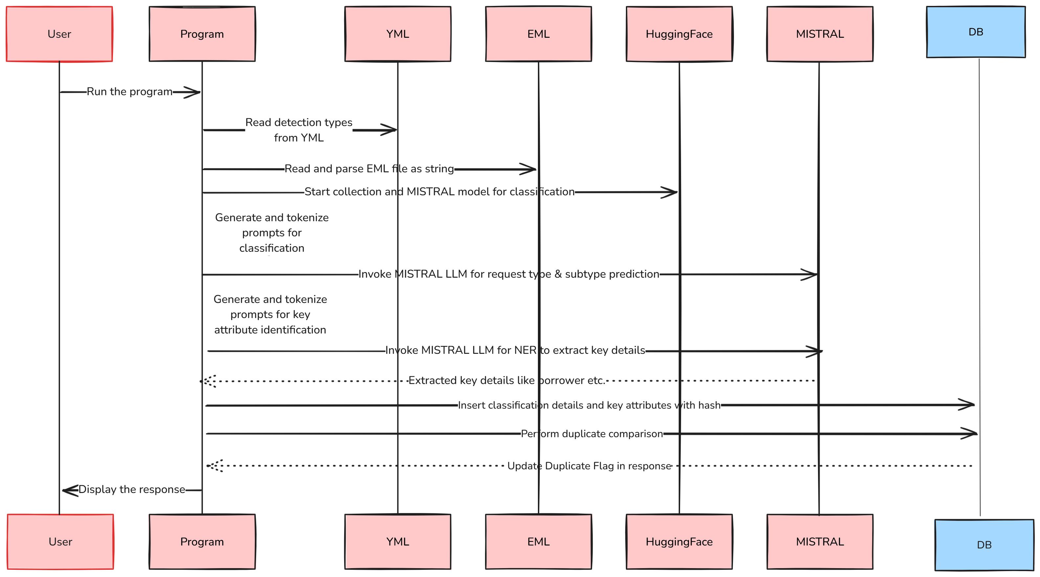
High Level Flow

Slide 4




Key Models and Techniques
Mistral 7B
Hugging Face
LLM for Classification and NER.
Model collection for access.
Named Entity Recognition
Few Shot Classification
Predict Email Type and Subtype
Extract key attributes.

Slide 5





Core Advantages
Configurable
Easily modify key phrases.
Plug and Play
Flexible model integration.
Open Source
Utilizes open models.
Accuracy
Duplicate detection through hashing.

Slide 6




Improvements
Prompting
Explore better prompts for accuracy.
Attachments
Read and prioritize attachments.
Custom Models
Train models on email samples.
Agentic AI
For complete automation of the process

