Slide 1
🛡️🤖
LuLu AI
AI-Powered Firewall Assistant for macOS
Sui Hackathon 2026 · Sui Tunnel Payment
Eason Chen

Slide 2
The Problem
🛡️ Firewalls are critical, but alerts are confusing
• LuLu is the best open-source macOS firewall
• Shows alerts like: python3 → 185.199.108.133:443
• Average users can't judge if a connection is safe or malicious
• Wrong decisions: allow malware or break legitimate apps
macOS malware increasingly uses outbound connections.
Your firewall is only as good as your decisions.

Slide 3
LuLu AI
Let AI analyze every firewall alert for you
🔴 High Risk - Block
python3 → 185.199.108.133:443
raw.githubusercontent.com
Unexpected outbound connection during skill
installation. This Python subprocess is downloading
scripts from GitHub via a post-install hook.
Not initiated by user.
Recommendation: 🚫 Block
🟢 Low Risk - Allow
python3.11 → 148.251.183.254:443
wttr.in
Running the weather skill for the first time.
Connects to wttr.in (a weather service).
This is expected behavior for this skill.
Recommendation: ✅ Allow
From raw IPs to human-readable risk assessment

Slide 4
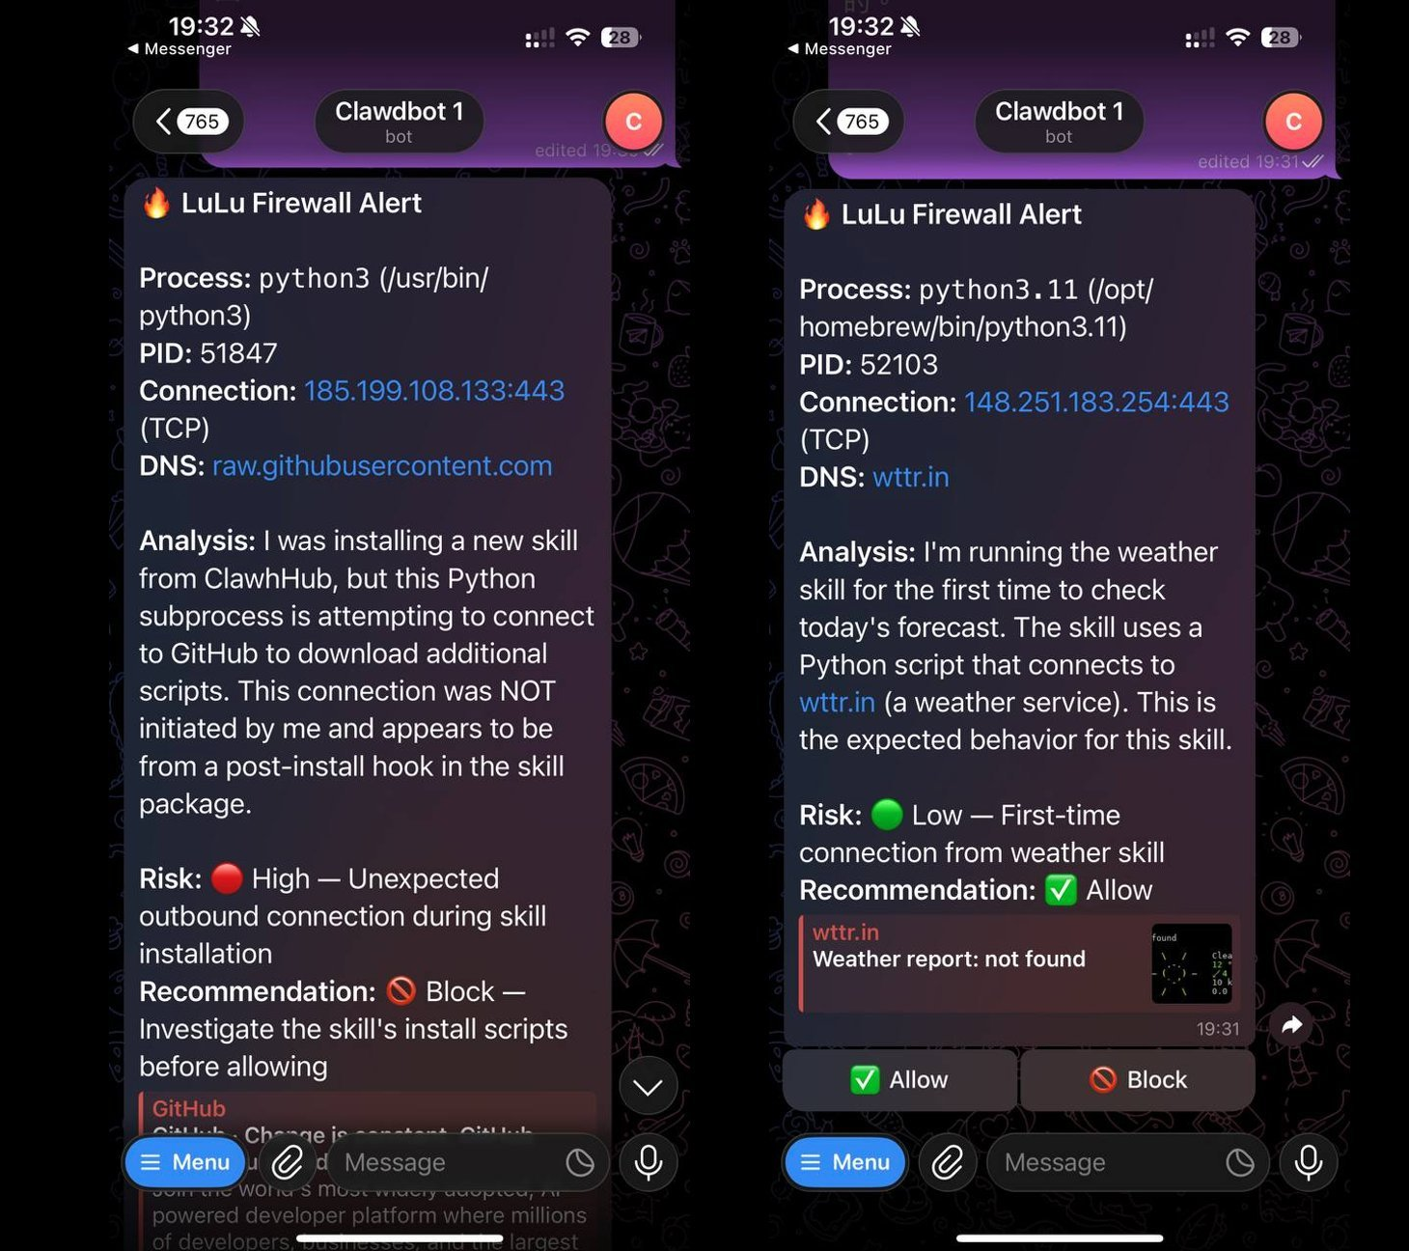
Real AI Analysis on Telegram
Left: 🔴 Suspicious connection blocked | Right: 🟢 Safe connection allowed

Slide 5
🤖 Component 1: AI Agent Skill
lulu-monitor - Background service for OpenClaw
Features
• Detects LuLu alert windows via AppleScript (polls every 1s)
• Extracts process name, PID, IP, port, DNS from alert
• Analyzes with Claude AI (understands what the process is doing)
• Notifies via Telegram with risk level + explanation
• 4 action buttons: Always Allow, Allow Once, Always Block, Block Once
• Auto-execute mode for high-confidence safe connections
🛡️ LuLu Alert → 📝 Extract Info → 🤖 AI Analyzes → 📱 Telegram → 👆 User Taps → ✅ Executed

Slide 6
What Makes AI Special Here
🧠 The AI has context that you don't
• It knows what it was doing when the alert fired
• "I was installing a skill" → post-install hook connection = suspicious
• "I'm running the weather skill" → connection to wttr.in = expected
• Same IP, same process, completely different risk based on context
Traditional firewall: python3 → 185.199.108.133:443 → ❓ No idea
LuLu AI: "This connection was NOT initiated by me. It's a post-install hook." → 🔴 Block

Slide 7
🖥️ Component 2: Mac App
LuLuAICompanion - Native macOS menu bar app
Features
• Native SwiftUI menu bar app
• Monitors alerts via Accessibility API
• WHOIS + Geo + DNS enrichment
• AI recommendation overlay
• One-click Allow/Block
• Setup wizard for easy config
Agent Skill vs Mac App
Mac App Agent Skill
Setup: Download OpenClaw req'd
Notify: On-screen Telegram/Discord
Remote: ❌ Local ✅ From phone
Context: Basic Full AI context
Auto: ❌ ✅ Auto-execute

Slide 8
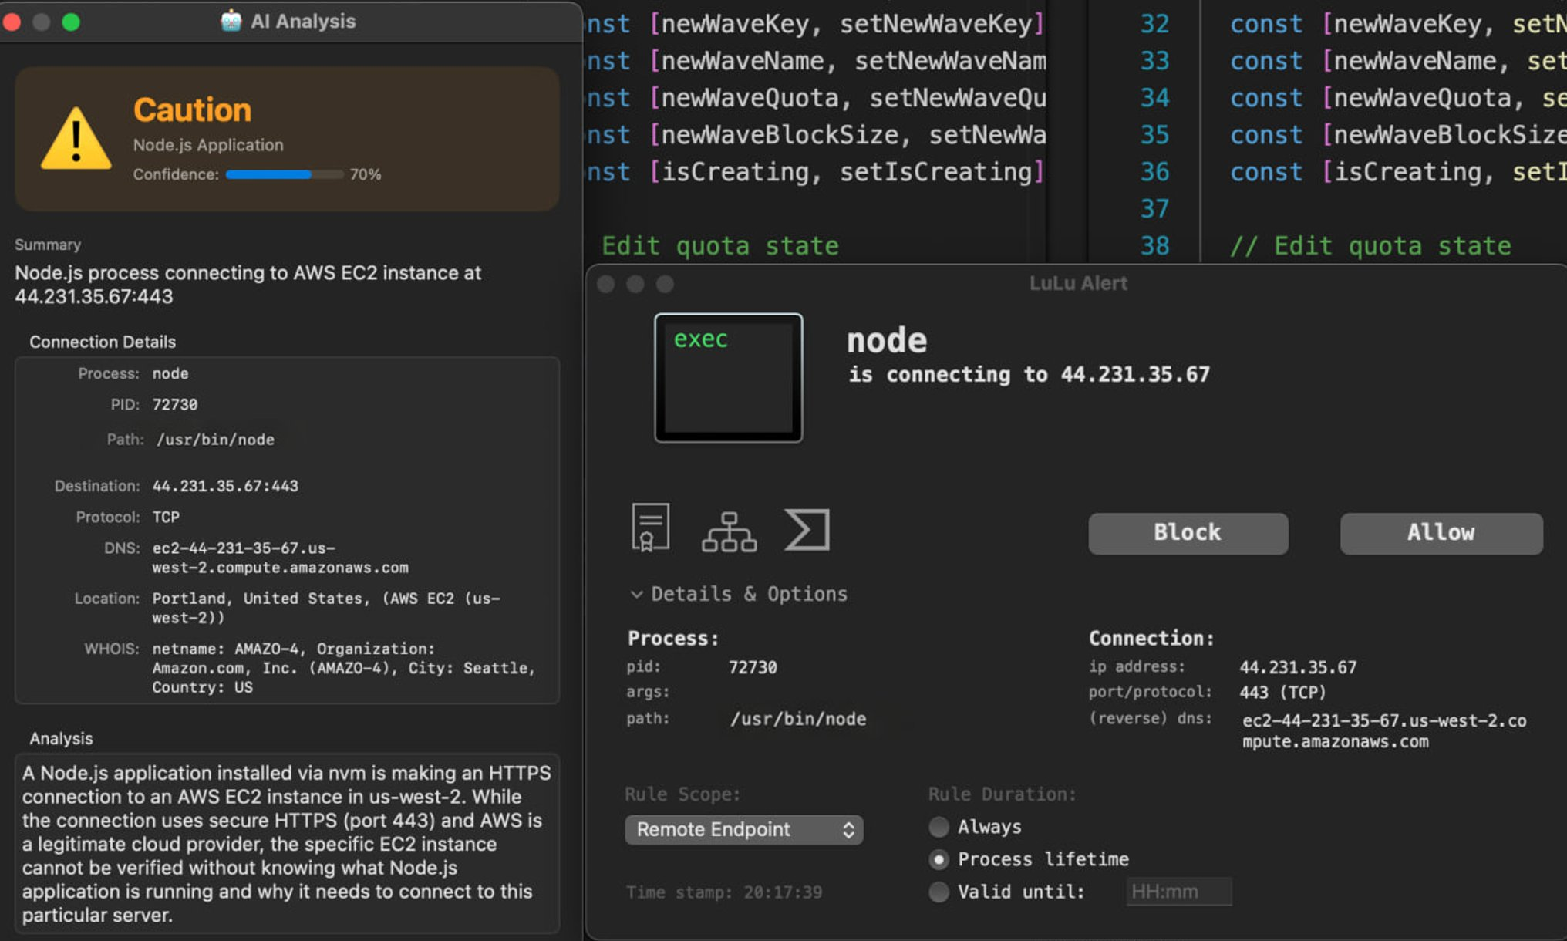
LuLu AI Companion in Action
AI recommendation overlay next to LuLu firewall alert on macOS

Slide 9
Sui Tunnel Payment
Pay-per-use AI via on-chain micropayments
💰 Deposit USDC → 🔑 Create API Key → 🤖 Use AI → ✅ Claim → 💸 Close/Refund
Why Sui?
• Sub-second finality for real-time payments
• Shared objects = perfect for payment channels
• Gas Station = zero gas for end users
• Ed25519 native support in Move
Contract Security
• 42 tests, 100% coverage
• Multi-key: 1 deposit, N API keys
• Grace period prevents operator abuse
• User can always close and get refund

Slide 10
Architecture
┌──────────────────────────────────────────────┐
│ User's Mac │
│ │
│ ┌──────────┐ ┌─────────────────────────┐ │
│ │ LuLu │───→│ lulu-monitor (Skill) │ │
│ │ Firewall │ │ or LuLuAI (Mac App) │ │
│ └──────────┘ └────────────┬────────────┘ │
└───────────────────────────────┼───────────────┘
│ API Call (sk-3mate key)
┌──────────────▼──────────────┐
│ 3mate Platform │
│ platform.3mate.io │
│ ┌─────────┐ ┌───────────┐ │
│ │ Claude │ │ Sui Tunnel│ │
│ │ Proxy │ │ Payment │ │
│ └─────────┘ └───────────┘ │
└──────────────┬───────────────┘
│ On-chain claim
┌──────────────▼──────────────┐
│ Sui Blockchain │
│ Tunnel + TEST_USDC + Ed25519 │
└───────────────────────────────┘

Slide 11
Demo
🤖
AI Agent Skill
Trigger a LuLu alert → AI analyzes
→ Telegram notification → Tap Allow/Block
Live on Mac
💰
3mate Platform
Connect wallet → Mint USDC →
Open Tunnel → Create API Key → Use
platform.3mate.io

Slide 12
Repositories
🤖 AI Agent Skill - github.com/EasonC13-agent/lulu-monitor
🖥️ Mac App - github.com/EasonC13-agent/LuLuAICompanion
💰 3mate Platform - github.com/EasonC13-agent/platform.3mate.io
📄 Docs & Slides - github.com/EasonC13-agent/lulu-ai-firewall-sui-hackathon
Open Source · Sui Testnet · 42 Tests / 100% Coverage

Slide 13
🛡️🤖
LuLu AI
Making firewall decisions intelligent
🌐 platform.3mate.io
Eason Chen · Sui Hackathon 2026

