Slide 1
L07: Basics of Counting
Outline
  Product Rule
  Sum Rule
Reading: Rosen 6.1, 6.2

Slide 2
Introduction
Examples of when counting is needed in computer science:
Determining the time or space complexity of algorithms
Computing the probabilities of events
Determining whether there are enough Internet protocol (IP) addresses to meet the demand
Two basic counting principles:
Product rule (or sequential rule)
Sum rule (or disjunctive rule)

Slide 3
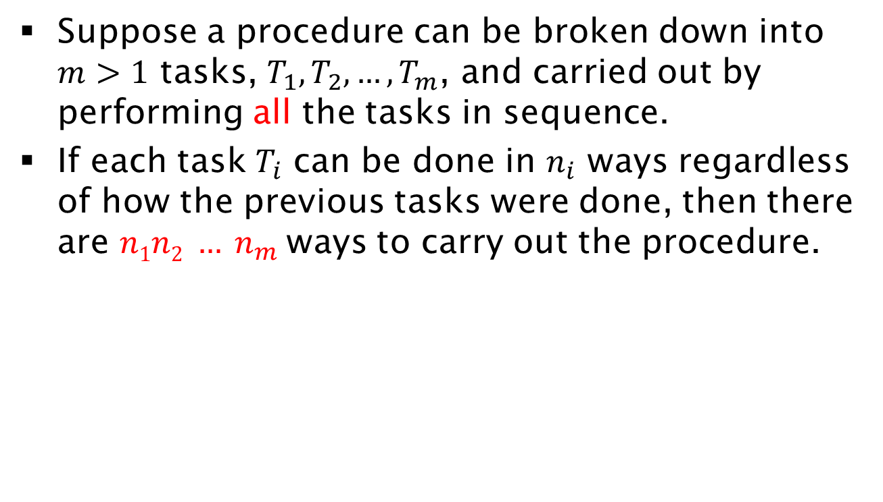
Product Rule
Suppose a procedure can be broken down into $m>1$ tasks, $T_{1},T_{2},…, T_{m}$, and carried out by performing all the tasks in sequence.
If each task $T_{i}$ can be done in $n_{i}$ ways regardless of how the previous tasks were done, then there are $n1n2 … n_{m}$ ways to carry out the procedure.

Slide 4
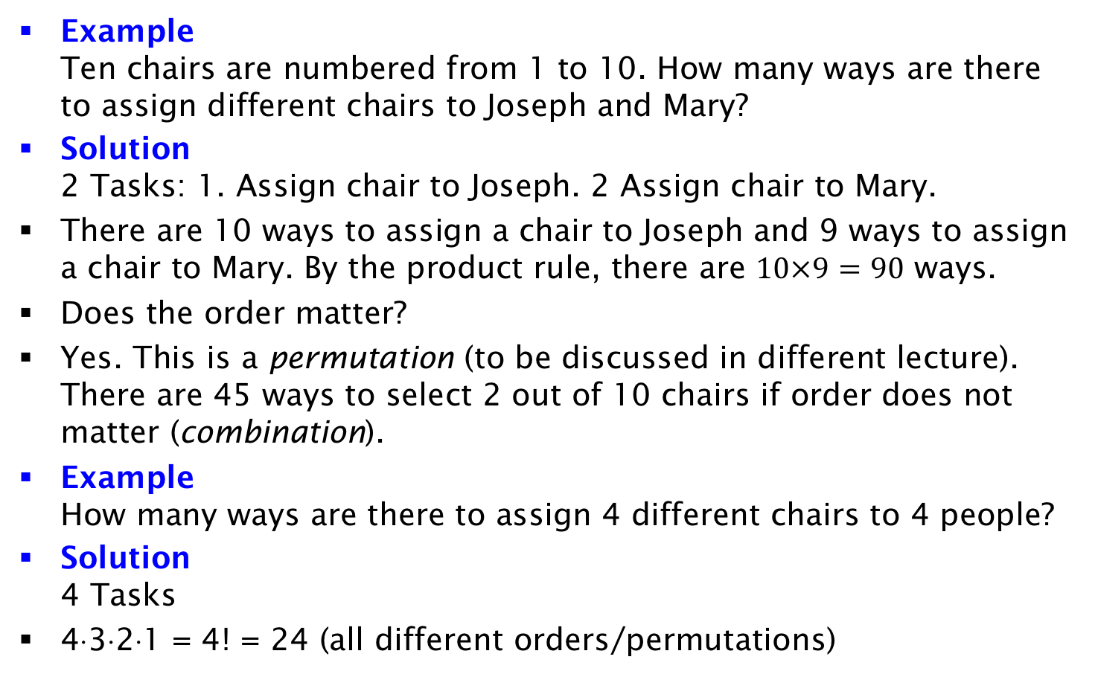
Examples
Example
Ten chairs are numbered from 1 to 10. How many ways are there to assign different chairs to Joseph and Mary?
Solution
2 Tasks: 1. Assign chair to Joseph. 2 Assign chair to Mary.
There are 10 ways to assign a chair to Joseph and 9 ways to assign a chair to Mary. By the product rule, there are $10×9=90$ ways.
Does the order matter?
Yes. This is a permutation (to be discussed in different lecture). There are 45 ways to select 2 out of 10 chairs if order does not matter (combination).
Example
How many ways are there to assign 4 different chairs to 4 people?
Solution
4 Tasks
4⋅3⋅2⋅1 = 4! = 24 (all different orders/permutations)

Slide 5
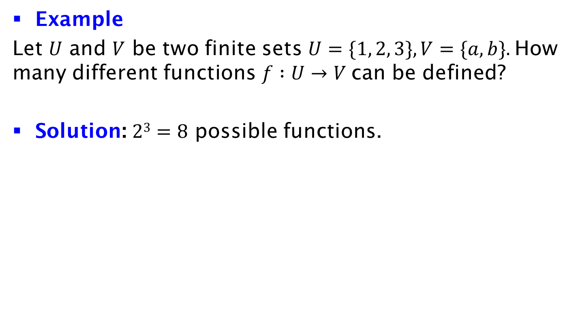
Example
Example
Let $U$ and $V$ be two finite sets $U=\{1, 2, 3\}, V=\{a, b\}.$How many different functions $f :U→V$can be defined?
Solution: $23=8$ possible functions.
 | f(1) | f(2) | f(3)
f₁ | a | a | a
f₂ | a | a | b
f₃ | a | b | a
f₄ | a | b | b
f₅ | b | a | a
f₆ | b | a | b
f₇ | b | b | a
f₈ | b | b | b

Slide 6
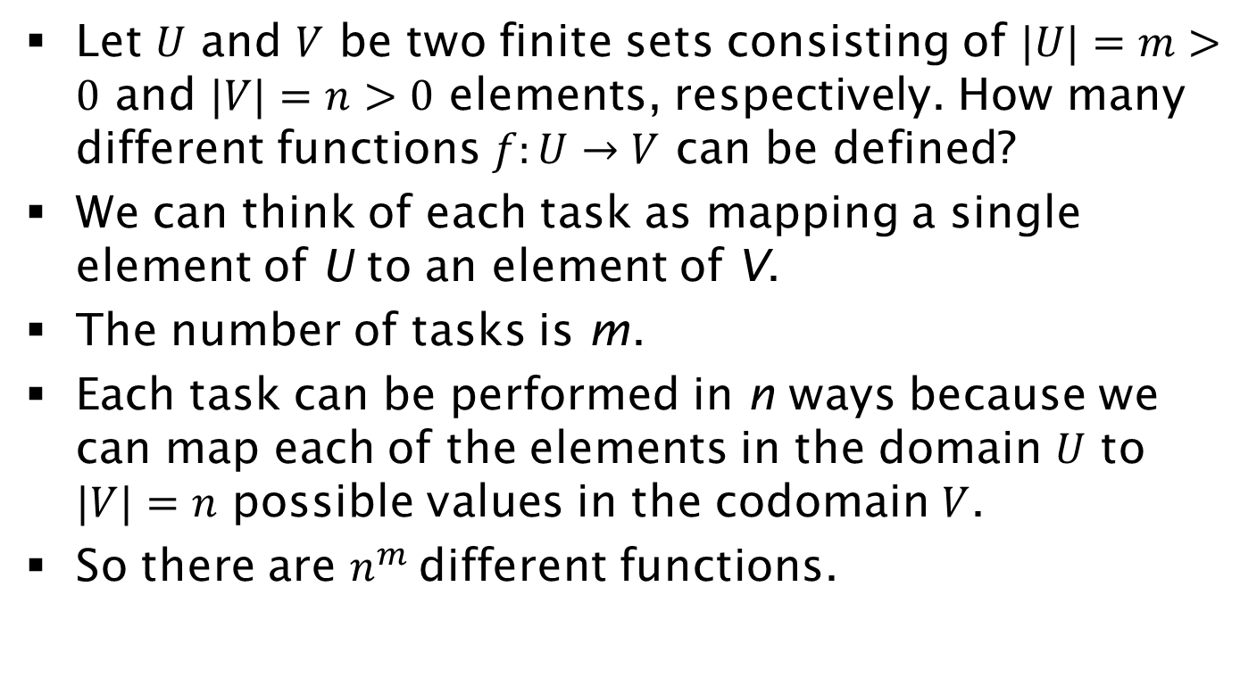
Exercise on Functions
Let $U$ and $V$ be two finite sets consisting of $|U|=m>0$ and $|V|=n>0$ elements, respectively. How many different functions $f:U→V$ can be defined?
We can think of each task as mapping a single element of U to an element of V.
The number of tasks is m.
Each task can be performed in n ways because we can map each of the elements in the domain $U$ to $|V|=n$ possible values in the codomain $V$.
So there are $n^{m}$ different functions.

Slide 7
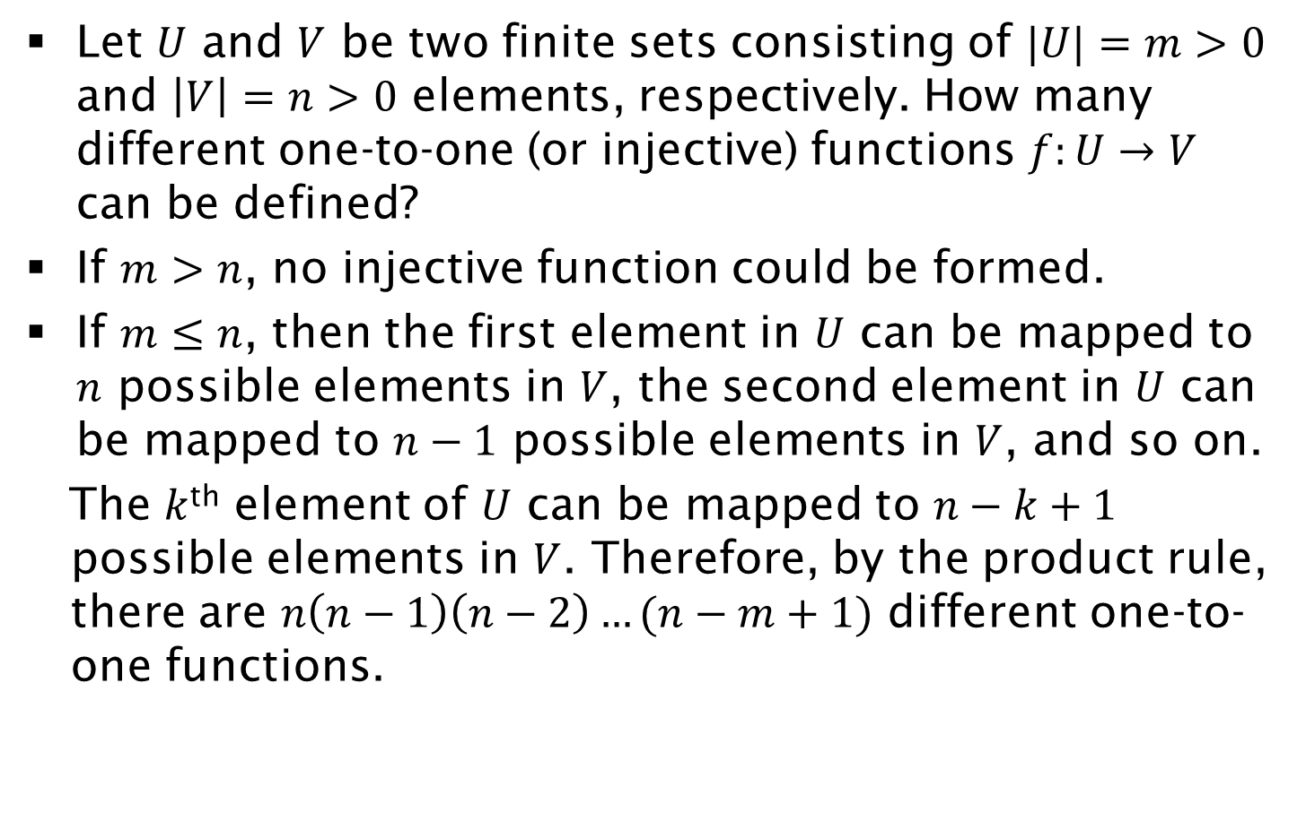
Exercise on Functions 2
Let $U$ and $V$ be two finite sets consisting of $|U|=m>0$ and $\left|V\right|=n>0$ elements, respectively. How many different one-to-one (or injective) functions $f:U→V$ can be defined?
If $m>n$, no injective function could be formed.
If $m≤n$, then the first element in $U$ can be mapped to $n$ possible elements in $V$, the second element in $U$ can be mapped to $n−1$ possible elements in $V$, and so on.
The $k$^{th} element of $U$ can be mapped to $n−k+1$ possible elements in $V$. Therefore, by the product rule, there are $n\left(n−1\right)\left(n−2\right)…(n−m+1)$ different one-to-one functions.

Slide 8
Matrix Multiplication
2 | 5
1 | 0
6 | 1 | 1
2 | 4 | 2
22 | 22 | 12
6 | 1 | 1
X
=
General Case
Given matrices A(mxn), B(nxp) compute product C(mxp). How many scalar multiplications are needed?

Slide 9
Matrix Multiplication Pseudocode
Consider the following algorithm for matrix multiplication:
    for i = 1 to m
    for j = 1 to n
    s = 0
    for k = 1 to p
    s = s + A[i, k] x B[k, j]
    C[i, j] = s
    end for
    end for
How many multiplications are executed?

Slide 10
Solution:
The multiplication operation is in the “loop k”, so it will be executed as many times as the total number of iterations the program will enter “loop k” :
For a fixed j value, the program loops through “loop k” p times, performing the multiplication operation p times.
Since there are n different j values, the multiplication operation is performed n⋅p times , considering the “loop j” and “loop k”.
Taking into account “loop i”, for each fixed value i, the program iterates through the big “loop j” and “loop k” once (i.e. performing n*p multiplications). Since there are m values for i, therefore in total the multiplication is performed m⋅n⋅p times.

Slide 11
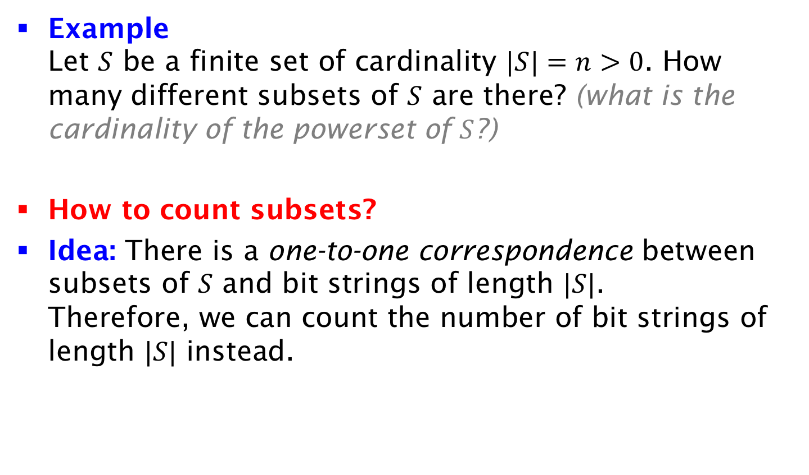
Example
Example
Let $S$ be a finite set of cardinality $|S|=n>0$. How many different subsets of $S$ are there? (what is the cardinality of the powerset of $S$?)
How to count subsets?
Idea: There is a one-to-one correspondence between subsets of $S$ and bit strings of length $|S|$.
Therefore, we can count the number of bit strings of length $|S|$ instead.

Slide 12
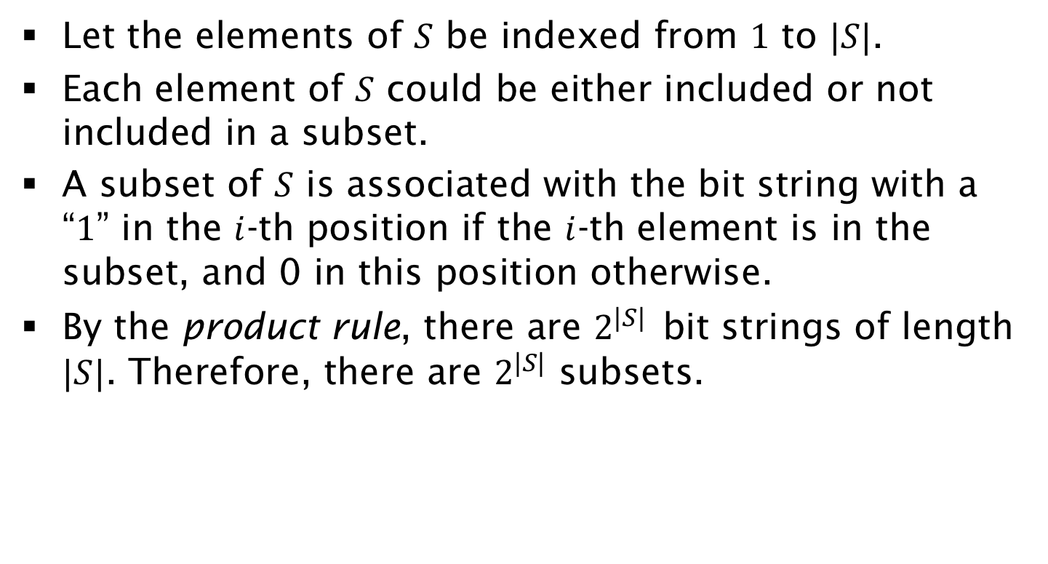
Solution (cont’d)
Let the elements of $S$ be indexed from $1$ to $|S|$.
Each element of $S$ could be either included or not included in a subset.
A subset of $S$ is associated with the bit string with a “$1$” in the $i$-th position if the $i$-th element is in the subset, and 0 in this position otherwise.
By the product rule, there are $2^{|S|}$ bit strings of length $|S|$. Therefore, there are $2^{|S|}$ subsets.

Slide 13
Exercise on License Plates
Assume each car has a license plate that starts with 3 uppercase English letters, followed by 4 decimal digits. The first digit cannot be zero. How many different license plates can exist?
Hint: the license plate has the form LLLDDDD, where L must be one of 26 letters (A,B,..,Z), and D must be one of 10 digits (0,1,..,9), except for the first digit ≠0.
There are 26 options for each letter, 9 options for the first digit, and 10 options for the remaining 3 digits.
Total number of options 26³⋅9⋅10³⋅

Slide 14
Exercise on Dice
How many ways are there to roll 2 different dice such that the product is an odd number?
Solution: For the product to be odd, both numbers should be odd. There are 3x3=9 ways for both dice to be odd.
How many ways are there to roll 2 different dice such that the product is an even number?
There is a total of 36 combinations. 36-9=27 have even product.

Slide 15
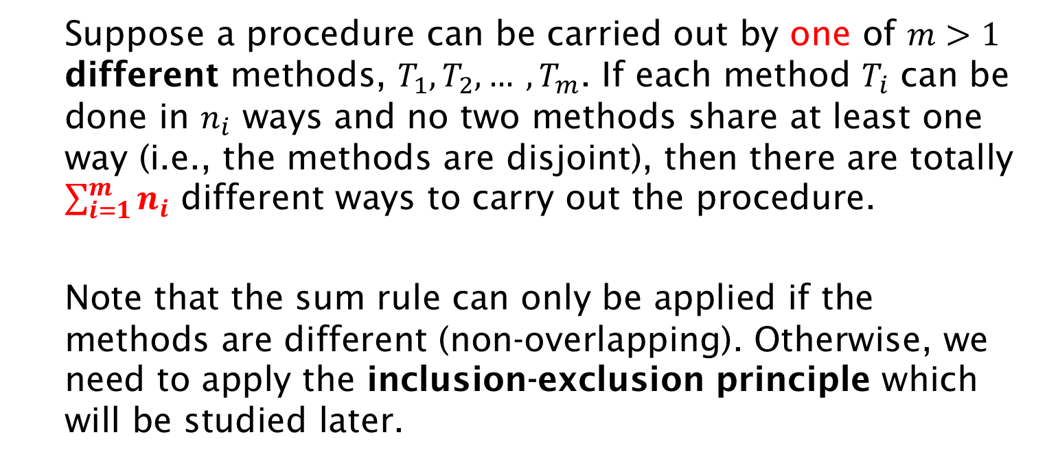
Sum Rule
Suppose a procedure can be carried out by one of $m>1$ different methods, $T_{1}, T_{2}, … ,T_{m}$. If each method $T_{i}$ can be done in $n_{i}$ ways and no two methods share at least one way (i.e., the methods are disjoint), then there are totally $\sum_{i=1}^{m}{n_{i}}$ different ways to carry out the procedure.
Note that the sum rule can only be applied if the methods are different (non-overlapping). Otherwise, we need to apply the inclusion-exclusion principle which will be studied later.

Slide 16
Example
There are 15 boys and 18 girls in a class. How many ways are there to choose one representative (boy or girl) for the class?
Solution
  There are 15 ways to choose a boy representative and 18 ways to choose a girl representative.
  No one is both a boy and a girl.
  By the sum rule it follows that there are 15+18=33 possible ways to pick the representative.
How many ways are there to choose a boy and a girl representative for the class?
15⋅18, by the product rule.

Slide 17
Example
Example
Consider the following selection sort algorithm:
(1) for i = 1 to n - 1
(2) for j = i + 1 to n
(3) if ( A[i] > A[j] )
(4) swap A[i] and A[j]
(5) endif
(6) endfor
(7) endfor
How many times the comparison in line (3) is executed?

Slide 18
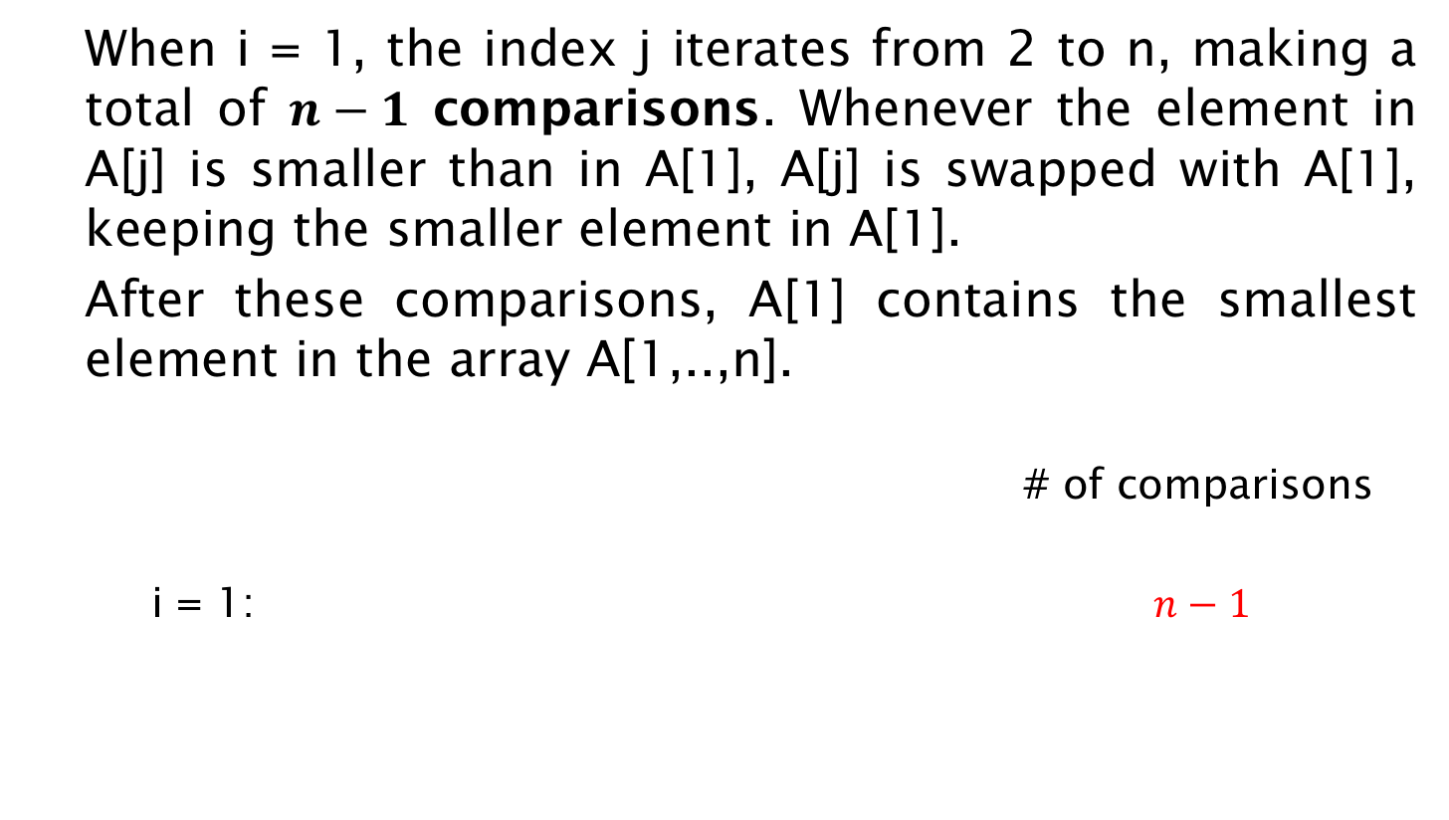
Solution:
When i = 1, the index j iterates from 2 to n, making a total of $n−1$ comparisons. Whenever the element in A[j] is smaller than in A[1], A[j] is swapped with A[1], keeping the smaller element in A[1].
After these comparisons, A[1] contains the smallest element in the array A[1,..,n].
# of comparisons
i = 1: $n−1$
2
n
1
3
… …
n-1

Slide 19
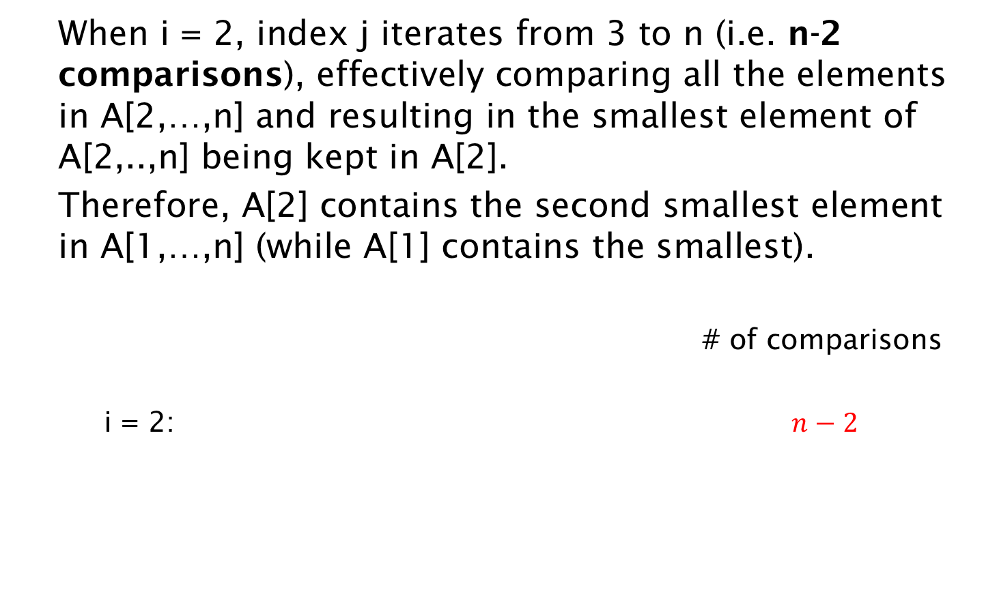
Solution (cont’d):
When i = 2, index j iterates from 3 to n (i.e. n-2 comparisons), effectively comparing all the elements in A[2,…,n] and resulting in the smallest element of A[2,..,n] being kept in A[2].
Therefore, A[2] contains the second smallest element in A[1,…,n] (while A[1] contains the smallest).
# of comparisons
i = 2: $n−2$
2
n
1
3
… …
n-1

Slide 20
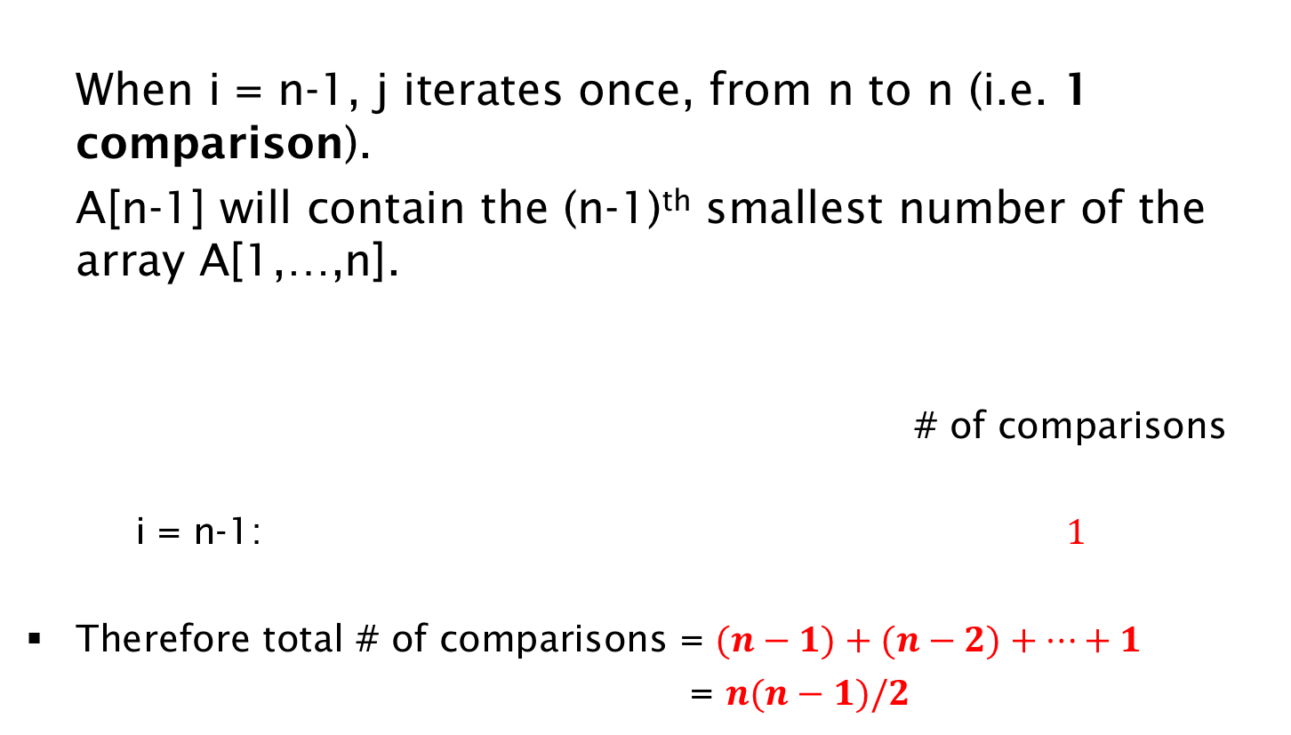
Solution (cont’d):
When i = n-1, j iterates once, from n to n (i.e. 1 comparison).
A[n-1] will contain the (n-1)^{th} smallest number of the array A[1,…,n].
# of comparisons
i = n-1: $1$
Therefore total # of comparisons = $(n−1)+(n−2)+…+1$
= $n(n−1)/2$
2
n
1
3
… …
n-1

Slide 21
Using Both Product and Sum Rules
Example
In a programming language, a variable name is a string of 1 or 2 alphanumeric characters which are not case-sensitive, i.e., an alphanumeric character is either one of the 26 English letters or one of the 10 digits. Moreover, a variable name must begin with a letter. Finally, a variable name must be different from the five strings of two characters that are reserved for programming use.
How many different variable names are there in the language?

Slide 22
Using Both Product and Sum Rules
Solution:
There are two cases (sum rule): one to account for variables of length 1 (formed by a single alphanumeric character), and the other to account for variables of length 2 (formed by two alphanumeric characters).
(case 1) For variables formed by a single alphanumeric character, we have a total of 26 possible variables (it cannot be a numerical digit, since variable names need to start with a letter)

Slide 23
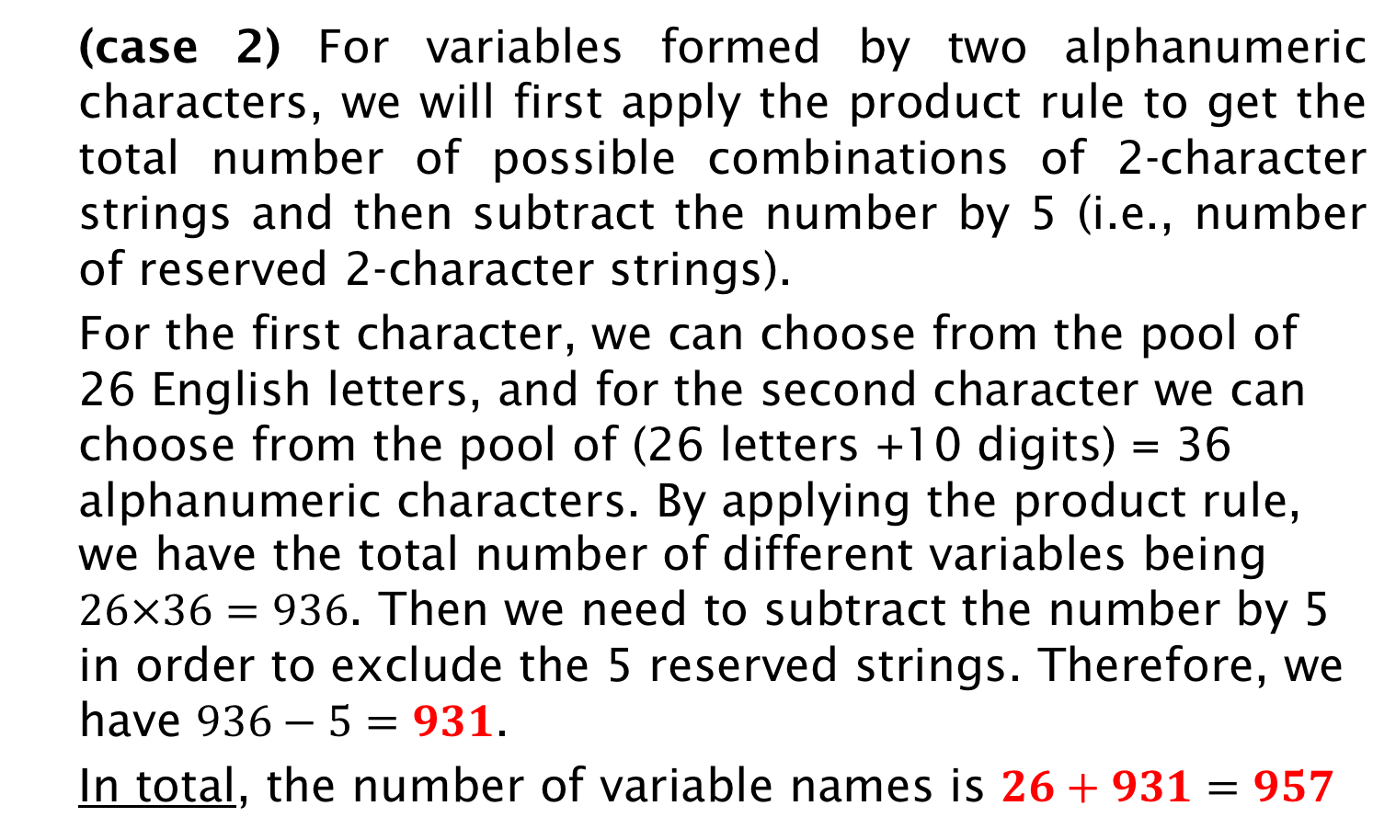
Solution (cont’d):
(case 2) For variables formed by two alphanumeric characters, we will first apply the product rule to get the total number of possible combinations of 2-character strings and then subtract the number by 5 (i.e., number of reserved 2-character strings).
For the first character, we can choose from the pool of 26 English letters, and for the second character we can choose from the pool of (26 letters +10 digits) = 36 alphanumeric characters. By applying the product rule, we have the total number of different variables being $26×36=936$. Then we need to subtract the number by 5 in order to exclude the 5 reserved strings. Therefore, we have $936−5=931$.
In total, the number of variable names is $26+931=957$

Slide 24
Using Both Product and Sum Rules
Example
In a computer system, each user has a password of six to eight characters long where each character is an uppercase letter or a digit. Each password must contain at least one digit. How many possible passwords are there?

Slide 25
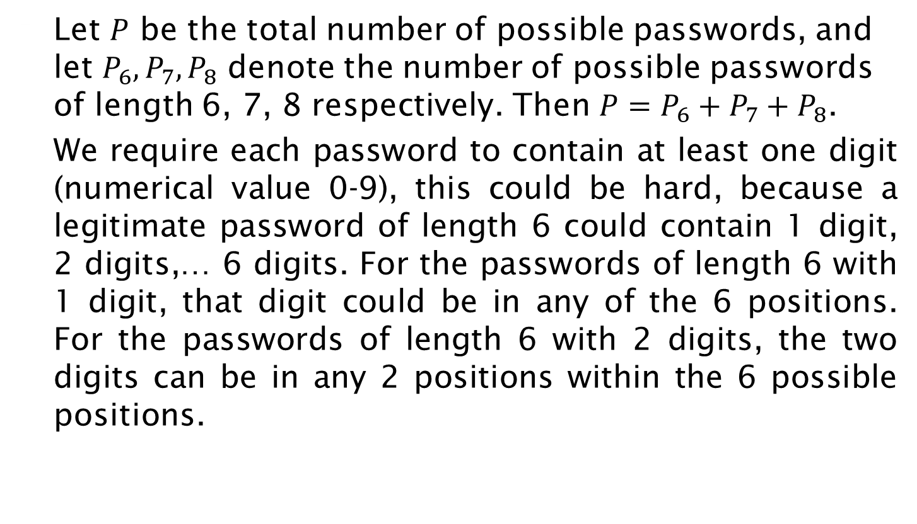
Solution:
Let $P$ be the total number of possible passwords, and let $P_{6},P_{7}, P_{8}$ denote the number of possible passwords of length 6, 7, 8 respectively. Then $P=P_{6}+P_{7}+P_{8}$.
We require each password to contain at least one digit (numerical value 0-9), this could be hard, because a legitimate password of length 6 could contain 1 digit, 2 digits,… 6 digits. For the passwords of length 6 with 1 digit, that digit could be in any of the 6 positions. For the passwords of length 6 with 2 digits, the two digits can be in any 2 positions within the 6 possible positions.

Slide 26
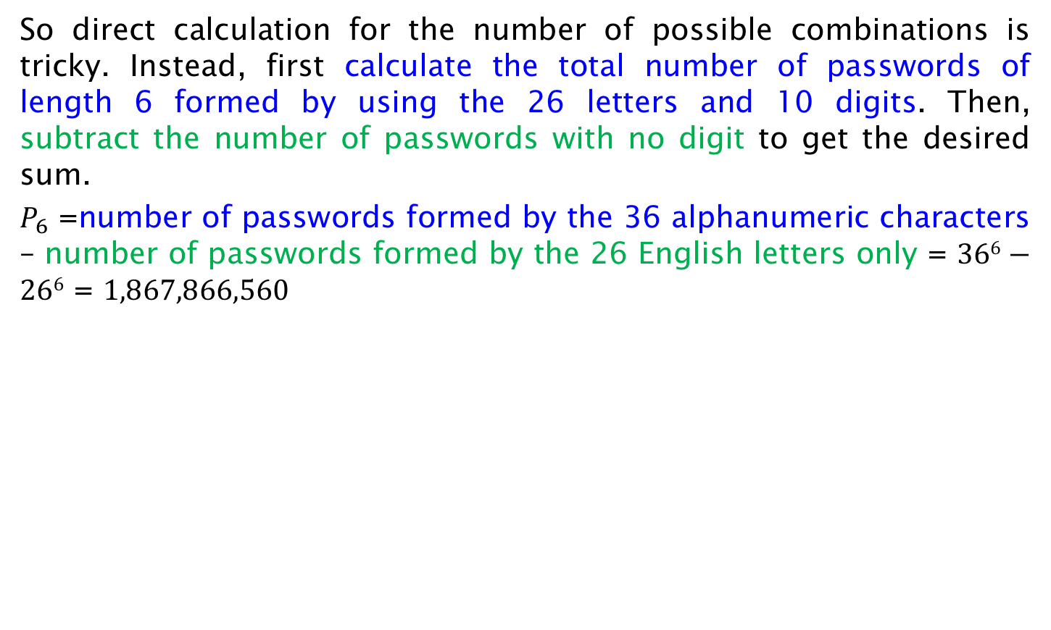
Solution (cont’d)
So direct calculation for the number of possible combinations is tricky. Instead, first calculate the total number of passwords of length 6 formed by using the 26 letters and 10 digits. Then, subtract the number of passwords with no digit to get the desired sum.
$P_{6}$ =number of passwords formed by the 36 alphanumeric characters – number of passwords formed by the 26 English letters only = $366−266$ = $1,867,866,560$
Wrong Solution: Since the password must contain a digit, I have 10 options for the digit, 6 options for the position of the digit, and $365$ for the remaining characters. Therefore, one could claim that the answer is $365\text{}$10⋅6.
First note that $365\text{}$10⋅6 = $365\text{}$60> $366$, i.e., the resulting number is larger than the number of passwords of length 6, even without additional constraints. The reason is that the formula counts the same password containing multiple digits, many times. This issue will be discussed in the lecture about generalized permutations and combinations.

Slide 27
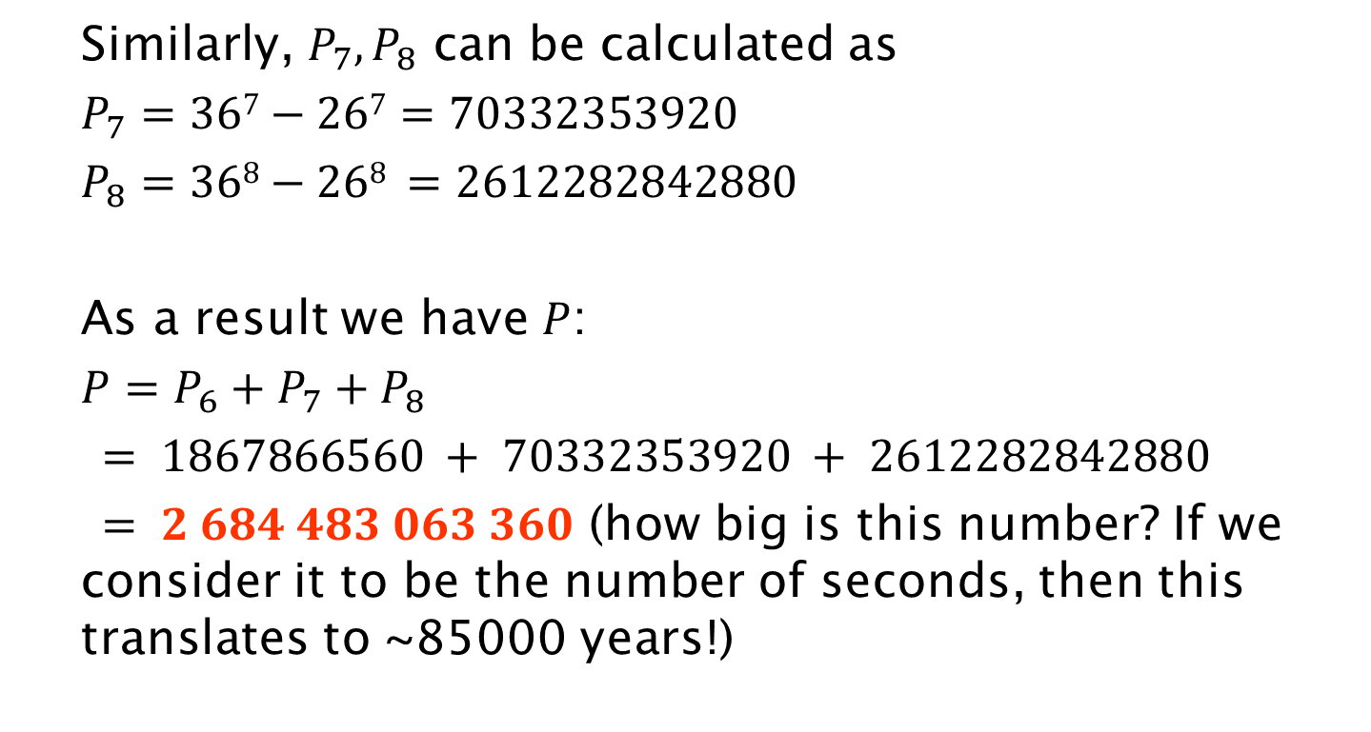
Solution (cont’d)
Similarly, $P_{7}, P_{8}$ can be calculated as
$P_{7}=367−267=70332353920$
$P_{8}=368−268 =2612282842880$
As a result we have $P$:
$P=P_{6}+P_{7}+P_{8}$
$= 1867866560 + 70332353920 + 2612282842880$
$= 2 684 483 063 360$ (how big is this number? If we consider it to be the number of seconds, then this translates to ~85000 years!)

Slide 28
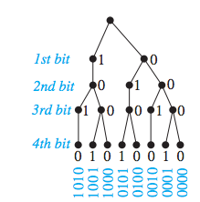
Tree Diagrams
Some counting problems can be solved more easily using tree diagrams.
How many bit strings of length four do not have two consecutive 1s?
In future lectures, we will see alternative ways to solve such problems.

Slide 29
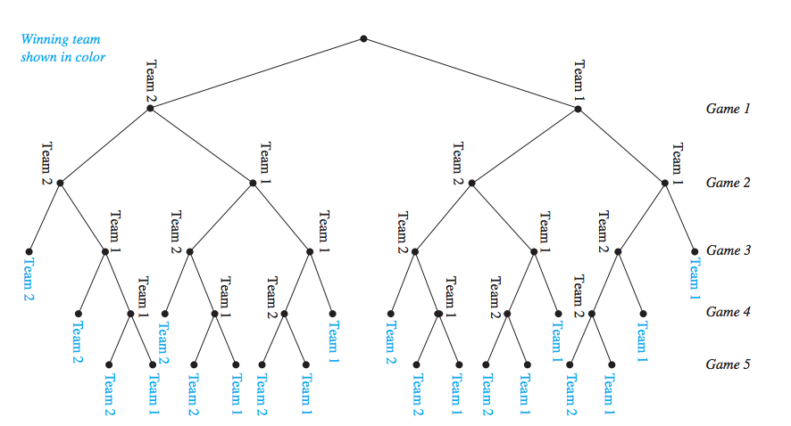
Tree Diagrams
A playoff between two teams consists of at most five games. The first team that wins three games wins the playoff. In how many different ways can the playoff occur?
  Similar to previous problem. How many bit strings of length up to five, contain exactly three 1, or exactly three 0?

Slide 30
Pigeonhole Principle
If k + 1 or more objects (pigeons) are placed into k boxes (pigeonholes) where k is a positive integer, then there is at least one box (pigeonhole) containing two or more of the objects (pigeons).
Proof
By contradiction.
Assume that each of the k boxes contains at most 1 object. Then the maximum number of objects is k.
Corollary
A function f from a set with k + 1 or more elements to a set with k elements is not one-to-one.
The challenge is to correctly determine what are the objects (pigeons) and the boxes (pigeonholes).

Slide 31
Examples
Example
Among any group of 367 people, there must be at least two with the same birthday.
Example
In any group of 27 English words, there must be at least two that begin with the same letter.
Example
How many students must be in a class to guarantee that at least two students receive the same score on the final exam, if the exam is graded on a scale from 1 to 100 points?

Slide 32
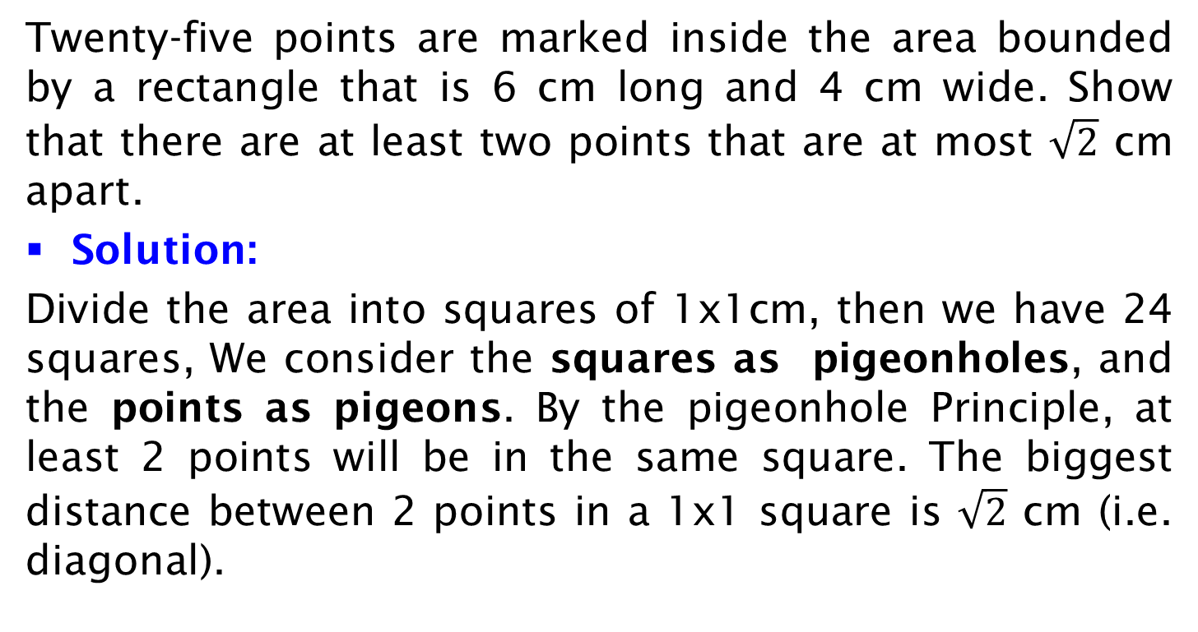
Exercise on Regular Grid
Twenty-five points are marked inside the area bounded by a rectangle that is 6 cm long and 4 cm wide. Show that there are at least two points that are at most $\sqrt{2}$ cm apart.
Solution:
Divide the area into squares of 1x1cm, then we have 24 squares, We consider the squares as pigeonholes, and the points as pigeons. By the pigeonhole Principle, at least 2 points will be in the same square. The biggest distance between 2 points in a 1x1 square is $\sqrt{2}$ cm (i.e. diagonal).

Slide 33
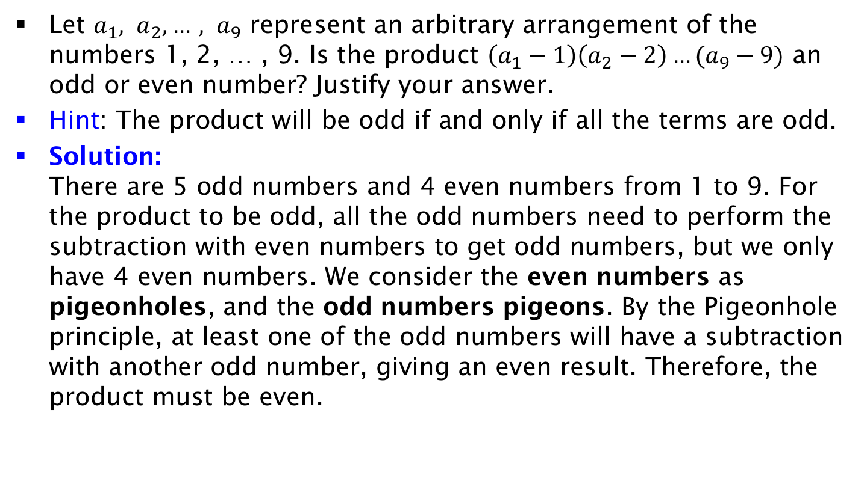
Exercise on Product
Let $a_{1}, a_{2}, …, a_{9}$ represent an arbitrary arrangement of the numbers 1, 2, … , 9. Is the product $\left(a_{1}−1\right)\left(a_{2}−2\right)…(a_{9}−9)$ an odd or even number? Justify your answer.
Hint: The product will be odd if and only if all the terms are odd.
Solution:
There are 5 odd numbers and 4 even numbers from 1 to 9. For the product to be odd, all the odd numbers need to perform the subtraction with even numbers to get odd numbers, but we only have 4 even numbers. We consider the even numbers as pigeonholes, and the odd numbers pigeons. By the Pigeonhole principle, at least one of the odd numbers will have a subtraction with another odd number, giving an even result. Therefore, the product must be even.

Slide 34

Generalized Pigeonhole Principle
If n objects are placed into k boxes (where n>k), then there is at least one box containing at least objects.
Proof
We prove it by contradiction. Suppose none of the boxes contains more than – 1 objects. Then, the total number of objects is at most k( – 1). Note that
< n/k + 1. This implies
k( – 1) < k ((n/k + 1) – 1) = n,
which contradicts the fact that there are a total of n objects.

Slide 35

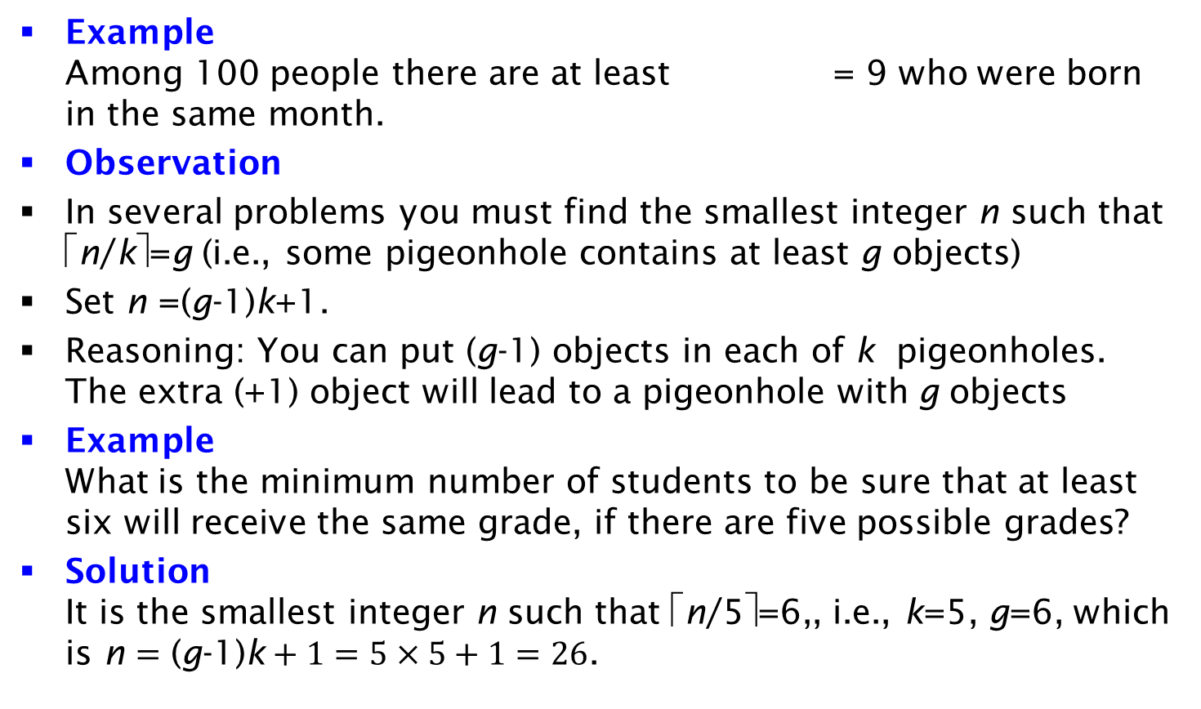
Examples
Example
Among 100 people there are at least = 9 who were born in the same month.
Observation
In several problems you must find the smallest integer n such that ⎡n/k⎤=g (i.e., some pigeonhole contains at least g objects)
Set n =(g-1)k+1.
Reasoning: You can put (g-1) objects in each of k pigeonholes. The extra (+1) object will lead to a pigeonhole with g objects
Example
What is the minimum number of students to be sure that at least six will receive the same grade, if there are five possible grades?
Solution
It is the smallest integer n such that ⎡n/5⎤=6,, i.e., k=5, g=6, which is n $=\text{(}\text{g}\text{−1)}\text{k}+1=5×5+1=26$.

Slide 36
Exercise on Cards
How many cards must be selected from a standard deck of 52 cards to guarantee that at least three cards of the same suit are chosen?
Solution:
Let the selected cards be pigeons and the suits be pigeonholes. By the generalized pigeonhole principle, to guarantee at least three cards of the same suit among n cards, we need to have ⎡n/4⎤ =3, so we have n=2*4+1=9 cards.
How many cards must be selected to guarantee that at least three hearts are selected?
Solution:
To guarantee that at least three hearts are selected, we have to exhaust all the clubs (13), diamonds (13), and spades (13) first, and then pick three more cards = 13*3+3=42 cards (note: this is not based on the generalized pigeonhole principle).

Slide 37
Exercise on Socks
In a dark drawer there are 100 black and 100 white socks. What is the minimum number of socks that you should select in order to ENSURE that you have 2 socks of the same color (both black or both white)?
Solution:
Let the selected socks be pigeons and the colors be pigeonholes. By the generalized pigeonhole principle, to guarantee at least 2 socks of the same color, we need to have ⎡n/2⎤ =2, so we have n=3 socks.
In a dark drawer there are 100 black and 100 white socks. What is the minimum number of socks that you should select in order to ENSURE that you have 2 WHITE socks?
Solution:
To guarantee at least 2 WHITE socks, we have to exhaust all the black socks first and then pick 2 more socks: 102 socks.

Slide 38
Exercise on Phone Numbers
Assume that phone numbers are of the form NXX-NXX-XXXX, where the first three digits form the area code, N represents a digit from 2 to 9 inclusive, and X represents any digit. What is the least number of area codes needed to guarantee that the 25 million phones in a state can be assigned distinct 10-digit phone numbers?
Solution:
Discarding the area code, by the product rule, there are 8*10⁶ different phone numbers of the form NXX-XXXX. Applying the generalized Pigeonhole principle, we have ⎡25*10⁶ / 8*10⁶⎤ = 4, so at least one phone number of the form NXX-XXXX is shared by 4 phones.
In order to have 25*10⁶ phones assigned distinct numbers, 4 area codes are required in order to distinguish the phones sharing the same NXX-XXXX number into different areas.

Slide 39
Exercise on Games
Assume 16 teams. Each team plays exactly 5 games. A win gains 3 points, draw gains 1 point and loss gains 0 point. Prove that at least two teams will have the same number of points.
  Solution: Maximum possible points are 15 as a team can win all the games and the minimum possible score is 0 if its all lose.
  So possible scores are 0,1,2,3,4,...,13,14,15 (16 cases so far)
  However, its not possible to get 14 points in total. Because the second best possible score for a team is to win 4 games and a draw which is 12+1 = 13. So now the possible scores are:
  0,1,2,....,13,15 (which are 15 cases). We have 16 teams and 15 possible scores. Two teams must have the same scores.

