Slide 1
Permutations and Combinations
Objectives
  Permutations
  Combinations
  Generalized Permutations and Combinations
Reading: Rosen 6.3, 6.5

Slide 2
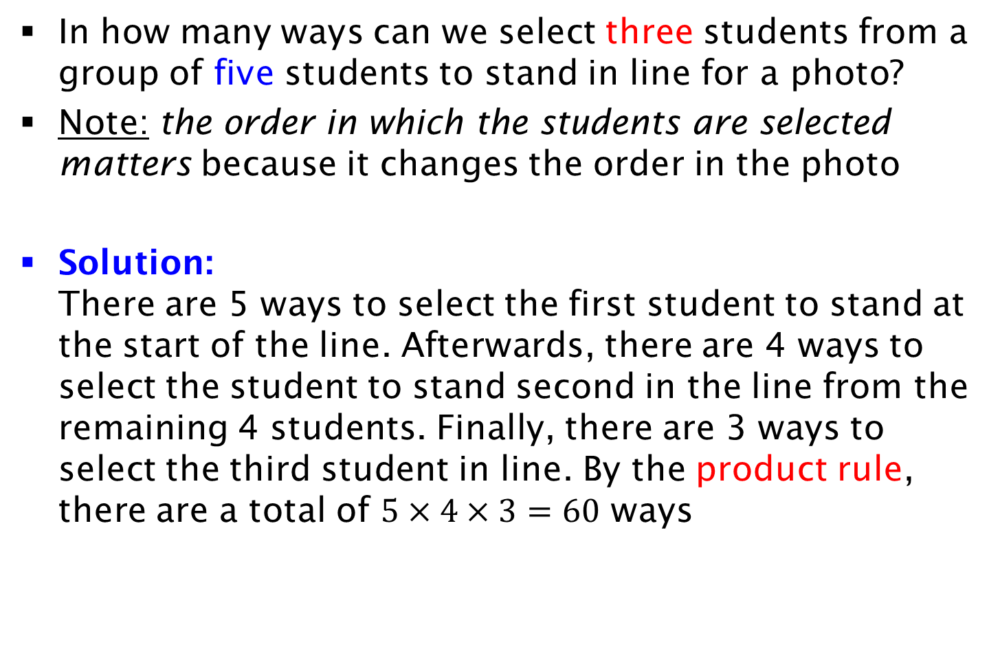
Permutations
In how many ways can we select three students from a group of five students to stand in line for a photo?
Note: the order in which the students are selected matters because it changes the order in the photo
Solution:
There are 5 ways to select the first student to stand at the start of the line. Afterwards, there are 4 ways to select the student to stand second in the line from the remaining 4 students. Finally, there are 3 ways to select the third student in line. By the product rule, there are a total of $5×4×3=60$ ways

Slide 3
Example
In how many ways can we arrange n students in a line for a photo?
Solution:
This example is similar to the previous one, except that we are now selecting all n students. Using the same rationale as the previous question, there are n⋅(n-1)⋅ ..⋅2 ⋅1= n! ways

Slide 4
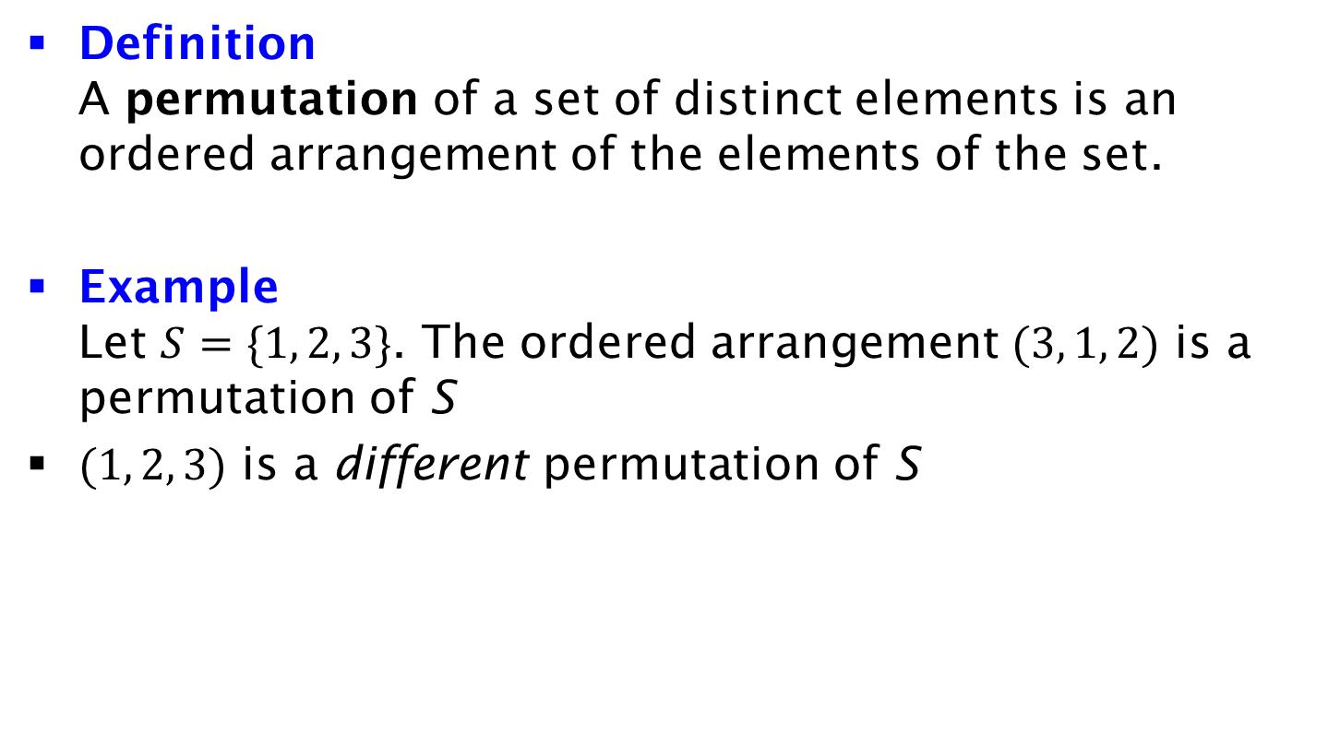
Permutation
Definition
A permutation of a set of distinct elements is an ordered arrangement of the elements of the set.
Example
Let $S=\{1, 2, 3\}$. The ordered arrangement $(3, 1, 2)$ is a permutation of S
$(1, 2, 3)$ is a different permutation of S

Slide 5
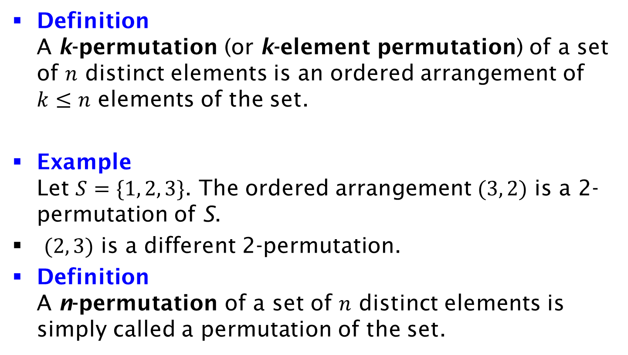
k-Permutation
Definition
A k-permutation (or k-element permutation) of a set of $n$ distinct elements is an ordered arrangement of $k≤n$ elements of the set.
Example
Let $S=\{1, 2, 3\}$. The ordered arrangement $(3, 2)$ is a 2-permutation of S.
$(2, 3)$ is a different 2-permutation.
Definition
A n-permutation of a set of $n$ distinct elements is simply called a permutation of the set.

Slide 6
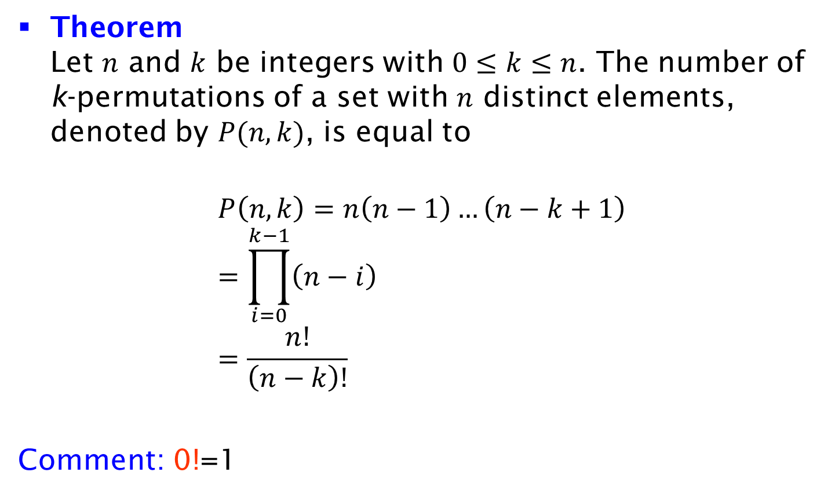
Number of k-Permutations
Theorem
Let $n$ and $k$ be integers with $0≤k≤n$. The number of k-permutations of a set with $n$ distinct elements, denoted by $P(n, k)$, is equal to
$$P\left(n, k\right)=n\left(n−1\right)…\left(n−k+1\right) \\ =\prod_{i=0}^{k−1}{\left(n−i\right)} \\ =\frac{n!}{\left(n−k\right)!}$$
Comment: 0!=1

Slide 7
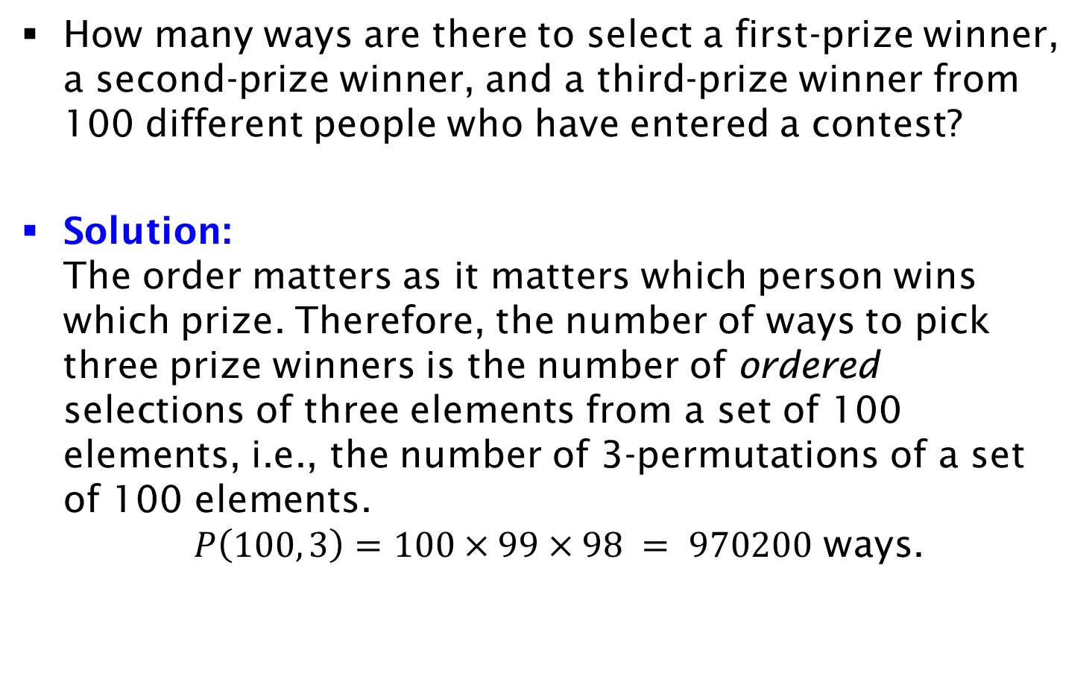
Example
How many ways are there to select a first-prize winner, a second-prize winner, and a third-prize winner from 100 different people who have entered a contest?
Solution:
The order matters as it matters which person wins which prize. Therefore, the number of ways to pick three prize winners is the number of ordered selections of three elements from a set of 100 elements, i.e., the number of 3-permutations of a set of 100 elements.
$P\left(100, 3\right)=100×99×98 = 970200$ ways.

Slide 8
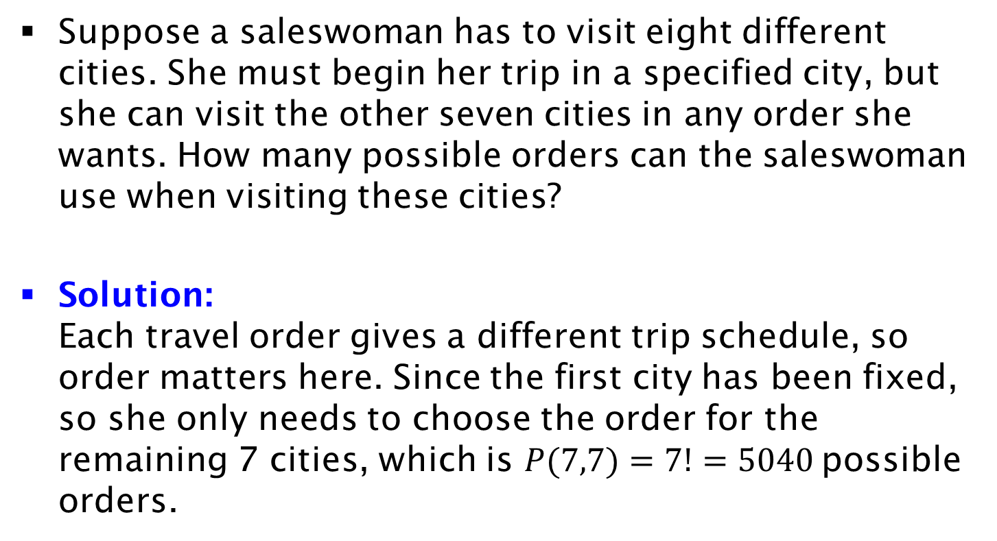
Example
Suppose a saleswoman has to visit eight different cities. She must begin her trip in a specified city, but she can visit the other seven cities in any order she wants. How many possible orders can the saleswoman use when visiting these cities?
Solution:
Each travel order gives a different trip schedule, so order matters here. Since the first city has been fixed, so she only needs to choose the order for the remaining 7 cities, which is $P(7,7)=7!=5040$possible orders.

Slide 9
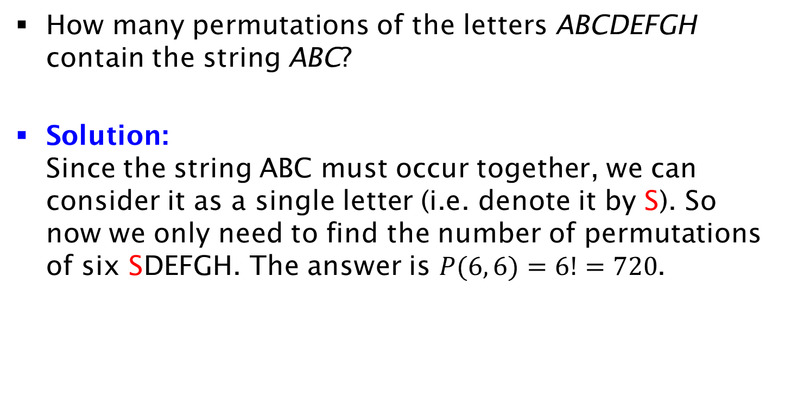
Exercise on Strings
How many permutations of the letters ABCDEFGH contain the string ABC?
Solution:
Since the string ABC must occur together, we can consider it as a single letter (i.e. denote it by S). So now we only need to find the number of permutations of six SDEFGH. The answer is $P(6, 6)=6!=720$.

Slide 10
Exercise on Seating Arrangement
n people sit down at a round table with n chairs. We consider two seating arrangements equivalent, if each person has the same neighbor to the right in both arrangements. How many different arrangements are equivalent to a given arrangement of n people?
n-1

Slide 11
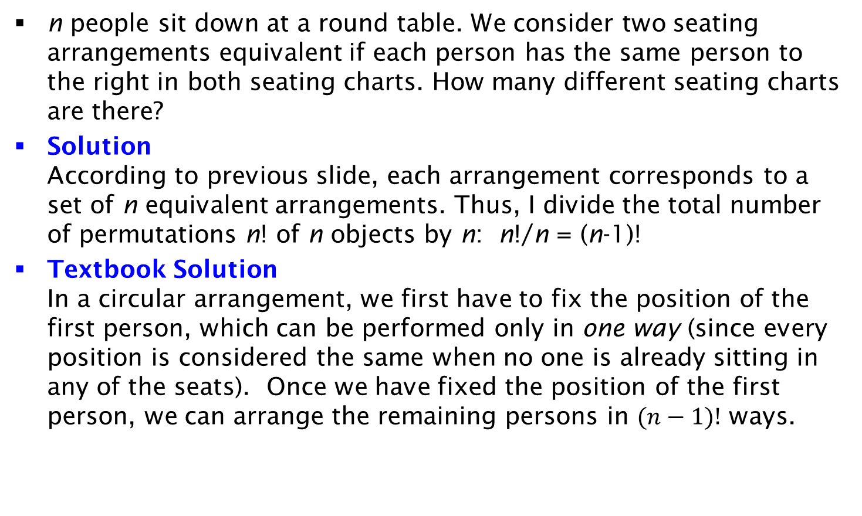
Exercise on Seating Arrangement
n people sit down at a round table. We consider two seating arrangements equivalent if each person has the same person to the right in both seating charts. How many different seating charts are there?
Solution
According to previous slide, each arrangement corresponds to a set of n equivalent arrangements. Thus, I divide the total number of permutations n! of n objects by n: n!/n = (n-1)!
Textbook Solution
In a circular arrangement, we first have to fix the position of the first person, which can be performed only in one way (since every position is considered the same when no one is already sitting in any of the seats). Once we have fixed the position of the first person, we can arrange the remaining persons in $(n−1)!$ ways.

Slide 12
Exercise on Parking Lots
A parking lot has 10 parking spaces arranged in a row. There are 7 different cars parked in 7 of these parking spaces. How many ways are there to park the cars such that the three empty places are adjacent to each other?
Solution
The beginning of the 3 empty spaces can be at positions 1,2,…,8. For each of the 8 choices, there are 7! permutations of the 7 cars. Thus: 7!8=40320

Slide 13
k-Combinations
Example
In how many ways can we select three students to form a study-team, from a group of four students?
Note: the order in which the students are selected does not matter!
Solution:
We need only to find the number of subsets containing 3 elements from the set of 4 students. There are 4 such subsets (each subset excludes one student). Therefore, there are 4 ways to choose the three students for the team.
Equivalent Question: How many bit strings of length four have exactly three 1?

Slide 14
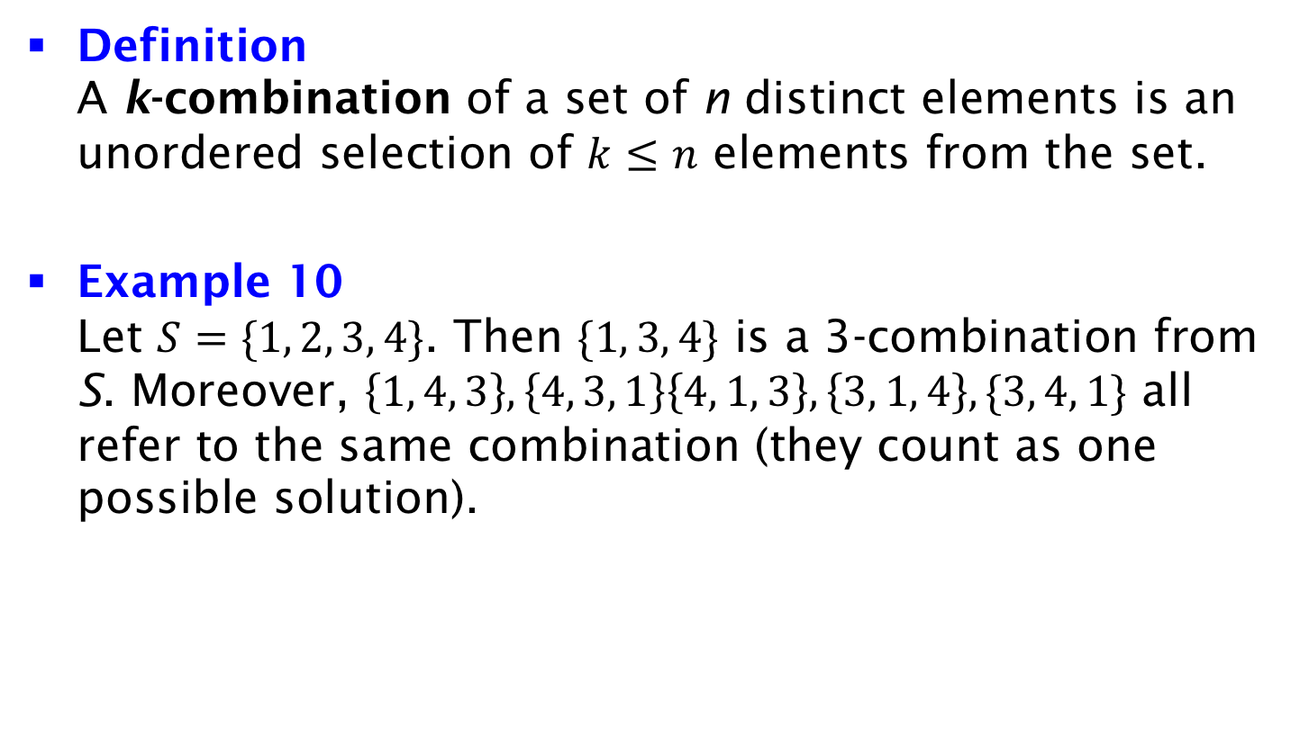
k-Combinations
Definition
A k-combination of a set of n distinct elements is an unordered selection of $k≤n$ elements from the set.
Example 10
Let $S=\{1, 2, 3, 4\}$. Then $\{1, 3, 4\}$ is a 3-combination from S. Moreover, $\left\{1, 4, 3\right\},\left\{4, 3, 1\right\}\left\{4, 1, 3\right\},\left\{3, 1, 4\right\},\{3, 4, 1\}$ all refer to the same combination (they count as one possible solution).

Slide 15
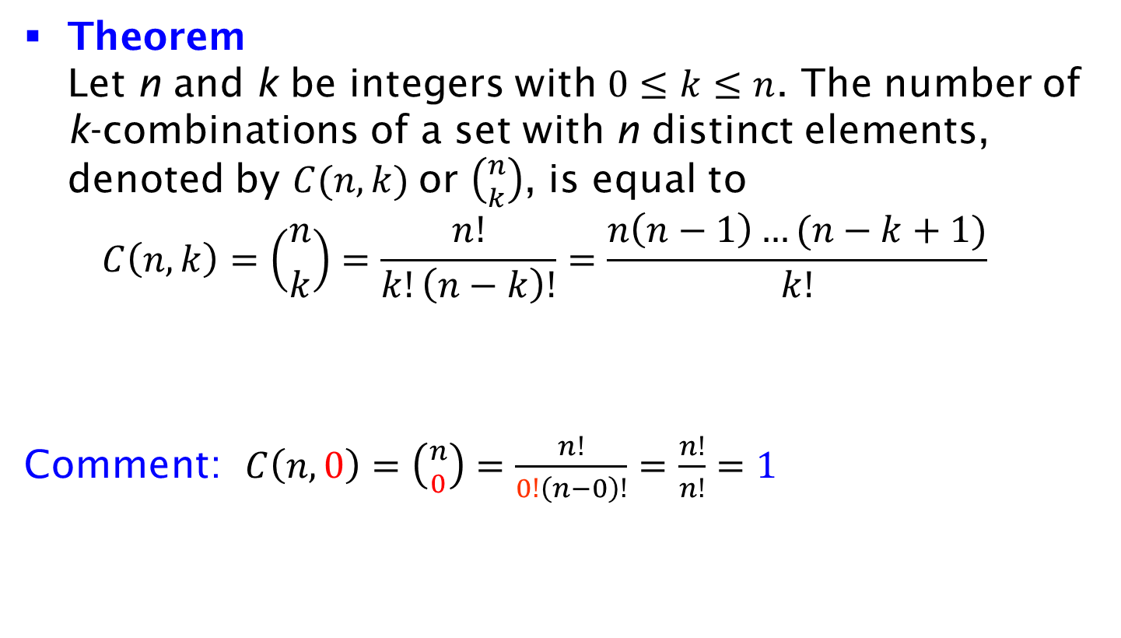
Number of k-Combinations
Theorem
Let n and k be integers with $0≤k≤n$. The number of k-combinations of a set with n distinct elements, denoted by $C(n, k)$or $\left({n \atop k}\right)$, is equal to
$C\left(n, k\right)=\left({n \atop k}\right)=\frac{n!}{k!\left(n−k\right)!}=\frac{n\left(n−1\right)…(n−k+1)}{k!}$
Comment: $C\left(n, 0\right)=\left({n \atop 0}\right)=\frac{n!}{0!\left(n−0\right)!}=\frac{n!}{n!}=1$

Slide 16
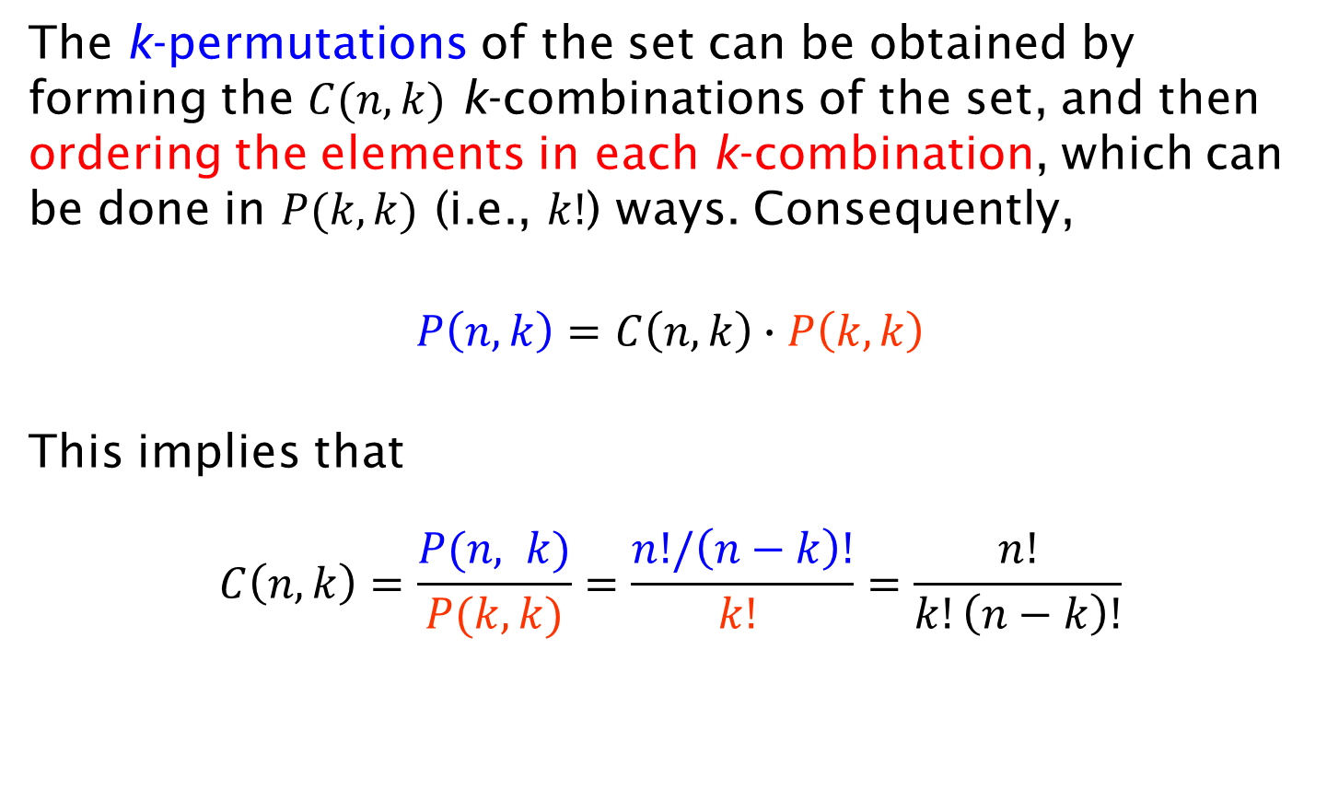
Proof
The k-permutations of the set can be obtained by forming the $C(n, k)$ k-combinations of the set, and then ordering the elements in each k-combination, which can be done in $P(k, k)$ (i.e., $k!$) ways. Consequently,
$$P\left(n, k\right)=C\left(n, k\right)∙P\left(k,k\right)$$
This implies that
$$C\left(n, k\right)=\frac{P(n, k)}{P(k,k)}=\frac{n!/\left(n−k\right)!}{k! }=\frac{n!}{k!\left(n−k\right)!}$$

Slide 17
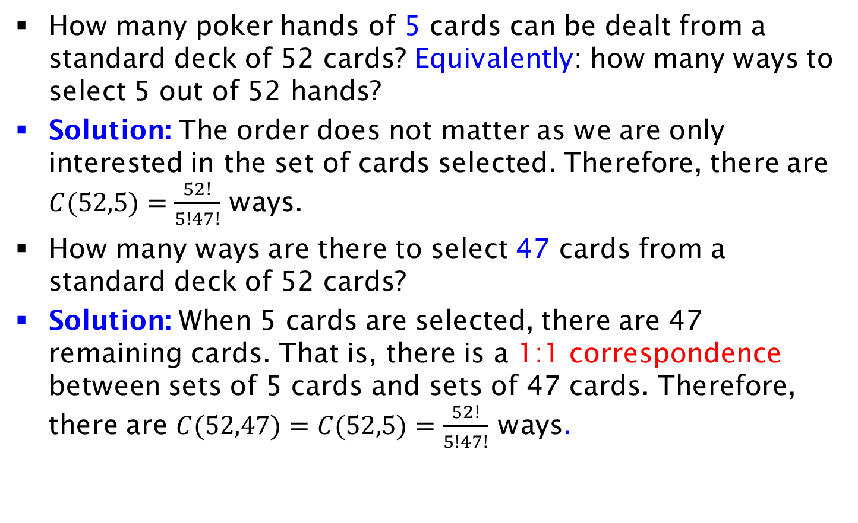
Example
How many poker hands of 5 cards can be dealt from a standard deck of 52 cards? Equivalently: how many ways to select 5 out of 52 hands?
Solution: The order does not matter as we are only interested in the set of cards selected. Therefore, there are $C(52,5)=\frac{52!}{5!47!}$ ways.
How many ways are there to select 47 cards from a standard deck of 52 cards?
Solution: When 5 cards are selected, there are 47 remaining cards. That is, there is a 1:1 correspondence between sets of 5 cards and sets of 47 cards. Therefore, there are $C(52,47)=C(52,5)=\frac{52!}{5!47!}$ ways.

Slide 18
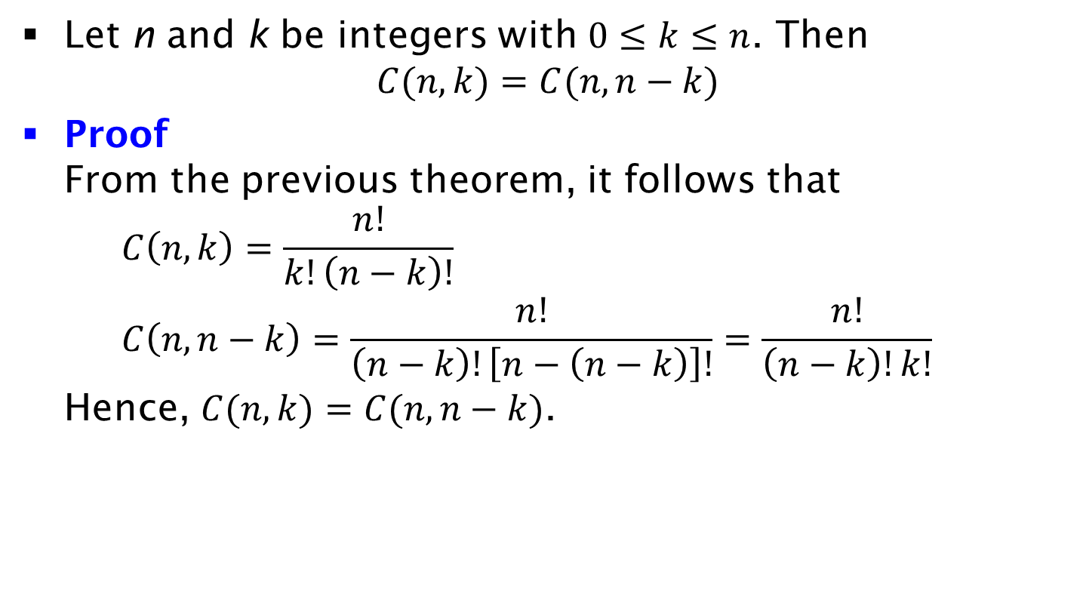
Corollary
Let n and k be integers with $0≤k≤n$. Then
$C(n, k)=C(n, n−k)$
Proof
From the previous theorem, it follows that
$C\left(n,k\right)=\frac{n!}{k!\left(n−k\right)!}$
$C\left(n,n−k\right)=\frac{n!}{\left(n−k\right)!\left[n−\left(n−k\right)\right]!}=\frac{n!}{\left(n−k\right)!k!}$
Hence, $C(n, k)=C(n, n−k)$.

Slide 19
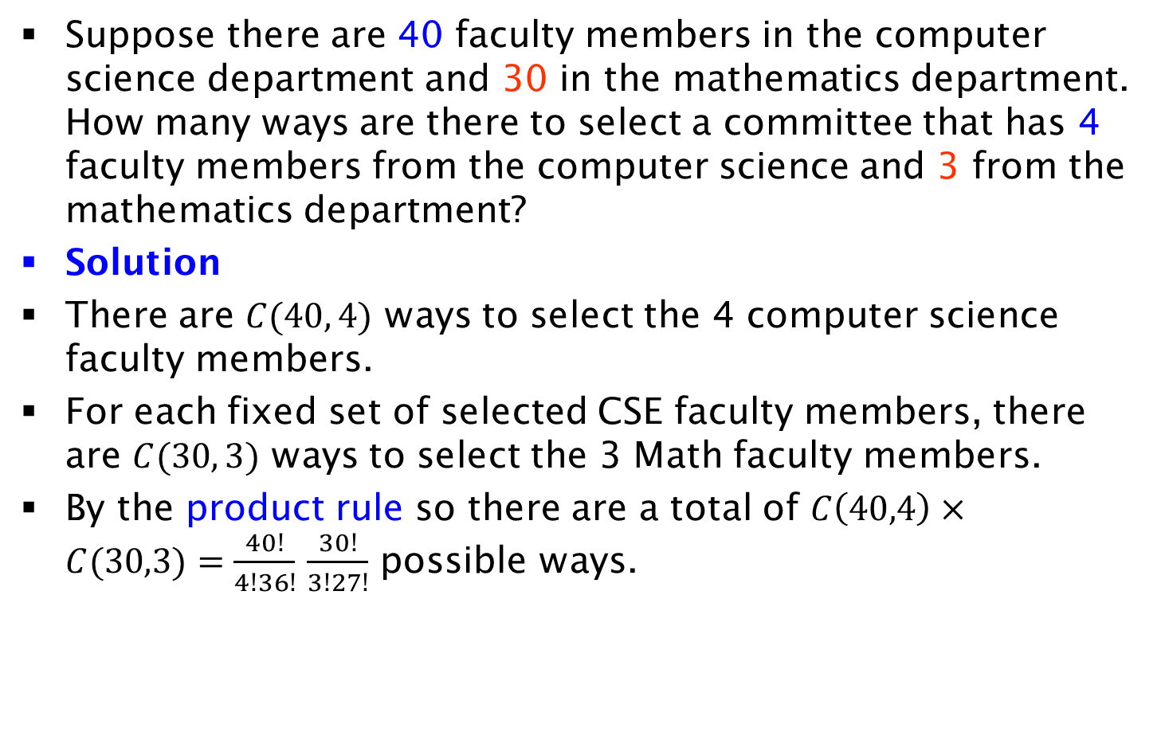
Exercise on Committee Selection
Suppose there are 40 faculty members in the computer science department and 30 in the mathematics department. How many ways are there to select a committee that has 4 faculty members from the computer science and 3 from the mathematics department?
Solution
There are $C(40, 4)$ ways to select the 4 computer science faculty members.
For each fixed set of selected CSE faculty members, there are $C(30, 3)$ ways to select the 3 Math faculty members.
By the product rule so there are a total of $C\left(40,4\right)×C(30,3)=\frac{40!}{4!36!}$ $\frac{30!}{3!27!}$ possible ways.

Slide 20
Exercise on Group Selection
There are 7 boys and 5 girls in a class. We want to form a 4-person group from these 12 people, so that there is at least 1 girl in the group. In how many ways can the 4-person group be chosen?
Solution:
  Select without any constraint C(12,4)=495.
  Select only boys C(7,4)=35.
  Select at least one girl: C(12,4)- C(7,4)=460.
Alternative Solution: The group may contain:
  4 girls in C(5,4)=5 ways, or
  3 girls and 1 boy in C(5,3)xC(7,1)=10x7=70 ways, or
  2 girls and 2 boys in C(5,2)xC(7,2)=10x210=210 ways, or
  1 girl and 3 boys in C(5,1)xC(7,3) = 5x35 = 175 ways.
  The sum of all ways is 460.

Slide 21
Exercise on Ball Selection
3 balls are selected randomly from a bag with 36 balls. If the bag contains 8 yellow balls, 7 green balls, 6 blue balls, 5 red balls, and 10 black balls. How many ways are there such that at least 1 blue ball is selected?
Solution
There are C(36,3) to select 3 balls with no constraints.
There are C(30,3) ways to select 3 balls that are not blue.
Thus, the number of ways to select 3 balls with at least one blue is: C(36,3)-C(30,3)=3080.

Slide 22
Exercise on Earring Selection
Mary has 9 different earrings. Mary must wear at least one earring. Each ear has two piercings for wearing an earring. It is not necessary for her to wear all the 4 earrings on her ears, e.g. she can wear one earring and leave the other 3 piercings empty. How many possible ways for Mary to wear her 9 earrings if the position of the earrings matters?
Solution:
If Mary wears 4 earrings there are 9x8x7x6 permutations.
If Mary wears 3 earrings we must select the 3 piercings in C(4,3) ways, and permute the earrings in 9x8x7 ways.
If Mary wears 2 earrings we must select the 2 piercings in C(4,2) ways, and permute the earrings in 9x8 ways.
If Mary wears 1 earring we must select the 1 piercing in C(4,1) ways, and permute the earrings in 9 ways.
Sum of all ways is: C(4,3)x9x8x7 + C(4,2)x9x8 + C(4,1)x9 = 5508

Slide 23
Exercise on Decreasing Numbers
Assume that in any decimal number the leftmost digit cannot be 0. How many 6-digit numbers exist such that their digits from left to right (i.e., no two digits are identical)
(a) Are strictly decreasing (e.g., 864320). Hint: Any six different digits give you a unique number with strictly decreasing digits.
  By choosing any 6 digits from {0, 1, 2, · · · , 9} we can form a unique 6 digit number that its digits are strictly decreasing from left to right. The answer is C(10,6)
(b) Are strictly increasing (e.g., 136789).
  Similar to part (a), but we can not pick 0 because then it has to be the leftmost digit. So, the answer is C(9,6)

Slide 24
Exercise on Seating Arrangements
In how many ways, can 5 boys and 3 girls sit around a circular table so that no two girls are together? (Order matters. Since people sit on a circular table, the arrangement 12345678 and 23456781 are considered to be same.)
Solution
There are 4! seating arrangements for the 5 boys, when rotations are equivalent (see slide 11).
For each girl not to seat next to another girl, she must have a boy to the left in C(5,3) ways (also a boy to the right). Moreover, there are 3! permutations for the girls. Thus, C(5,3)4!3!

Slide 25
Poker Exercises 1
A poker hand contains 5 out of 52 cards. The cards are 13 kinds (1-Ace, 2,..,10,J,Q,K) and 4 suites (spades, hearts, clubs, diamonds)
What is the total number of poker hands?
C(52,5)
How many hands contain 5 different kinds?
There are C(13,5) ways to choose the 5 kinds. For each card there are 4 choices of suit: 4⁵⋅C(13,5)
How many hands contain the Ace of Spades and the King of Spades?
Since these 2 cards are fixed, I have C(50,3) choices for the remaining 3 cards.
How many hands contain exactly 1 Ace?
There are 4 ways to choose the Ace. Once the Ace is selected, there are C(48,4) ways to choose the remaining four cards: 4⋅C(48,4)

Slide 26
Poker Exercises 2
A poker hand contains 5 out of 52 cards. The cards are 13 kinds (1-Ace, 2,..,10,J,Q,K) and 4 suites (spades, hearts, clubs, diamonds)
How many hands are royal flush? Royal flush is {10,J,Q,K,Ace} of the same suit. This is the strongest card in poker.
There are 4 royal flushes/one per suit
How many hands are straight flush? A straight flush is a hand with all five cards of the same suit in sequential order starting at 1,2,….,9. 10 is excluded because it would lead to a Royal flush.
I have C(9,1)=9 options for the beginning of straight flush, and 4 options for the suit, yielding a total of 4⋅9=36. There is a single option for each of the remaining cards.
How many hands are straight? A straight is a hand with all five cards in sequential order. At least two cards are of different suit; otherwise, it would be a royal or straight flush.
I will first count all straights including straight and royal flushes.
I have C(10,1)=10 options for the beginning of the straight. For each of the five cards, there are 4 suite options. Therefore, total number of straights is: 10⋅4⁵.
If I exclude the straight and royal flushes, the number becomes: 10⋅4⁵ - 40.

Slide 27
Poker Exercises 3
A poker hand contains 5 out of 52 cards. The cards are 13 kinds (1-Ace, 2,..,10,J,Q,K) and 4 suites (spades, hearts, clubs, diamonds)
How many hands are flush, i.e., a flush consists of 5 card of the same suit, excluding the cases of royal and straight flush.
The flush is a combination of 5 out of 13 cards of the same suit. Thus, there are 4⋅C(13,5) flushes. After excluding the straight and the royal flashes the number is 4⋅C(13,5)-40
How many hands contain 3-of a kind (e.g., 3 aces - the 4th and 5th card must be different because otherwise we would have stronger hands, to be discussed later):
Number of ways to select the kind of the 3-of a kind C(13,1).
Number of ways to select the suites of the 3-of a kind C(4,3).
Number of ways to select the kind of the 4th and 5th card: C(12,2).
Number of ways to select the suit of the 4th and 5th card: C(4,1)⋅C(4,1)
Total number: C(13,1)⋅C(4,3)⋅C(12,2)⋅ C(4,1)⋅C(4,1)
How many hands contain 2 pairs (e.g., 2 aces and 2 kings - the 5th card cannot be ace or king):
Number of ways to select 2 pairs is C(13,2).
Number of ways to select suites of the 2 pairs C(4,2)⋅C(4,2).
Number of ways to select fifth card: 52-8=44 (e.g., 5th card different from 2 pairs).
Total number: C(13,2)⋅C(4,2)⋅C(4,2)⋅44=C(13,2)⋅C(4,2)⋅C(4,2)⋅C(11,1)⋅4

Slide 28
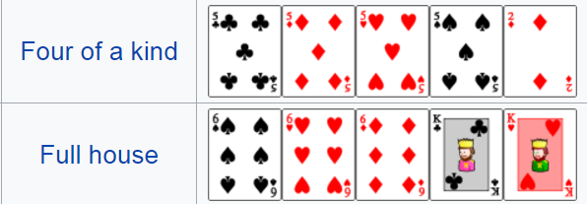
Poker Exercises 4
How many hands contain 4-of a kind?
Number of ways to select the kind of the 4-of a kind C(13,1).
Number of ways to select the 5th card: 48 (12 for the rank times 4 for the suit).
Total number is: 13⋅48
How many hands contain a full house?
Number of ways to select the 2 kinds C(13,2).
Number of ways to select the kind for the 3-of a kind C(2,1).
Number of ways to select the suits for the 3-of a kind C(4,3)
Number of ways to select the suits for the pair C(4,2).
Total number is: C(13,2)⋅C(2,1)⋅C(4,3) ⋅C(2,2)
Poker Hands: Royal Flush > Straight Flush > 4-of a kind > Full house > Flush > Straight > 3-of a kind > 2 pairs > 1 pair

Slide 29
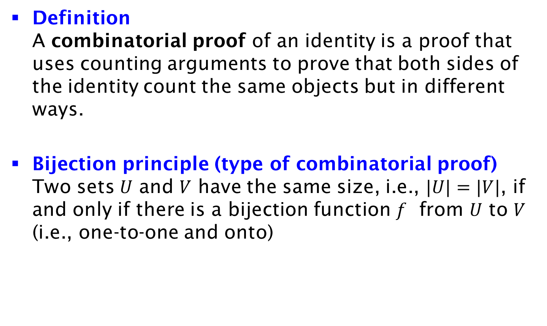
Combinatorial Proof and Bijection Principle
Definition
A combinatorial proof of an identity is a proof that uses counting arguments to prove that both sides of the identity count the same objects but in different ways.
Bijection principle (type of combinatorial proof)
Two sets $U$ and $V$ have the same size, i.e., $|U|=|V|$, if and only if there is a bijection function $f$ from $U$ to $V$ (i.e., one-to-one and onto)

Slide 30
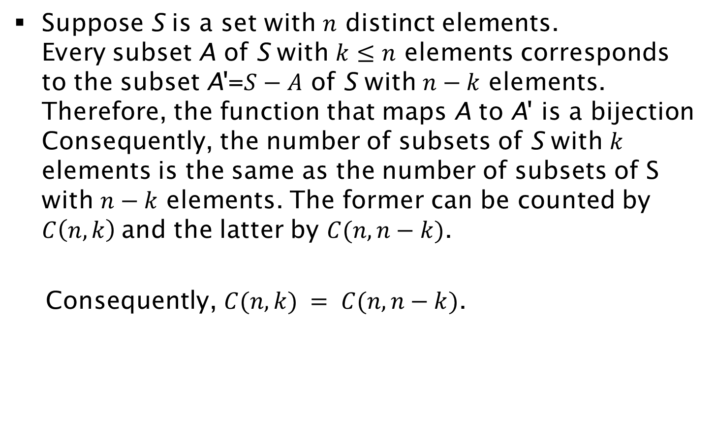

Proof of $C(n, k) = C(n, n−k)$ by Bijection Principle
Suppose S is a set with $n$ distinct elements.
Every subset A of S with $k≤n$ elements corresponds to the subset A'=$S−A$ of S with $n−k$ elements. Therefore, the function that maps A to A' is a bijection Consequently, the number of subsets of S with $k$ elements is the same as the number of subsets of S with $n−k$ elements. The former can be counted by $C\left(n, k\right)$and the latter by $C(n, n−k)$.
Consequently, $C(n, k) = C(n, n−k)$.

Slide 31
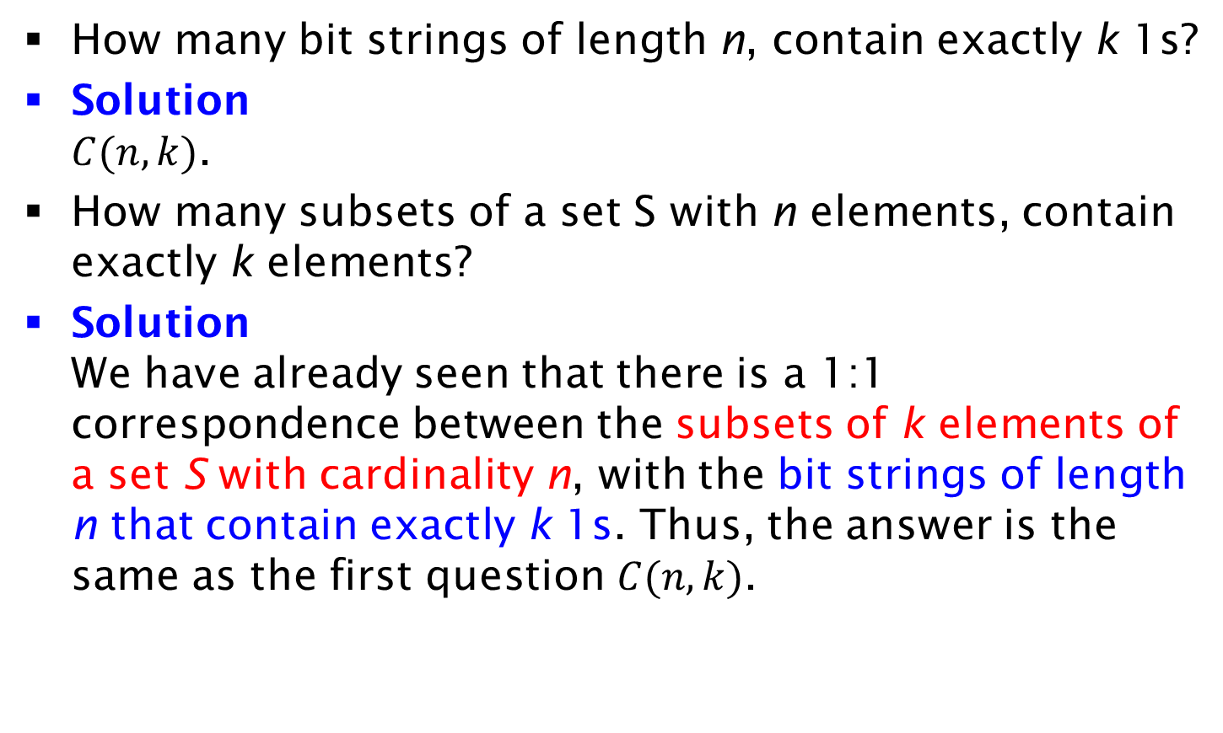
Example by Bijection Principle
How many bit strings of length n, contain exactly k 1s?
Solution
$C(n,k)$.
How many subsets of a set S with n elements, contain exactly k elements?
Solution
We have already seen that there is a 1:1 correspondence between the subsets of k elements of a set S with cardinality n, with the bit strings of length n that contain exactly k 1s. Thus, the answer is the same as the first question $C(n,k)$.

Slide 32
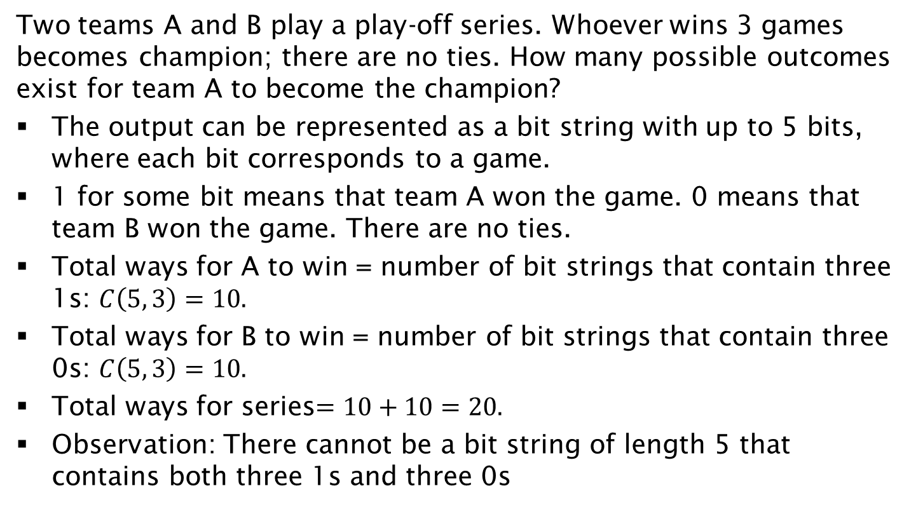
The Playoff Example (solved using tree diagrams in previous lecture)
Two teams A and B play a play-off series. Whoever wins 3 games becomes champion; there are no ties. How many possible outcomes exist for team A to become the champion?
The output can be represented as a bit string with up to 5 bits, where each bit corresponds to a game.
1 for some bit means that team A won the game. 0 means that team B won the game. There are no ties.
Total ways for A to win = number of bit strings that contain three 1s: $C\left(5, 3\right)=10.$
Total ways for B to win = number of bit strings that contain three 0s: $C\left(5, 3\right)=10.$
Total ways for series$=10+10=20.$
Observation: There cannot be a bit string of length 5 that contains both three 1s and three 0s

Slide 33
Exercise on Coin Flipping
How many ways are there to repeatedly flip a coin until the number of tails is more than the number of heads or the coin is flipped for five times? Example 1: The first flip is head, the second flip is tail and the third flip is tail. No fourth flip. Example 2: All the five flips are head.
Solution:
There are 2⁵ =32 bit-strings of length 5. Let 1 denote tails.
If the first flip is a tail you stop the experiment – i.e., you exclude 2⁴ bit-strings that start with 1.
The only other outcome where you stop the experiment before 5 flips is when the first 3 flips are HTT (i.e., 011). In this case, you exclude 01100, 01101, 01110, 01111. Thus, the total number of ways is: 2⁵-2⁴-4=12.
Add the two cases of early termination (1 and 011), the total is 12+2=14 ways.
Specifically, the possible strings are: 1, 011, 00000, 00001, 00010, 00011, 00100, 00101, 00110, 00111, 01000, 01001, 01010, 01011.

Slide 34
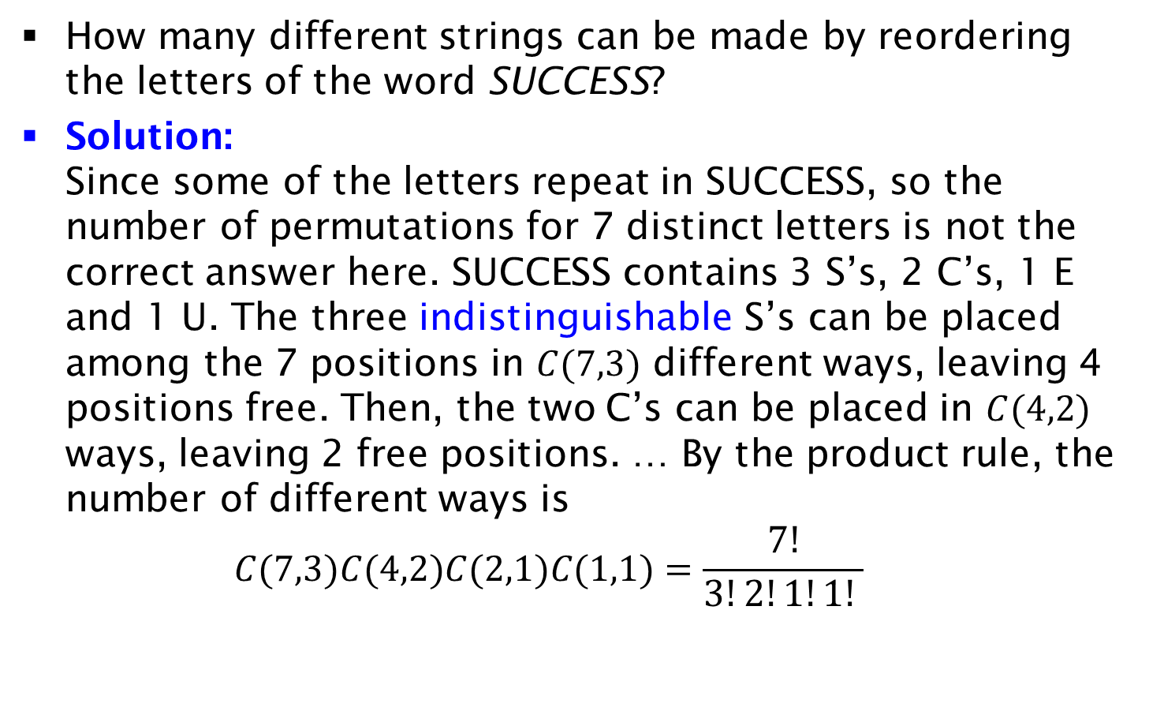
Permutations with Indistinguishable Objects
How many different strings can be made by reordering the letters of the word SUCCESS?
Solution:
Since some of the letters repeat in SUCCESS, so the number of permutations for 7 distinct letters is not the correct answer here. SUCCESS contains 3 S’s, 2 C’s, 1 E and 1 U. The three indistinguishable S’s can be placed among the 7 positions in $C(7,3)$ different ways, leaving 4 positions free. Then, the two C’s can be placed in $C(4,2)$ ways, leaving 2 free positions. … By the product rule, the number of different ways is
$C(7,3)C(4,2)C(2,1)C(1,1)=\frac{7!}{3!2!1!1! }$

Slide 35
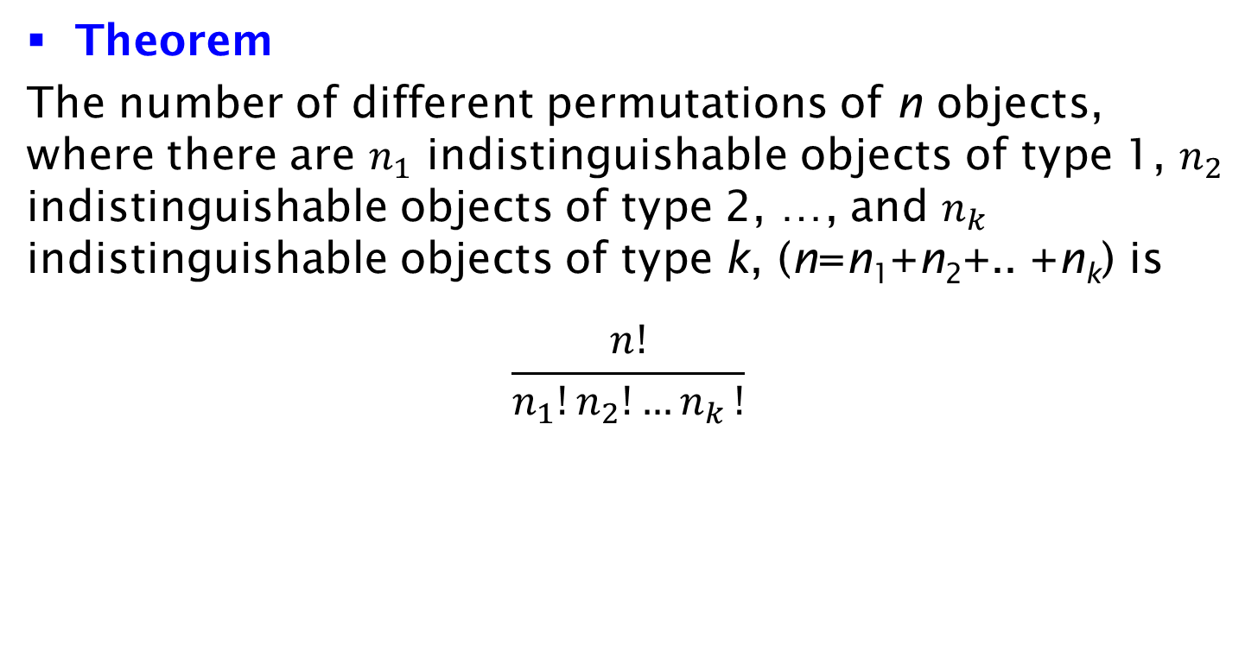
Permutations with Indistinguishable Objects
Theorem
The number of different permutations of n objects, where there are $n_{1}$ indistinguishable objects of type 1, $n_{2}$ indistinguishable objects of type 2, …, and $n_{k}$ indistinguishable objects of type k, (n=n₁+n₂+.. +n_{k}) is
$$\frac{n!}{n_{1}!n_{2}!{…n}_{k}!}$$

Slide 36
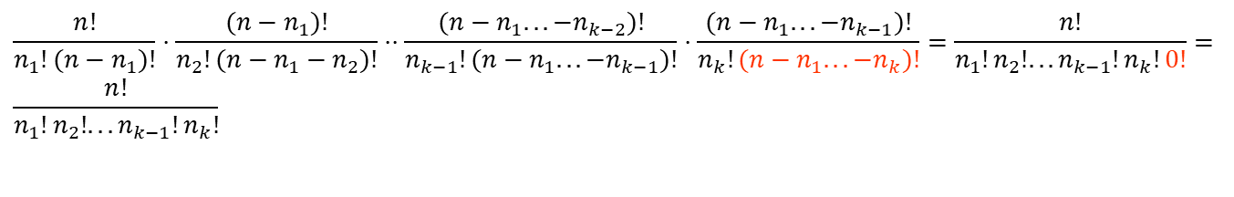
Proof of Theorem
The n₁ indistinguishable objects of type 1 can be placed among the n positions in C(n,n₁)=n!/n₁!(n-n₁)! ways.
The n₂ indistinguishable objects of type 2 can be placed among the (n-n₁) positions in C(n-n₁,n₂)=(n-n₁)!/n₂! (n-n₁-n₂)! ways.
….
The n_{k-1} indistinguishable objects of type k-1 can be placed among the (n-n₁-…-n_{k-2}) positions in C(n-n₁-…-n_{k-2}, n_{k-1})= (n-n₁-…-n_{k-2})!/ n_{k-1}! (n-n₁-n₂ …-n_{k-2}-n_{k-1})! ways.
The n_{k} indistinguishable objects of type k can be placed among the (n-n₁-…-n_{k-1}) positions in C(n-n₁-…-n_{k-1}, n_{k})= (n-n₁-…-n_{k-1})!/ n_{k}! (n-n₁-n₂ …-n_{k-1}-n_{k})! ways.
$$\frac{n!}{n_{1}!(n−n_{1})!}⋅\frac{(n−n_{1})!}{n_{2}!(n−n_{1}−n_{2})!}⋅⋅\frac{(n−n_{1}...−n_{k−2})!}{n_{k−1}!(n−n_{1}...−n_{k−1})!}⋅\frac{(n−n_{1}...−n_{k−1})!}{n_{k}!(n−n_{1}...−n_{k})!}=\frac{n!}{n_{1}!n_{2}!...n_{k−1}!n_{k}!0!}= \\ \frac{n!}{n_{1}!n_{2}!...n_{k−1}!n_{k}!}$$

Slide 37
Distributing Objects into Boxes
Many counting problems can be solved by enumerating the different ways objects can be placed into boxes where the order these objects are placed into the boxes does not matter.
The objects and the boxes can be either Distinguishable (labeled) or Indistinguishable (unlabeled).
Examples:
D-D: How many ways to place n labeled objects in m labeled boxes
D-I: How many ways to place n labeled objects in m unlabeled boxes
I-D: How many ways to place n unlabeled objects in m labeled boxes
I-I: How many ways to place n unlabeled objects in m unlabeled boxes

Slide 38
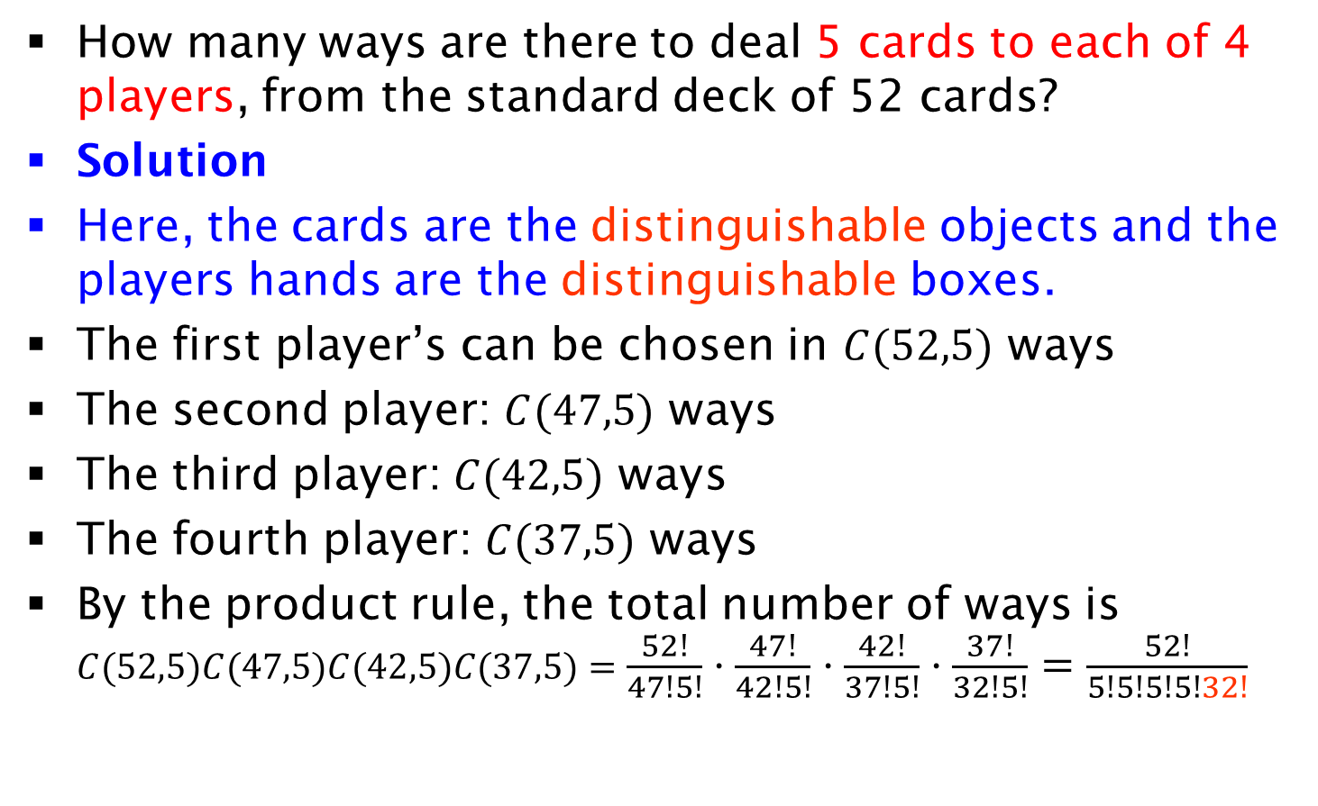
Distributing Objects into Boxes
How many ways are there to deal 5 cards to each of 4 players, from the standard deck of 52 cards?
Solution
Here, the cards are the distinguishable objects and the players hands are the distinguishable boxes.
The first player’s can be chosen in $C(52,5)$ ways
The second player: $C(47,5)$ ways
The third player: $C(42,5)$ ways
The fourth player: $C(37,5)$ ways
By the product rule, the total number of ways is $C(52,5)C(47,5)C(42,5)C(37,5)=\frac{52!}{47!5!}⋅\frac{47!}{42!5!}⋅\frac{42!}{37!5!}⋅\frac{37!}{32!5!}=\frac{52!}{5!5!5!5!32!}$

Slide 39
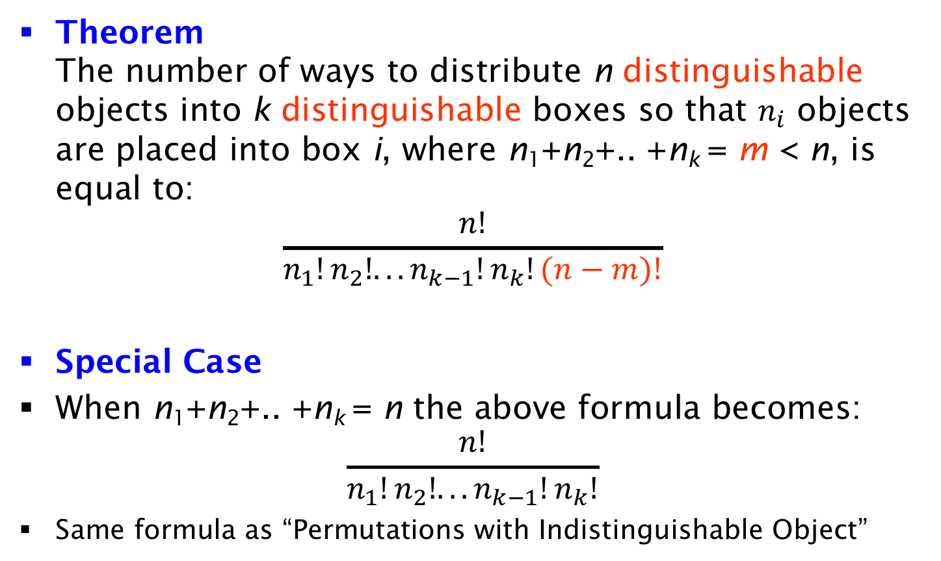
Distributing Objects into Boxes
Theorem
The number of ways to distribute n distinguishable objects into k distinguishable boxes so that $n_{i}$ objects are placed into box i, where n₁+n₂+.. +n_{k} = m < n, is equal to:
$$\frac{n!}{n_{1}!n_{2}!...n_{k−1}!n_{k}!(n−m)!}$$
Special Case
When n₁+n₂+.. +n_{k} = n the above formula becomes:
$$\frac{n!}{n_{1}!n_{2}!...n_{k−1}!n_{k}!}$$
Same formula as “Permutations with Indistinguishable Object”

Slide 40
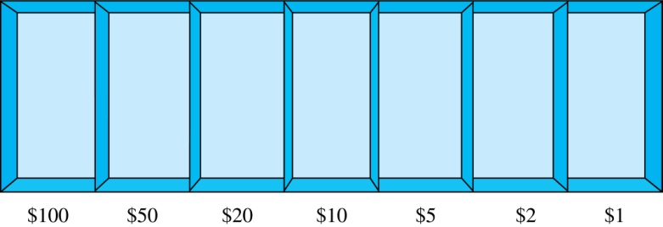
Combinations with Repetition
How many ways are there to select 5 bills from the following 7 denominations: $1, $2, $5, $10, $20, $50, and $100? Assume there are enough bills of each denomination
Solution
Select the bills from the appropriate position of a cash box illustrated below.
Equivalently, according to the "Distributing Objects into Boxes" framework, distribute 5 indistinguishable objects (bills) into 7 distinguishable boxes (denominations).

Slide 41
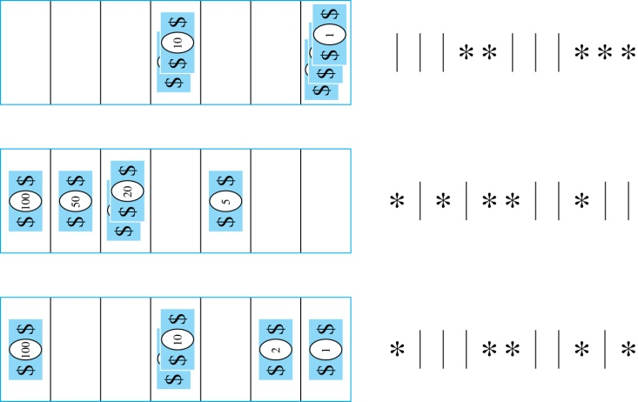
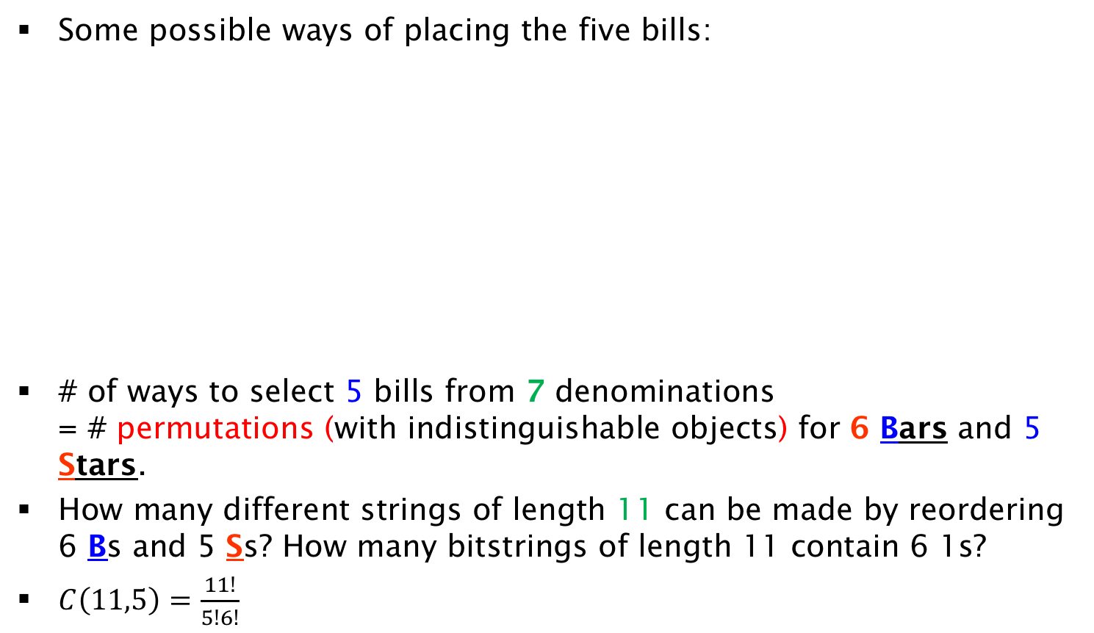
Solution
Some possible ways of placing the five bills:
# of ways to select 5 bills from 7 denominations
= # permutations (with indistinguishable objects) for 6 Bars and 5 Stars.
How many different strings of length 11 can be made by reordering 6 Bs and 5 Ss? How many bitstrings of length 11 contain 6 1s?
$C\left(11,5\right)=\frac{11!}{5!6!}$

Slide 42
Comments on the Bill Example
How many ways are there to select 5 bills from 7 denominations, assuming there are enough bills of each denomination
An alternative solution
Given that there are 7 choices for the first bill, 7 choices for the second bill,…., 7 choices for the fifth bill, somebody could argue that
The total number of ways is 7⁵.
What is wrong with this solution?
Lets take a choice by the alternative solution : e.g., (7,7,1,1,1) means that for the first 3 bills, I select the first denomination, while for the next 2, I select the 7th.
Any other choice, e.g., (1,7,1,1,7) with the same number of 1s and 7 is considered distinct by the alternative solution.
But it should not be distinct because the order in which the bills are selected is not important. Bills of the same denomination are indistinguishable.
The bars and stars representation eliminates this problem.
All choices with three 1s and two 7s have the same representation and are counted once.
Representation of (1,7,1,1,7) (7,7,1,1,1) and all equivalent choices using bars and stars:**||||||***

Slide 43
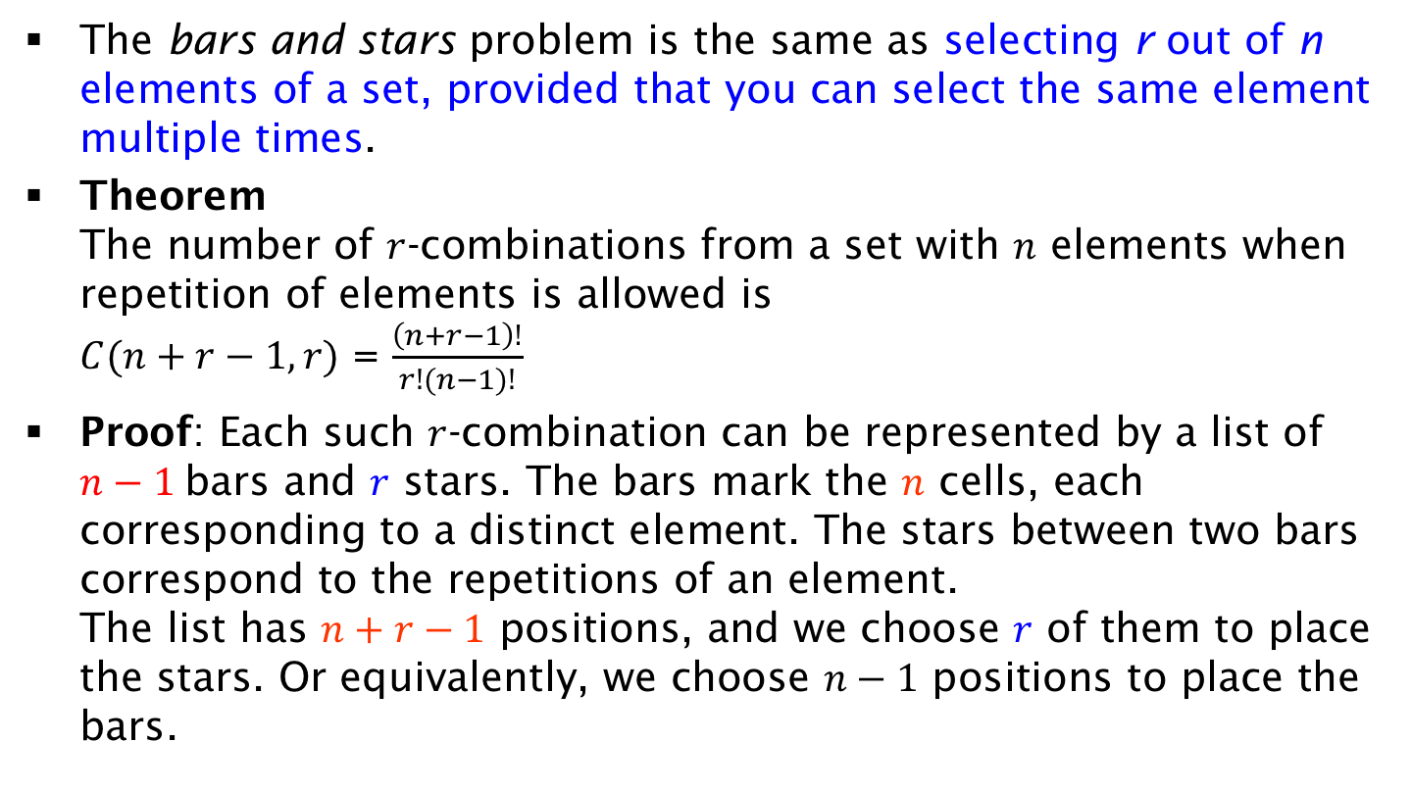
Combinations with Repetition (bars and stars)
The bars and stars problem is the same as selecting r out of n elements of a set, provided that you can select the same element multiple times.
Theorem
The number of $r$-combinations from a set with $n$ elements when repetition of elements is allowed is
$C(n+r−1,r)$ = $\frac{\left(n+r−1\right)!}{r!(n−1)!}$
Proof: Each such $r$-combination can be represented by a list of $n−1$ bars and $r$ stars. The bars mark the $n$ cells, each corresponding to a distinct element. The stars between two bars correspond to the repetitions of an element.
The list has $n+r−1$ positions, and we choose $r$ of them to place the stars. Or equivalently, we choose $n−1$ positions to place the bars.

Slide 44
Combinations with Repetition - Cookies
Suppose that a cookie shop has n different kinds of cookies. In how many different ways can r cookies be chosen? There are no constraints on how many cookies of each kind are chosen (e.g., all may be of the same kind)
Solution
Equivalently, I wish to distribute r indistinguishable cookies to n distinguishable cookie boxes.
I indicate cookies with r stars. Instead of n boxes, I use n-1 bars to indicate their boundaries.
A selection corresponds to a bars and stars arrangement
Example: **|*|*|** (2 cookies from first and fourth kind, 1 from the rest).
# of arrangements = # combinations with repetition =
= # strings of length (r+n-1) by reordering r stars and n-1 bars =
# select positions of r stars and among possible (r+n-1) positions
C(r+n-1,r)=(r+n-1)!/r!(n-1)!.

Slide 45
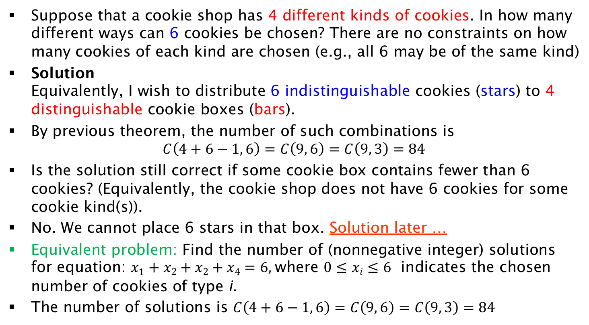
Example of Combinations with Repetition
Suppose that a cookie shop has 4 different kinds of cookies. In how many different ways can 6 cookies be chosen? There are no constraints on how many cookies of each kind are chosen (e.g., all 6 may be of the same kind)
Solution
Equivalently, I wish to distribute 6 indistinguishable cookies (stars) to 4 distinguishable cookie boxes (bars).
By previous theorem, the number of such combinations is
$C\left(4+6−1, 6\right)=C\left(9, 6\right)=C\left(9, 3\right)=84$
Is the solution still correct if some cookie box contains fewer than 6 cookies? (Equivalently, the cookie shop does not have 6 cookies for some cookie kind(s)).
No. We cannot place 6 stars in that box. Solution later …
Equivalent problem: Find the number of (nonnegative integer) solutions for equation: $x_{1}+x2+x2+x4=6$, where $0≤xi≤6$ indicates the chosen number of cookies of type i.
The number of solutions is $C\left(4+6−1, 6\right)=C\left(9, 6\right)=C\left(9, 3\right)=84$

Slide 46
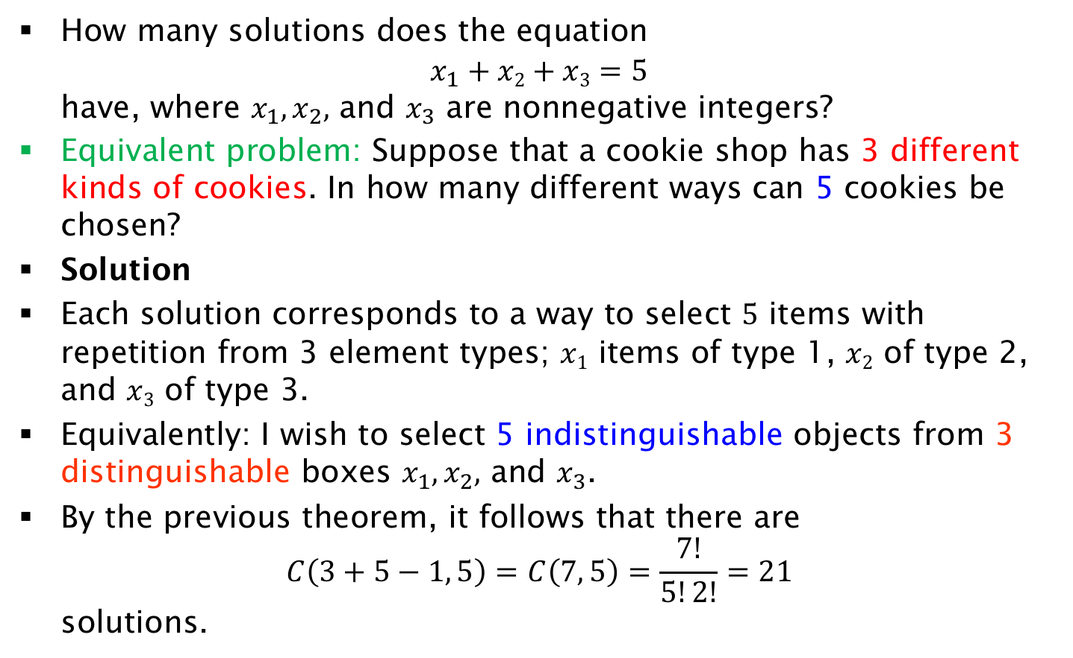
Exercise on Equation Solutions
How many solutions does the equation
$x_{1}+x2+x3=5$
have, where $x_{1},x_{2},$ and $x_{3}$ are nonnegative integers?
Equivalent problem: Suppose that a cookie shop has 3 different kinds of cookies. In how many different ways can 5 cookies be chosen?
Solution
Each solution corresponds to a way to select 5 items with repetition from 3 element types; $x1$ items of type 1, $x2$ of type 2, and $x3$ of type 3.
Equivalently: I wish to select 5 indistinguishable objects from 3 distinguishable boxes $x_{1},x_{2},$ and $x_{3}$.
By the previous theorem, it follows that there are
$C\left(3+5−1, 5\right)=C\left(7, 5\right)=\frac{7!}{5!2!}=21$
solutions.

Slide 47
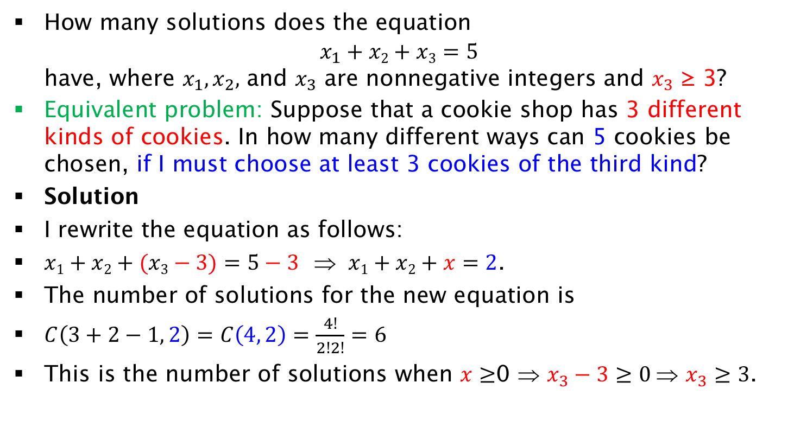
Exercise on Equation Solutions with minimum constraint
How many solutions does the equation
$x_{1}+x2+x3=5$
have, where $x_{1},x_{2},$ and $x_{3}$ are nonnegative integers and $x_{3}$ ≥ 3?
Equivalent problem: Suppose that a cookie shop has 3 different kinds of cookies. In how many different ways can 5 cookies be chosen, if I must choose at least 3 cookies of the third kind?
Solution
I rewrite the equation as follows:
$x1+x2+(x3−3)=5−3$ ⇒ $x1+x2+x=2$.
The number of solutions for the new equation is
$C\left(3+2−1, 2\right)=C\left(4, 2\right)=\frac{4!}{2!2!}=6$
This is the number of solutions when $x≥$0 ⇒ $x_{3}−3≥0 \text{⇒} x_{3}≥3$.

Slide 48
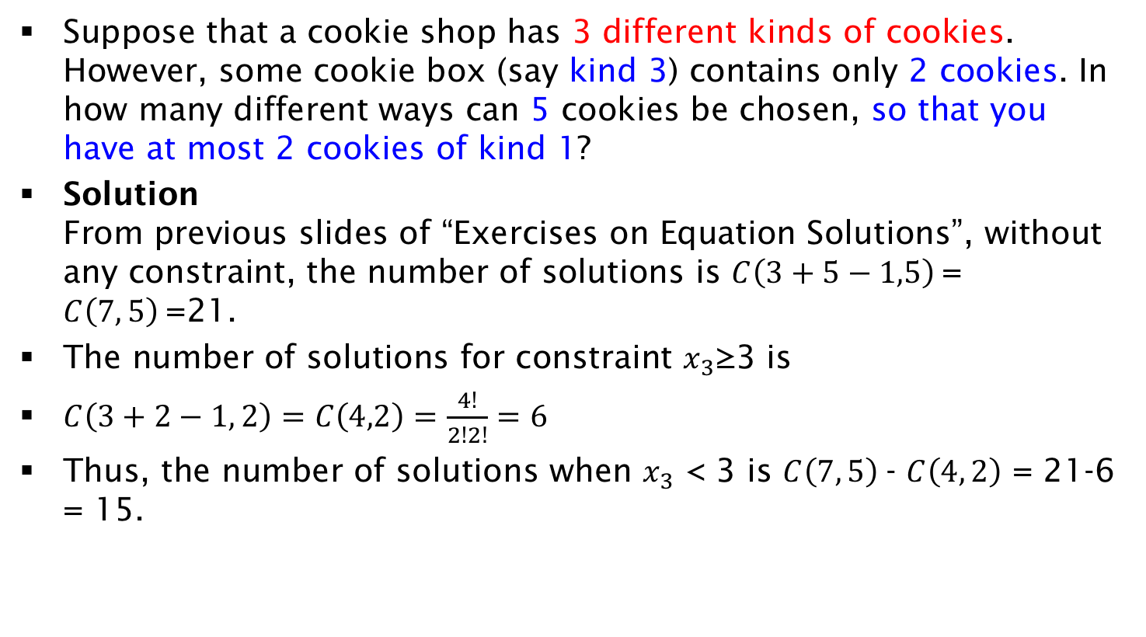
Exercise on Equation Solutions with maximum constraint
Suppose that a cookie shop has 3 different kinds of cookies. However, some cookie box (say kind 3) contains only 2 cookies. In how many different ways can 5 cookies be chosen, so that you have at most 2 cookies of kind 1?
Solution
From previous slides of “Exercises on Equation Solutions”, without any constraint, the number of solutions is $C\left(3+5−1,5\right)$= $C\left(7, 5\right)$=21.
The number of solutions for constraint $x_{3}$≥3 is
$C\left(3+2−1, 2\right)=C\left(4,2\right)=\frac{4!}{2!2!}=6$
Thus, the number of solutions when $x_{3}$ < 3 is $C\left(7, 5\right)$- $C\left(4, 2\right)$ = 21-6 = 15.

Slide 49
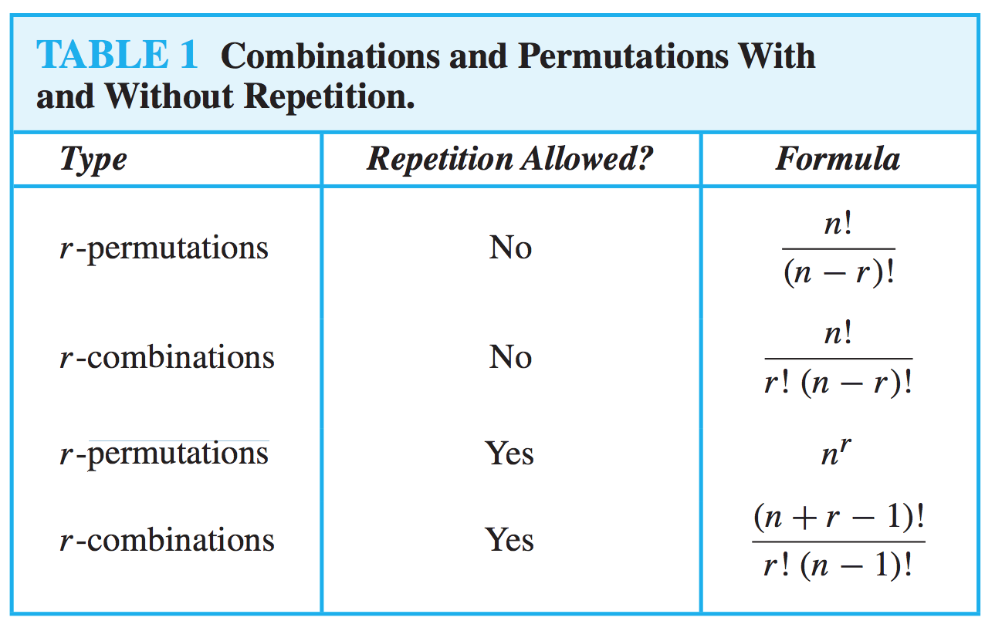
Summary

Slide 50
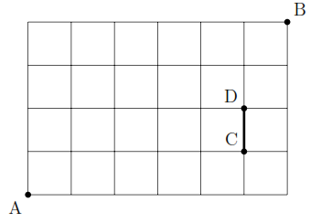
Exercise on Paths 1
In the following picture, starting from A we wish to reach B, by taking edges Up or Right. How many different paths (two paths are different if they differ in at least one edge) exist from A to B such that.
(i)There are no restrictions. Hint: Any path from A to B is a combination of Up and Right moves for a total of 10.
  Each path from A to B contains 10 edges, 4 of which must go up. Finding a specific path is just a matter of deciding when to take the up moves out of the 10 total available moves: C(10, 4) ways. The rest must go right.
(ii) You have to pass from CD edge.
  6 (ways from A to C) x 3 (ways from D to B) = 18
(iii) You can not pass from CD edge.
  C(10, 4) - 18

Slide 51
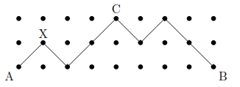
Exercise on Paths 2
Consider the following picture. You are only allowed to move ↗ (one to the right and up) and ↘ (one to the right and down) only. In how many ways you can get from A to B such that:
(i) There are no restrictions. Hint: Note that in order to get from A to B you have to pass from some certain points like X.
The path has to pass from the middle point (e.g., X) of every other column. There are 4 such points (in red). The path between any two successive red points has only two options (top or bottom row). Total number of paths 2³.
(ii) You want to pass from C.
2 (ways from A to C) x 2 (ways from C to B) = 4

