Slide 1
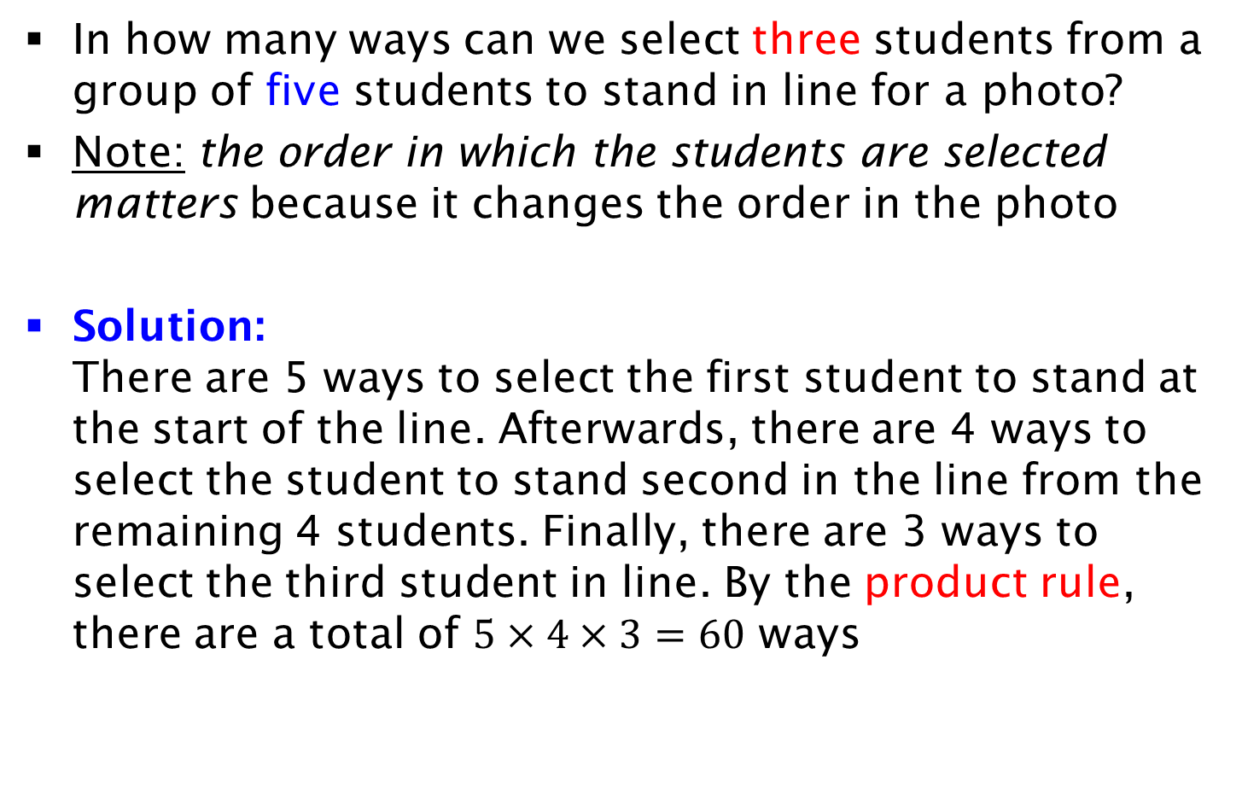
Permutations
In how many ways can we select three students from a group of five students to stand in line for a photo?
Note: the order in which the students are selected matters because it changes the order in the photo
Solution:
There are 5 ways to select the first student to stand at the start of the line. Afterwards, there are 4 ways to select the student to stand second in the line from the remaining 4 students. Finally, there are 3 ways to select the third student in line. By the product rule, there are a total of $5×4×3=60$ ways

