Slide 1
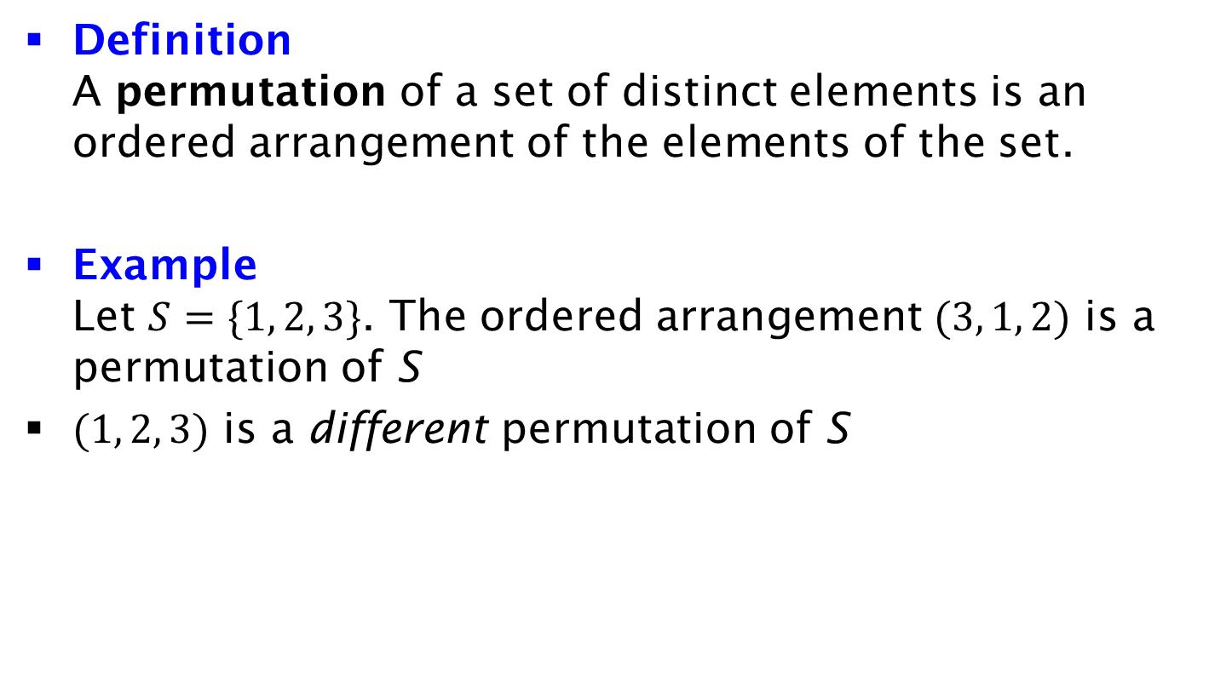
Permutation
Definition
A permutation of a set of distinct elements is an ordered arrangement of the elements of the set.
Example
Let $S=\{1, 2, 3\}$. The ordered arrangement $(3, 1, 2)$ is a permutation of S
$(1, 2, 3)$ is a different permutation of S

