Slide 1
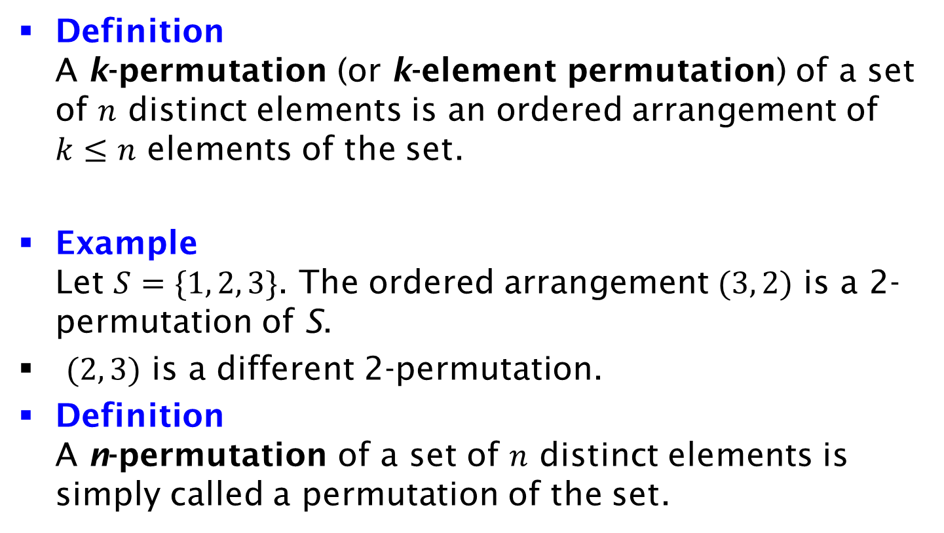
k-Permutation
Definition
A k-permutation (or k-element permutation) of a set of $n$ distinct elements is an ordered arrangement of $k≤n$ elements of the set.
Example
Let $S=\{1, 2, 3\}$. The ordered arrangement $(3, 2)$ is a 2-permutation of S.
$(2, 3)$ is a different 2-permutation.
Definition
A n-permutation of a set of $n$ distinct elements is simply called a permutation of the set.

