Slide 1
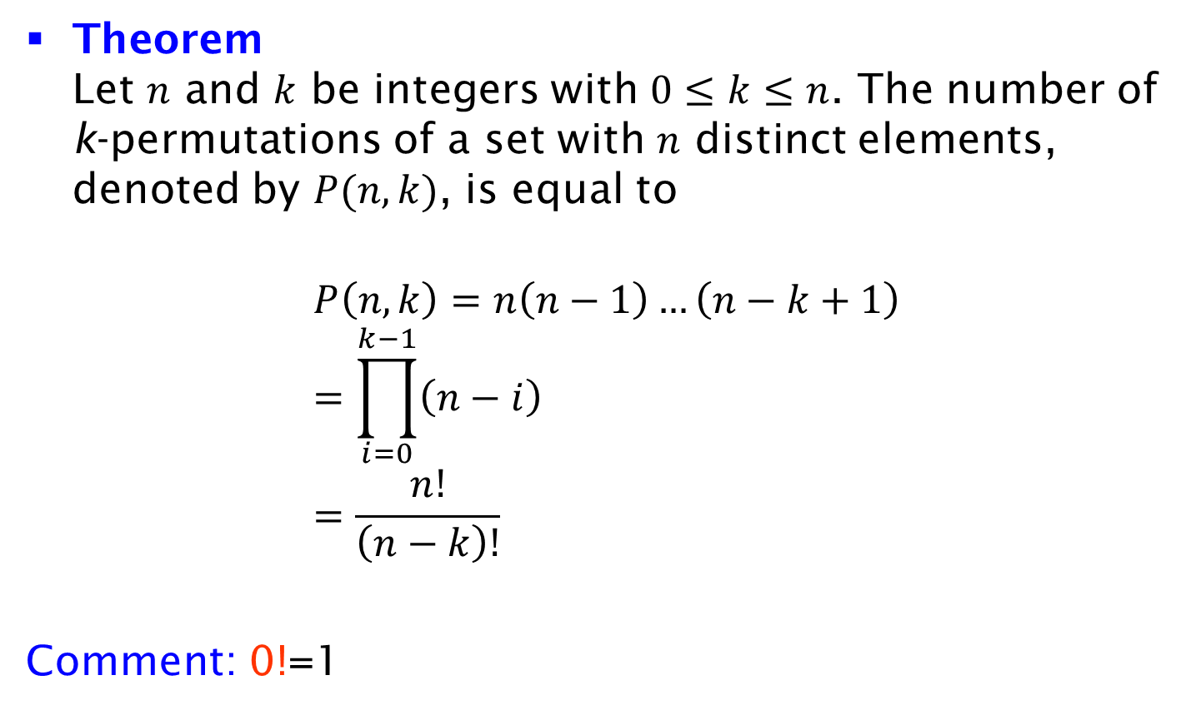
Number of k-Permutations
Theorem
Let $n$ and $k$ be integers with $0≤k≤n$. The number of k-permutations of a set with $n$ distinct elements, denoted by $P(n, k)$, is equal to
$$P\left(n, k\right)=n\left(n−1\right)…\left(n−k+1\right) \\ =\prod_{i=0}^{k−1}{\left(n−i\right)} \\ =\frac{n!}{\left(n−k\right)!}$$
Comment: 0!=1

