Slide 1
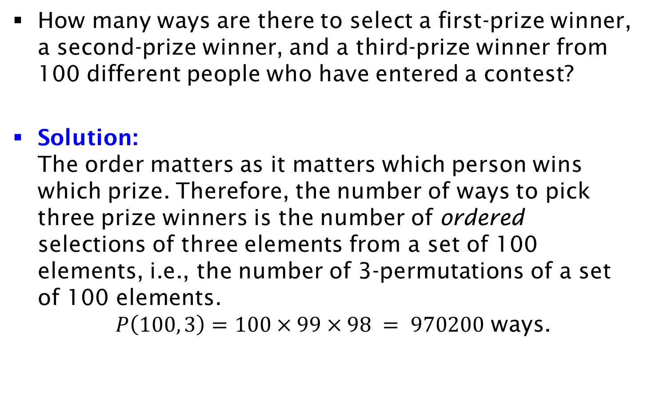
Example
How many ways are there to select a first-prize winner, a second-prize winner, and a third-prize winner from 100 different people who have entered a contest?
Solution:
The order matters as it matters which person wins which prize. Therefore, the number of ways to pick three prize winners is the number of ordered selections of three elements from a set of 100 elements, i.e., the number of 3-permutations of a set of 100 elements.
$P\left(100, 3\right)=100×99×98 = 970200$ ways.

