Slide 1
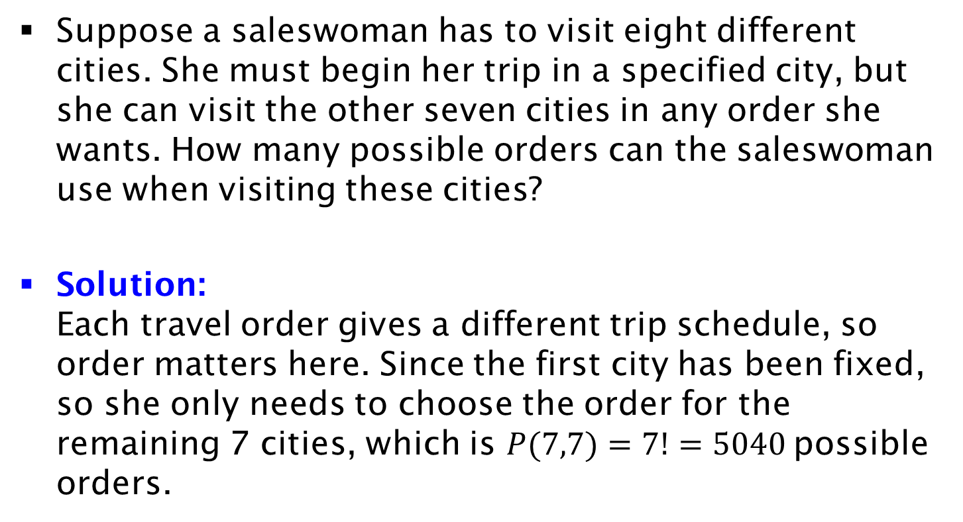
Example
Suppose a saleswoman has to visit eight different cities. She must begin her trip in a specified city, but she can visit the other seven cities in any order she wants. How many possible orders can the saleswoman use when visiting these cities?
Solution:
Each travel order gives a different trip schedule, so order matters here. Since the first city has been fixed, so she only needs to choose the order for the remaining 7 cities, which is $P(7,7)=7!=5040$possible orders.

