Slide 1
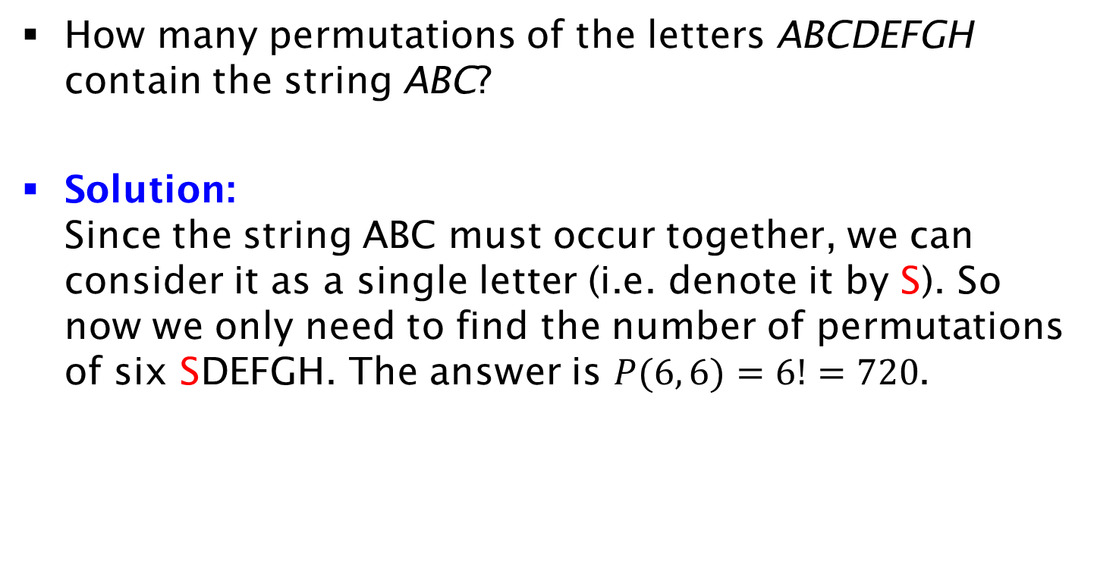
Exercise on Strings
How many permutations of the letters ABCDEFGH contain the string ABC?
Solution:
Since the string ABC must occur together, we can consider it as a single letter (i.e. denote it by S). So now we only need to find the number of permutations of six SDEFGH. The answer is $P(6, 6)=6!=720$.

