Slide 1
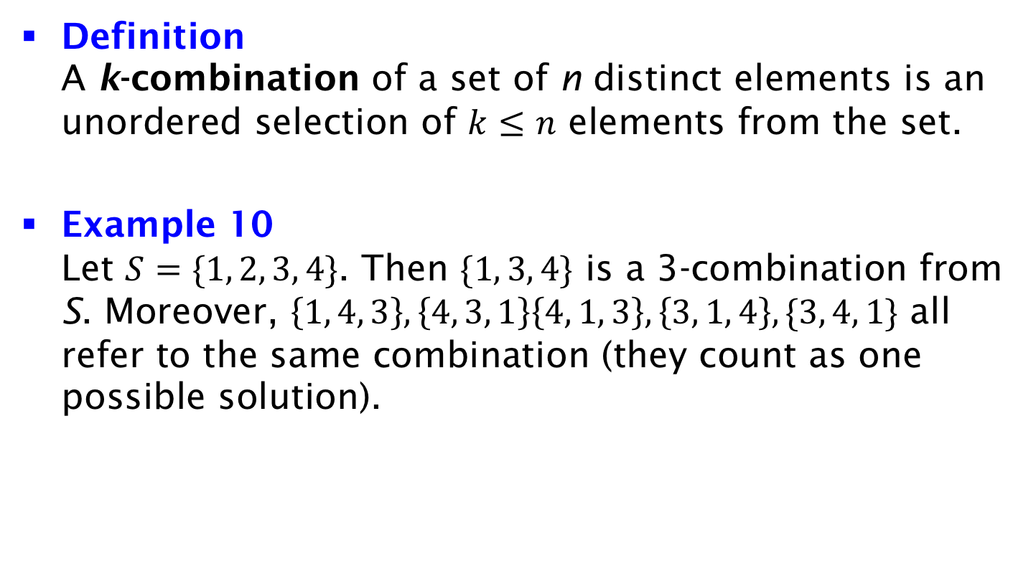
k-Combinations
Definition
A k-combination of a set of n distinct elements is an unordered selection of $k≤n$ elements from the set.
Example 10
Let $S=\{1, 2, 3, 4\}$. Then $\{1, 3, 4\}$ is a 3-combination from S. Moreover, $\left\{1, 4, 3\right\},\left\{4, 3, 1\right\}\left\{4, 1, 3\right\},\left\{3, 1, 4\right\},\{3, 4, 1\}$ all refer to the same combination (they count as one possible solution).

