Slide 1
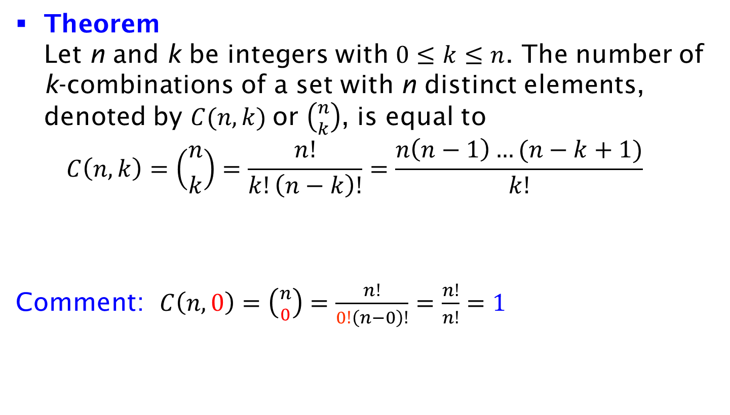
Number of k-Combinations
Theorem
Let n and k be integers with $0≤k≤n$. The number of k-combinations of a set with n distinct elements, denoted by $C(n, k)$or $\left({n \atop k}\right)$, is equal to
$C\left(n, k\right)=\left({n \atop k}\right)=\frac{n!}{k!\left(n−k\right)!}=\frac{n\left(n−1\right)…(n−k+1)}{k!}$
Comment: $C\left(n, 0\right)=\left({n \atop 0}\right)=\frac{n!}{0!\left(n−0\right)!}=\frac{n!}{n!}=1$

