Slide 1
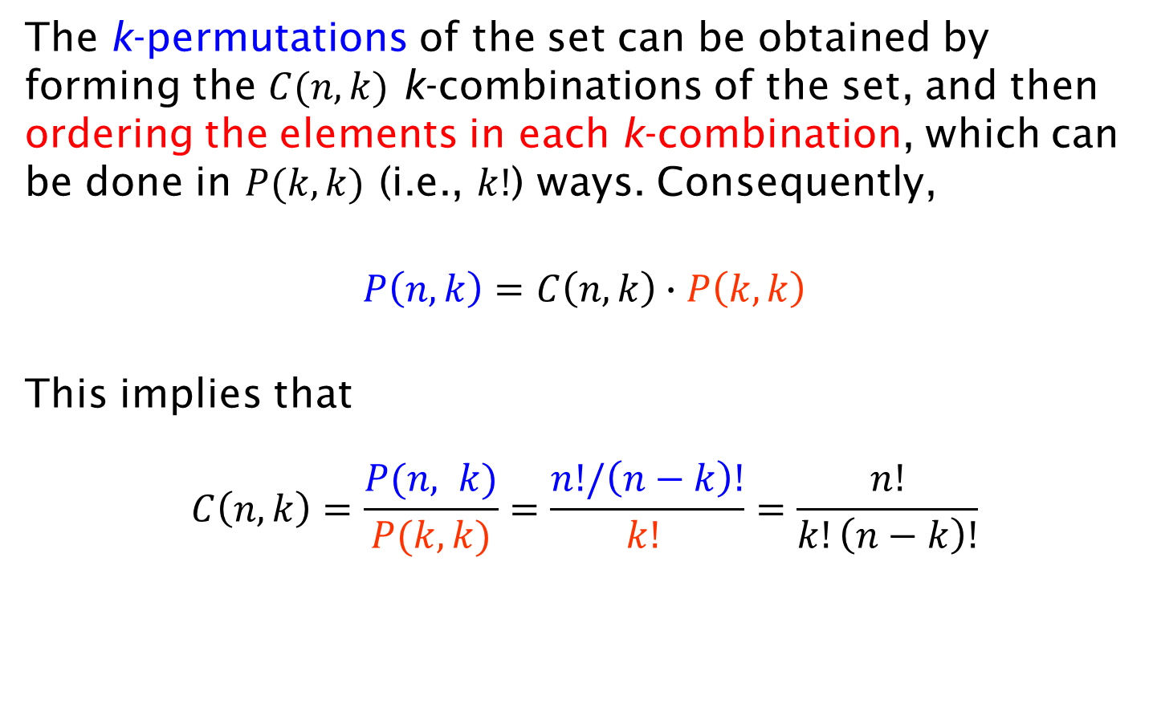
Proof
The k-permutations of the set can be obtained by forming the $C(n, k)$ k-combinations of the set, and then ordering the elements in each k-combination, which can be done in $P(k, k)$ (i.e., $k!$) ways. Consequently,
$$P\left(n, k\right)=C\left(n, k\right)∙P\left(k,k\right)$$
This implies that
$$C\left(n, k\right)=\frac{P(n, k)}{P(k,k)}=\frac{n!/\left(n−k\right)!}{k! }=\frac{n!}{k!\left(n−k\right)!}$$

