Slide 1
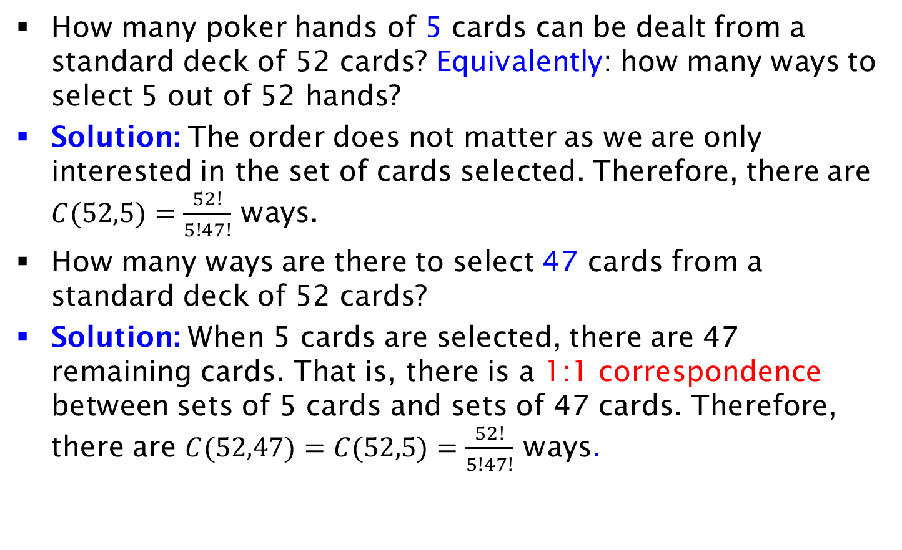
Example
How many poker hands of 5 cards can be dealt from a standard deck of 52 cards? Equivalently: how many ways to select 5 out of 52 hands?
Solution: The order does not matter as we are only interested in the set of cards selected. Therefore, there are $C(52,5)=\frac{52!}{5!47!}$ ways.
How many ways are there to select 47 cards from a standard deck of 52 cards?
Solution: When 5 cards are selected, there are 47 remaining cards. That is, there is a 1:1 correspondence between sets of 5 cards and sets of 47 cards. Therefore, there are $C(52,47)=C(52,5)=\frac{52!}{5!47!}$ ways.

