Slide 1
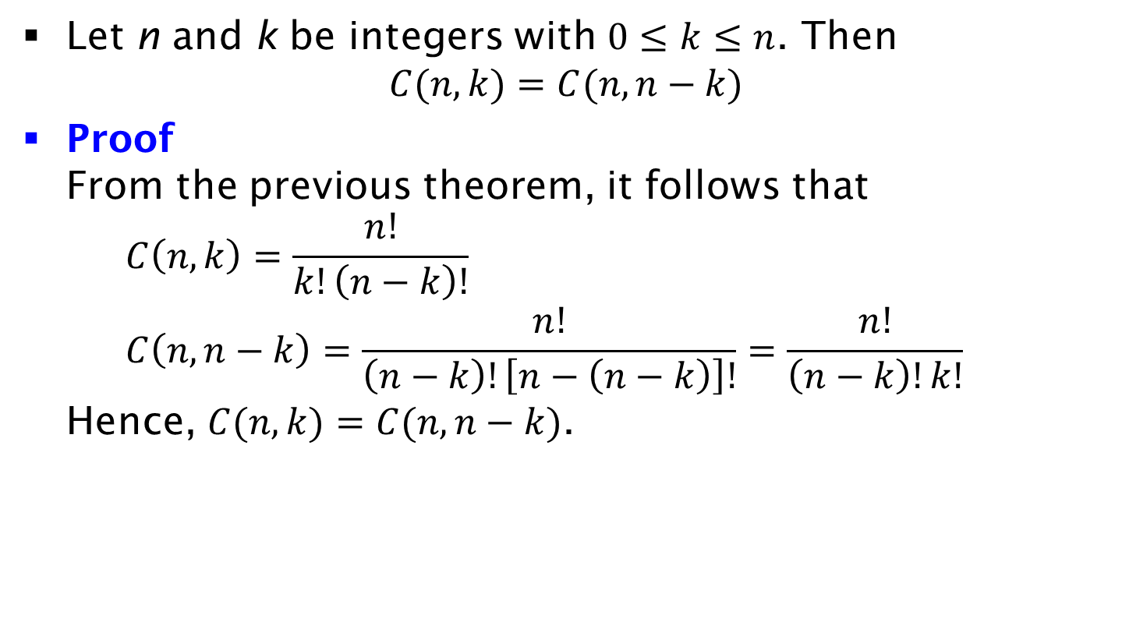
Corollary
Let n and k be integers with $0≤k≤n$. Then
$C(n, k)=C(n, n−k)$
Proof
From the previous theorem, it follows that
$C\left(n,k\right)=\frac{n!}{k!\left(n−k\right)!}$
$C\left(n,n−k\right)=\frac{n!}{\left(n−k\right)!\left[n−\left(n−k\right)\right]!}=\frac{n!}{\left(n−k\right)!k!}$
Hence, $C(n, k)=C(n, n−k)$.

