Slide 1
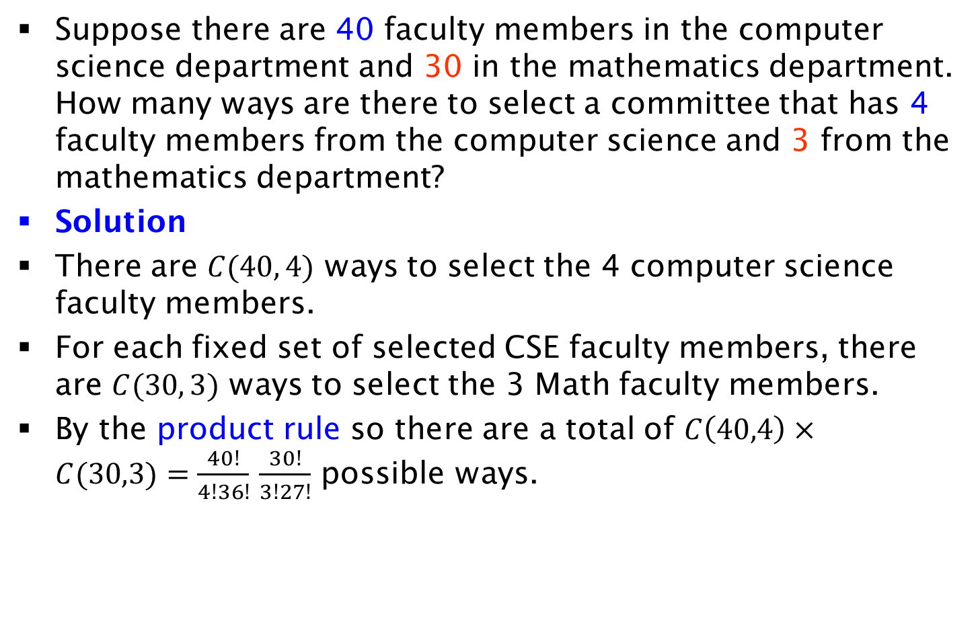
Exercise on Committee Selection
Suppose there are 40 faculty members in the computer science department and 30 in the mathematics department. How many ways are there to select a committee that has 4 faculty members from the computer science and 3 from the mathematics department?
Solution
There are $C(40, 4)$ ways to select the 4 computer science faculty members.
For each fixed set of selected CSE faculty members, there are $C(30, 3)$ ways to select the 3 Math faculty members.
By the product rule so there are a total of $C\left(40,4\right)×C(30,3)=\frac{40!}{4!36!}$ $\frac{30!}{3!27!}$ possible ways.

