Slide 1
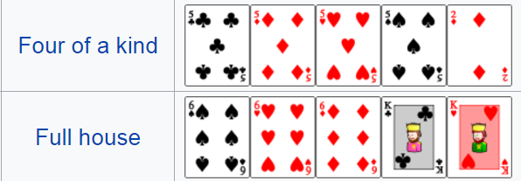
Poker Exercises 4
How many hands contain 4-of a kind?
Number of ways to select the kind of the 4-of a kind C(13,1).
Number of ways to select the 5th card: 48 (12 for the rank times 4 for the suit).
Total number is: 13⋅48
How many hands contain a full house?
Number of ways to select the 2 kinds C(13,2).
Number of ways to select the kind for the 3-of a kind C(2,1).
Number of ways to select the suits for the 3-of a kind C(4,3)
Number of ways to select the suits for the pair C(4,2).
Total number is: C(13,2)⋅C(2,1)⋅C(4,3) ⋅C(2,2)
Poker Hands: Royal Flush > Straight Flush > 4-of a kind > Full house > Flush > Straight > 3-of a kind > 2 pairs > 1 pair

