Slide 1
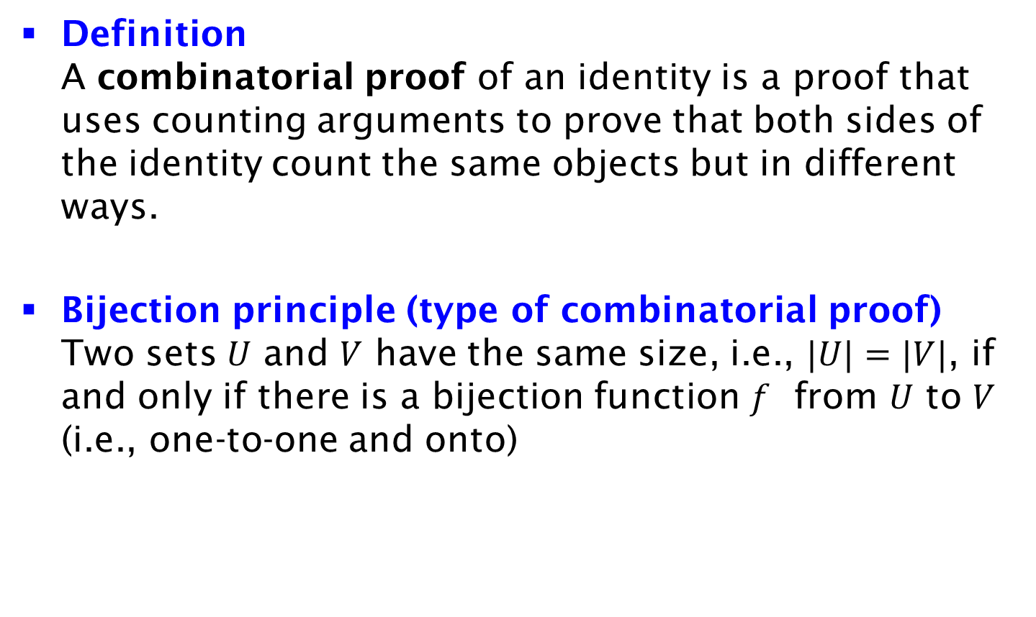
Combinatorial Proof and Bijection Principle
Definition
A combinatorial proof of an identity is a proof that uses counting arguments to prove that both sides of the identity count the same objects but in different ways.
Bijection principle (type of combinatorial proof)
Two sets $U$ and $V$ have the same size, i.e., $|U|=|V|$, if and only if there is a bijection function $f$ from $U$ to $V$ (i.e., one-to-one and onto)

