Slide 1
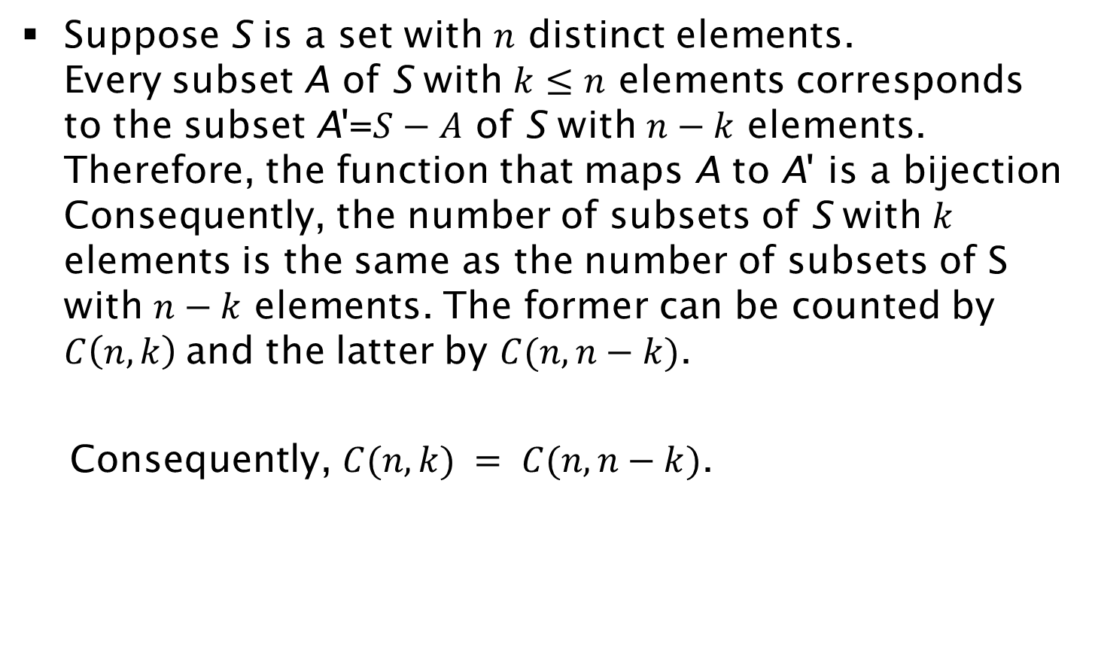

Proof of $C(n, k) = C(n, n−k)$ by Bijection Principle
Suppose S is a set with $n$ distinct elements.
Every subset A of S with $k≤n$ elements corresponds to the subset A'=$S−A$ of S with $n−k$ elements. Therefore, the function that maps A to A' is a bijection Consequently, the number of subsets of S with $k$ elements is the same as the number of subsets of S with $n−k$ elements. The former can be counted by $C\left(n, k\right)$and the latter by $C(n, n−k)$.
Consequently, $C(n, k) = C(n, n−k)$.

