Slide 1
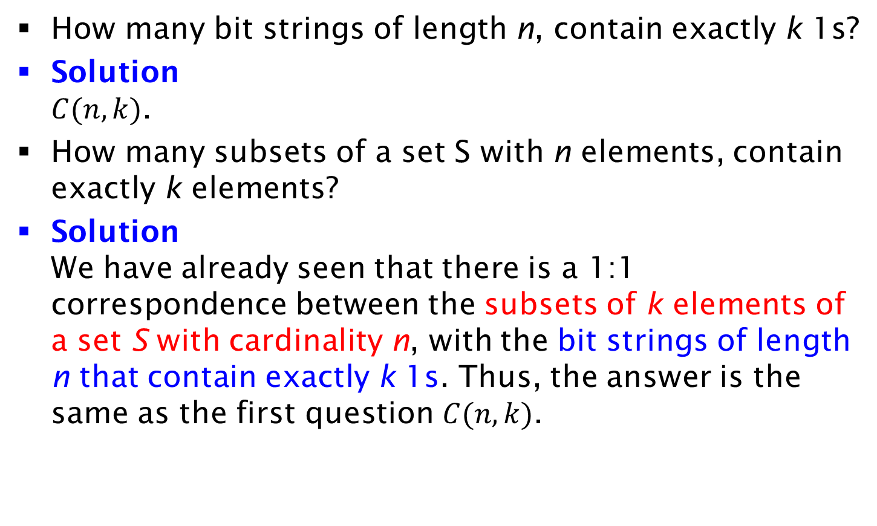
Example by Bijection Principle
How many bit strings of length n, contain exactly k 1s?
Solution
$C(n,k)$.
How many subsets of a set S with n elements, contain exactly k elements?
Solution
We have already seen that there is a 1:1 correspondence between the subsets of k elements of a set S with cardinality n, with the bit strings of length n that contain exactly k 1s. Thus, the answer is the same as the first question $C(n,k)$.

