Slide 1
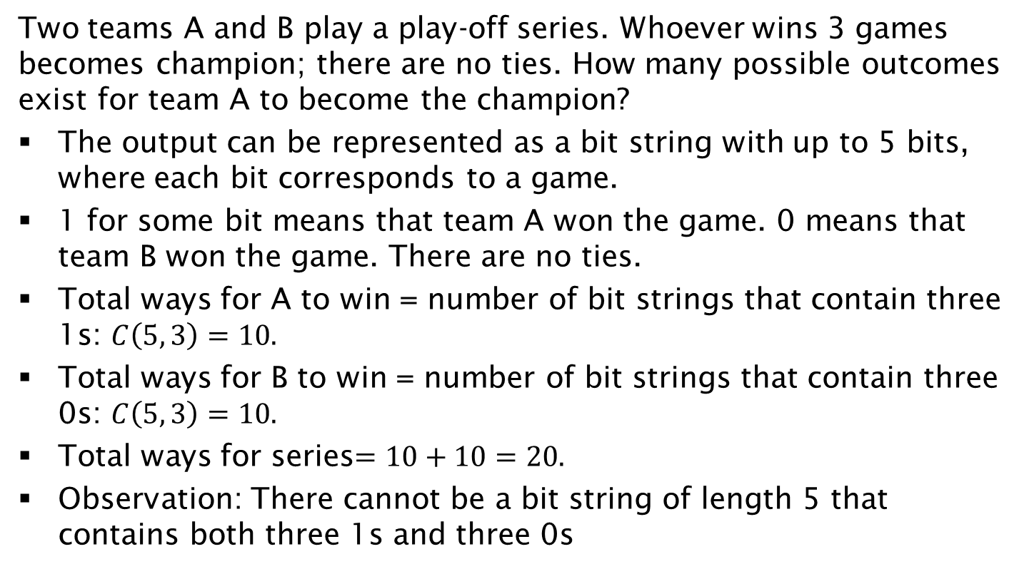
The Playoff Example (solved using tree diagrams in previous lecture)
Two teams A and B play a play-off series. Whoever wins 3 games becomes champion; there are no ties. How many possible outcomes exist for team A to become the champion?
The output can be represented as a bit string with up to 5 bits, where each bit corresponds to a game.
1 for some bit means that team A won the game. 0 means that team B won the game. There are no ties.
Total ways for A to win = number of bit strings that contain three 1s: $C\left(5, 3\right)=10.$
Total ways for B to win = number of bit strings that contain three 0s: $C\left(5, 3\right)=10.$
Total ways for series$=10+10=20.$
Observation: There cannot be a bit string of length 5 that contains both three 1s and three 0s

