Slide 1
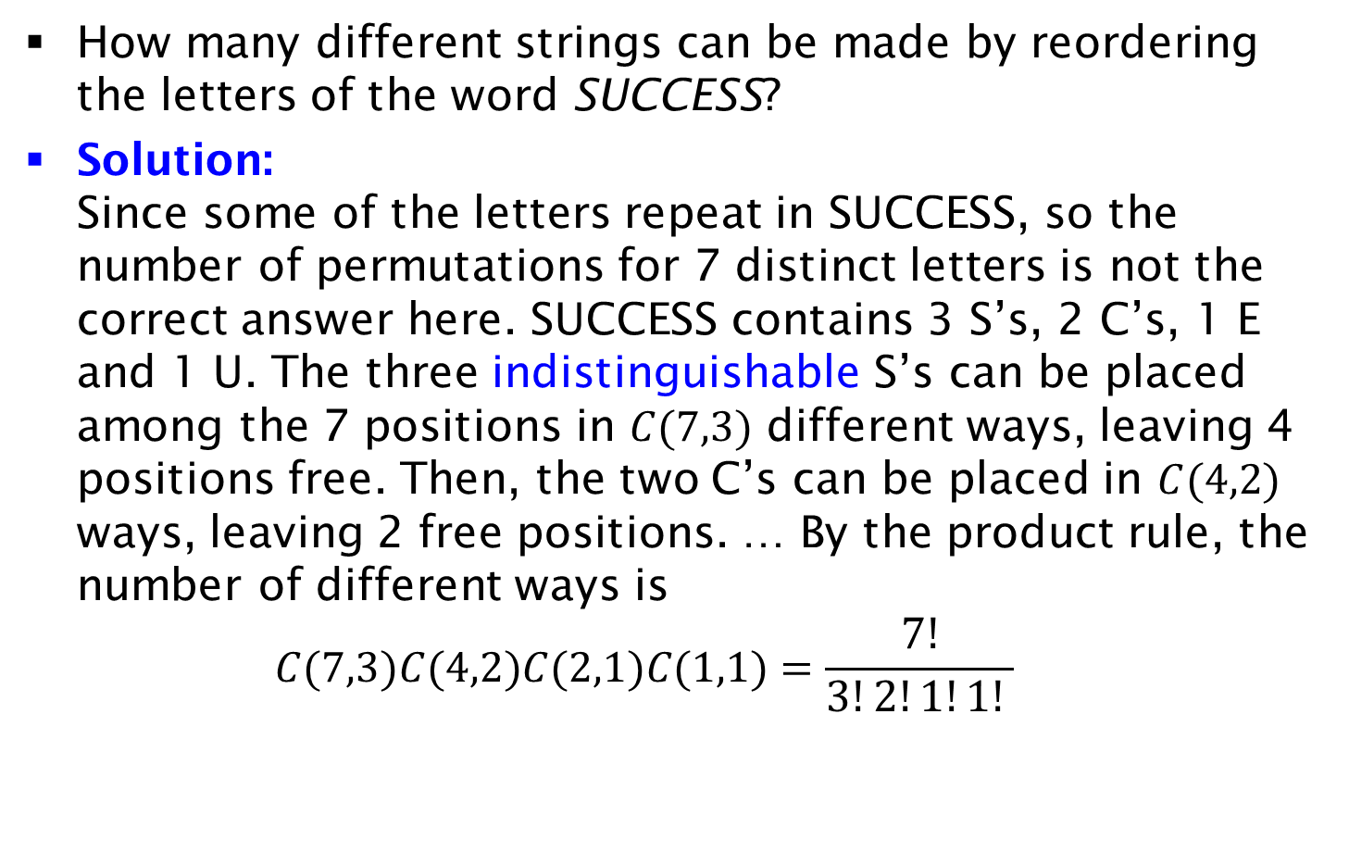
Permutations with Indistinguishable Objects
How many different strings can be made by reordering the letters of the word SUCCESS?
Solution:
Since some of the letters repeat in SUCCESS, so the number of permutations for 7 distinct letters is not the correct answer here. SUCCESS contains 3 S’s, 2 C’s, 1 E and 1 U. The three indistinguishable S’s can be placed among the 7 positions in $C(7,3)$ different ways, leaving 4 positions free. Then, the two C’s can be placed in $C(4,2)$ ways, leaving 2 free positions. … By the product rule, the number of different ways is
$C(7,3)C(4,2)C(2,1)C(1,1)=\frac{7!}{3!2!1!1! }$

