Slide 1
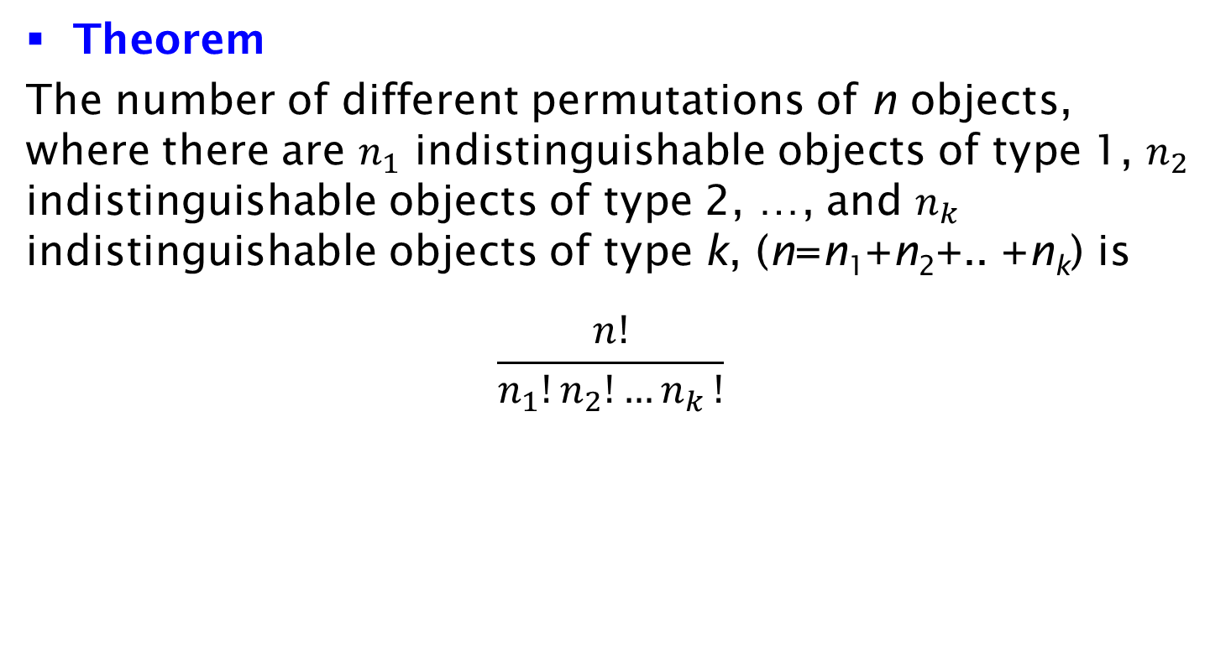
Permutations with Indistinguishable Objects
Theorem
The number of different permutations of n objects, where there are $n_{1}$ indistinguishable objects of type 1, $n_{2}$ indistinguishable objects of type 2, …, and $n_{k}$ indistinguishable objects of type k, (n=n₁+n₂+.. +n_{k}) is
$$\frac{n!}{n_{1}!n_{2}!{…n}_{k}!}$$

