Slide 1
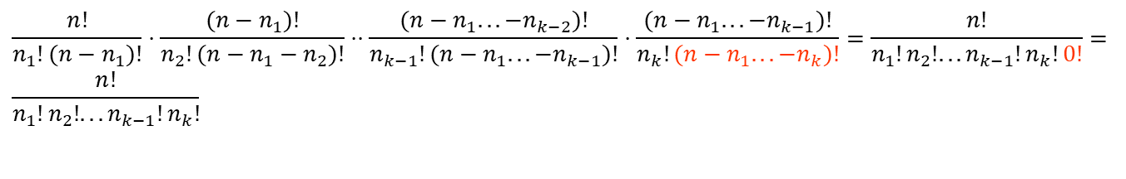
Proof of Theorem
The n₁ indistinguishable objects of type 1 can be placed among the n positions in C(n,n₁)=n!/n₁!(n-n₁)! ways.
The n₂ indistinguishable objects of type 2 can be placed among the (n-n₁) positions in C(n-n₁,n₂)=(n-n₁)!/n₂! (n-n₁-n₂)! ways.
….
The n_{k-1} indistinguishable objects of type k-1 can be placed among the (n-n₁-…-n_{k-2}) positions in C(n-n₁-…-n_{k-2}, n_{k-1})= (n-n₁-…-n_{k-2})!/ n_{k-1}! (n-n₁-n₂ …-n_{k-2}-n_{k-1})! ways.
The n_{k} indistinguishable objects of type k can be placed among the (n-n₁-…-n_{k-1}) positions in C(n-n₁-…-n_{k-1}, n_{k})= (n-n₁-…-n_{k-1})!/ n_{k}! (n-n₁-n₂ …-n_{k-1}-n_{k})! ways.
$$\frac{n!}{n_{1}!(n−n_{1})!}⋅\frac{(n−n_{1})!}{n_{2}!(n−n_{1}−n_{2})!}⋅⋅\frac{(n−n_{1}...−n_{k−2})!}{n_{k−1}!(n−n_{1}...−n_{k−1})!}⋅\frac{(n−n_{1}...−n_{k−1})!}{n_{k}!(n−n_{1}...−n_{k})!}=\frac{n!}{n_{1}!n_{2}!...n_{k−1}!n_{k}!0!}= \\ \frac{n!}{n_{1}!n_{2}!...n_{k−1}!n_{k}!}$$

