Slide 1
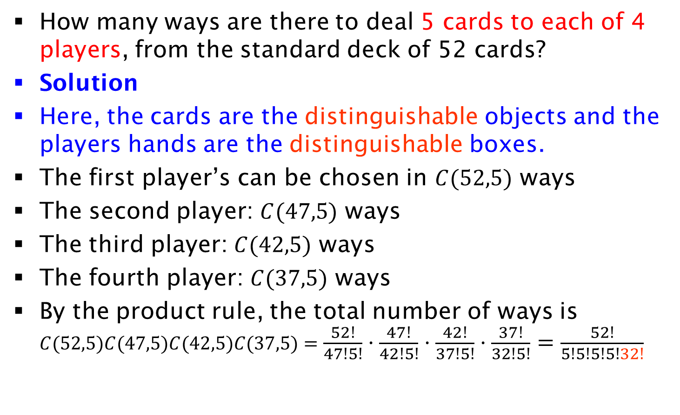
Distributing Objects into Boxes
How many ways are there to deal 5 cards to each of 4 players, from the standard deck of 52 cards?
Solution
Here, the cards are the distinguishable objects and the players hands are the distinguishable boxes.
The first player’s can be chosen in $C(52,5)$ ways
The second player: $C(47,5)$ ways
The third player: $C(42,5)$ ways
The fourth player: $C(37,5)$ ways
By the product rule, the total number of ways is $C(52,5)C(47,5)C(42,5)C(37,5)=\frac{52!}{47!5!}⋅\frac{47!}{42!5!}⋅\frac{42!}{37!5!}⋅\frac{37!}{32!5!}=\frac{52!}{5!5!5!5!32!}$

