Slide 1
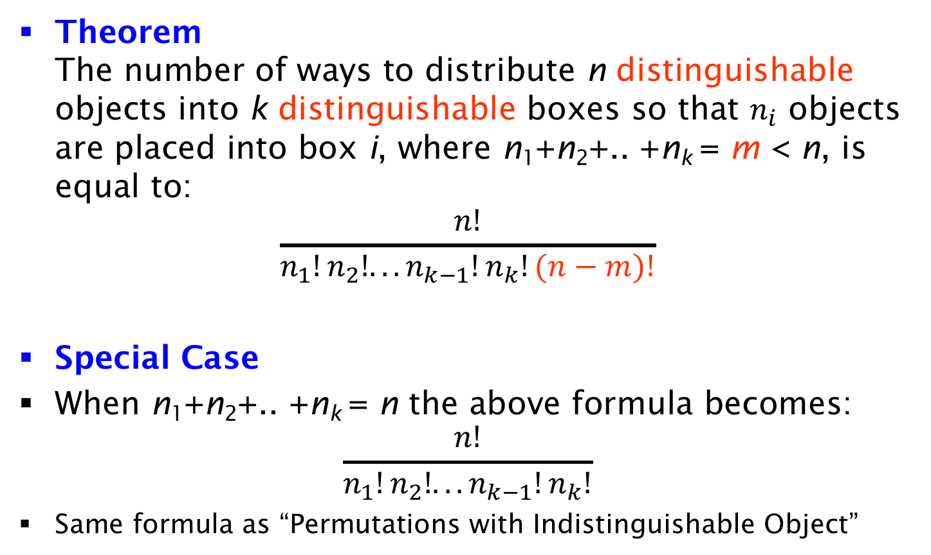
Distributing Objects into Boxes
Theorem
The number of ways to distribute n distinguishable objects into k distinguishable boxes so that $n_{i}$ objects are placed into box i, where n₁+n₂+.. +n_{k} = m < n, is equal to:
$$\frac{n!}{n_{1}!n_{2}!...n_{k−1}!n_{k}!(n−m)!}$$
Special Case
When n₁+n₂+.. +n_{k} = n the above formula becomes:
$$\frac{n!}{n_{1}!n_{2}!...n_{k−1}!n_{k}!}$$
Same formula as “Permutations with Indistinguishable Object”

