Slide 1
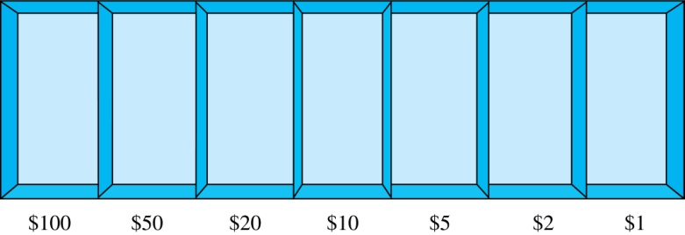
Combinations with Repetition
How many ways are there to select 5 bills from the following 7 denominations: $1, $2, $5, $10, $20, $50, and $100? Assume there are enough bills of each denomination
Solution
Select the bills from the appropriate position of a cash box illustrated below.
Equivalently, according to the "Distributing Objects into Boxes" framework, distribute 5 indistinguishable objects (bills) into 7 distinguishable boxes (denominations).

