Slide 1
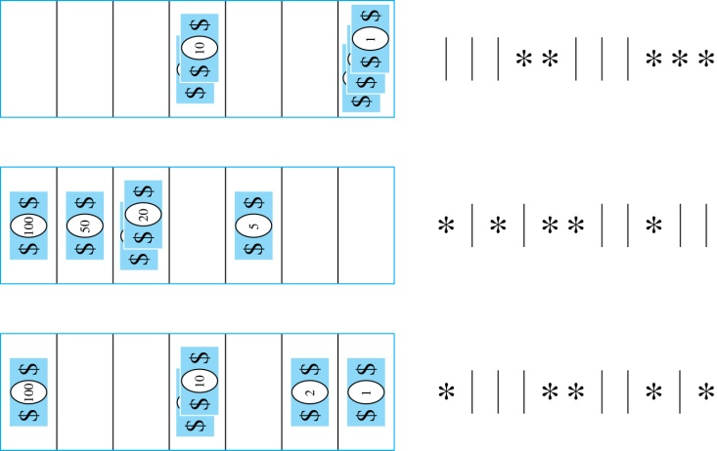
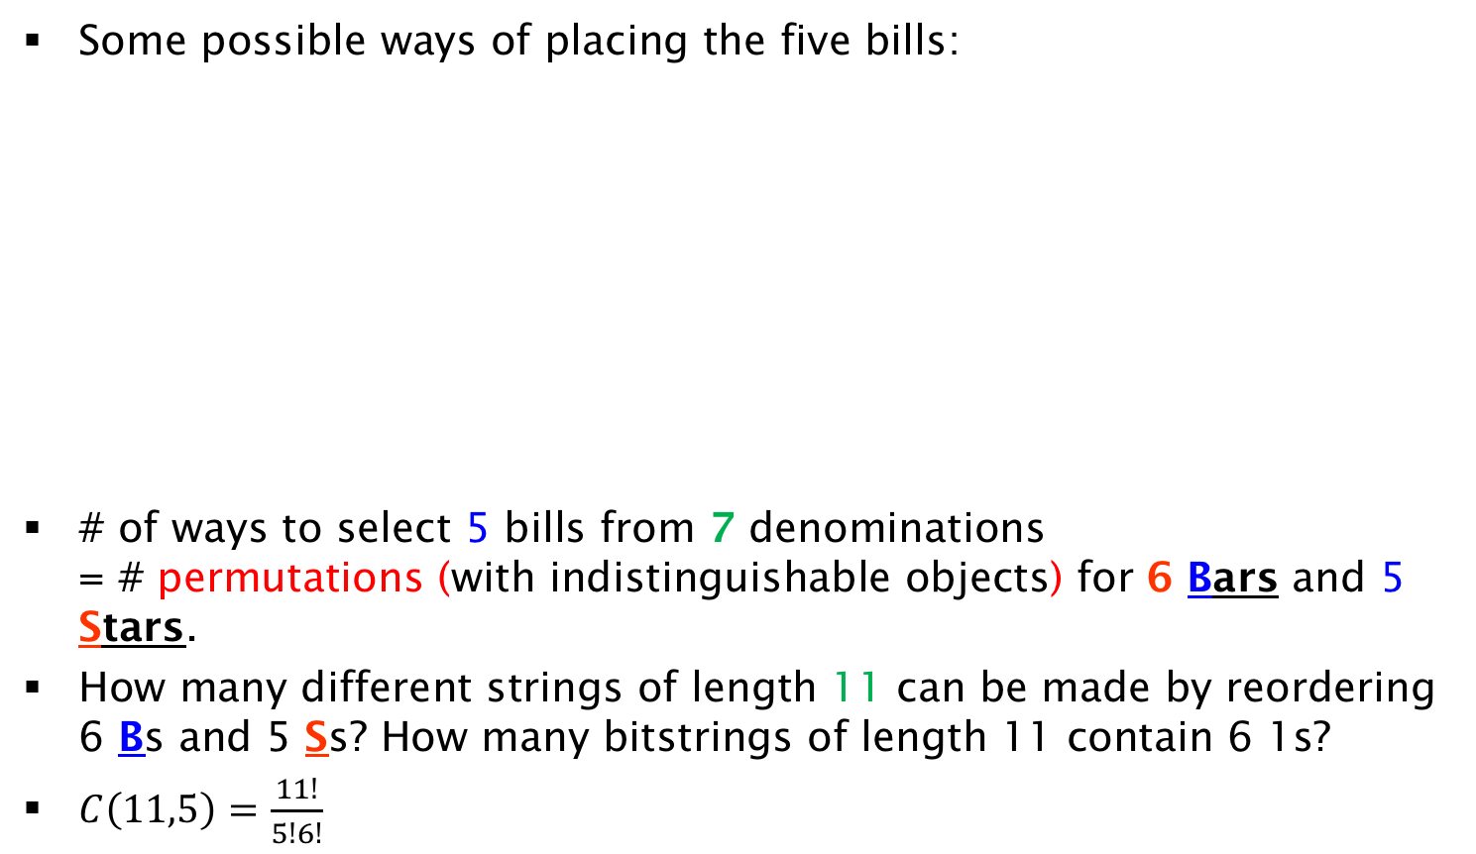
Solution
Some possible ways of placing the five bills:
# of ways to select 5 bills from 7 denominations
= # permutations (with indistinguishable objects) for 6 Bars and 5 Stars.
How many different strings of length 11 can be made by reordering 6 Bs and 5 Ss? How many bitstrings of length 11 contain 6 1s?
$C\left(11,5\right)=\frac{11!}{5!6!}$

